Slide 1
GWAS: Data quality control and analysis
Beben Benyamin
CNSG Teaching, 1 June 2016
(Shell and R scripts are available)

Slide 2
What is GWAS?
A method to map gene associated with a trait/disease using genetic markers (SNPs) throughout the genome
Statistically testing for the association between SNPs and the trait/disease ~ linear regression or chi-squared test
“Hypothesis-free” approach

Slide 3
Stages of GWAS
How much genetics account for the phenotypic variation?
  Heritability analysis using twin and family studies
  Epidemiological studies ~ risk factors for disease
Collection of data
  Genetic (SNP genotypes)
  Phenotypic (height measure, disease status)
Where are the genes?
  Genome wide association analysis (GWAS)

Slide 4
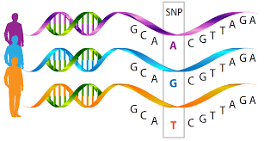
GWAS Data
The genotype (i.e. DD, Dd, dd) at 100,000’s – Millions of SNPs
Data normally collected on 1000’s – 10,000’s individuals
  Phenotype or clinical data
  Age, sex, other ‘covariates’

Slide 5
Genetic Association
Disease/ Phenotype
Test for association between phenotype and marker
Test for genetic association between the phenotype and genetic variants
LD / correlation
Genome
Genetic variants
Marker/SNPs
Weiss and Lange

Slide 6
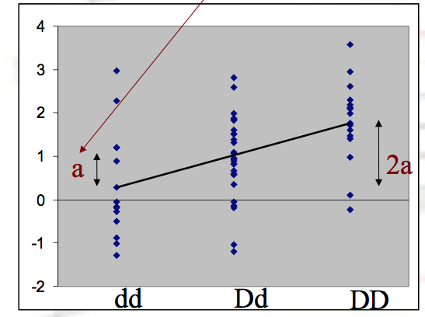
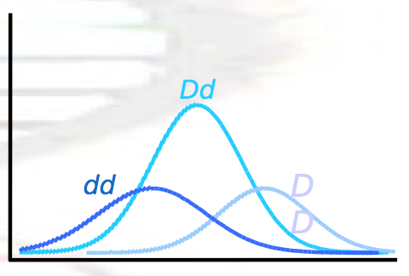
Quantitative traits- Linear model (regression)
What are we testing here?
What is the null hypothesis?
Is the slope of the regression (beta) significantly different from zero
Slope is fitted through the mean effects of the genotypes
Y = μ+ b*x + e
x = 0, 1, 2 for genotypes DD, Dd and dd
Powell, lecture notes

Slide 7
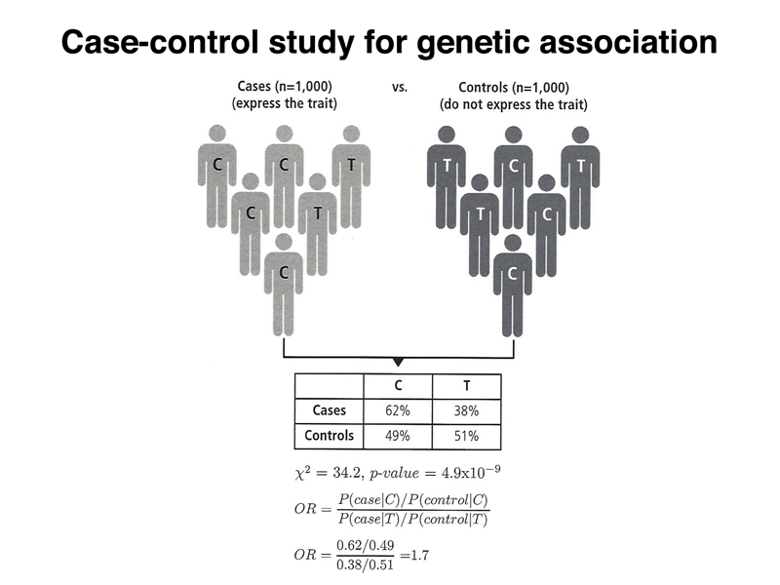
http://www.discoveryandinnovation.com/BIOL202/notes/lecture25.html

Slide 8
Case-control
Clarke et al Nat Prot 2011

Slide 9
Case / Control – chi-squared test
Is there a difference in allele frequency between cases and controls for SNP rsxxxxxxx?
  i.e. case / control study in 10651 cases and 10495 controls
Test for independence – chi-squared (2x2) contingency table or Fisher Exact test
Observed | Case | Control | Total
D | 11781 | 10327 | 22108
d | 9521 | 10663 | 20184
Total | 21302 | 20990 | 42292
Powell, lecture notes

Slide 10

Case/Control – chi-squared test
Expected = (Row Total x Column Total)/ Grand total
Example for Case – D = (22108 x 21302)/42292 = 11136
X² = (11781-11136)²/11136 + (10327-10972)²/10972 + (9521-10166)²/10166 + (10663-10018)²/10018 = 157.7
P-value = 5 x 10⁻³⁶
Observed Expected | Case | Control | Total
D | 11781 11136 | 10327 10972 | 22108
d | 9521 10166 | 10663 10018 | 20184
Total | 21302 | 20990 | 42292
Powell, lecture notes

Slide 11
Logistic regression
Similar to linear regression, used for binary outcomes instead of continuous outcomes
  Let Y_{i} be the phenotype for individual i
  Y_{i} = 0 for controls
  Y_{i} = 1 for cases
  Let X_{i} be the genotype of individual i at a particular SNP
  dd X_{i} = 0
  Dd X_{i} = 1
  DD X_{i} = 2
Powell, lecture notes

Slide 12
Association models and methods
Models:
  Allelic: D versus d
  Dominant: (DD, Dd) versus dd
  Recessive: DD versus (Dd, dd)
  Genotypic: DD versus Dd versus dd
Methods
  Linear regression
  ANOVA
  other: maximum likelihood, Bayesian)
Specialized software
  PLINK (http://pngu.mgh.harvard.edu/~purcell/plink/)
  MERLIN (http://www.sph.umich.edu/csg/abecasis/merlin/)

Slide 13
Data quality control and cleaning
Individual-level QC
  Individuals with discordant sex
    Use Chr X: Male have one copy ~ cannot be heterozygous
    Indicates plating errors or sample mix-ups
  Individuals with high missing genotype rate
    Indicates sample problem; low quality DNA
  Individuals with extreme heterozygosity rate
    Indicates sample contamination (high) or inbreeding (low)
  Related or duplicated individuals
    Use IBS or GRM. Avoids bias in test statistic
  Ancestry outliers
    Avoids population stratification

Slide 14
Data quality control and cleaning
SNP-level QC
  SNP with high missing genotype rate
    Indicates bad quality SNPs
  SNP that deviates from Hardy-Weinberg
    Should be stable from generation to generation: (1-p2); 2p(1-p);p2. Tested in controls.
  SNP with lower minor allele frequency
    Difficult to call using genotyping platform. Indicates bad quality SNPs
  SNP with differential missingness in cases and controls
    Indicates confounding with disease status, especially cases and controls processed separately
  Comparing allele frequency to known database, such as HapMap or 1000G

Slide 15
Example – Data before QC

Slide 16
Example: Ancestry information
6SD From CHB Mean:
34 ethnic outliers

Slide 17
Example: PCA after QCs

Slide 18
Example: Samples relatedness

Slide 19
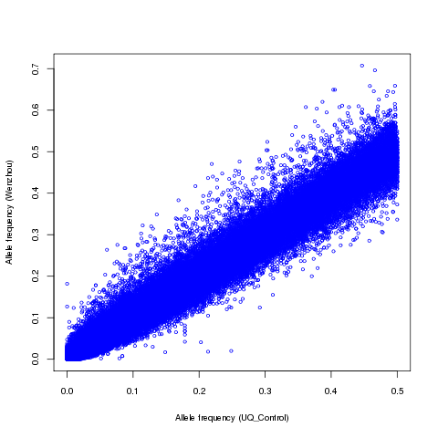
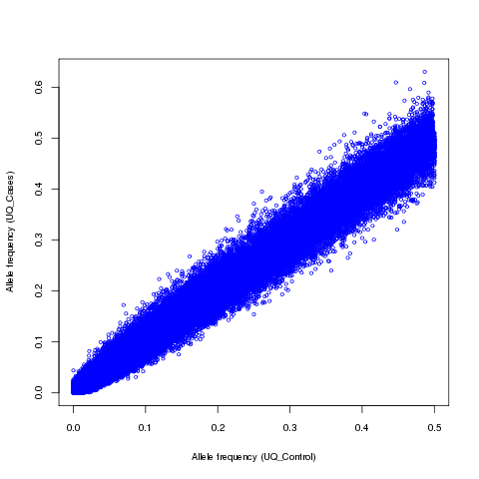
Example: MAF Comparison: SNPs passed QC (N: 447,237)
r=0.990
r=0.994

