Slide 1
Prediction and estimation using linear mixed models
CNSG
8 June 2016

Slide 2
A bit of history
For most statisticians, random effects are ‘nuisance’ effects
fit to properly model covariance structure of the data (when the real interest is in fixed effects)
no interest in the random effects themselves, other than in their variance

Slide 3
Example
y = Xb + e
(random effect not explicitly in the model)
var(y) = var(e) = var(Zu + ε) = Vσ²
= ZZ^{T}σ_{u}² + Iσ_{ε}²

Slide 4
Animal breeding
y = Xb + Zu + e
var(y)= Zvar(u)Z^{T} + var(e)
Interest in individual u effects. With pedigree data
var(u) = G = Aσ_{a}², with A = relationship matrix

Slide 5
Notation (Robinson)
y = Xb + Zu + e
V = (ZGZ^{T} + R)σ²
Could be written as V = ZAZ^{T}σ_{a}² + Rσ_{e}²
in which case σ² = σ_{e}² and Gσ_{e}² = Aσ_{a}²,
so G = Aσ_{a}²/σ_{e}².
In Robinson’s toy example, R = I and G = 0.1I, so σ_{a}²/σ_{e}² = 0.1. Many notations use a variance ratio because that’s what matters (the actual residual variance ‘drops out’).

Slide 6
Generalised linear model
y = Xb + e
var(e) = Rσ_{e}²
Solutions for fixed effects b from normal equations:
(X^{T}(Rσ_{e}²)⁻¹X)b = X^{T}(Rσ_{e}²)⁻¹y
= (X^{T}R⁻¹X)b = X^{T}R⁻¹y

Slide 7
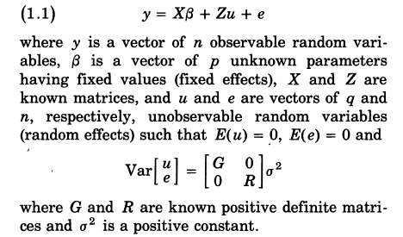
Robinson 1991

Slide 8
Derivations of BLUP
Robinson gives a number of derivations
See also Lynch & Walsh
Intuitive explanations easiest if there are no fixed effects to estimate

Slide 9
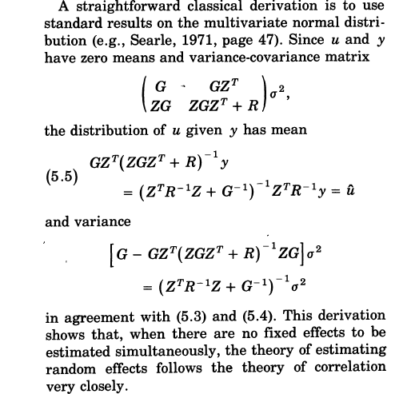
regression of u on y
u|y = cov(u,y)/var(y)

Slide 10
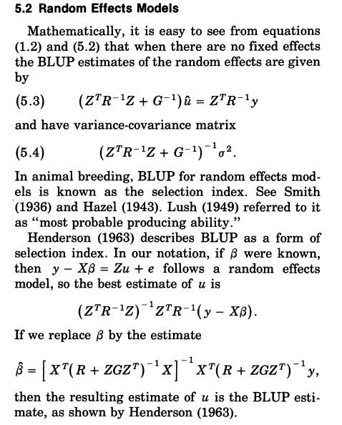
Typo: Ginv missing

Slide 11
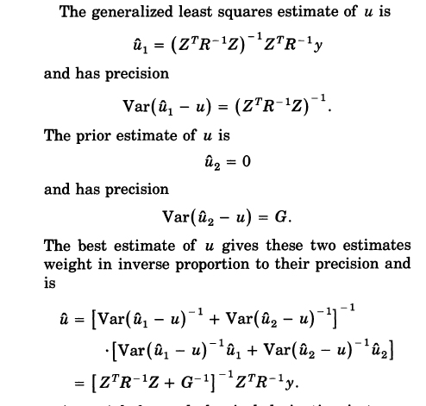

Slide 12
Implications
u-hat = E(u|y)
Or
y-hat = E(y_{future}| y_{now})

Slide 13
Unbiasedness
Fixed effects
E(b-hat|b) = b
Random effects
E(u|u-hat) = u-hat

Slide 14
Estimation of variance components
Long history
ANOVA (Fisher 1918)
Balanced vs unbalanced designs
sums of squares not orthogonal
1960s: maximum likelihood for mixed models
Problems: computational and bias
REML: 1960s for balanced designs
Patterson & Thompson 1971 (Biometrika)

Slide 15
REML vs ML
y = μ + e
ML estimate of σ_{e}² = Σ(y_{i} – mean(y))² / n
REML takes account of the number of fixed effects fitted:
REML estimate of σ_{e}² = Σ(y_{i} – mean(y))² / (n-1)

Slide 16
Consider the linear model y = Xb + e
V = var(e)
R = y – Xb
Difference is log|X^{T}V⁻¹X|, a “penalty” term

Slide 17
Example (toy example in R)
y = 1μ + e
V = Iσ_{e}²
log|V| = nlog(σ_{e}²)
log|X^{T}V⁻¹X|= -nlog(σ_{e}²)
R^{T}V⁻¹R = Σ(y – μ)²/σ_{e}²

