Slide 1

Lecture 1
Quantifying the genetic contribution to disease
Naomi Wray
2016 Module 18:
Statistical & Quantitative Genetics of Disease

Slide 2
Aims of Lecture 1
If a disease affects 1% of the population and has heritability 80%
We will show why these statements are consistent :
If an individual is affected ~8% of his/her siblings affected
If an MZ twin is affected ~50% of their co-twins are affected
If an individual is affected > 60% will have no known family history
Bringing together genetic epidemiology and quantitative genetics
- The key papers were published 40 and 70 years ago……

Slide 3
Structure
Disease data and risk to relatives
Aside: Quantitative Traits
Liability Threshold Model
Practical

Slide 4
Disease data and risk to relatives

Slide 5
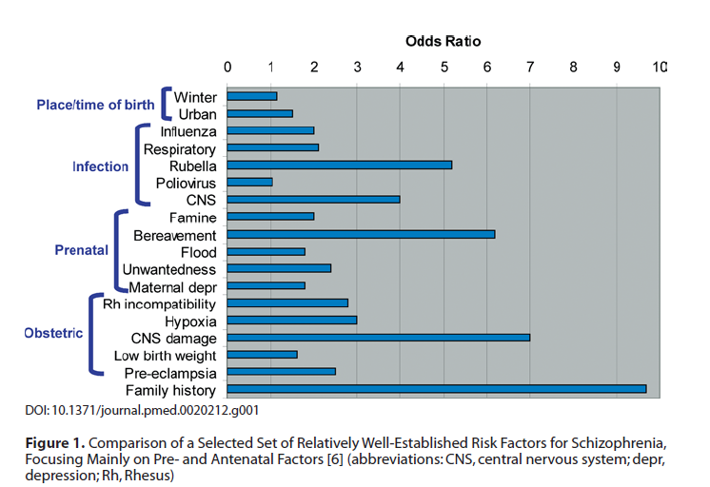
Risk Factors for Schizophrenia
Sullivan, PLoS Med 05

Slide 6
Complex genetic diseases
Unlike Mendelian disorders, there is no clear pattern of inheritance
Tend to “run” in families
Few large pedigrees of multiply affected individuals
Most people have no known family history
What can we learn from genetic epidemiology about genetic architecture?

Slide 7
Evidence for a genetic contribution comes from risks to relatives

Slide 8
Affected Probands
5/55 are affected;
Risk = 0.09
Random sample of the population - 1% affected
Relative Risk (RR) = 0.09 / 0.01 = 9
Increased risk of disease in relatives of those affected

Slide 9
Relative risk to relatives
Recurrence risk to relatives
How much more likely are you to be diseased if your relative is affected compared to a person selected randomly from the population?
Relative risk to relatives (λ_{R}) = p(affected|relative affected) = K_{R} p(affected in population)
K

Slide 10
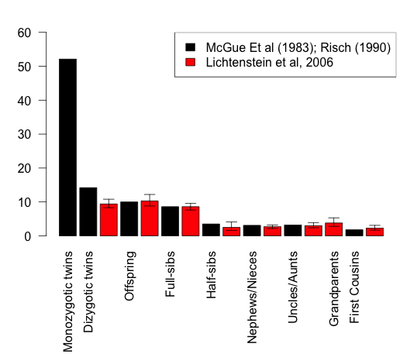
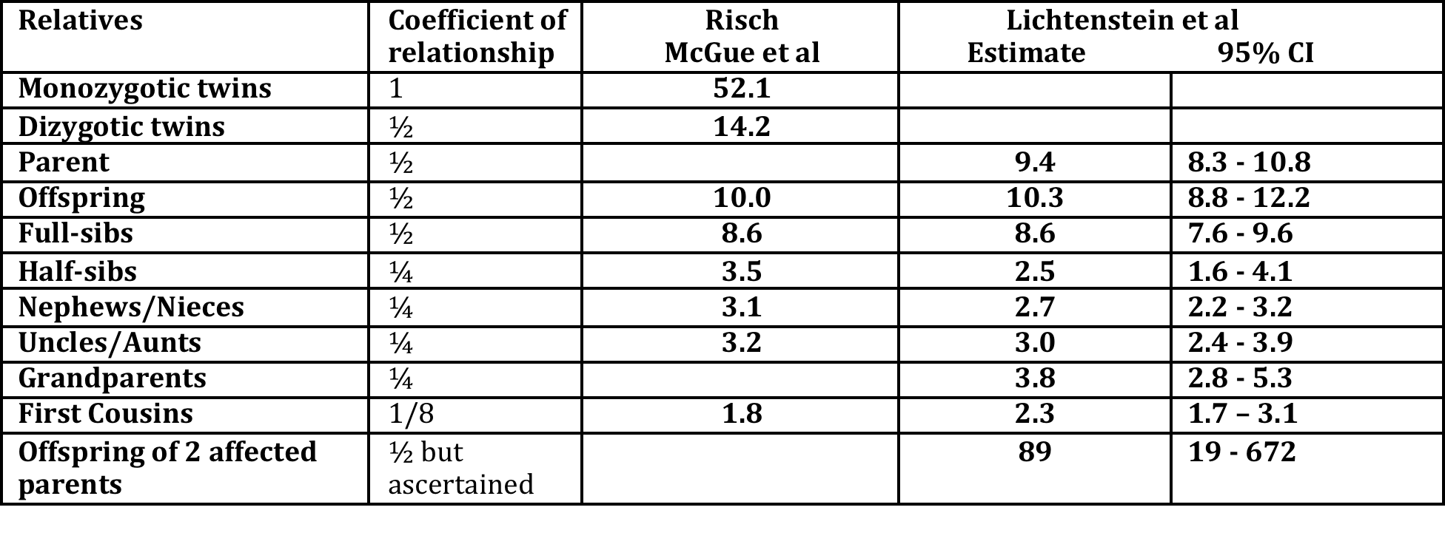
Schizophrenia risks to relatives
Baseline risk, K = 0.85% McGue et al
= 0.407% Lichtenstein et al
0.5 0.25 0.125 coefficient of relationship
Risch(1990) Linkage Strategies for Genetically Complex Traits AJHG
McGue et al (1983) Genetic Epidemiology 2: 99
Lichtenstein et al (2006) Recurrence risks for schizophrenia in a Swedish National Cohort.Psychological Medicine

Slide 11
James (1971) relationship between K and K_{R}
X = scores of disease yes/no for individuals
Y = scores of disease yes/no in relatives of X
K proportion of the population affected
E(X) = E(Y) = K
K_{R} = E(Y|X=1)
Probability that both X and Y = 1: E(XY) = K*K_{R}
Cov(X,Y) = E(XY) – E(X)*E(Y) = K*K_{R}– K²
So Cov_{R} = Cov(X,Y) = K*K_{R} – K² = (K_{R} –K)K = (λ_{R} -1)K²
James (1971) Frequency in relatives for an all-or-non trait Ann Hum Genet 35 47
Derivation from Risch (1990) Linkage strategies for genetically complex traits. I Multi-locus models. AJHG

Slide 12
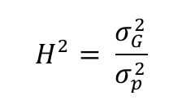
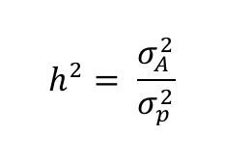
Aside 1: Heritability
P = G + ε
P = phenotype
G = genetic factors
ε = residual, anything other than genetic, including environmental and stochastic factors
Broad sense heritability
Parameters vs Estimates
Often confused and confusing
We can measure P but we cannot directly measure G or A.
Estimate variance of G or A by using cohorts of individuals for whom we know the coefficient of relationship, but difficulties arise because of confounding
P = A + ε
P = phenotype
A = additive genetic factors
ε = residual, anything other than additive genetic, including environmental and stochastic factors
Narrow sense heritability

Slide 13
Aside 2: Covariances between relatives
P = A + ε
V(P) = V(A) + V(ε), A and ε uncorrelated
P_{child} = A_{child} + ε = ½ A_{mum} + ½ A_{dad} + A_{seg} + ε
V(A_{child}) = ¼ V(A_{mum}) + ¼ V(A_{dad}) + V(A_{seg})
V(A) = ¼ V(A) + ¼ V(A) + V(A_{seg}) so V(A_{seg}) = ½ V(A)
Cov(P_{child},P_{dad}) = Cov(A_{child},A_{dad}) = Cov(½ A_{mum} + ½ A_{dad} + A_{seg} , A_{dad}) = ½ V(A)
Cov(P_{child},P_{sib}) = Cov(A_{child},A_{sib}) =
Cov(½ A_{mum} + ½ A_{dad} + A_{seg-ch} , ½ A_{mum} + ½ A_{dad} + A_{seg-sib})
=¼ V(A) + ¼ V(A) = ½ V(A)

Slide 14

General covariance between relatives
cov_{R} = covariance between relatives on the disease scale
cov_{R} =
cov_{R =} (K_{R} –K)K = (λ_{R} -1)K² V_{P} = K(1-K) (from a few slides back!)
An estimate of narrow sense (additive) heritability on the disease scale is
But covR contains non-additive genetic terms.
We don’t know if non-additive genetic effects exist - What to do?
Estimate from different types of relatives to see if the estimates are consistent
James (1971) Frequency in relatives for an all-or-non trait Ann Hum Genet 35 47

Slide 15
James (1971) genetic variance on the disease scale
K = 0.0085
λ_{OP}= 10 a_{R}= ½
λ_{HS} = 3 a_{R}= ¼
λ_{FS} = 8.6 a_{R}= ½
λ_{MZ}= 52 a_{R}= 1
The estimates of are very different (even if sampling variance is taken into account)
Implies that the estimates of are contaminated by non-additive variance on this scale of measurement
James (1971) Frequency in relatives for an all-or-non trait Ann Hum Genet 35 47

Slide 16
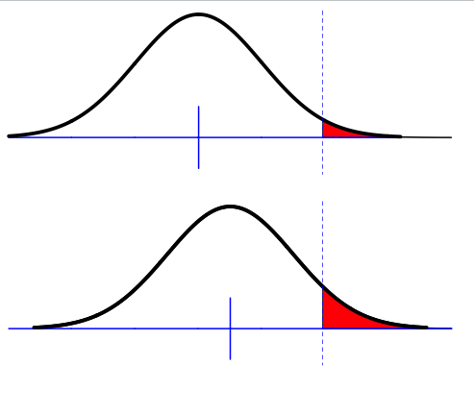
Liability threshold model
Phenotypic liability of a sample from the population
Proportion K affected
Assumption of normality
Only appropriate for multifactorial disease
i.e. more than a few genes but doesn’t have to be highly polygenic
Key – unimodal

Slide 17
Falconer (1965)
Phenotypic liability of a sample from the population
Proportion K affected
Relationship of relatives to affected individuals a_{R}
Phenotypic liability of relatives of affected individuals
Proportion K_{R} affected
Using normal distribution theory what percentage of the variance in liability is attributale to genetic factors given K, K_{R} and a_{R}

Slide 18
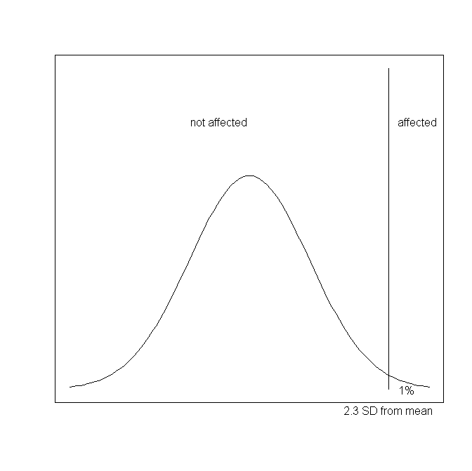
Prediction of response to selection and rates of inbreeding under directional selection
Not selected
Not diseased
Selected
Next generation
Diseased
Frequency
Frequency
Relatives
Quantitative Phenotype
Liability
Strong parallels to quantitative genetics of disease
Not selected
Not diseased
Selected
Diseased

Slide 19
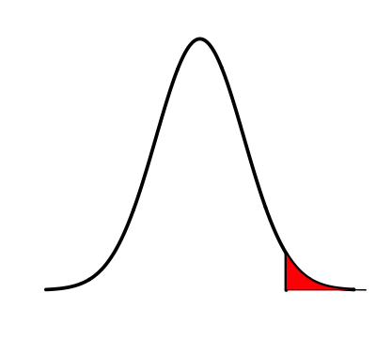
Definitions
z = density at t
K = Proportion of the population that are diseased
Density
Phenotypic liability
i = mean phenotypic liability of the diseased group
t = threshold

Slide 20
How to get from observed risks to relatives to heritability?- Falconer (1965)
Phenotypic liability of a sample from the population
Proportion K affected
Relationship of relatives to affected individuals r
Phenotypic liability of relatives of affected individuals
Proportion K_{R} affected
Using normal distribution theory what percentage of the variance in liability is attributale to genetic factors given K, K_{R} and r

Slide 21


Liability Threshold Model
–truncated normal distribution theory
Φ(x) =cumulative density until liability x
standard normal distribution function
ϕ (x) = probability density at x
Phi
z = density at t
z = ϕ (t) = dnorm(t)
Density
K = Proportion of the population that are diseased
Standard
Deviation =1
σ_{p} = 1
K= 1-Φ(t) = 1-pnorm(t)
Phenotypic liability
i = mean phenotypic liability of the diseased group
i= z/K “selection intensity”
Variance in liability amongst the diseased individuals
= ((1-k), where k = i(i-t)
t = threshold
t= Φ⁻¹(1-K) = qnorm(1-K)
Inverse standard normal distribution (probit) function

Slide 22
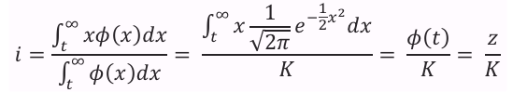
Mean of diseased group
Pearson & Lee (1908) On the generalized probable error in normal correlation. Biometrika
Lee (1915) Table of Gaussian tail functions..Biometrika
Fisher (1941) Properties and application of Hh functions. Introduction to mathematical tables
Cohen (1949) On estimating the mean and standard deviation of truncated normal distributions Am Stat Association
Cohen & Woodward (1953)Pearson-Lee-Fisher Functions of singly truncated normal distributions. Biometrics
Mean (i): = sum( x * freq of x)
The phenotype frequencies must sum to 1, hence the denominator
Lynch and Walsh equations 2.13 and 2.14; variance equation 2.15

Slide 23
Falconer (1965)
Phenotypic liability of a sample from the population
Proportion K affected
Assumption of normality
Only appropriate for multifactorial disease
i.e. more than a few genes but doesn’t have to be highly polygenic
Key – unimodal

Slide 24
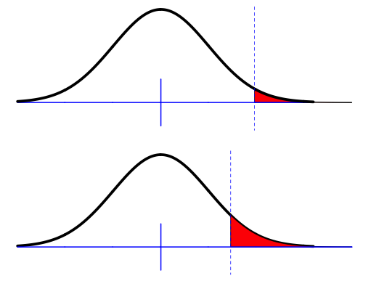
Falconer (1965)
The difference between the means for the same threshold
t
m
The difference between the thresholds when standardised to have the same mean
m_{R}
t_{R}
m_{R}-m = t-t_{R}
Given the difference in thresholds, and given known additive genetic relationship between relatives, what proportion of the total variance must be due to genetic factors
Falconer (1965) The inheritance of liability to certain diseases, estimated from incidences in relatives,
Ann. Hum Genet. 29 51
Crittenden (1961) an interpretation o familial aggregation based on multiple genetic and environmental factors
Ann NY Acad Sci 91 769

Slide 25
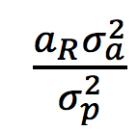
Calculate heritability of liability using regression theory
X = phenotypic liability for individuals
Y = phenotypic liability for relatives of X
E(X) = E(Y) = m = 0
Relationship between X and Y is linear
Y = μ_{Y} + b_{Y.X}(X-μ_{x})+ ε
= m + cov(A_{R},A) (X-m) + ε , since m = 0
Var(X)
= X +ε= a_{R}h²X + ε
z
K
m
t
i
Falconer (1965) The inheritance of liability to certain diseases, estimated from incidences in relatives,
Ann. Hum Genet. 29 51
Crittenden (1961) an interpretation o familial aggregation based on multiple genetic and environmental factors
Ann NY Acad Sci 91 769

Slide 26
Calculate heritability of liability using regression theory
X = phenotypic liability for individuals
Y = phenotypic liability for relatives of X
Y = a_{R}h²X + ε
For affected individuals X = i
Expected phenotypic liability of relatives of those affected
E(Y|X>t) = m_{R}-m = t- t_{R}
Substitute t- t_{R}= a_{R}h²i
Rearrange h² =(t- t_{R})/ia_{R}
z
K
m
t
i
Falconer (1965) The inheritance of liability to certain diseases, estimated from incidences in relatives,
Ann. Hum Genet. 29 51
Crittenden (1961) an interpretation o familial aggregation based on multiple genetic and environmental factors
Ann NY Acad Sci 91 769

Slide 27
Assumptions made by Falconer (1965)
Assumption: Covariance between relatives reflects only shared additive genetic effects
Check: Use different types of relatives with different a_{R} and different u_{R}(dominance coefficient) and different shared environment to see consistency of estimates of h²
Assumption: Phenotypic variance in relatives is unaffected by ascertainment on affected probands

Slide 28
Accounting for reduction in variance in relatives as a result of ascertainment on affected individuals
t
Variance in liability amongst the diseased individuals
= ((1-k), where k = i(i-t)
P
m
Variance in liability amongst relatives the diseased individuals
V(P_{R}|P>t) = V(P_{R})-kCov(P_{R},P)²
=
P_{R}
m_{R}
Reich, James, Morris (1972) The use of multiple thresholds in determining the mode of transmission of semi-continuous traits. Ann Hum Gen 36: 163.

Slide 29
Reich et al: heritability of liability
The difference between the means for the same threshold
t
The difference between the thresholds when standardised to have the mean 0 and variance 1
m
m_{R}
t_{R}
m_{R}-m = t-t_{R}
Reich, James, Morris (1972) The use of multiple thresholds in determining the mode of transmission of semi-continuous traits. Ann Hum Gen 36: 163.

Slide 30

Reich et al: heritability of liability
t
X = phenotypic liability for individuals
Y = phenotypic liability for relatives of X
Y = a_{R}h²X + ε
For affected individuals X = i
Expected phenotypic liability of relatives of those affected
E(Y|X>t) = m_{R}-m =
Substitute
Rearrange
NB. Distribution of relatives may also be skewed – especially for MZ twins-Estimates could be biased upwards
Also useful – calculation of t_{R} when K and h² are known

Slide 31
Practical
Uses simulation to give understanding to the theory.
How to calculate heritability of liability from risks to relatives.
Feel for sample size and sampling variation
Relationship between narrow sense heritability on disease and liability scales

Slide 32
Practical
1. Polygenic models generate a normal distribution of genetic values.
a) Simulate a population of N=10,000 for 10 loci of frequency p
Binomial distribution of genotypes
G1, G2..G10=rbinom(N,2,p), set p =0.5
Make a count of risk alleles across 1,2,..10 loci
R1=G1, R2=G1+G2, …R10 = G1+G2…+G10
Plot histogram of R1…R10
b) repeat for allele freq p = 0.1
c) set p randomly eg uniform c(runif(10,0,1))
d) a-c demonstrate normal distribution of risk allele count.
If the effect size for the risk locus at SNP i is a_{i} then what is the distribution of variance of risk allele. Draw the ai from different distributions.
Skip this come back if there is time

Slide 33
2. Using simulation to explore the liability threshold model.
Section 2a-2e. Already programmed.
2a. Run the section – generates sliders (make plot window as big as possible) – Not so important
2b-2e Run line by line
2b. Simulates phenotypic liability and disease status of parents and children
2c. Some graphs and calculates risks to relatives
2d. Compare simulated values with normal distribution theory
2e. Estimate heritability from recurrence risks to relatives
2f. Complete table to feel sampling variation

Slide 34
2g. Extend the simulation to include different types of relatives
#############################
Add to the simulation a Monozygotic twin of the child
Add to the simulation a full-sibling of the child
Add to the simulation a paternal half-sibling of the child
Calculate lambdaMZ, lambdaFS, and lambdaHS
Estimate heritability of liability from lambdaMZ, lambdaFS, and lambdaHS

Slide 35
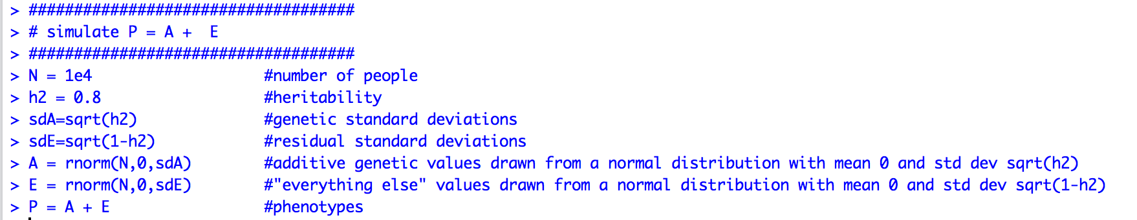
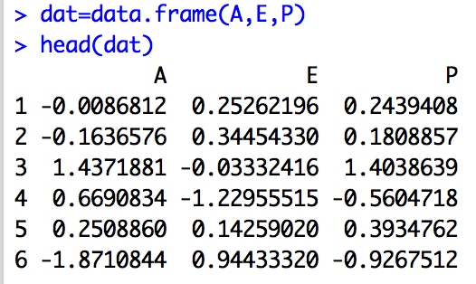
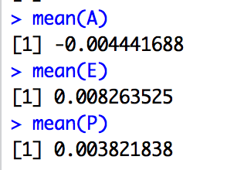
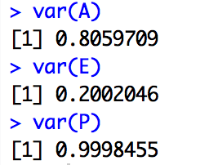
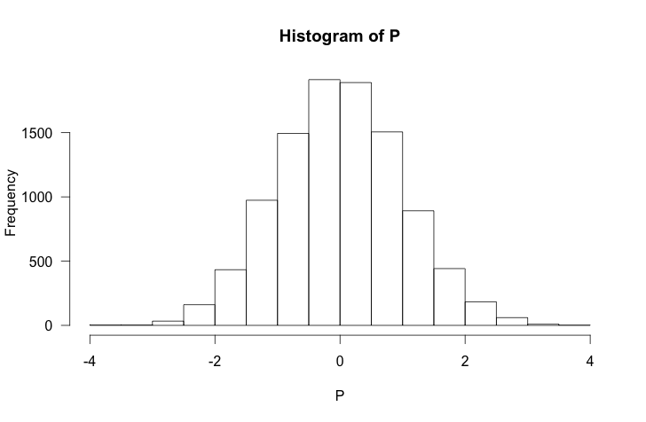
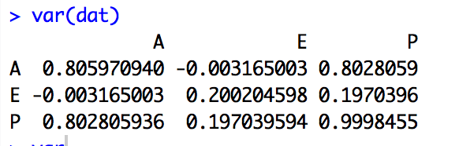
Simulate P = A+ E
Screen Shot 2014-10-05 at 11.54.57 AM
If we only measure P how do we estimate heritability?

Slide 36
Need relatives
P = A + E
P_dad = A_dad + E_dad
P_mum = A_mum + E_mum
P_child = A_child + E_child
A_child = 0.5*A_mum + 0.5*A_dad + A_w
genetic segregation
unique to the child
What is the variance of A_w?
Var(A_child) = 0.25*Var(A_mum) + 0.25*Var(A_dad) + Var(A_w )
Var(A) = 0.25*Var(A) + 0.25*Var(A) + Var(A_w )
Half of the genetic variance in a population is within family variance
Var(A_w) = 0.5*Var(A)

Slide 37
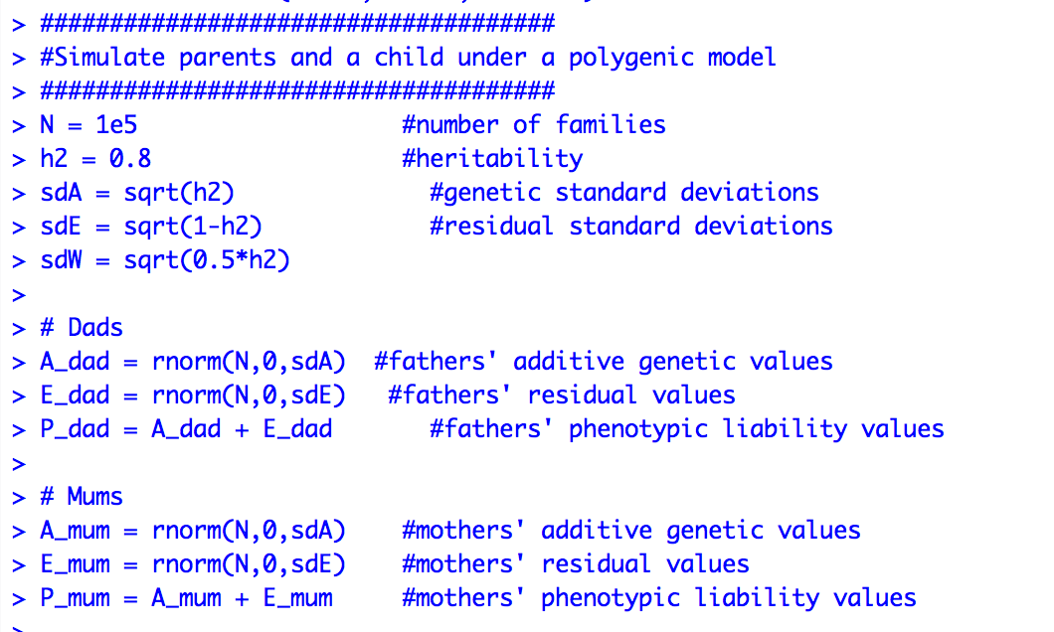
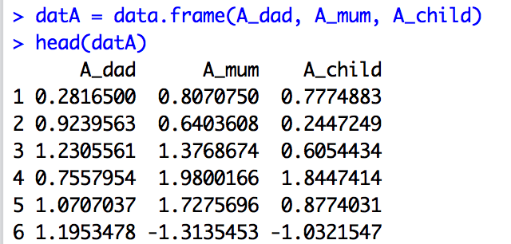
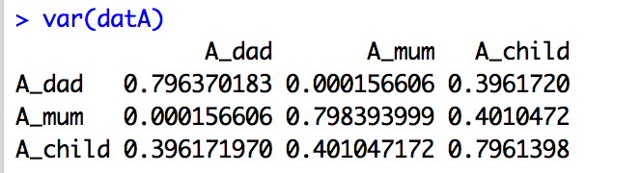
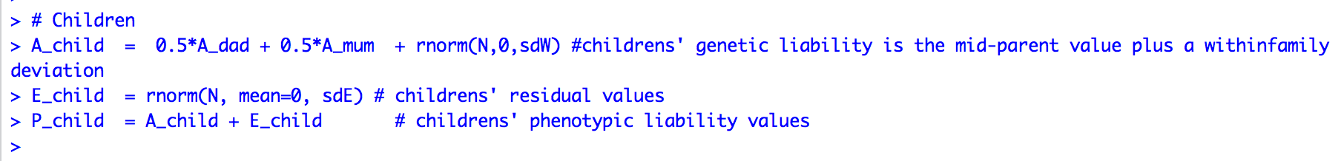
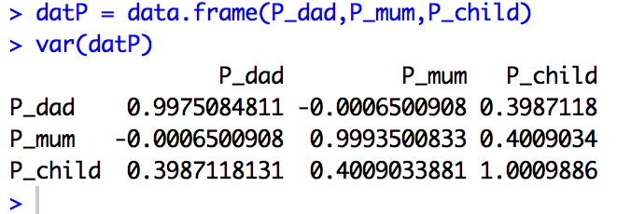
Simulate families

Slide 38
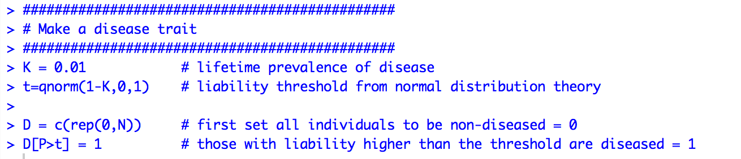
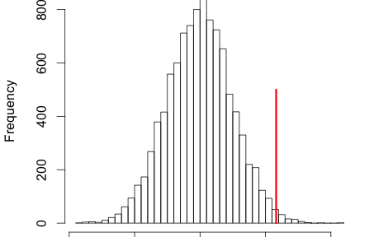
Simulation, phenotype is now liability
D = 0
D = 1

Slide 39
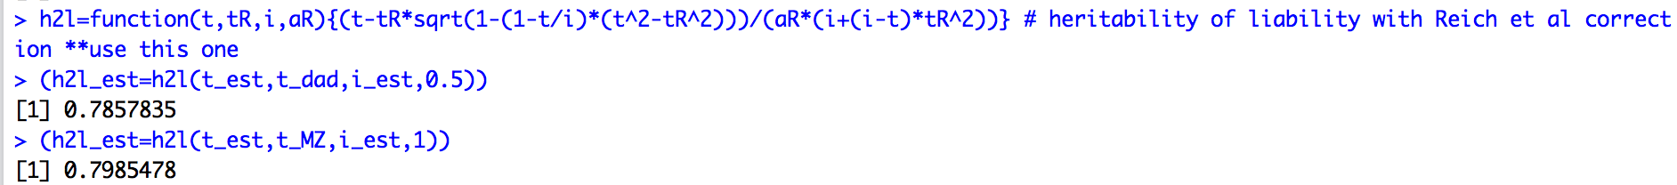
Accounting for reduction in variance in relatives as a result of ascertainment on affected individuals
Variance in liability amongst the diseased individuals
= ((1-i(i-t)) = (1-k)
P
m
Variance in liability amongst relatives the diseased individuals = 1- i(i-t)(a_{R}h²)²
P_{R}
m_{R}
Reich, James, Morris (1972) The use of multiple thresholds in determining the mode of transmission of semi-continuous traits. Ann Hum Gen 36: 163.

