Slide 1

Lecture 1- Extras
Quantifying the genetic contribution to disease
Naomi Wray
2016 Module 18:
Statistical & Quantitative Genetics of Disease

Slide 2
Misunderstandings in MZ twins
“Estimates of heritability of liability to a number of diseases turned out to be quite high. This was a surprise to those not versed in quantitative genetics who tended to think that low concordances rates in MZ twins implied low heritability.” Fraser (1976)
Fraser(1976) The multifactorial/Threshold concept –uses and misuses Teratology

Slide 3
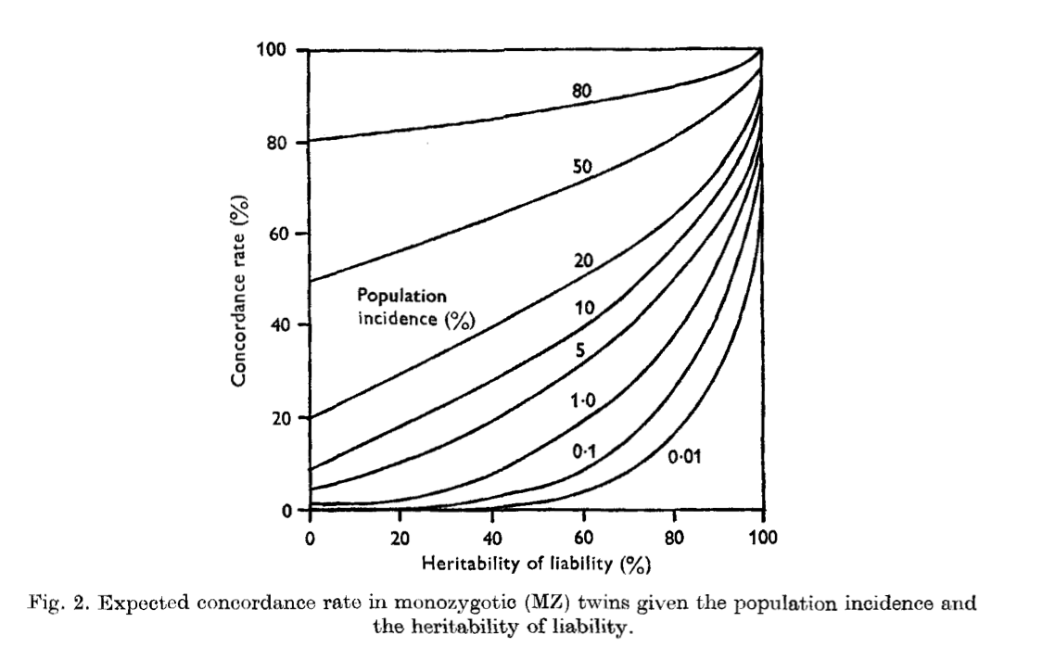
Smith (1970) MZ twins
For rare diseases concordance is not expected to be high even when heritability is high
Smith (1970) Heritabiity of liability and concordance in monozygous twins Ann Hum Genet 34: 85

Slide 4
Genetic Risk Prediction: Expectations in Context
Under a polygenic model most cases appear sporadic
Up to 3rd degree relative
Yang, Visscher & Wray (2009) Sporadic cases are the norm for complex disease. European J Human Genetics

Slide 5
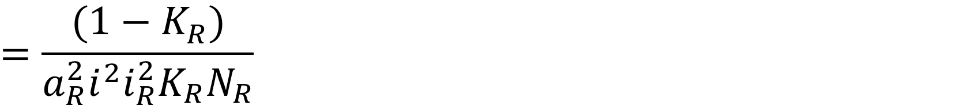

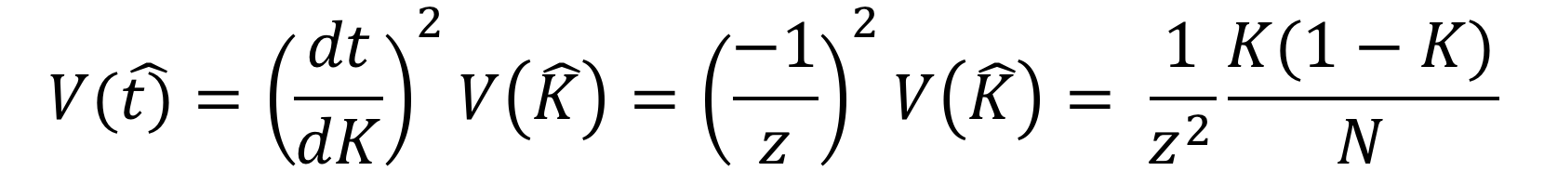
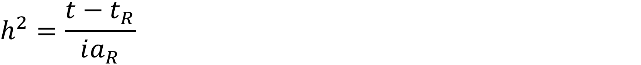
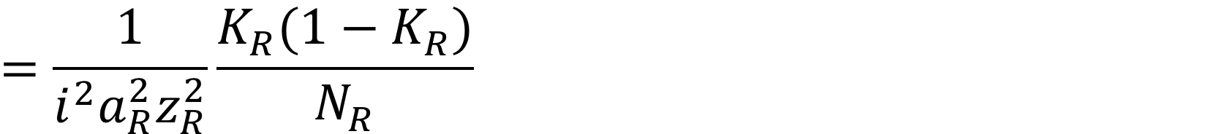
Sampling variance?
Variance of the estimate of a threshold based on the estimate of prevalence K
If K has been estimated from a very large sample then we can ignore the sampling variance of t and i
Where N_{RA} is the number of affected relatives

Slide 6
Sampling variance?
If K also has sampling variance associated, then
Falconer (1965) The inheritance of liability to certain diseases, estimated from incidences in relatives, Ann. Hum Genet. 29 51 Appendix B

Slide 7
Estimation of heritability on large samples
Linear mixed model
  Accounts for different relationships between individuals
  Include fixed effects eg sex
  Maximum likelihood estimate of the threshold that best fits the data
The “information” essence comes from the risks to relatives
Lichtenstein et al (2009) Common genetic determinants of schizophrenia and bipolar disorder in Swedish families: a population-based study. Lancet 373: 234.
Wray & Gottesman (2012) Using summary data from the Danish National Registers to estimate heritabilities for schizophrenia, bipolar disorder, and major depressive disorder . Frontiers in Genetics

Slide 8
Different types of relatives
Weighted average vs proper analysis
Lichtenstein et al (2009) Common genetic determinants of schizophrenia and bipolar disorder in Swedish families: a population-based study. Lancet
Wray & Gottesman (2012) Frontiers in Genetics

Slide 9
K= “Prevalence” in Quantitative Genetics
Very specific meanings in epidemiology:
Prevalence – the proportion of people in a population who have the disease in a stated time frame
Point prevalence – at point of assessment
Period prevalence – at any time during the period of assessment
Cumulative prevalence – had disease at any time in life
Lifetime prevalence – had disease at any time in life
Incidence- the proportion of people who are newly diagnosed with a disease in a given time frame,
Annual incidence– newly diagnosed within a 12-month period
Lifetime incidence – diagnosed at any time in their life
Lifetime Morbid Risk- the proportion of a birth cohort that are diseased in their lifetime
The same

Slide 10
Disease Prevalence, Incidence and Lifetime Morbid Risk
Usually reported
Prevalence – point prevalence
Incidence- annual incidence
Lifetime Morbid Risk-
Schizophrenia:
Age of onset: 20’s
Long mean life expectancy after diagnosis (albeit reduced)
Annual incidence: 2.5 per 10,000
Prevalence: 46 per 10,000
LMR: 72 per 10,000
Motor Neurone Disease:
Age of onset: 60’s
Life expectancy after diagnosis: 2-5 years
Annual incidence: 0.3 per 10,000
Prevalence: 0.6 per 10,000
LMR: 25 per 10,000

Slide 11
How well is prevalence estimated?
Sampling variance of risks
Either diseased or not diseased ~ Bernouilli (K)
Sampling variance K(1-K)
n
Standard error √(K(1-K)/n)
K = 0.01 n=10 s.e = 0.03
n=100 s.e.= 0.01
n= 1000 s.e. = 0.003
K = 0.10 n=10 s.e = 0.10
n=100 s.e.= 0.03
n= 1000 s.e. = 0.01

Slide 12
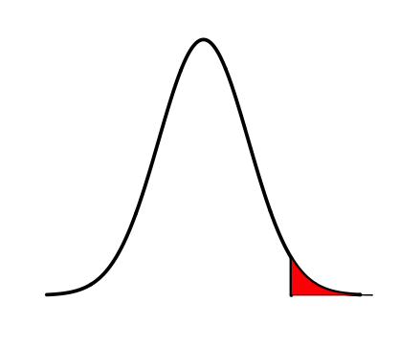
Relationship between heritabilities on disease and liability scales
Consider a linear regression of genetic values on the disease scale (A₀₁) on genetic values on the liability scale (A_{L}):
A₀₁ = μ+bA_{L} b=cov(A₀₁,A_{L})
var(A_{L})
Var(A₀₁) = b²Var(A_{L}) =cov(A₀₁,A_{L})² by differential calculus normal var(A_{L}) distribution theory….
z
K
t
i = z/K
NB Estimates of narrow heritability on observed scale from family data often contaminated by non-additive heritability
Robertson (1950) Appendix of Dempster & Lerner (1950) Heritability of threshold characters. Genetics 35

Slide 13
Relationship between heritability on the disease and liability scales
Lines are heritability of liability
On the disease scale
= Prevalence
Dempster & Lerner (1950) Appendix by Alan Robertson. Heritability of threshold characters. Genetics 35

Slide 14
A(n incomplete) history of the liability threshold model
Pearson (1900) –used “tetrachoric correlation” to describe correlation between 2 dichotomous traits
Wright(1934) showed that 3 vs 4 toes in guinea pigs “cannot correspond to alternate phases of a single factor (=gene)” and used crosses to show several factors (“> 3”) underly a physiological threshold
Robertson & Lerner (1949) provided the quantitative genetics maths for all-or-none traits – thinking about response to selection
Dempster & Lerner (1950) with Appendix by Robertson – converts between heritability on the 0/1 and liability scales
Crittenden (1961) & Falconer (1965) – provided the quantitative genetics maths – probably independently –for disease traits
Smith (1970) – clarifies consistency of high heritability, low prevalence and high discordance of MZ twins
Credit is generally given to Falconer (1965), but really it should be Robertson & Lerner (1949)
Wright (1934) An analysis of variability in number of digits in an inbred strain of guineapig. Genetics 19 506
Wright (1934) The results of crosses between inbred strains of guinea pigs, differing in the number of. Genetics 19 537
Robertson & Lerner (1949) The heritability of all-or-none traits: viability of poultry. Genetics
Dempster & Lerner (1950) Heritability of threshold characters. Genetics 35
Crittenden (1961) an interpretation o familial aggregation based on multiple genetic and environmental factors
Ann NY Acad Sci 91 769
Falconer (1965) The inheritance of liability to certain diseases, estimated from incidences in relatives,
Ann. Hum Genet. 29 51
Smith (1970) Heritabiity of liability and concordance in monozygous twins Ann Hum Genet 34: 85

