Slide 1
Everyday Lab Issues Can Affect Data Analysis
Protocol Development and Consistency
Types of biological samples
Whole blood collections
DNA extraction methods - points to considor
Generating large data sets – manifests and samples
Specific issues around GWAS, methylation and expression
Lab tour next week

Slide 2
Protocol Development and Consistency
Sample collection – site specific, clinic, staff and equipment
Esp impt for longitudinal projects – tracking of phenotypes, environmental influences, aging of samples and participants
Tracking the surce of the samples – dilutions / daughter stamps

Slide 3
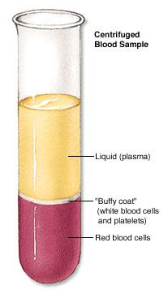
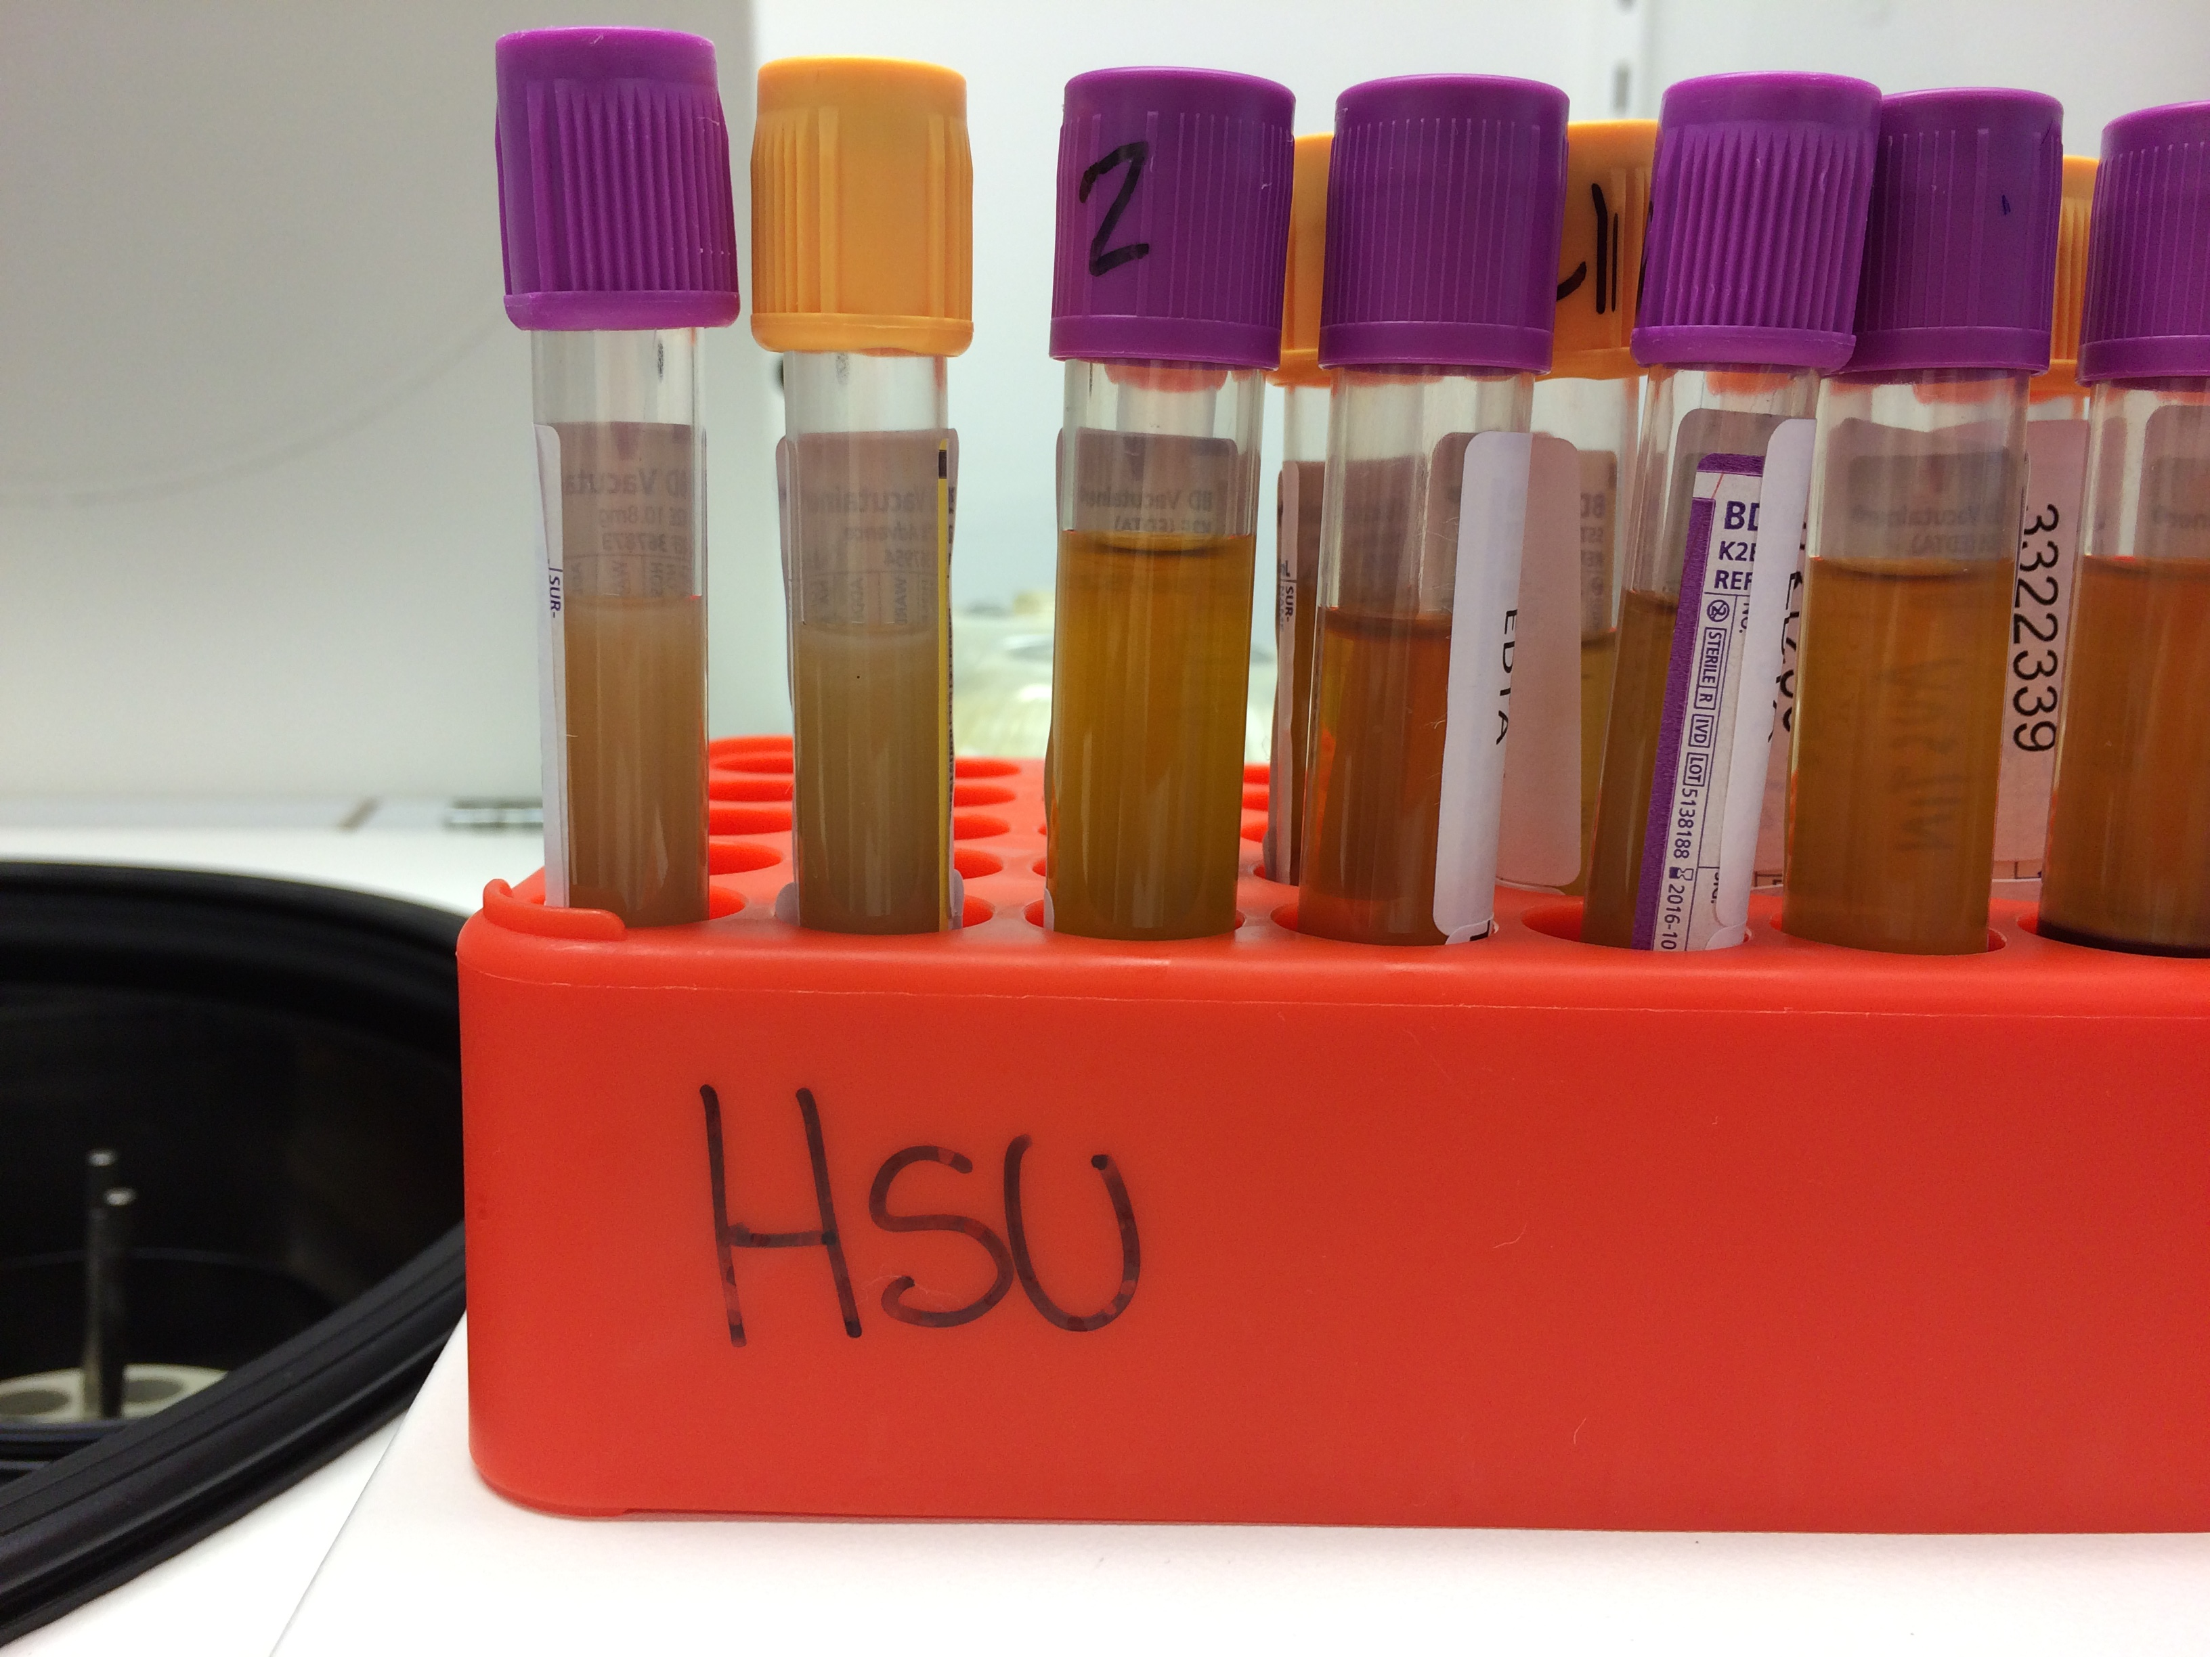
Whole blood collections
Different samples for different aims
Collection of samples / tissues / products – biomarkers
Associated information about samples –phenotype influences

Slide 4
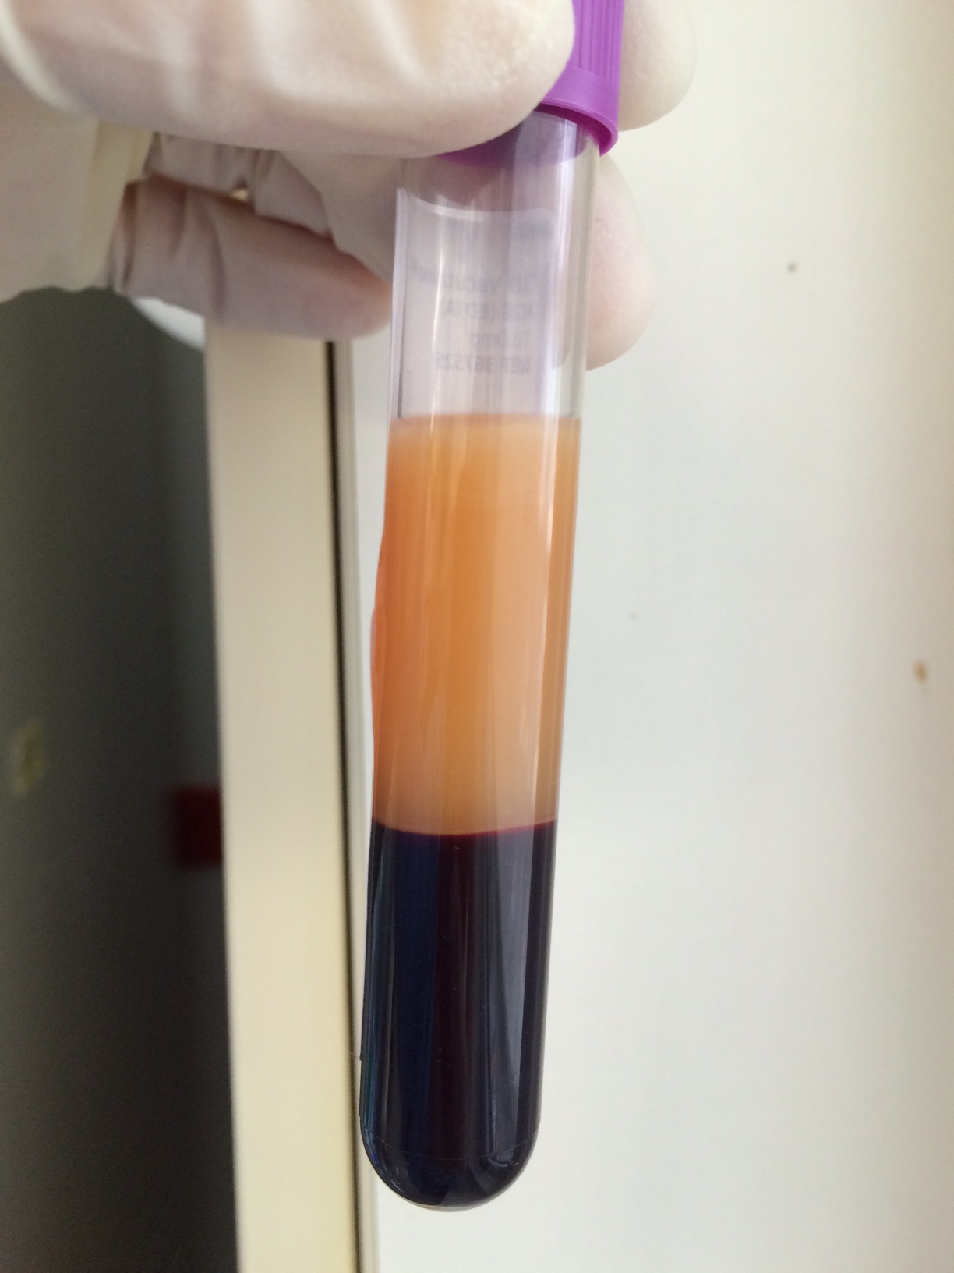
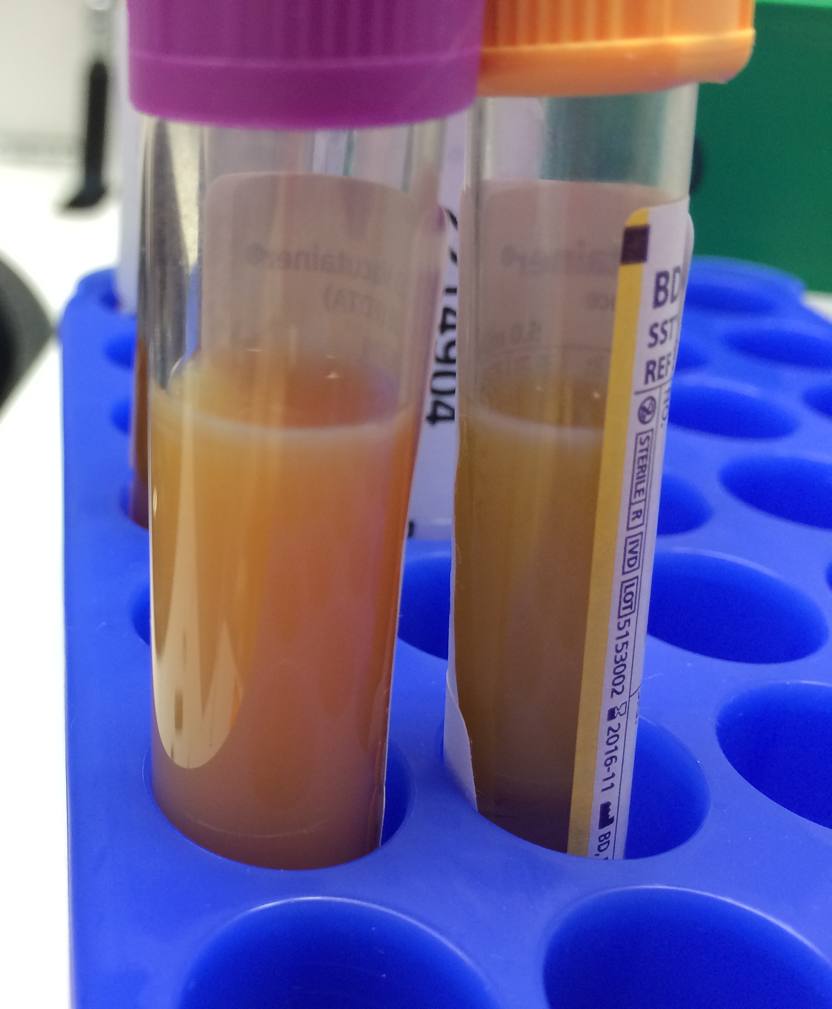
Cloudy samples - Plasma is very cloudy and difficult to harvest the buffy coat
Serum is very cloudy
Adverse event will need to be reported back to treating clinician to follow up with patient. (our experience has shown that cloudy samples could be a result of undiagnosed metabolic disorders, lipideamias, excess protein secretion)

Slide 5
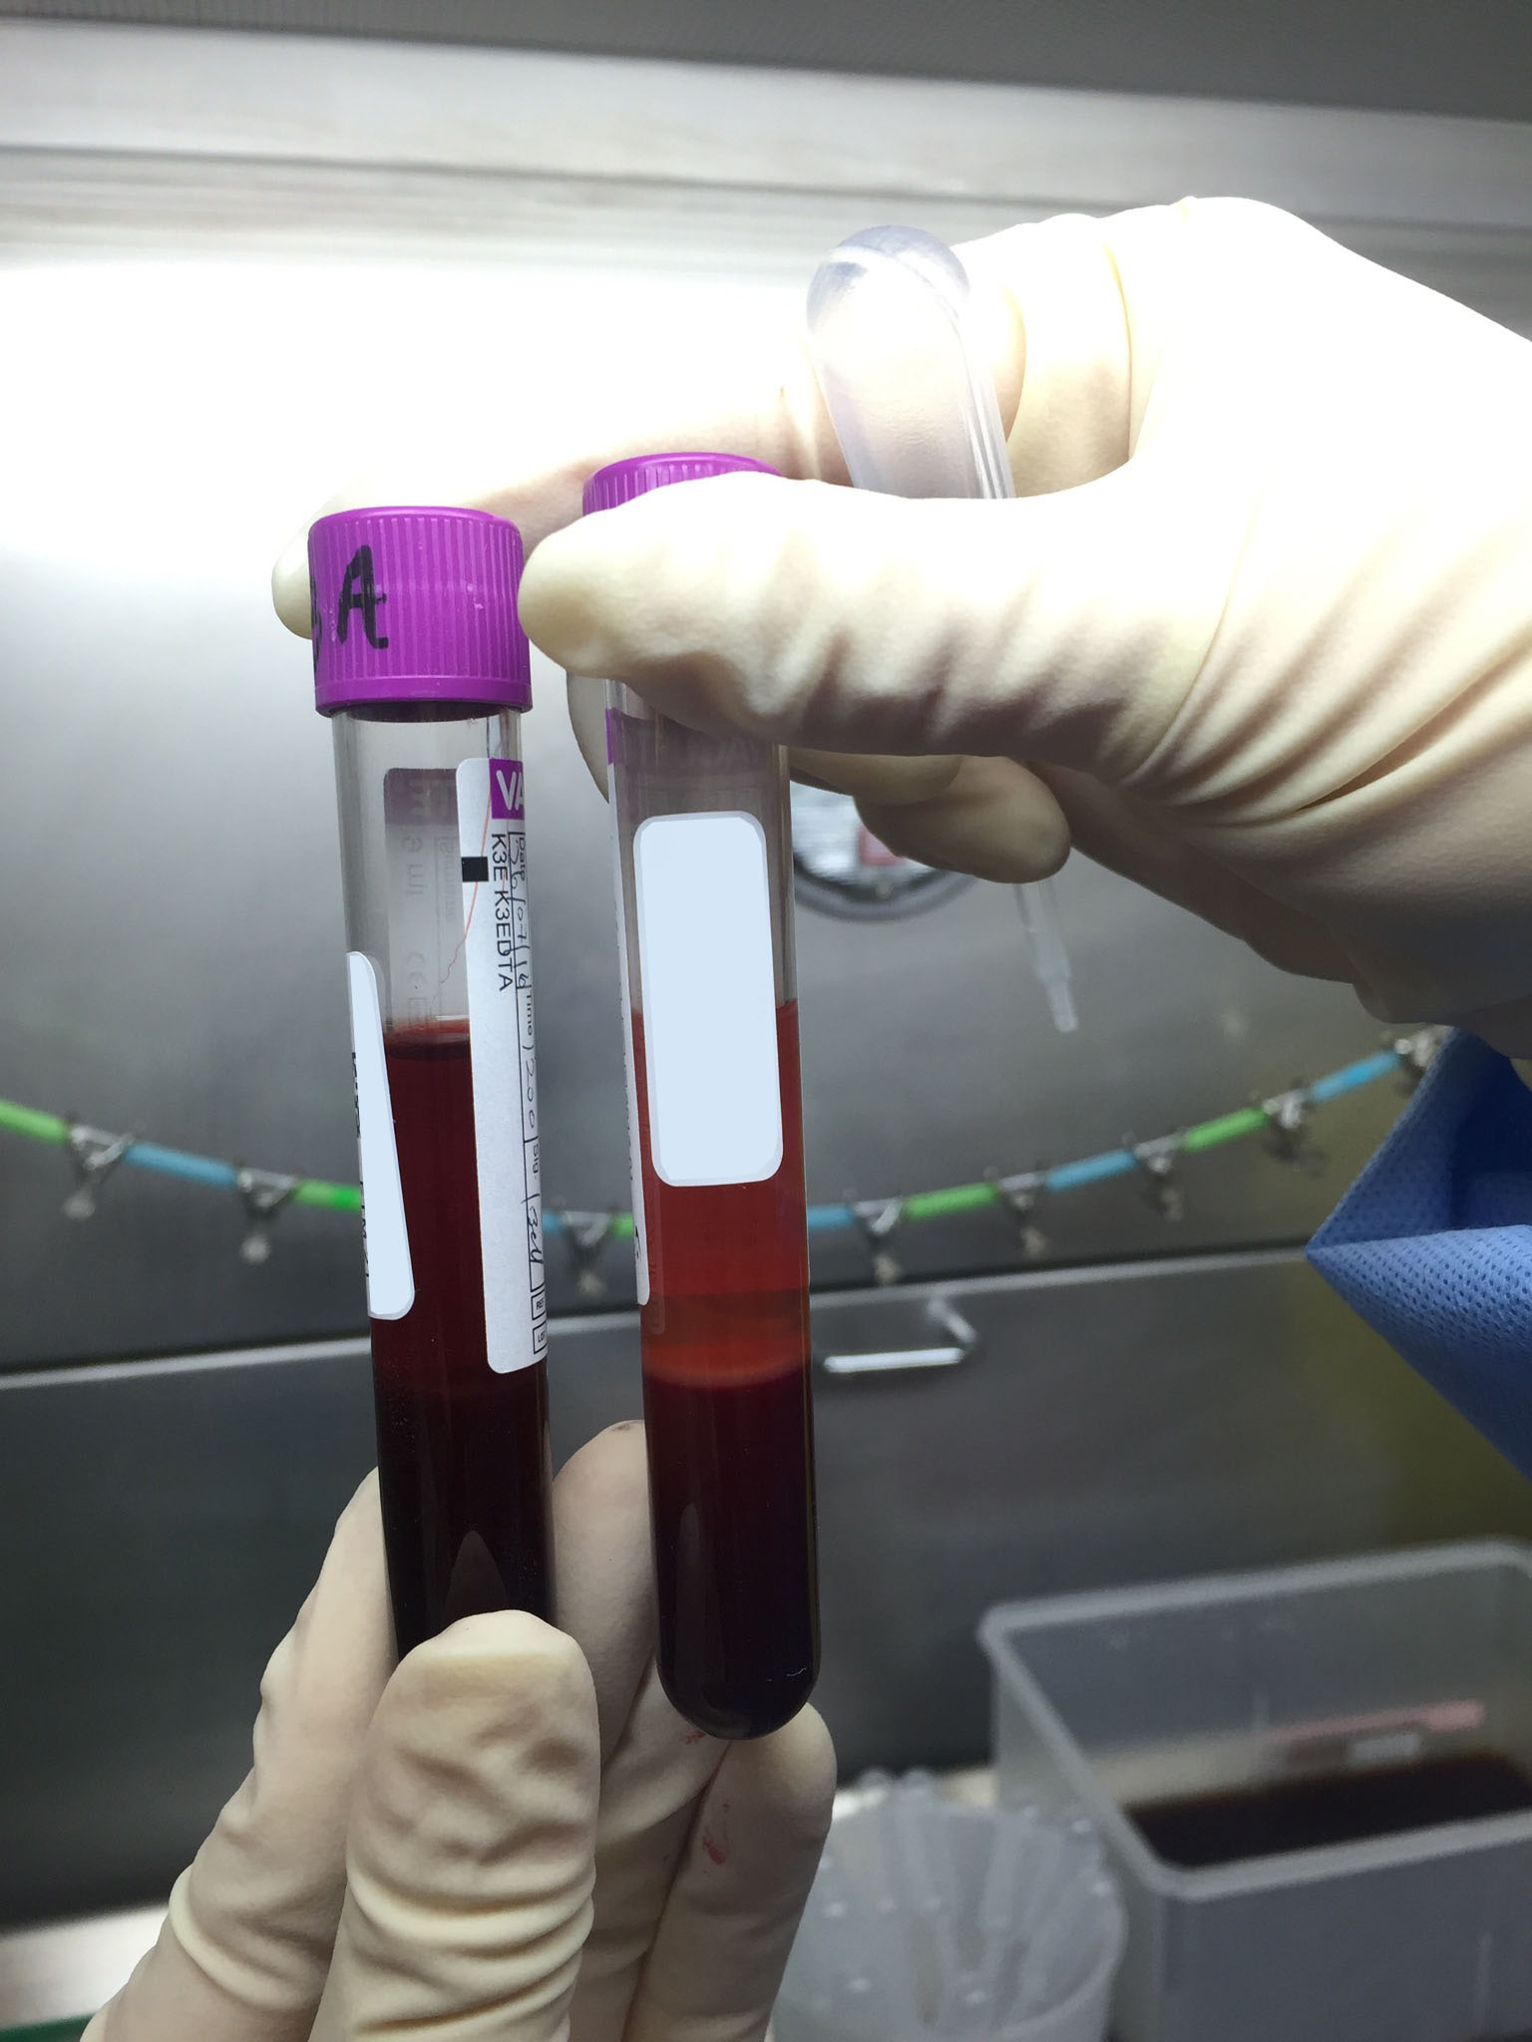
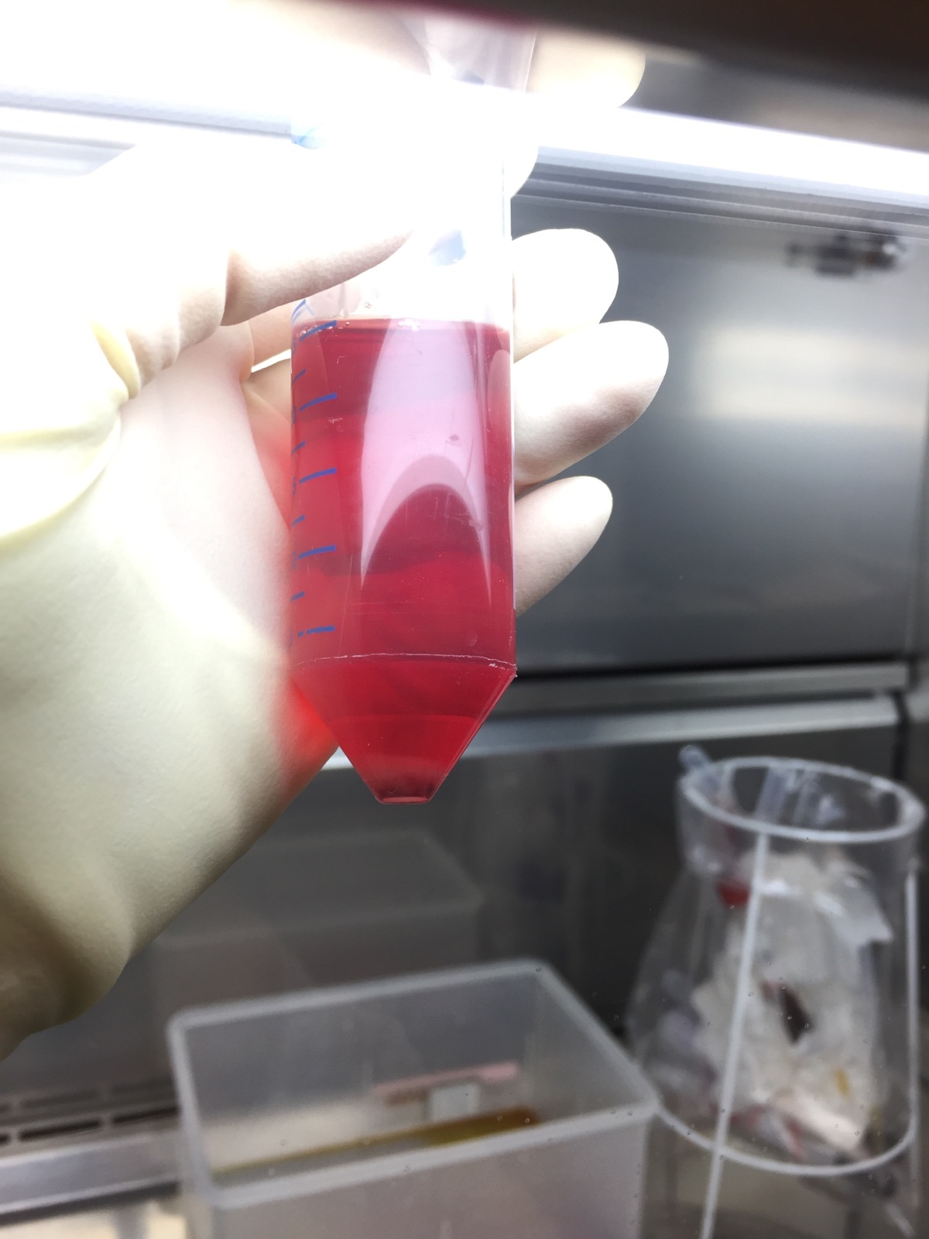
Haemolysed samples
Caused by trauma, incorrect needle gauge, refrigeration, aged blood sample
Difficult to discern separation of fractions
No fractions are collected and buffy coat is obtained by blood washing procedure
Usually haem contaminated buffy coat which translates to poor quality DNA sample and issues with downstream genomics

Slide 6
DNA Extraction and Quantitation Methods
EXTRACTION
Manual vs kit such as columns / beads
Input material – fresh, frozen, PPE, and volume / amount
Max Binding capacity and expected extracted amounts
Manual Vs robotics
Batching and controls
QUANTITATION:
Spectrophotometry/ fluorescence / intercelating agents
Application driven and protocol specific esp to resuspension of extracts before quanting
Notes:
Array of biological samples – easy to collect/med procedures/ethically defensible?
Handling & Processing Protocols
Consistency is the key to batching effects
Sites/clinics/staff/equipment
Different samples for different aims – can you find efficiencies
Biomarkers – plasma/serum (iced/non-iced) preservatives added etc.
How will this be accommodated in the setting in which the samples are being
Feasibility/burden for R’s
Especially important for longitudinal projects – tracking progression/enviromental influences
Aging sample (samples & R’s) effects of this ie: (period through puberty/menopause/pruning)
All processes/protocols would need to satisfy any auditing requirements
Tracking samples through the lab – 1⁰ sample – aliquots – derivatius/dilutions
Most important can you track the origin of the sample you are working with back to its source – sample mix-ups/time-matched to p/types
Associated information about samples
bld transfusions/transplants/effects of medication/phenotype influences
Working with samples – labelling of tubes - how much identifying information
relabel and the start of every expt ie: 1-24
transposing information
consistent use of controls
use of barcode/data matrix labels
Larger patches of samples/plates
orientation of plates/racks
dble seq checking of order of samples
scanning to confirm order/selection of samples
Biological Samples
Controls – what to use!
Examples - AGRF saliva extractions – boss in the service/collected when they ran out (was not a standard collection of cells)
Plate orientation controls – service provider
Family info and orientation sample M/F odd/even plates
Selection of protocols upstream of d/stream analysis – extenstion/quant/etc.

Slide 7
Generating large data sets – manifests and samples
Larger batches of samples/plates
Sample selection – phenotype and other sample info
Orientation of racks and plates / seq checking of order of samples
CONTROLS***
Selection of control and source
Placement on the plate / chip

Slide 8
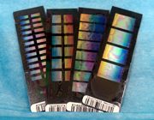
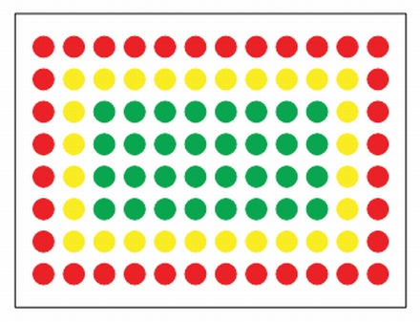
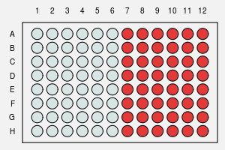
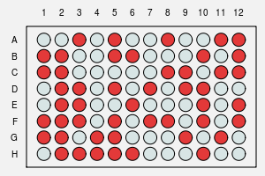

Slide 9
Specific issues around GWAS, methylation and expression
Selection of Sample
Time point of sample – within a disease course / development phase etc
Treatment of samples before methylation – frozen, fresh, manual, kit, robotics, storage etc
Input volumes into conversion assays
Conversion consistency and taking forward
** Controls at each step of the process

Slide 10
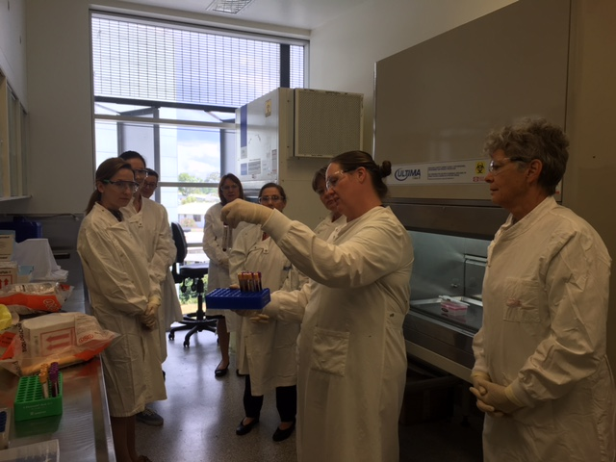
Lab Tour
Fractionation of whole blood samples
Robotics we use
DNA extraction - gDNA elution step
Illumina platforms
Please remember:
Closed in shoes
Hair tied back / up
We will provide PPE

