Slide 1
Summary-data-based Mendelian randomization to identify pleiotropic genes

Slide 2
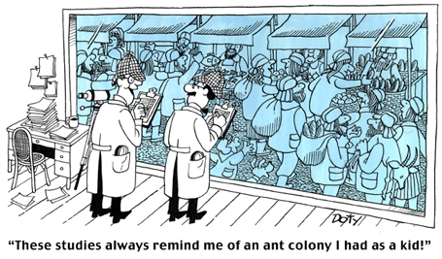
Epidemiology study
Regression: Disease ~ Risk factor
Example:
BMI ~ type 2 diabetes, cardiovascular disease, hyperlipidemia
Disadvantage:
Sample size is probably not large for some diseases
It might be caused by confounding effects
The correlation may be not repeatable.

Slide 3
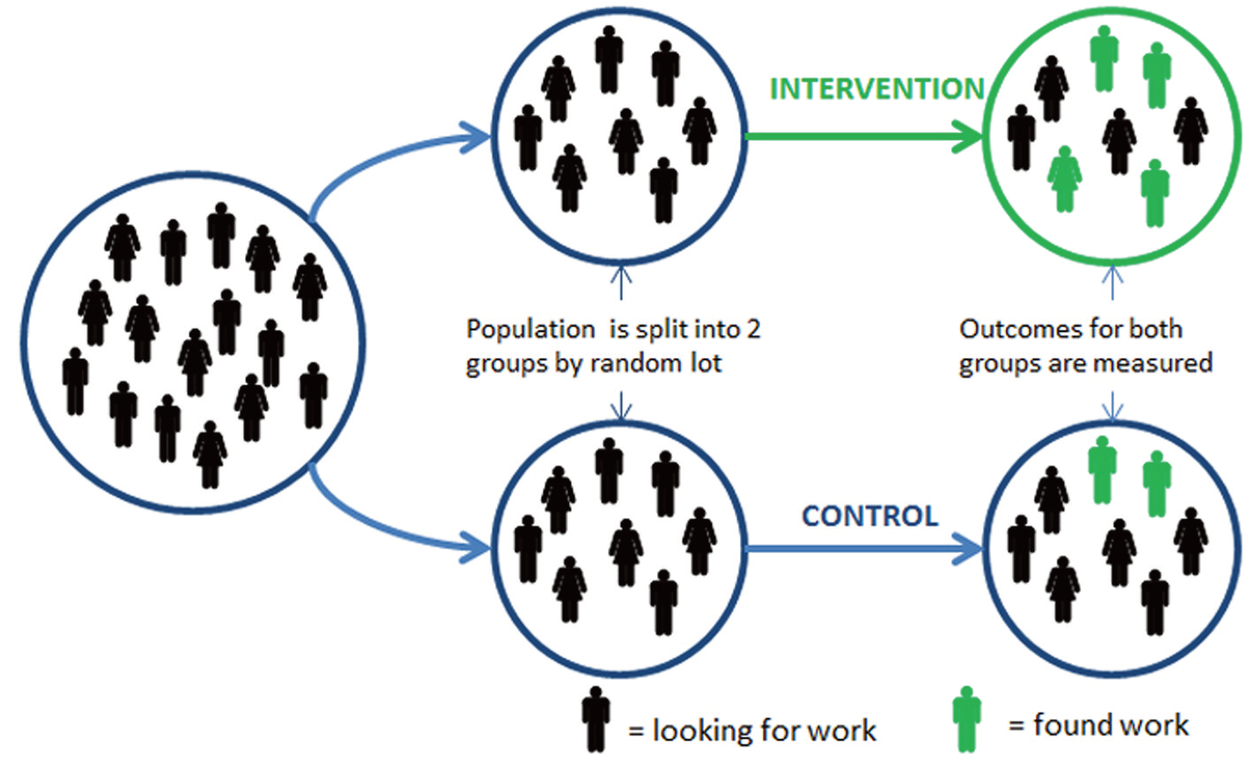
Randomized controlled trial
Risk factor
Intervention
Disease

Slide 4
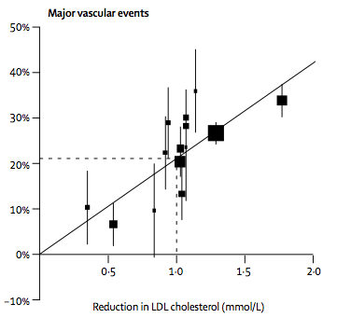
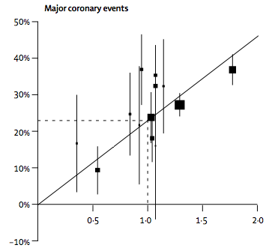
Correlation or association?
A successful RCT:
LDL -> coronary artery disease, 90,056 individuals, 14 randomized trials
Reduction in major vascular events vs. reduction in LDL
Reduction in major coronary events vs. reduction in LDL
Cholesterol Treatment Trialists’ (CTT) Collaborators 2005 Lancet

Slide 5
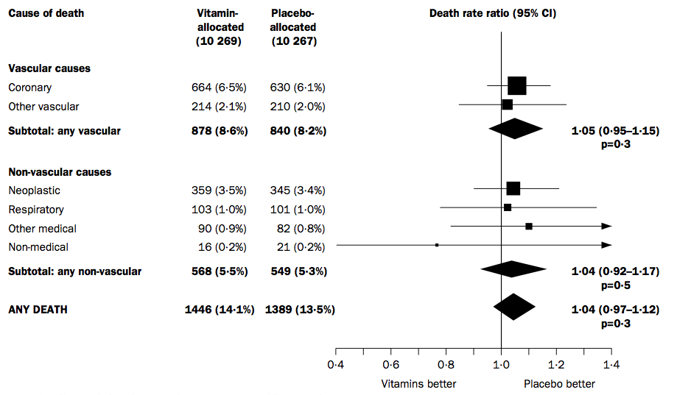
Correlation or association?
A failed RCT: Vitamin supplementation ~ common disease?
Heart Protection Study Collaborative Group 2002 Lancet

Slide 6
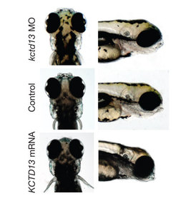
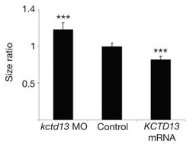
Genetic variants could be instruments
KCTD13 -> head size of zebra fish
16p11.2
Deletion
Duplication
KCTD13
Suppression
Overexpression

Slide 7
Medelian randomization

Slide 8
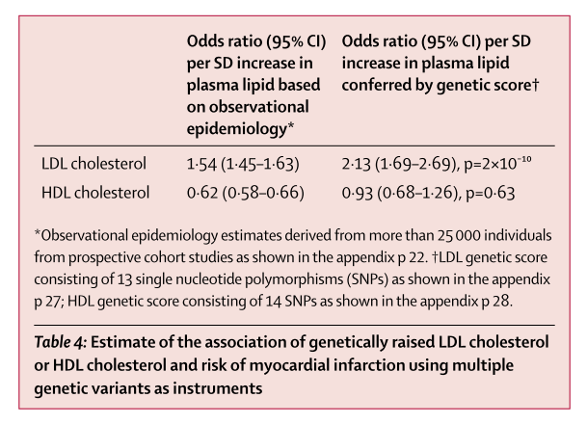
An example of MR analysis
HDL
Profile score (HDL)
CAD
Profile score (LDL)
LDL
Disadvantage of MR: individual-level data are required

Slide 9
Factors that affect MR analysis
R²_{zx}, variance in exposure (x) explained by instrument (z)
z should be strongly associated with x
2. R²_{xy}, variance in outcome (y) explained by exposure (x)
the association may be no significant, if R²_{xy} is small.
Thus we require a very large sample to identify the association between x (e.g. gene) and y (e.g. trait).
Whereas we do not have GWAS and eQTL study available in the same cohort with very large sample size.
3. Confounding factors in a cohort

Slide 10


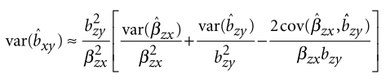

Summary-data-based Mendelian randomization
Single instrument
b_{xy}
s.e.
MR
SMR
the same if two methods are
applied in a single cohort
Different

Slide 11
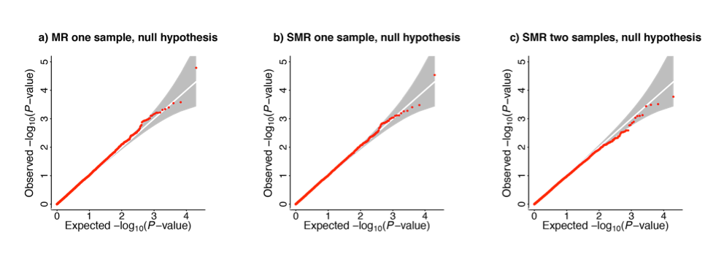
False positive rate and statistical power
False positive rate
Statistical power
Table 1 Mean chi-squared statistics for testing the association between gene expression and trait
Power is slightly smaller
than MR in one sample.

Slide 12
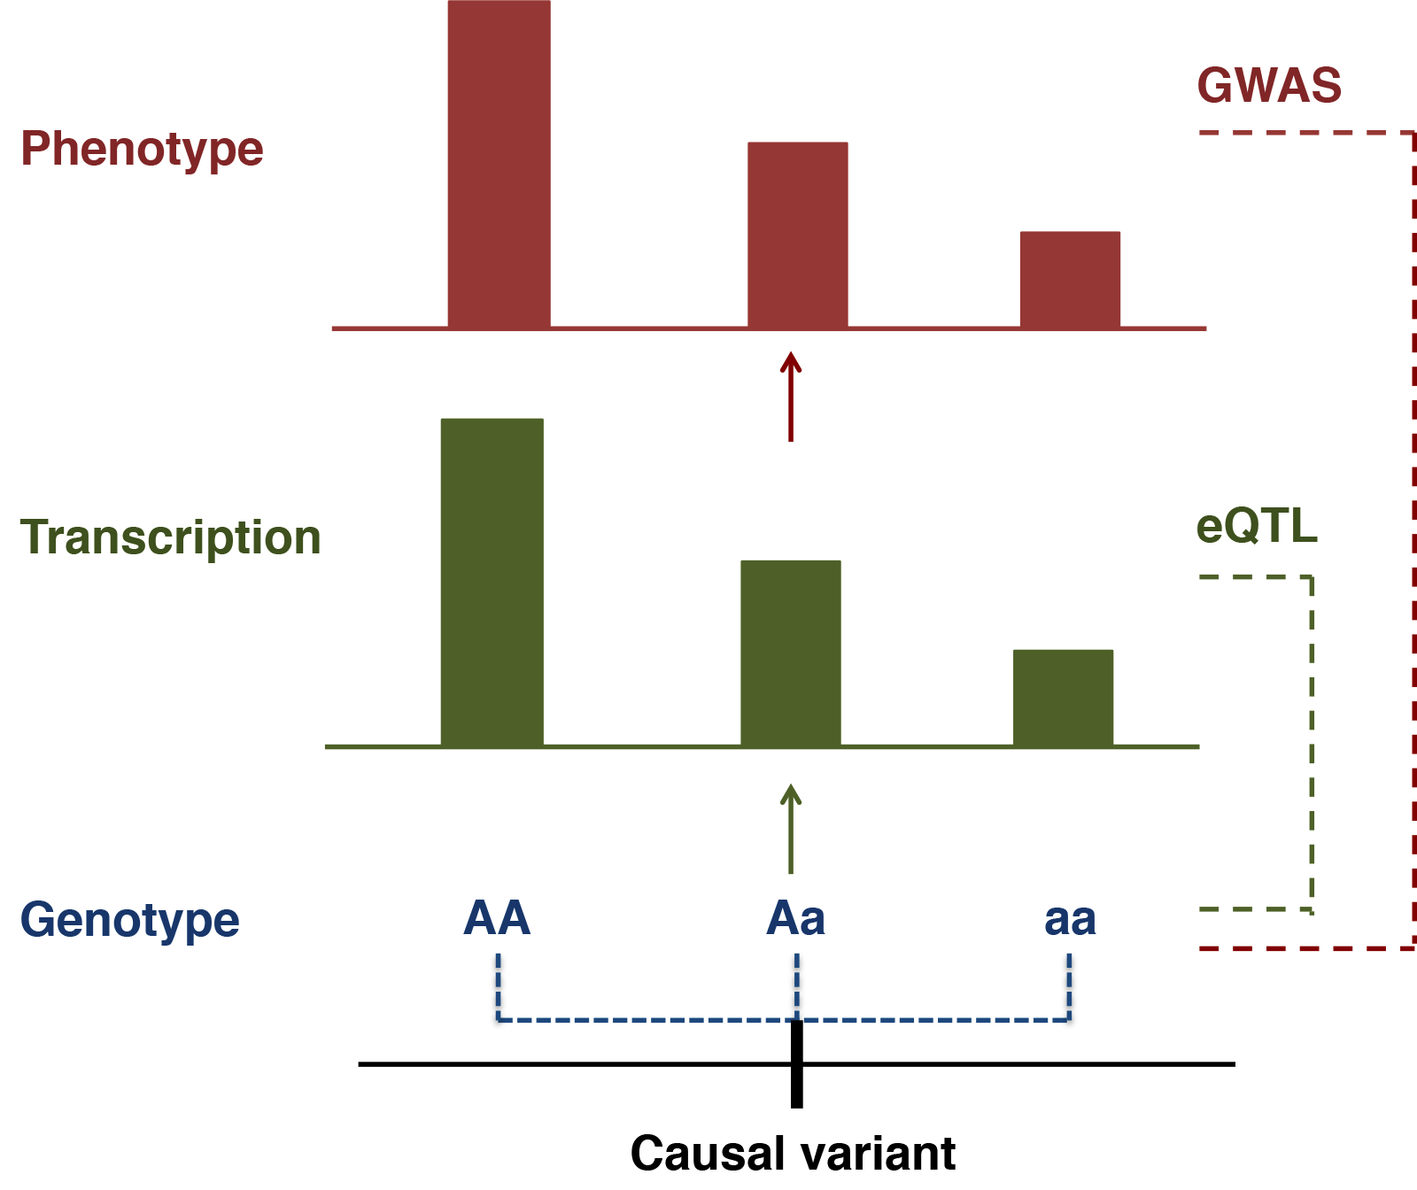
Genes associated with trait
Single instrument: we assume only one causal variant is associated with a single gene.
Multiple instruments: instruments are not independent, the association might be caused by close linkage

Slide 13
Causality or pleiotropy ?
We can not distinguish pleiotropy from causality, thus we interpret all the association as pleiotropy.

Slide 14
Pleiotropy or linkage ?

Slide 15

Heterogeneity in dependent instruments
d_{i} = b_{xy(i)} – b_{xy(top)}
We keep those genes where d_{i} = 0, opposite to traditional hypothesis test. Thus we use 0.05 as threshold without correcting for multiple tests.

Slide 16
Power to detect heterogeneity

Slide 17
Selecting instruments in HEIDI test
Instruments must be associated with the gene expression trait
Including more instruments that have moderate LD with the top SNP
SNPs in high LD may reduce the power
We improved our HEIDI test (to be published)
Threshold: 1e-3;
Removing SNPs that are in LD with the top SNP (LD R² > 0.9);
Removing SNPs with pair-wise LD R² > 0.9;
Selecting the top 20 SNPs.

Slide 18
Summary
MR requires instrument strongly associated with exposure.
R²_{zx} and R²_{xy} determine the power of mendelian randomization
Thus large samples are required.
3. SMR largely increases the power by utilizing summary data from two independent data.
4. False positive rate is well controlled in SMR.
5. All the identified genes are interpreted as pleiotropic ones.
6. HEIDI test can be applied to distinguish close linkage.

Slide 19
Thank you!

