Slide 1
Single locus model of disease risk & Power Calculations Naomi Wray

Slide 2
Aims of Lecture
Theory
Single locus disease model
Power calculations

Slide 3
Revision of Power

Slide 4
Single locus disease model
Single locus disease model:
G = genotype; D=disease; K = overall disease risk in population; p = risk allele frequency

Slide 5
Single locus disease model
Single locus disease model:
G = genotype; D=disease; K = overall disease risk in population;
p = risk allele frequency;
f0 = baseline risk for homozygote non-risk allele – UNKNOWN
R = relative risk for heterozygote; assume risk is multiplicative (on this scale)

Slide 6
Single locus disease model
Single locus disease model:
G = genotype; D=disease; K = overall disease risk in population;
p = risk allele frequency;
f0 = baseline risk for homozygote non-risk allele – UNKNOWN
R = relative risk for heterozygote; assume risk is multiplicative (on this scale)

Slide 7
Single locus disease model
Single locus disease model:
G = genotype; D=disease; K = overall disease risk in population;
p = risk allele frequency;
f0 = baseline risk for homozygote non-risk allele – UNKNOWN
R = relative risk for heterozygote; assume risk is multiplicative (on this scale)

Slide 8
Practical
Single locus disease model:
G = genotype; D=disease; K = overall disease risk in population = 0.01;
p = risk allele frequency = 0.2;
f0 = baseline risk for homozygote non-risk allele – UNKNOWN
R = relative risk for heterozygote; assume risk is multiplicative (on this scale) = 1.2

Slide 9
Practical
Single locus disease model:
G = genotype; D=disease; K = overall disease risk in population = 0.01;
p = risk allele frequency = 0.2;
f0 = baseline risk for homozygote non-risk allele – UNKNOWN
R = relative risk for heterozygote; assume risk is multiplicative (on this scale) = 1.2
Geno | P(G) | P(D|G) | P(D & G) | P(G|D)
aa | 0.64 | 0.0092 | 0.0059 | 0.59
Aa | 0.32 | 0.0111 | 0.0036 | 0.36
AA | 0.04 | 0.0133 | 0.0005 | 0.05
 |  |  | Sum= 0.01

Slide 10
Allele frequency in screened controls
Single locus disease model:
G = genotype; D=disease; K = overall disease risk in population

Slide 11
Find same for non-disease = screened controls
Single locus disease model:
G = genotype; D=disease; K = overall disease risk in population = 0.01;
p = risk allele frequency = 0.2;
f0 = baseline risk for homozygote non-risk allele – UNKNOWN
R = relative risk for heterozygote; assume risk is multiplicative (on this scale) = 1.2
Geno | P(G) | P(ND|G) | P(ND & G) | P(G|NDD)
aa | 0.64
Aa | 0.32
AA | 0.04
 |  |  | Sum= 0.99

Slide 12
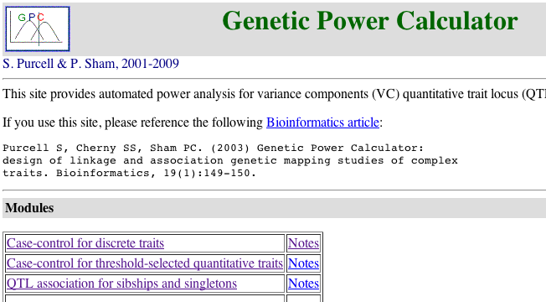
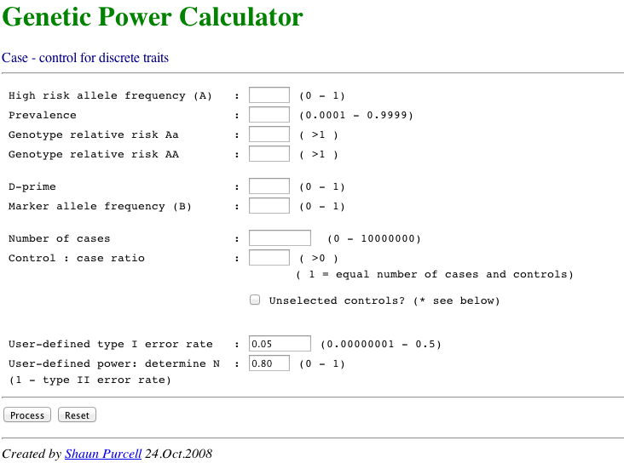
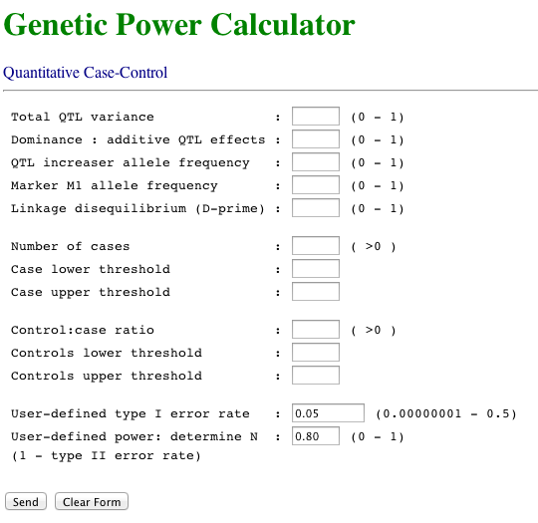
Online GWAS power calculator
Yang

Slide 14
Power of a case-control study
H₀: No difference in allele frequency between cases and controls
H_{A}: Difference of stated effect size between cases and controls
Z-Test statistic of association = test of difference of two proportions =
χ² non-centrality parameter = NCP₀₁ =
v = proportion of a sample of N that are cases
= mean allele frequency across cases and controls
= v p_{case} + (1-v) p_{control}

Slide 15
Power of a case-control study
NCP₀₁ =
α = significance level - acceptable level of type I error
Power =
Normal distribution threshold above which null hypothesis will be rejected
N=10000,v=0.5,p=0.2,R=1.2,K=0.01,α=5e-8,K=0.01, power = 0.46
Agrees with the genetic power calculator
Yang et al (2009) Comparing Apples and Oranges: Equating the Power of Case-Control and Quantitative Trait Association Studies. Genetic Epidemiology

Slide 16
Look at R script

Slide 17
Compare disease risk K =0.01 vs K =0.15 GRR =1.2, p =0.2, alpha=5x10⁻⁸
Power 0.46 vs 0.78
P_{case} 0.2308 vs 0.2308
P_{control} 0.1997 vs 0.1946
The same GRR implies a bigger difference in allele frequency between cases and controls.
This means a locus with same allele frequency and GRR explains more variance for a common disease than a rare disease.
Compares apples and oranges. Makes more sense to compare power based on variance explained by a locus

Slide 18
Approximate variance explained by a locus
Regression of disease on jth SNP, x_{[j]} = 0,1,2
When x[j]=0 = P(Disease|Genotype =aa)
When x[j]=1 = P(Disease|Genotype =Aa)
Relative Risk = R= P(Disease|Genotype =Aa)/P(Disease|Genotype =Aa)
= (K+b₀₁)/K so b₀₁ = K(R-1)
Variance attributable to the locus on the disease scale
Assumes a population sample not a case control sample
See Lecture 1: Dempster & Lerner (1950) Appendix by Alan Robertson. Heritability of threshold characters. Genetics 35

Slide 19
Power of a case-control association study expressed in terms of variance explained by the locus
χ² non-centrality parameter = NCP₀₁ =
NCP₀₁ =
If R is small then (1+p(R-1))² ≈ 1 e.g., p=0.2, R=1.2, (1+p(R-1))²= 1.08
Variance explained by a locus =
NCP₀₁ ≈
Yang et al (2009) Comparing Apples and Oranges: Equating the Power of Case-Control and Quantitative Trait Association Studies. Genetic Epidemiology

Slide 20
Power of a association study of a quantitative trait
χ² non-centrality parameter = NCP_{QT} =
NCP₀₁ ≈
When the variance explained is the same in c-c and for quantitative trait
Yang et al (2009) Comparing Apples and Oranges: Equating the Power of Case-Control and Quantitative Trait Association Studies. Genetic Epidemiology

Slide 22
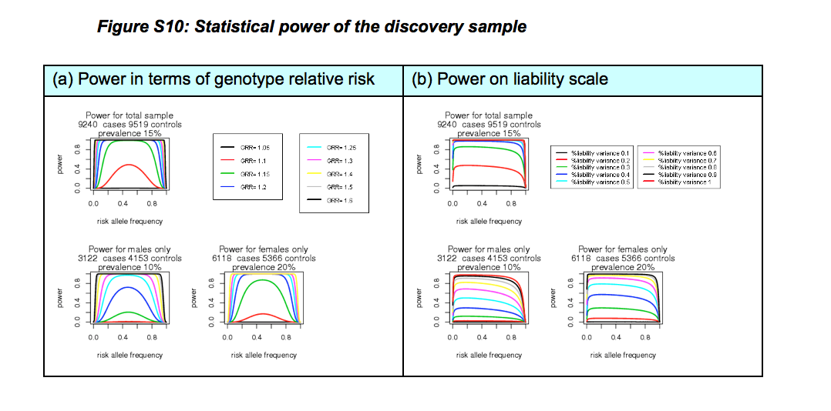

Slide 23
Practical
a) Code for slides 3-6. Done already
b) Power in case-control study design
i) Compare to GPC
ii) Compare power for screened to unscreened controls
iii) Compare the impact on power of screening controls for # schizophrenia K =0.01 and Major depression K = 0.15
iv) For which disorders is screening of controls most reccomended
c) Power Graphs in case-control study design
First run code through to see graphs, then look at code. Makes graph with 3 lines based on RAF for one disease risk
i) You make graph with 3 lines based on disease risk K=0.001,0.01,0.1
# Q: For a given GRR is the power bigger or smaller as disease prevalence increases
# Q: Why does this make sense?
d) Just run code

Slide 24
Section b)
# Q: Compare power to direct calculation as coded above# b) N =10000,v = 0.5,p=0.2,R=1.2,K=0.01,alpha=5e-8
# Q:Compare power for screened and unscreened controls
# A: - the code aboves assumes controls are screened, for unscreened controls pcont=p
# for schizophenia K =0.01 and Major depression K = 0.15
pcont=p
pbar <- v*pcase+(1-v)*pcont # Mean allele frequency in case-control
Screened: Power = 0.4586 (46%)
Unscreened: Power = 0.4469 (45%)
# Q:Compare the impact on power of screening controls for # schizophrenia K =0.01 and Major depression K = 0.15#
A: Now use K=0.15 re-run from line 44
Screened: Power = 0.79
Unscreened: Power = 0.44
Q: For which disorders is screening of controls most recommended# A: Common disorders

Slide 25
Section c)

Slide 26
Section c) Change to compare Disease Risk

Slide 27
Section d)

Slide 28
Section d) x-axis variance explained whatever allele freq

