Slide 1
Genetic risk prediction
Robert Maier
December 2016

Slide 2
Training set
GWAS (discovery)
From Phenotypes to SNPs
SNPs Phenotype
SNP effects
0 2 1 0 2 0
1 2 0 1 1 0
0 1 0 2 2 1
0 2 1 2 0 0
1 2 0 1 1 0
0 2 1 0 2 0
y₁
y₂
y₃
y₄
y₅
y₆
β₁
β₂
β₃
β₄
β₅
β₆
Individuals
Polygenic risk prediction
From SNPs
to Phenotypes
β₁
β₂
β₃
β₄
β₅
β₆
0 2 1 0 2 0
1 2 0 1 1 0
0 1 0 2 2 1
0 2 1 2 0 0
1 2 0 1 1 0
ŷ₁
ŷ₂
ŷ₃
ŷ₄
ŷ₅
Individuals
SNPs
SNP effects
Phenotype
Test set

Slide 3
Genetic risk prediction - topics
Prediction in general
Linear regression
BLUP
Expected prediction accuracy

Slide 4
Regression / classification
y ~ β₀ + β₁ x₁ + β₂ x₂ + … + e
Regression: predicting continuous outcome
Classification: predicting categorical outcome
Many methods can be used for both

Slide 5
Evaluation of prediction accuracy: Continuous outcome
R (Correlation)
R² (Variance explained, Coefficient of determination)
prediction | outcome
0.2 | 0.6
1.6 | -1.1
-0.5 | 0.7
0.4 | -0.6
0.4 | 1.5

Slide 6
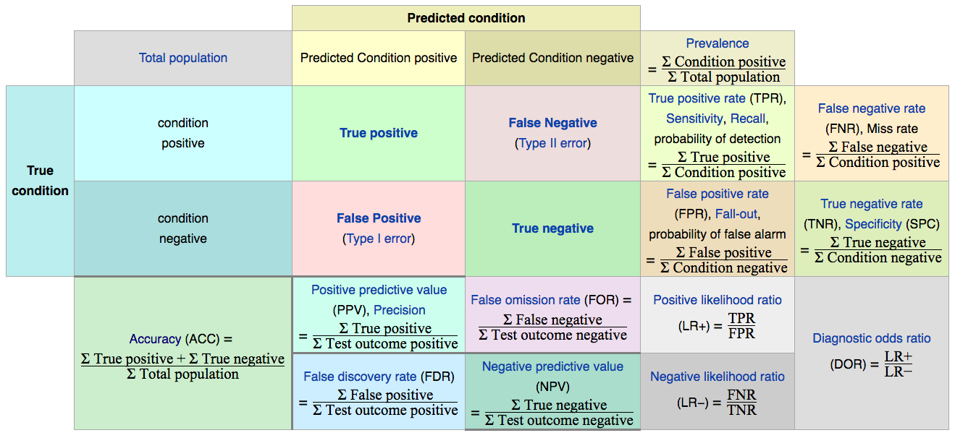
Evaluation of prediction accuracy: Binary outcome, binary predictor
prediction | outcome
0 | 0
1 | 0
1 | 0
0 | 1
1 | 1

Slide 7
Evaluation of prediction accuracy: Binary outcome, binary predictor

Slide 8
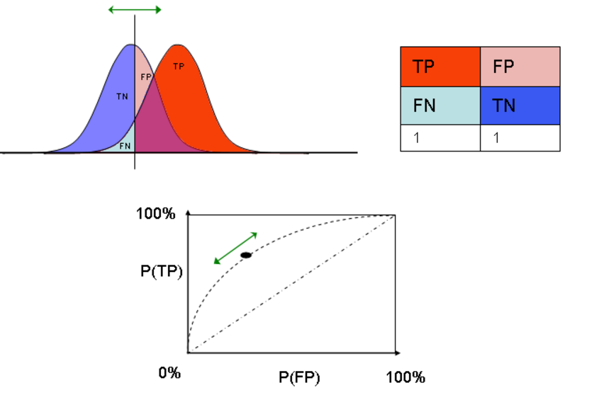
Evaluation of prediction accuracy: Binary outcome, continuous predictor
Receiver operating characteristic (ROC) curve
Area under the ROC curve
prediction | outcome
0.6 | 0
-1.1 | 1
0.7 | 1
-0.6 | 0
1.5 | 1

Slide 9
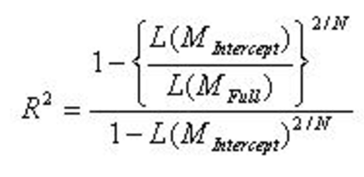
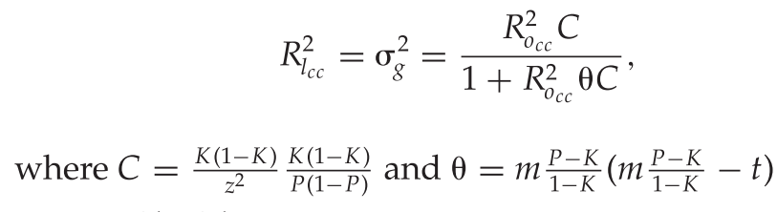
Evaluation of prediction accuracy: Binary outcome, continuous predictor
Nagelkerke R²
R² on liability scale, corrected for ascertainment
M_{Intercept}: Model without genetic predictor
M_{Full}: Model with genetic predictor
L: Likelihood
N: Sample size
K: Population prevalence
P: Sample prevalence
m: mean liability in cases
t: liability threshold
z: height at liability threshold

Slide 10
Training set / testing set
Have to be independent (no overlapping samples)
Otherwise inflated estimate of accuracy
For genetic prediction, no close relatives in prediction set

Slide 11
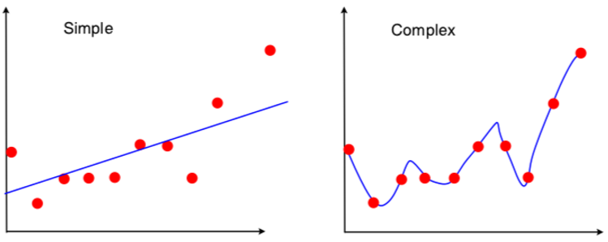
Model complexity / bias - variance tradeoff

Slide 12
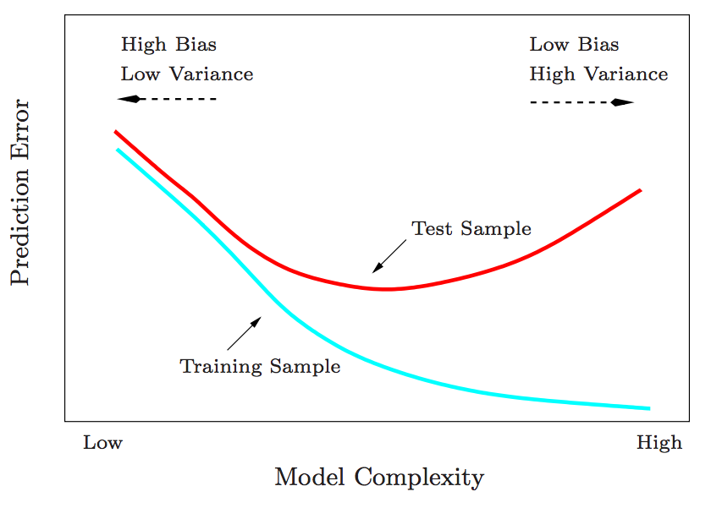
Model complexity / bias - variance tradeoff

Slide 13
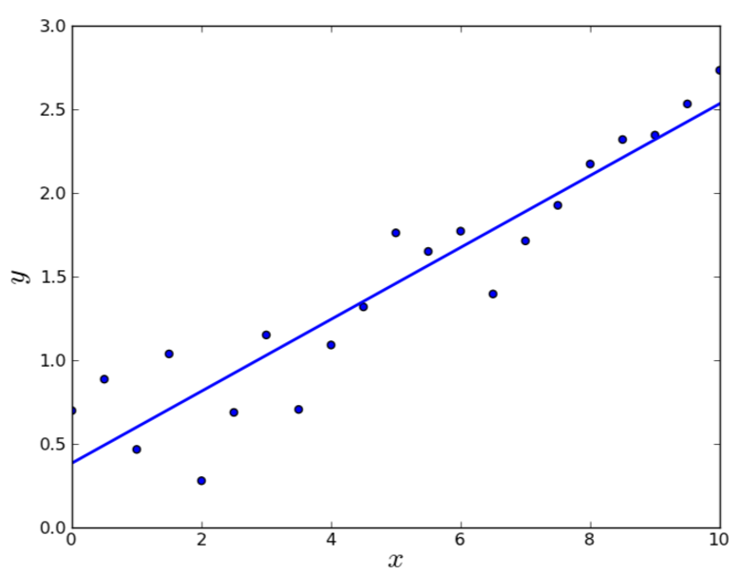
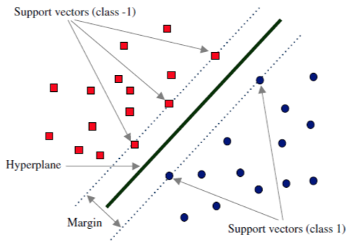
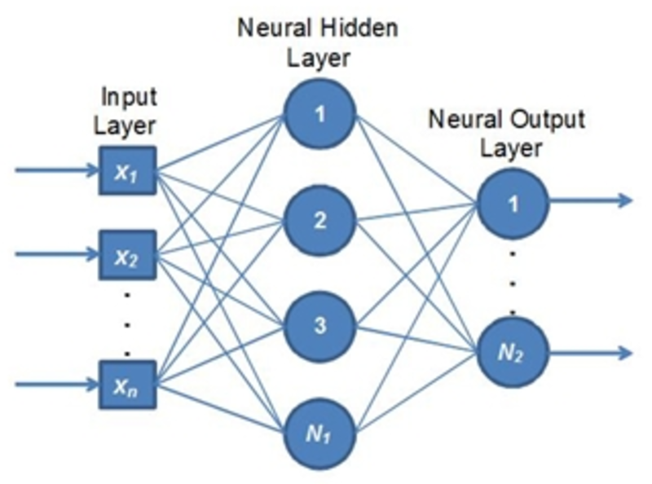
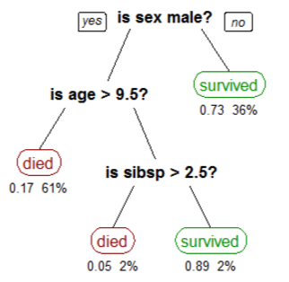
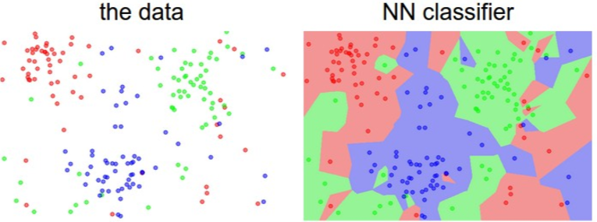
Examples of prediction models
Linear regression
(Ordinary Least Squares, OLS)
Regularised regression
(LASSO, ridge regression)
Support vector machine (SVM)
Arificial Neural Networks
Decision trees, Random forests
k-nearest neighbours

Slide 14
Why linear regression?
Computationally not very demanding
More complex models are useful when interaction effects are important
But for most traits, additive effects explain most of the variance
Mathematically more tractable

Slide 18
If M > N, (X’X)⁻¹ does not exist!
Model is underdetermined.
Solution: add something to diagonal of X’X to make it invertible
!

Slide 19
M = N

Slide 21
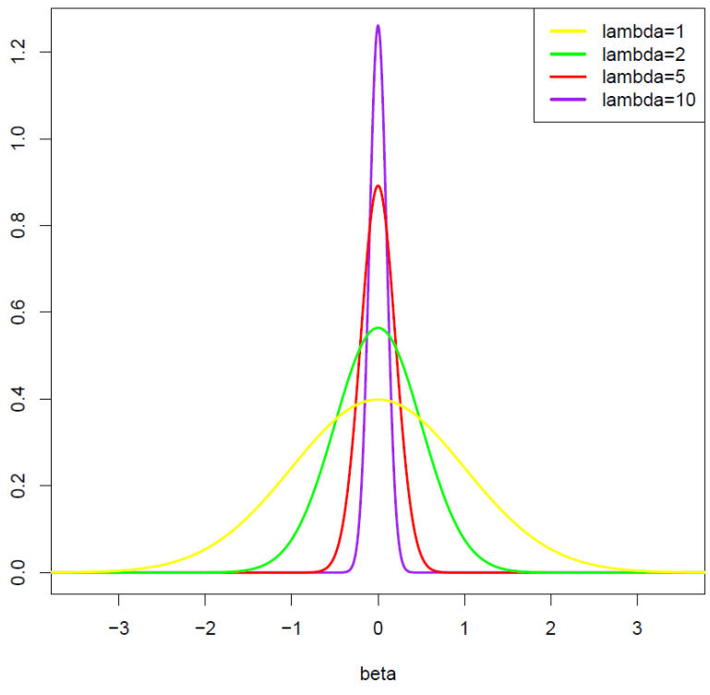

BLUP puts prior distribution on SNP effects:
β ~ N(0, (1-$σ_{e}^{2}$)/$σ_{e}^{2}$)
$σ_{e}^{2}$ -> 0, $λ$ -> 0
Prior becomes completely uninformative (flat)
BLUP becomes OLS (multiple regression)
$σ_{e}^{2}$ -> 1, $λ$ -> Inf
β -> 0; proportional to simple OLS

Slide 22
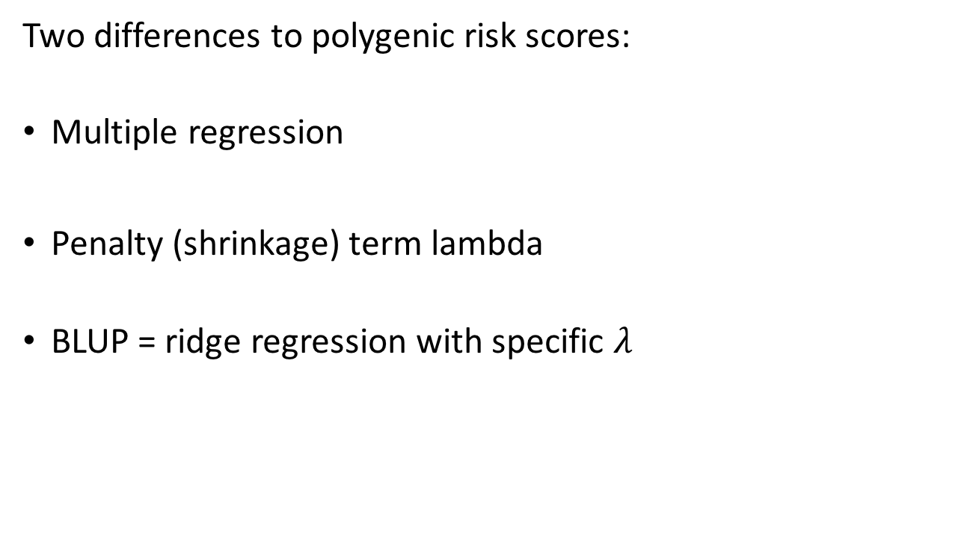
BLUP predictors
Two differences to polygenic risk scores:
Multiple regression
Penalty (shrinkage) term lambda
BLUP = ridge regression with specific $λ$

Slide 23
BLUP predictors
OLS

Slide 24
BLUP predictors
BLUP
OLS

Slide 26
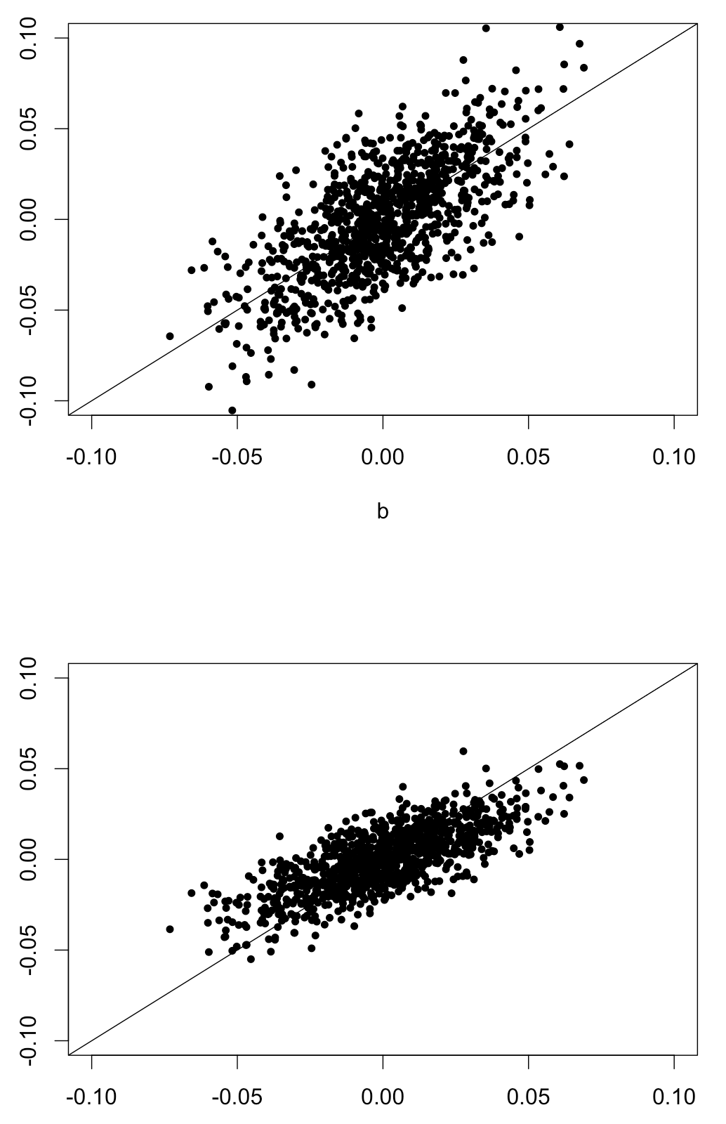

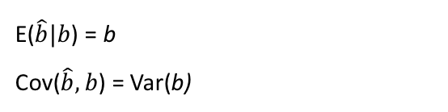
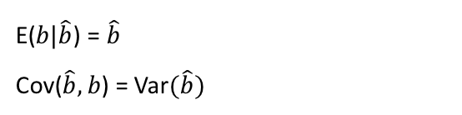

Unbiasedness
BLUE: Best Linear Unbiased Estimator
BLUE (OLS)
estimated effect
$$\hat{b}={\left(X^{′}X\right)}^{−1}X′y$$
E($\hat{b}|b$) = b
Cov($\hat{b},b$) = Var(b)
BLUP
BLUP: Best Linear Unbiased Prediction
estimated effect
$${\hat{b}}_{BLUP}={\left(X^{′}X+Iλ\right)}^{−1}X′y$$
E($b|\hat{b}$) = $\hat{b}$
Cov($\hat{b},b$) = Var$(\hat{b})$
true effect

Slide 27
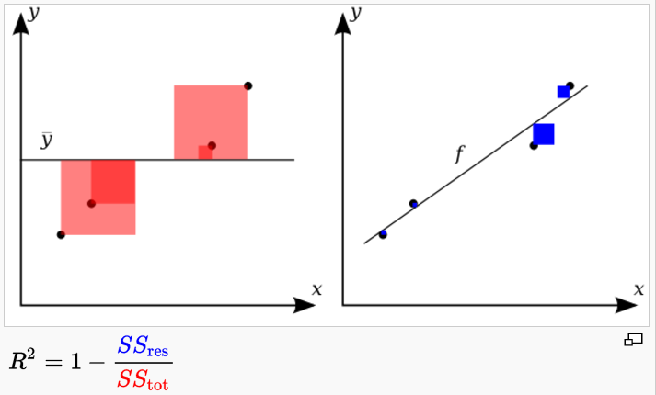

Slide 31
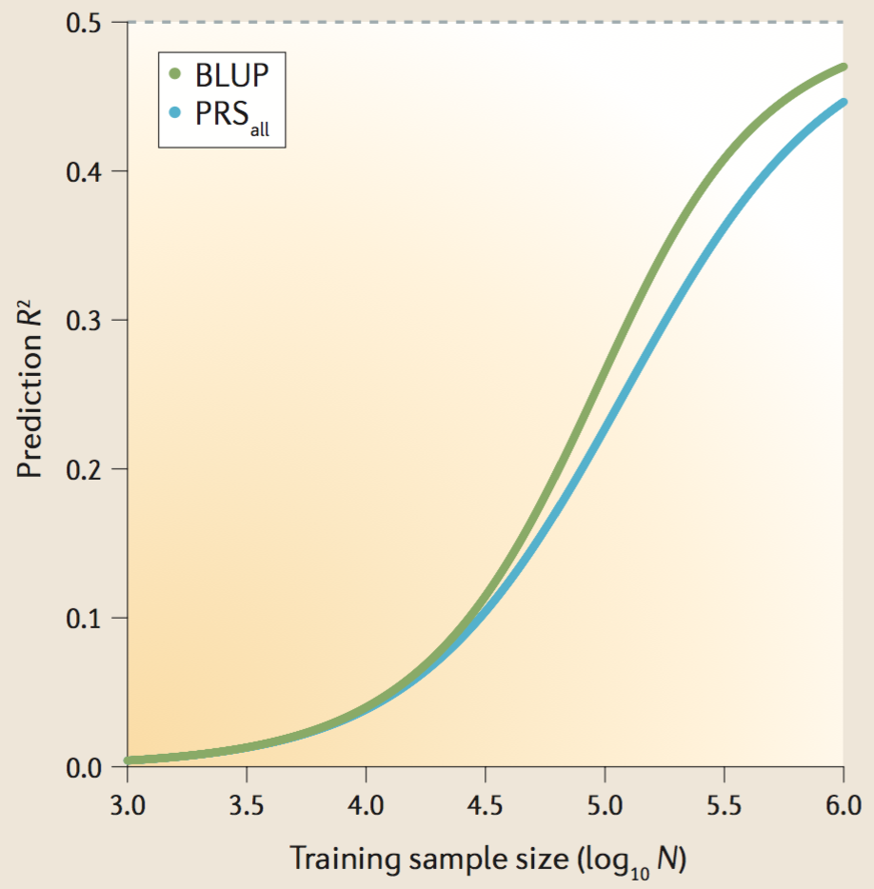
OLS
BLUP

Slide 32
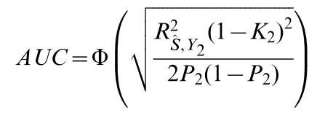
OLS
BLUP

Slide 33
Literature
Statistical learning textbook
http://statweb.stanford.edu/~tibs/ElemStatLearn/
R² for disease traits
Lee, S. H., Goddard, M. E., Wray, N. R., & Visscher, P. M. (2012). A Better Coefficient of Determination for Genetic Profile Analysis. Genetic Epidemiology, 36(3), 214–224. http://doi.org/10.1002/gepi.21614
Accuracy of a polygenic predictor
Daetwyler, H. D., Villanueva, B., & Woolliams, J. A. (2008). Accuracy of predicting the genetic risk of disease using a genome-wide approach. PloS One, 3(10), e3395. http://doi.org/10.1371/journal.pone.0003395
Wray, N. R., Yang, J., Hayes, B. J., Price, A. L., Goddard, M. E., & Visscher, P. M. (2013). Pitfalls of predicting complex traits from SNPs. Nature Reviews. Genetics, 14(7), 507–15. http://doi.org/10.1038/nrg3457
Dudbridge, F. (2013). Power and predictive accuracy of polygenic risk scores. PLoS Genetics, 9(3), e1003348. http://doi.org/10.1371/journal.pgen.1003348
Pasaniuc, B., & Price, A. L. (2016). Dissecting the genetics of complex traits using summary association statistics. bioRxiv. http://doi.org/10.1101/072934

Slide 35
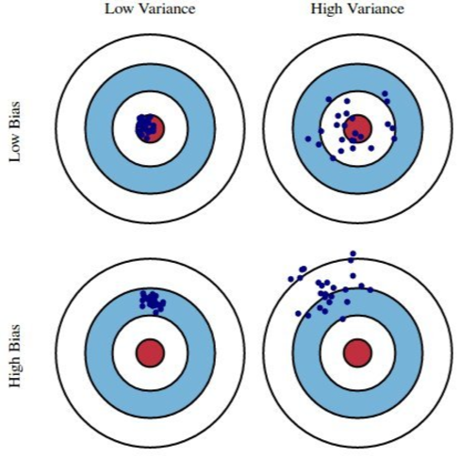
Model complexity / bias - variance tradeoff

Slide 36
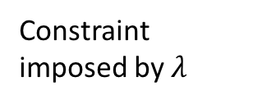
BLUP predictors
Residual Square Sum (RSS) gets larger, going away form center
(doing worse in training set)
Constraint imposed by $λ$

