Slide 1
Estimation of additive genetic variance and covariance using individual-level data
Genetics & Genomics Winter School
A/Prof Loic Yengo
l.yengo@imb.uq.edu.au
Institute for Molecular Bioscience
The University of Queensland

Slide 2
What quantitative genetics tells us about heritability?
Part 1

Slide 3
Outline
Definition of heritability (and genetic correlation)
What is heritability used and useful for?

Slide 4

Definitions
Heritability (h²) quantifies the degree to which inter-individual differences and resemblance in the population are due to genetic factors.
Chial, H. (2008) Polygenic inheritance and gene mapping.
Nature Education 1(1):17

Slide 5
Definitions
If the value, Y, of trait (=phenotype) can be modelled as
Y = G + E
then h² = var(G) / var(Y), i.e. proportion of trait variance explained by genetic factors.
Genetic
factors
Non-genetic
factors
Chial, H. (2008) Polygenic inheritance and gene mapping.
Nature Education 1(1):17
Nice definition but not very useful
unless we can observe G!

Slide 6
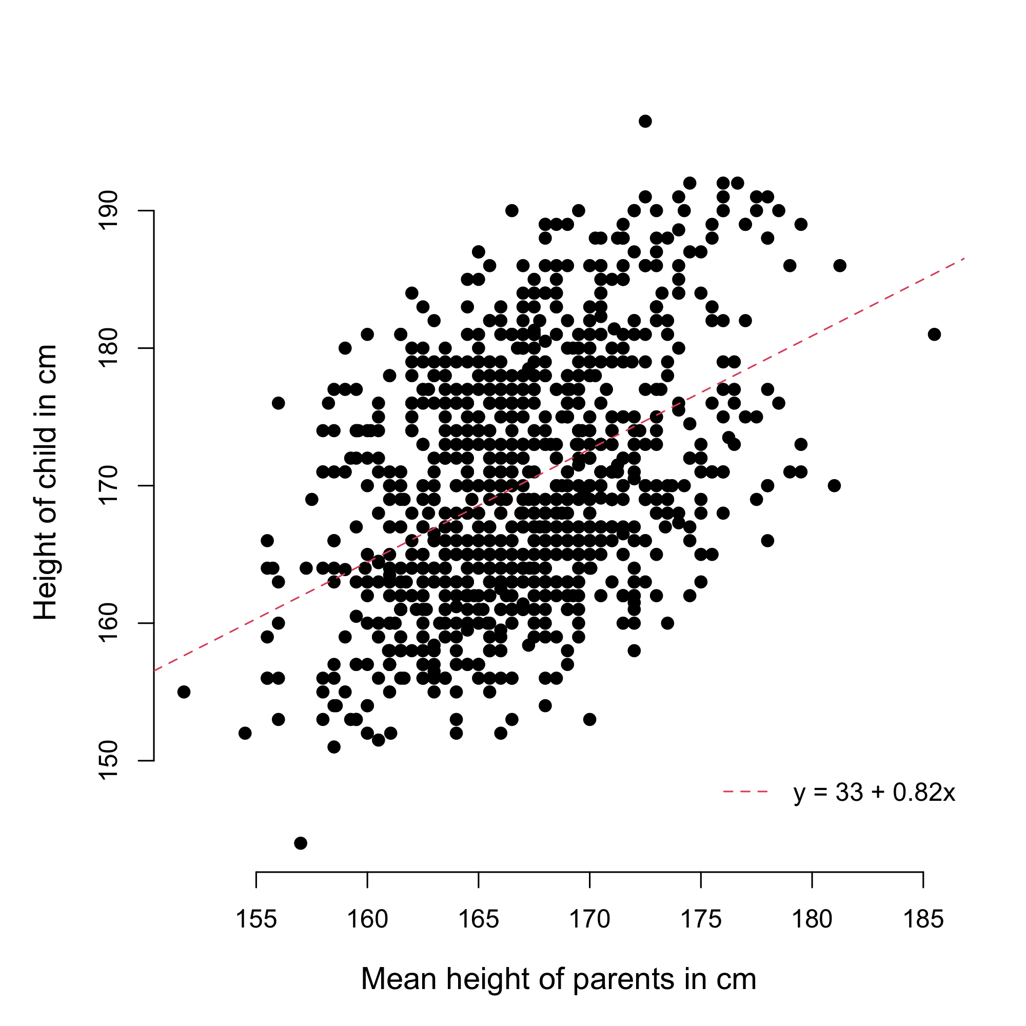
Definitions
Another view of h² is the given by the phenotypic correlation between relatives.
E.g.,
  How much is the height of siblings correlated?
  How much having a family history of schizophrenia predisposes you to also develop it?
Quantitative Genetics theory answers those questions using the following Equation
corr(Y_{i},Y_{j}) = h²R_{ij} + Residual
Data from UK Biobank participants
(Application number 12505)

Slide 7
Definitions
Quantitative Genetics theory answers those questions using the following Equation
corr(Y_{i},Y_{j}) = h²R_{ij} + Residual
where R_{ij} is the coefficient of genetic relationship between individual i and individual j (e.g., R_{ij}=0.5 for full siblings).
Data from UK Biobank participants
(Application number 12505)
this definition is a bit more useful
As we can observe both corr(Y_{i},Y_{j})
and R_{ij} (Part 2).

Slide 8
Definitions
Heritability (h²) quantifies the degree to which inter-individual differences and resemblance in the populations are due to genetic factors.
Heritability can be approached in terms of
Differences between people in the population: h² = var(G) / var(Y),
Resemblance between relatives (in families): corr(Y_{i},Y_{j}) = h²R_{ij} + Residual

Slide 9
Is heritability a universal constant?
No!
Heritability is a property of a trait, in a population, at a given time.
Heritability can change over time (e.g., Rimfeld et al. NHB 2018, heritability of educational attainment in Estonia before/after the cold war).
Larger is not necessarily better.

Slide 10
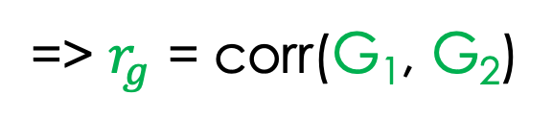
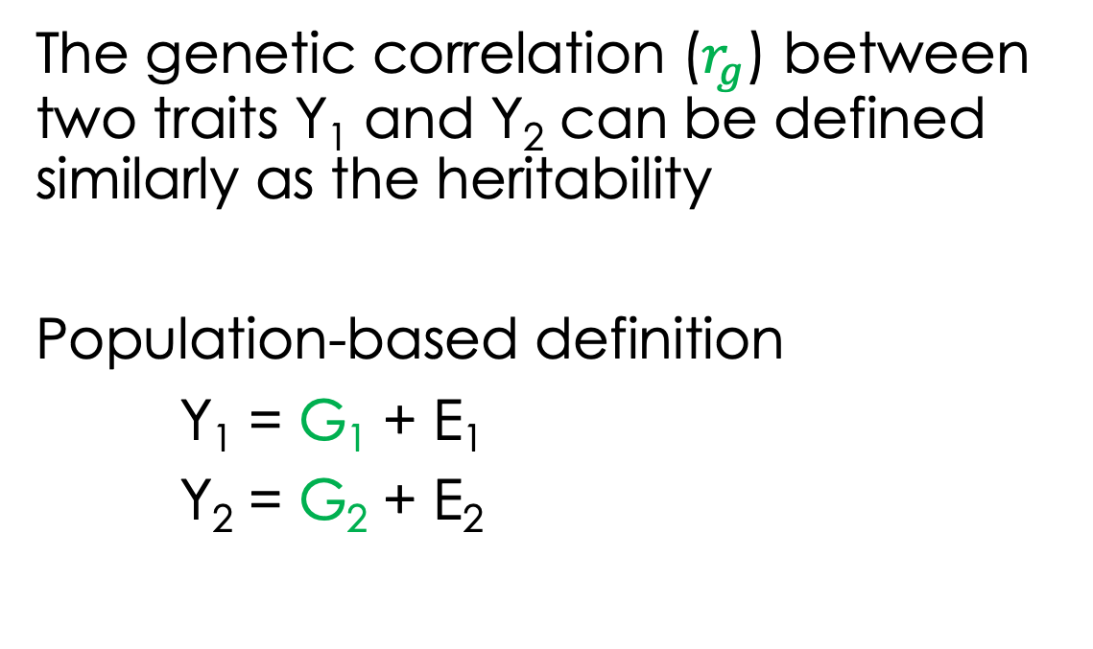
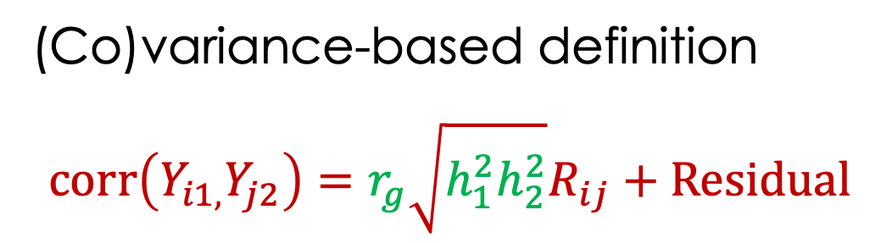
Genetic correlation
The genetic correlation ($r_{g}$) between two traits Y₁ and Y₂ can be defined similarly as the heritability
Population-based definition
Y₁ = G₁ + E₁
Y₂ = G₂ + E₂
=> $r_{g}$ = corr(G₁, G₂)
(Co)variance-based definition
$$corr\left(Y_{i1,}Y_{j2}\right)=r_{g}\sqrt{h_{1}^{2}h_{2}^{2}}R_{ij}+Residual$$

Slide 11
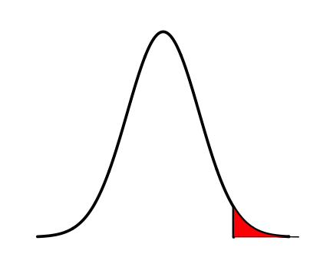
Heritability of binary traits
A binary trait (e.g., a disease) can be modelled as an extreme form of a certain liability (liability threshold model).
Obesity = BMI > 30 kg/m²
Type 2 diabetes = Fasting glucose > 7mmol/L.
Therefore, heritability is well defined as the heritability of the continuous liability.
Phenotypic liability
Falconer (1965): The inheritance of liability to certain diseases, estimated form incidence among relatives.

Slide 12
A few applications
1) The heritability of a trait gives an upper bound for the accuracy of genetic predictors of that trait.
2) The heritability predicts the response to (natural) selection.
3) The heritability predicts an individual’s risk to develop a certain disease knowing they have affected relatives.
4) The heritability influences the statistical power of genome-wide association studies (GWAS)

Slide 13
Part 2 will address
Definition of genetic relatedness
How to calculate it from SNP data?
How to use it to estimate heritability and genetic correlation.

Slide 14
Concepts and tools for estimating heritability using individual-level data?
Part 2

Slide 15
Outline
Concepts underlying estimation methods
Genetic relationship matrices (GRM)

Slide 16
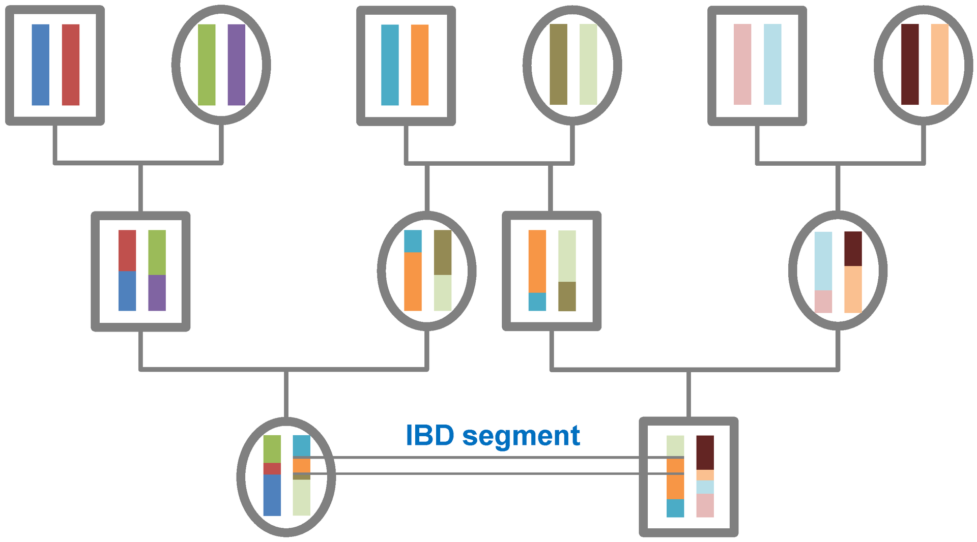
Coefficient of genetic relationship?
In Part 1, we introduced the following Equation:
corr(Y_{i},Y_{j}) = h²R_{ij} + Residual
But what is R_{ij}?
R_{ij} is defined as 2x the probability that two alleles picked at random in individual i and individual j are Identical-by-descent (IBD).
Source: Wikipedia

Slide 17
Genetic relatedness is the key
Most methods for estimating heritability (using individual-level data) are based upon this fundamental theorem of QG.
corr(Y_{i},Y_{j}) = h²R_{ij} + Residual
Methods differs in the ways they utilize they combine information from R_{ij} and that from corr(Y_{i},Y_{j}).

Slide 18
Genetic Relation Matrix (GRM)
A GRM is a matrix (of dimension say n,m), which entries are coefficients of genetic relationship.
GRMs can be quantified based expected IBD sharing (e.g., 0.5 for fullsibs) or using actual SNP data.
There are many ways to calculate a GRM using SNP data (nearly an infinite number) but we will focus on a standard estimator implemented in the software GCTA.

Slide 19
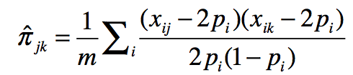
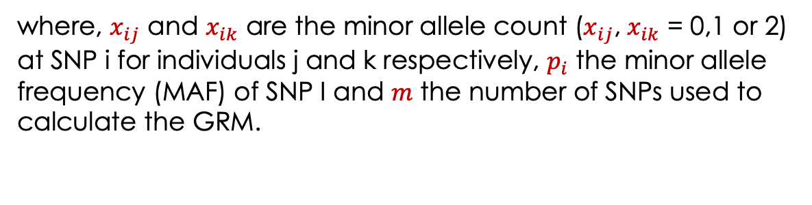
Standard GRM measure
Example of GRM between N=3 individuals
(over m=1000 SNPs)
[$bash] zless myGRM.grm.gz
1 1 1000 0.99
1 2 1000 -0.01
1 3 1000 0.01
2 2 1000 1.03
2 3 1000 0.03
3 3 1000 1.01
where, $x_{ij}$ and $x_{ik}$ are the minor allele count ($x_{ij}$, $x_{ik}$ = 0,1 or 2)
at SNP i for individuals j and k respectively, $p_{i}$ the minor allele frequency (MAF) of SNP I and $m$ the number of SNPs used to
calculate the GRM.

Slide 20
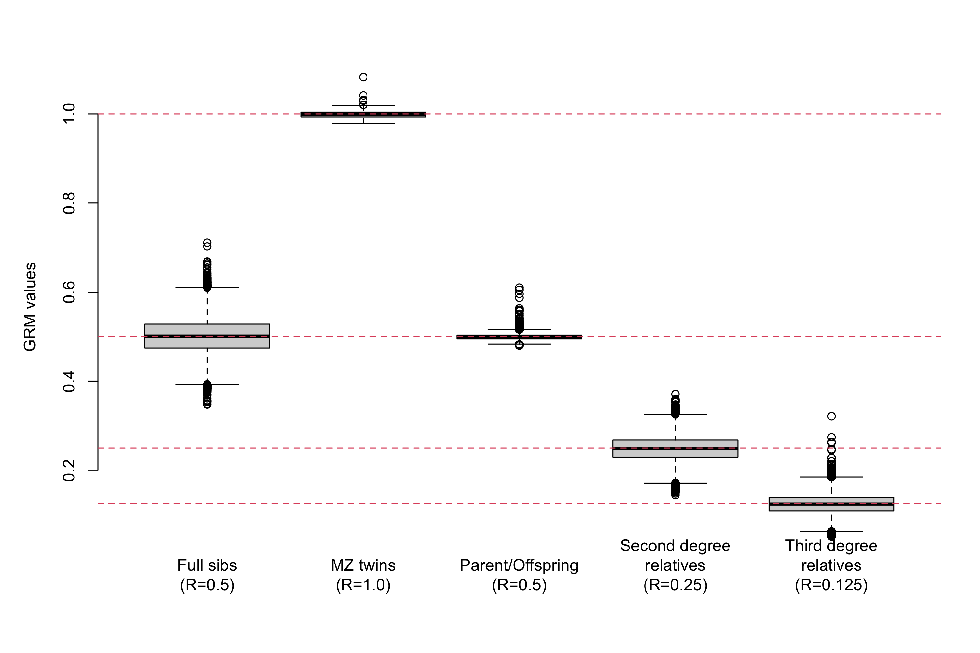
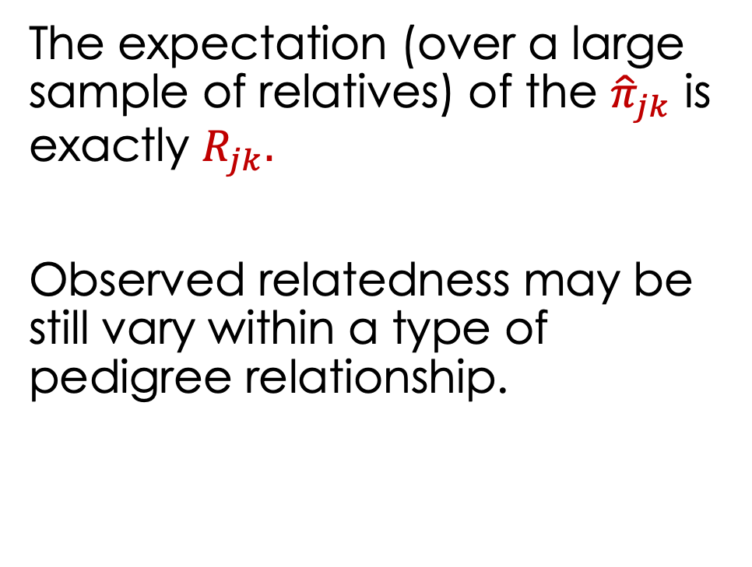
Distribution of GRM values
The expectation (over a large sample of relatives) of the ${\hat{π}}_{jk}$ is exactly $R_{jk}.$
Observed relatedness may be still vary within a type of pedigree relationship.
Data from UK Biobank participants
(Application number 12505)

Slide 21
Summary and next part
Observing simultaneously corr(Y_{i},Y_{j}) and R_{ij} is key to estimating h²
GRMs can be quantified using actual SNP data (show more variation than expected genetic relatedness)
Software GCTA can calculate GRM and use them for estimating h² (Part 3)

Slide 22
Methods for estimating heritability using individual-level data?
Part 3

Slide 23
Outline
Estimation using Haseman-Elston (HE) regression
Estimation using Genome-based REstricted Maximum Likelihood (GREML)

Slide 24
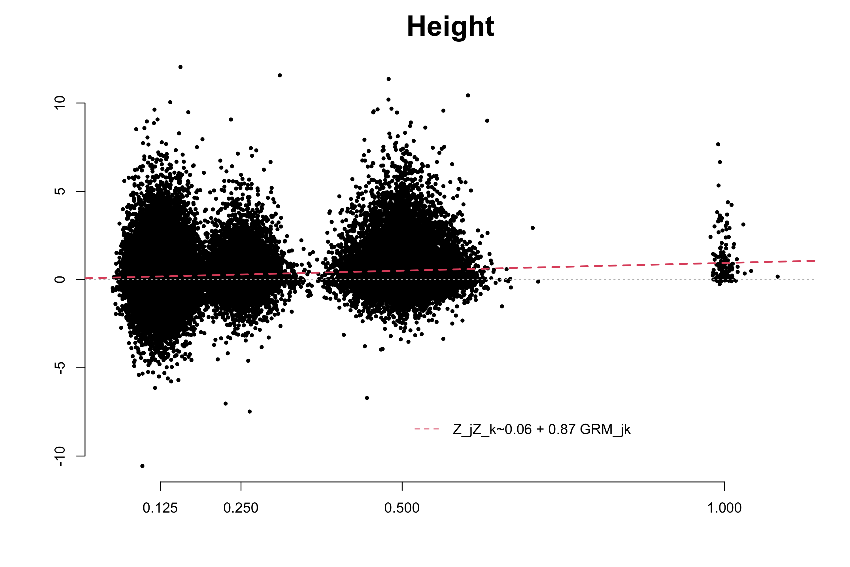
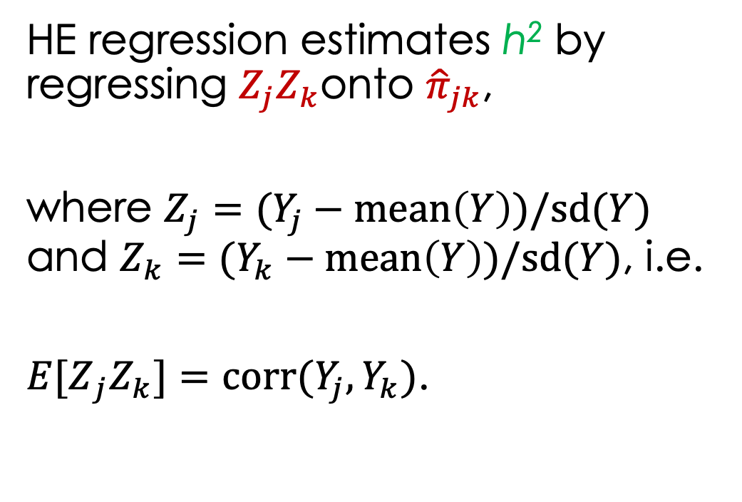
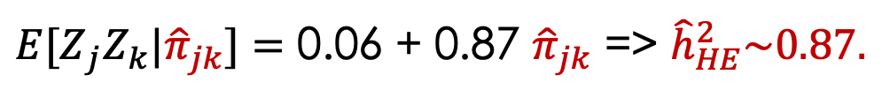


Haseman-Elston (HE) regression
HE regression estimates h² by regressing $Z_{j}Z_{k}$onto ${\hat{π}}_{jk}$,
where $Z_{j}=(Y_{j}−mean\left(Y\right))/sd(Y)$ and $Z_{k}=(Y_{k}−mean\left(Y\right))/sd(Y)$, i.e.
${E[Z}_{j}Z_{k}]=corr(Y_{j},Y_{k})$.
$$Z_{j}Z_{k}$$
$${\hat{π}}_{jk}$$
Data from UK Biobank participants
(Application number 12505)
${E[Z}_{j}Z_{k}|{\hat{π}}_{jk}]=$ 0.06 + 0.87 ${\hat{π}}_{jk}$ => ${\hat{h}}_{HE}^{2}\sim 0.87.$

Slide 25
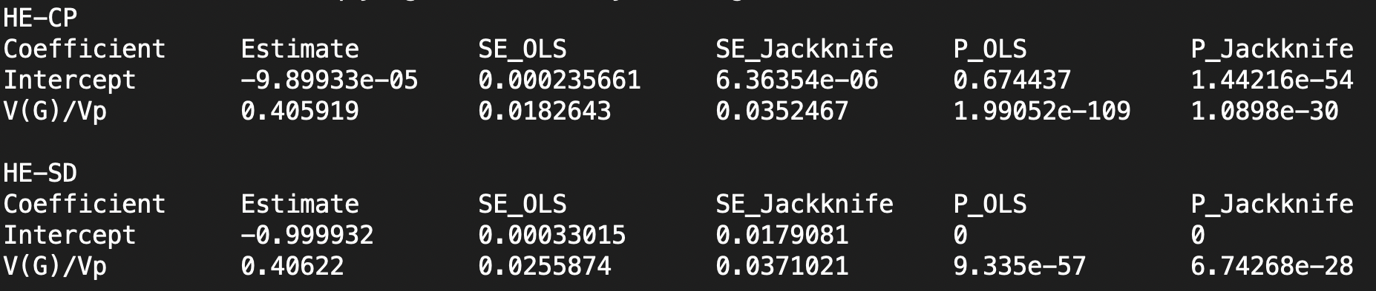
HE regression with GCTA
Step 1: Calculate the GRM
gcta64 --bfile myDataInPLINKformat --make-grm-bin --out myData
[generates 3 files: myData.grm.id, myData.grm.bin, myData.grm.N.bin]
Step 2: Prepare phenotype file (e.g., “phenotype.txt”) with two phenotypes (headers are not necessary)
FAMILY INDIV Y1 Y2
FAMID1 INDID1 123 0.1
FAMID1 INDID2 236 0.0
FAMID2 INDID1 393 0.5
FAMID2 INDID2 210 1.1
FAMID3 INDID1 122 -1.
Step 3: Run GCTA to estimate heritability of trait 1 using HE regression
gcta64 --grm myData --pheno phenotype.txt --mpheno 1 --HEreg --out myHE_estimates
[generates 2 files: myHE_estimates.log, myHE_estimates.HEreg]

Slide 26
Genome-based Restricted Maximum Likelihood (GREML)
The Model: the “G” part in GREML
The Estimation: the “REML” in GREML.

Slide 27
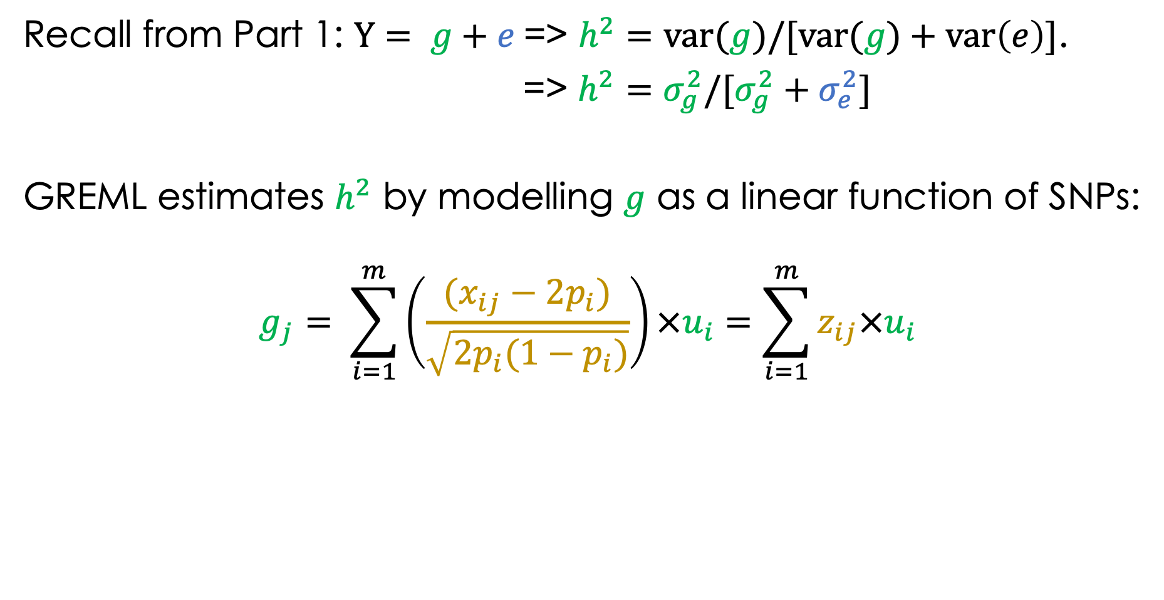
The “G” part in GREML…
Recall from Part 1: $Y= g+e$=> $h^{2}=var(g)/[var(g)+var\left(e\right)]$.
=> $h^{2}=σ_{g}^{2}/[σ_{g}^{2}+σ_{e}^{2}]$
GREML estimates $h^{2}$ by modelling $g$ as a linear function of SNPs:
$$g_{j}= \sum_{i=1}^{m}{\left(\frac{(x_{ij}−{2p}_{i})}{\sqrt{{2p}_{i}(1−p_{i})}}\right)×u_{i}=\sum_{i=1}^{m}{z_{ij}×u_{i}}}$$
Effect of SNP i
Scaled minor
allele count
Under Hardy-Weinberg Equilibrium: ${var(z}_{ij})=1.$

Slide 28
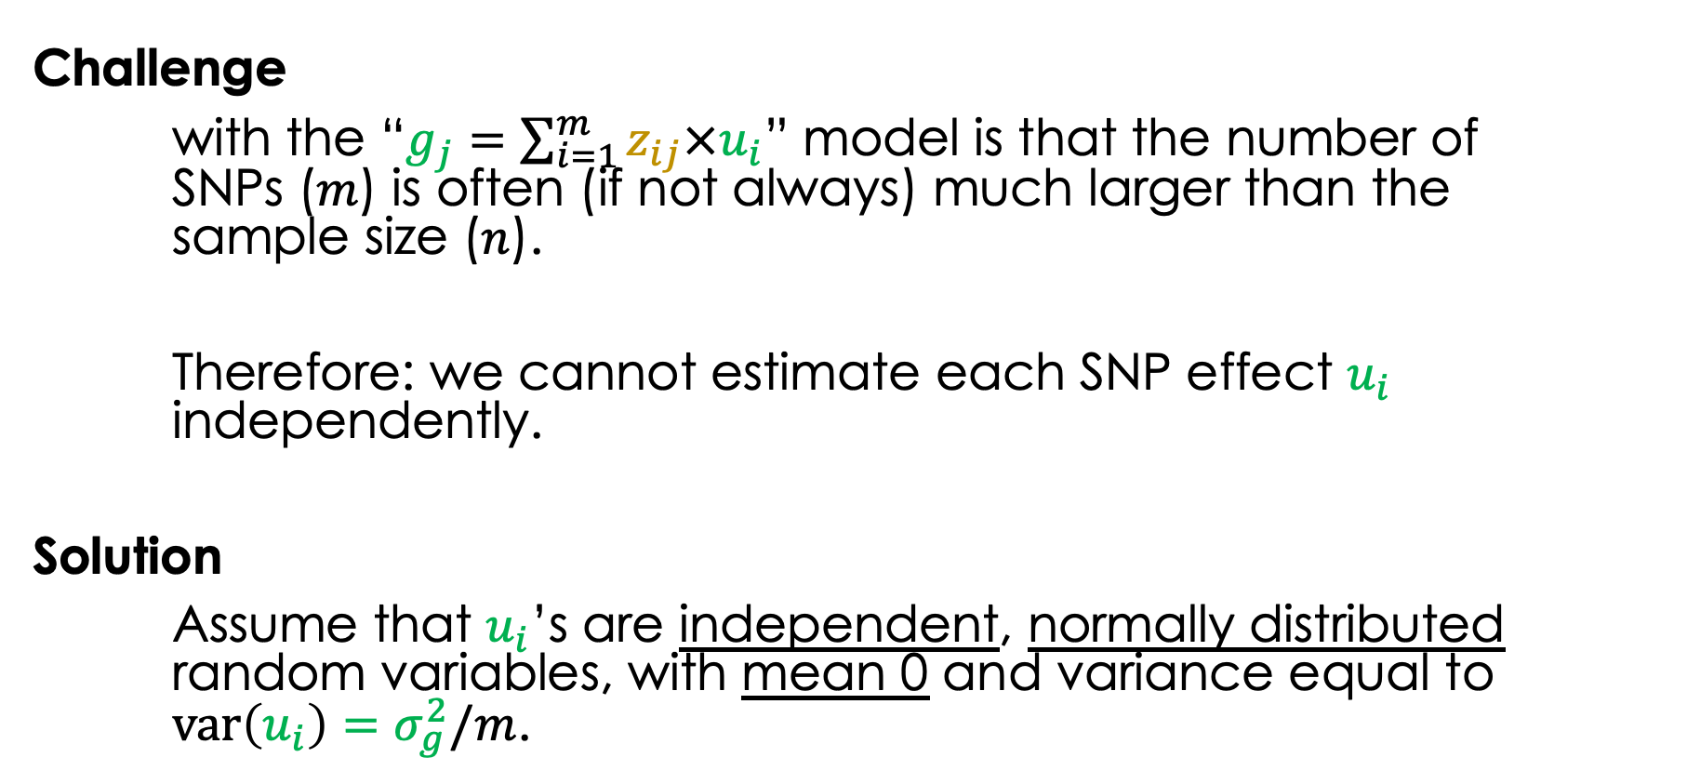
The “G” part in GREML…
Challenge
with the “$g_{j}=\sum_{i=1}^{m}{z_{ij}×u_{i}}$” model is that the number of SNPs ($m$) is often (if not always) much larger than the sample size ($n$).
Therefore: we cannot estimate each SNP effect $u_{i}$ independently.
Solution
Assume that $u_{i}$’s are independent, normally distributed random variables, with mean 0 and variance equal to ${var\left(u_{i}\right)=σ}_{g}^{2}/m$.

Slide 29

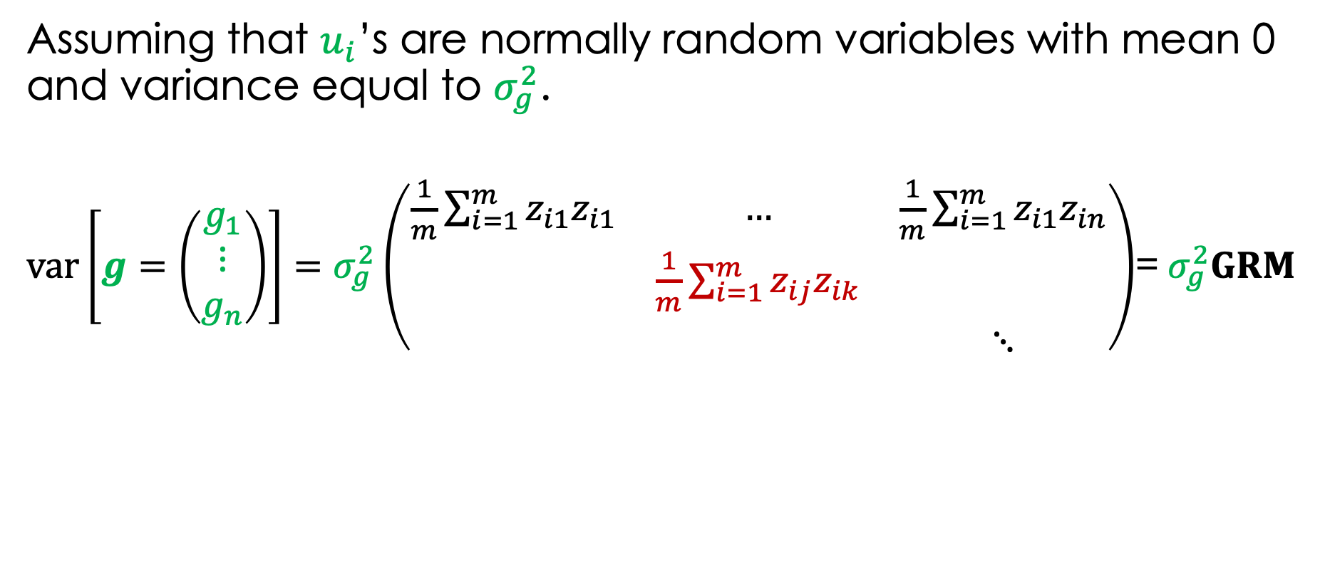
The “G” part in GREML…
Assuming that $u_{i}$’s are normally random variables with mean 0 and variance equal to $σ_{g}^{2}$.
$var\left[g=\left(\begin{matrix}g_{1} \\ ⋮ \\ g_{n}\end{matrix}\right)\right]=σ_{g}^{2}\left(\begin{matrix}\frac{1}{m}\sum_{i=1}^{m}{z_{i1}z_{i1}} & … & \frac{1}{m}\sum_{i=1}^{m}{z_{i1}z_{in}} \\ & \frac{1}{m}\sum_{i=1}^{m}{z_{ij}z_{ik}} & \\ & & ⋱\end{matrix}\right)$= $σ_{g}^{2}GRM$
$${\hat{π}}_{jk}$$

Slide 30
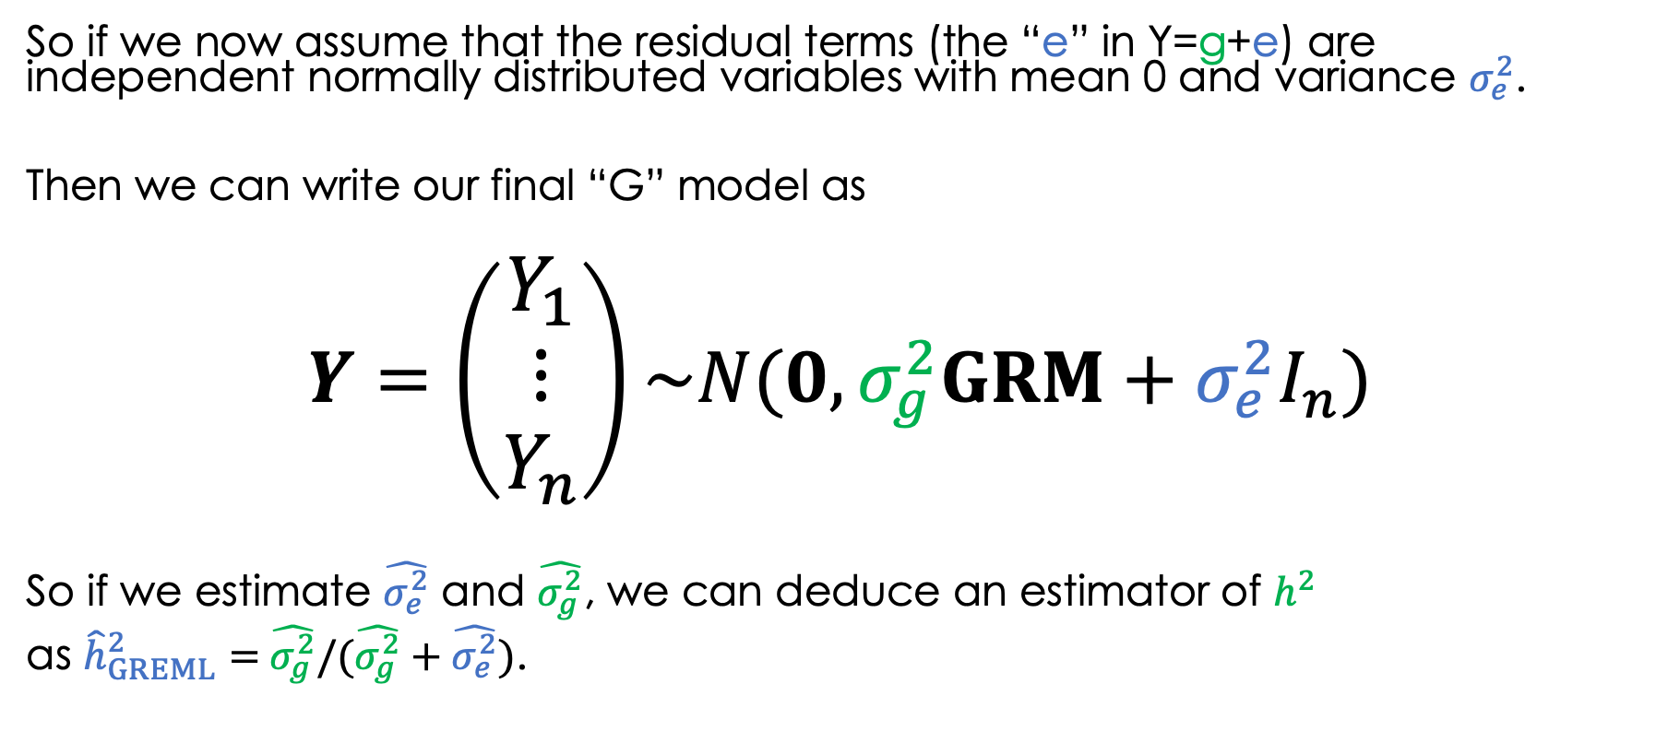
The “G” part in GREML…
So if we now assume that the residual terms (the “e” in Y=g+e) are independent normally distributed variables with mean 0 and variance $σ_{e}^{2}$.
Then we can write our final “G” model as
$$Y=\left(\begin{matrix}Y_{1} \\ ⋮ \\ Y_{n}\end{matrix}\right)\sim N(0,σ_{g}^{2}GRM+σ_{e}^{2}I_{n})$$
So if we estimate $\hat{σ_{e}^{2}}$ and $\hat{σ_{g}^{2}}$, we can deduce an estimator of $h^{2}$
as ${\hat{h}}_{GREML}^{2}=$ $\hat{σ_{g}^{2}}/(\hat{σ_{g}^{2}}+\hat{σ_{e}^{2}})$.

Slide 31
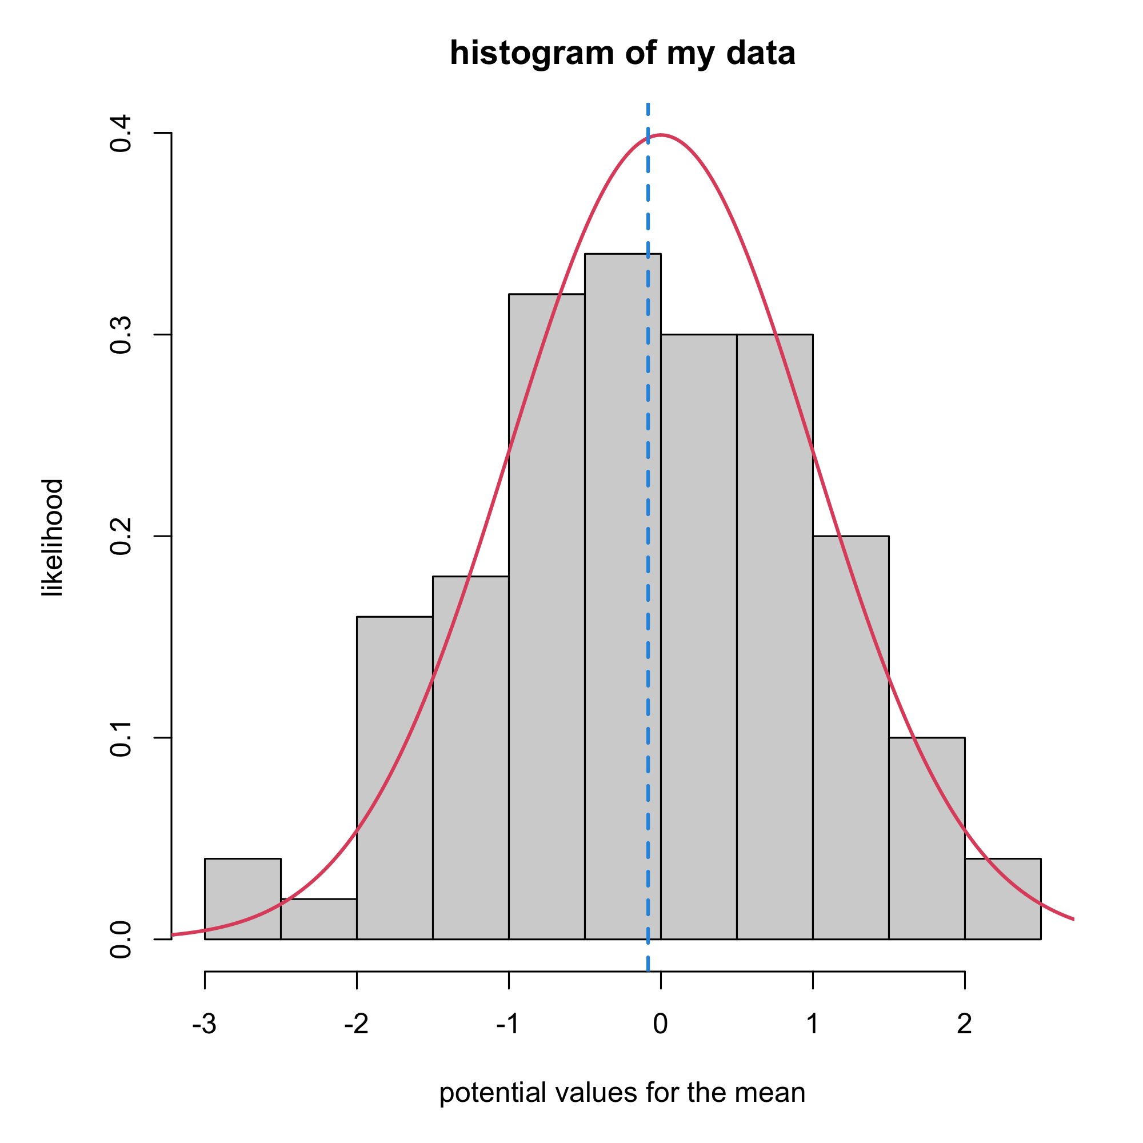
The “REML” part in GREML…
REML = Restricted Maximum Likelihood.
Maximum Likelihood.

Slide 32
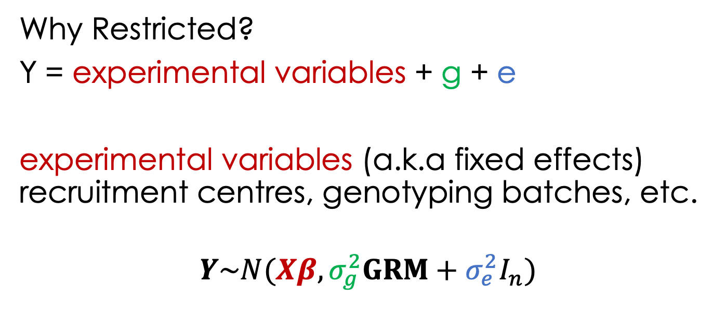
The “REML” part in GREML…
Why Restricted?
Y = experimental variables + g + e
experimental variables (a.k.a fixed effects) recruitment centres, genotyping batches, etc.
$$Y\sim N(Xβ,σ_{g}^{2}GRM+σ_{e}^{2}I_{n})$$
This extended model is known as a Linear Mixed Model (LMM)
REML = ML on transformed data
where the fixed effects are residualized.

Slide 33
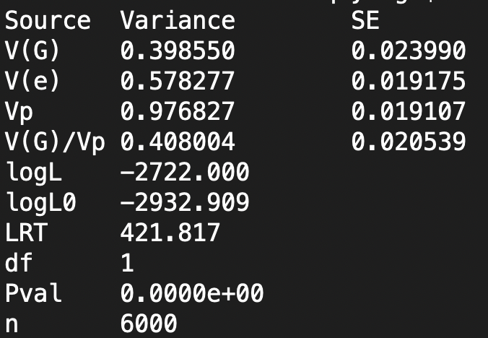
GREML estimation with GCTA
Run GCTA to estimate heritability of trait 1 using GREML
gcta64 --grm myData --pheno phenotype.txt --mpheno 1 --reml --out myGREML_estimates
[generates 2 files: myGREML_estimates.log, myGREML_estimates.hsq]

Slide 34
Summary and next part
We introduced two ways to estimate h² in sample of individuals knowing their phenotypes and the GRM.
1) HE regression
2) GREML model
Next part will discuss
1) interpretation of h² estimated from SNPs.
2) some of the biases affecting these methods.

Slide 35
Interpretation of heritability estimates from SNPs
Part 4

Slide 36
Outline
Missing heritability
Biases in heritability estimation

Slide 37
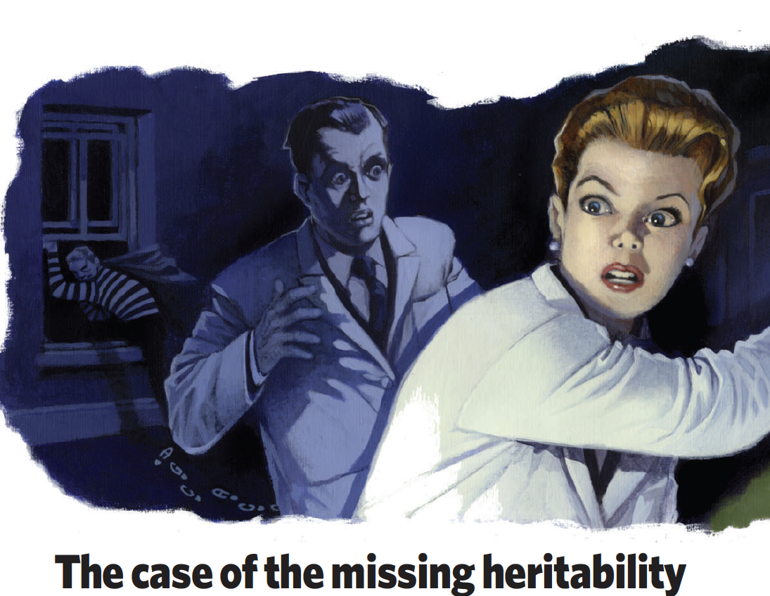
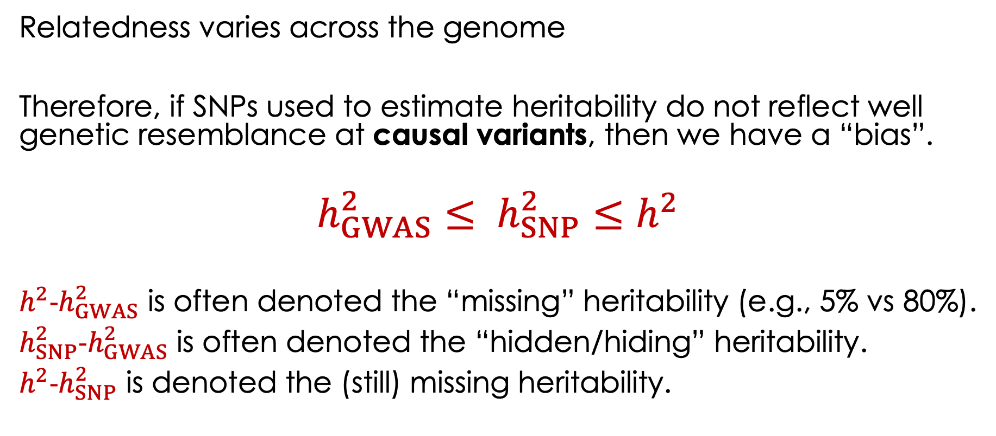
Missing heritability
Relatedness varies across the genome
Therefore, if SNPs used to estimate heritability do not reflect well genetic resemblance at causal variants, then we have a “bias”.
$$h_{GWAS}^{2}≤ h_{SNP}^{2}≤h^{2}$$
$h^{2}$-$h_{GWAS}^{2}$ is often denoted the “missing” heritability (e.g., 5% vs 80%).
$h_{SNP}^{2}$-$h_{GWAS}^{2}$ is often denoted the “hidden/hiding” heritability.
$h^{2}$-$h_{SNP}^{2}$ is denoted the (still) missing heritability.

Slide 38
Biases in heritability estimates
Shared environmental effects.
Population stratification
Distribution of MAF and linkage disequilibrium (LD) of SNPs used to calculate GRMs

Slide 39
Shared environmental effects
Phenotypic resemblance between relatives is not all due to genetic factors.
How much shared non-genetic factors vary with genetic relatedness is unknown.
Diagnosis: use different types of relatives in the inference and compare estimates.
Solution 1: model (i.e. make assumptions about) shared environmental effects. E.g., h² = 2(corrMZ-corrDZ).
Solution 2: only analyse distance relatives GRM<0.05 (or <0.025)

Slide 40
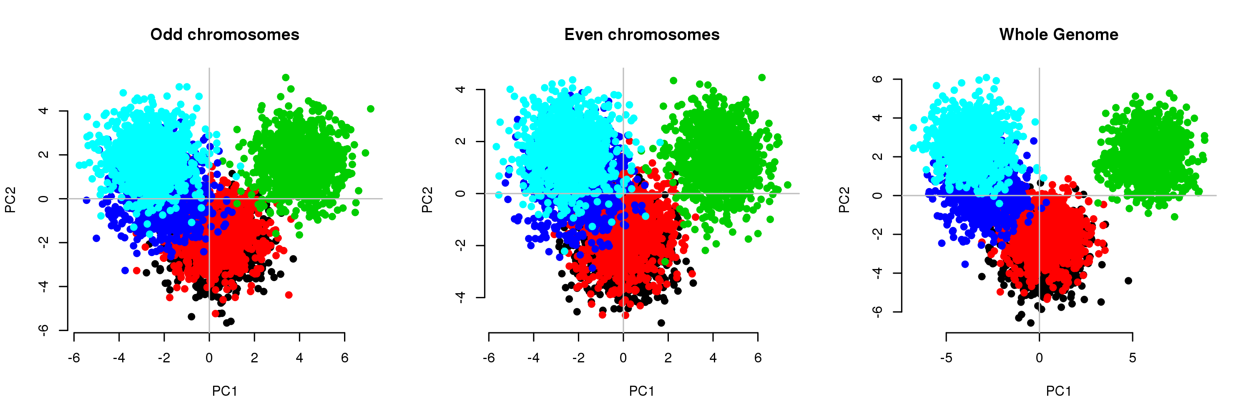
Population stratification
Solution 1: If ancestry differences, then restrict analyses to ancestry homogeneous samples.
Solution 2: Use genetic principal components as fixed effects.

Slide 41
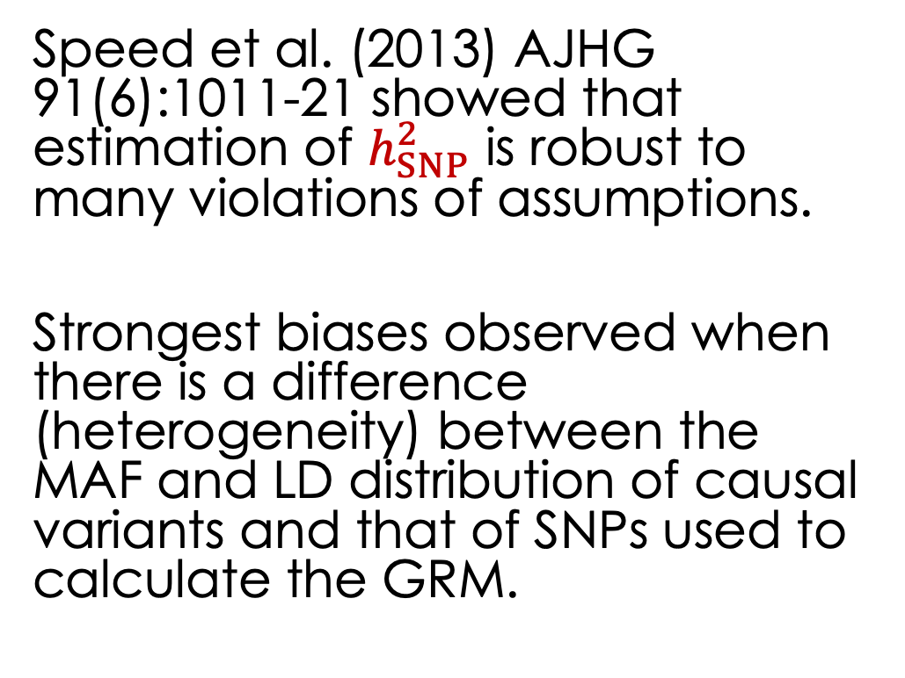
MAF and LD heterogeneity - issue
Speed et al. (2013) AJHG 91(6):1011-21 showed that estimation of $h_{SNP}^{2}$ is robust to many violations of assumptions.
Strongest biases observed when there is a difference (heterogeneity) between the MAF and LD distribution of causal variants and that of SNPs used to calculate the GRM.

Slide 42
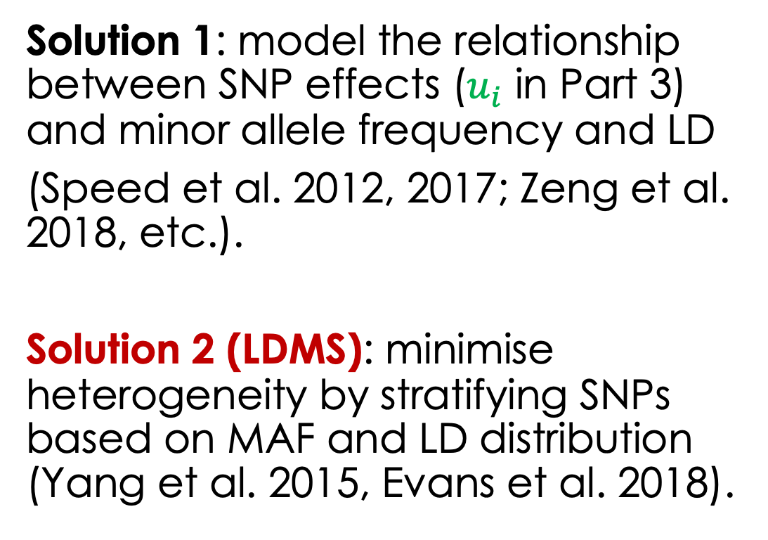
MAF and LD heterogeneity - solution
Solution 1: model the relationship between SNP effects ($u_{i}$ in Part 3) and minor allele frequency and LD
(Speed et al. 2012, 2017; Zeng et al. 2018, etc.).
Solution 2 (LDMS): minimise heterogeneity by stratifying SNPs based on MAF and LD distribution (Yang et al. 2015, Evans et al. 2018).

Slide 43
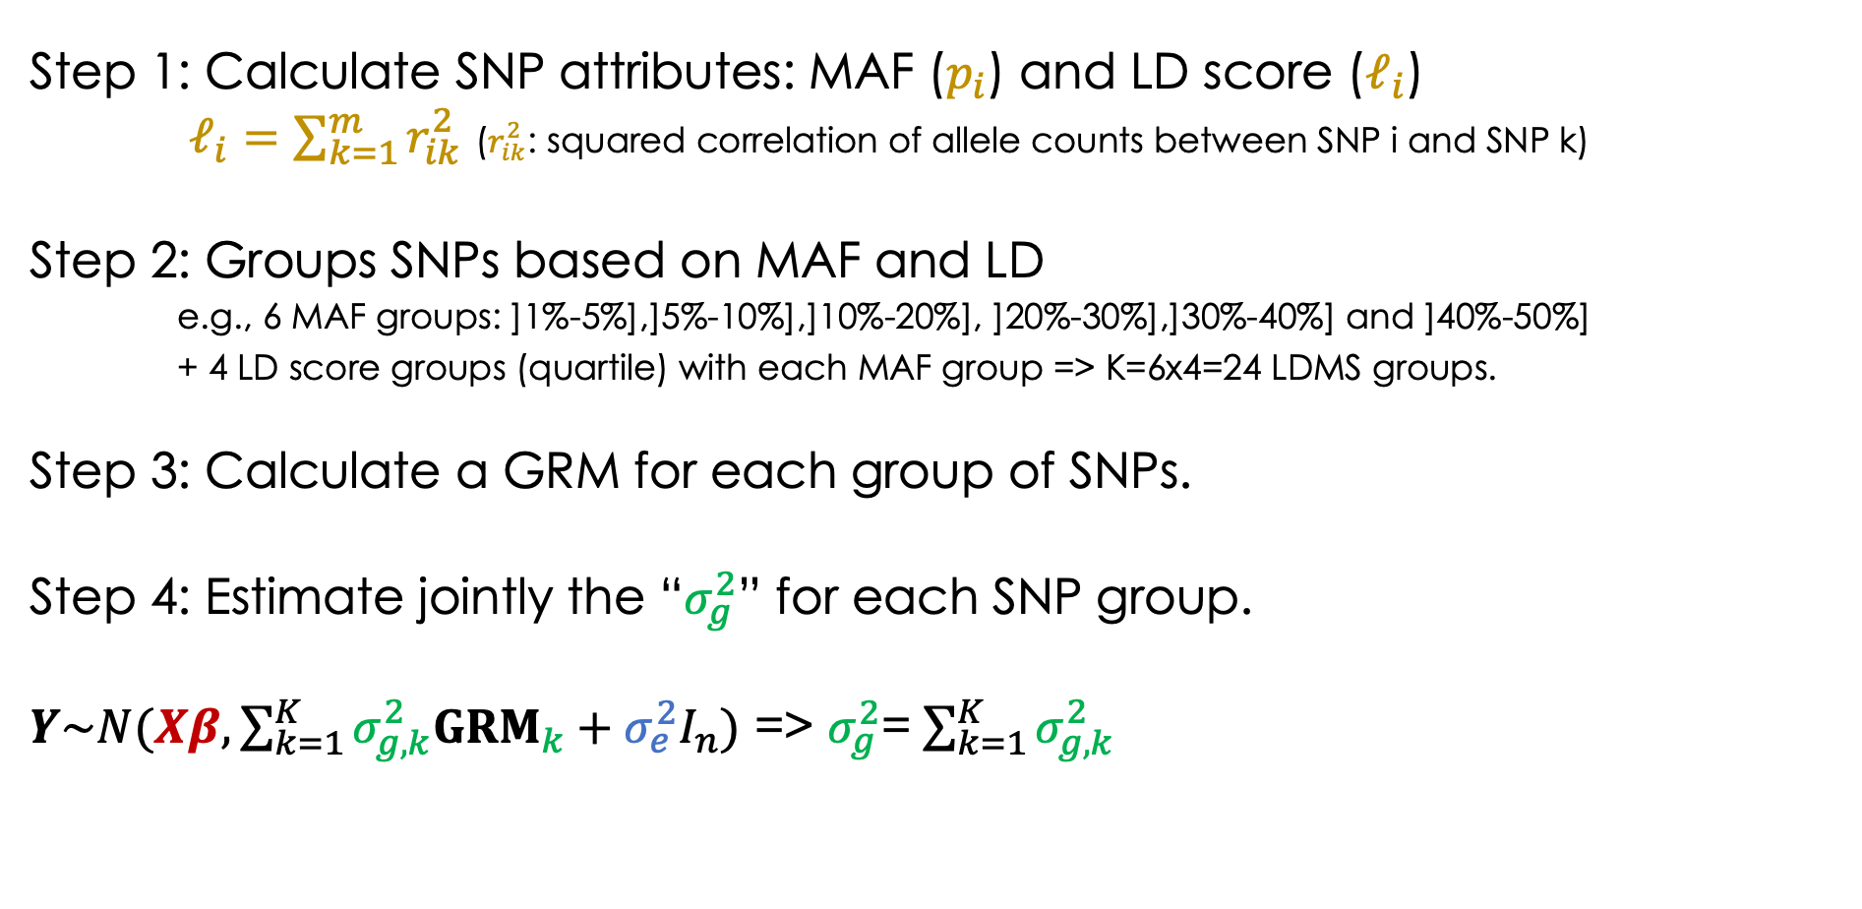
LDMS method
Step 1: Calculate SNP attributes: MAF ($p_{i}$) and LD score ($ℓ_{i}$)
$ℓ_{i}=\sum_{k=1}^{m}{r_{ik}^{2}}$ ($r_{ik}^{2}$: squared correlation of allele counts between SNP i and SNP k)
Step 2: Groups SNPs based on MAF and LD
e.g., 6 MAF groups: ]1%-5%],]5%-10%],]10%-20%], ]20%-30%],]30%-40%] and ]40%-50%]
+ 4 LD score groups (quartile) with each MAF group => K=6x4=24 LDMS groups.
Step 3: Calculate a GRM for each group of SNPs.
Step 4: Estimate jointly the “$σ_{g}^{2}$” for each SNP group.
$Y\sim N(Xβ,\sum_{k=1}^{K}{σ_{g,k}^{2}{GRM}_{k}}+σ_{e}^{2}I_{n})$ => $σ_{g}^{2}$= $\sum_{k=1}^{K}{σ_{g,k}^{2}}$

Slide 44
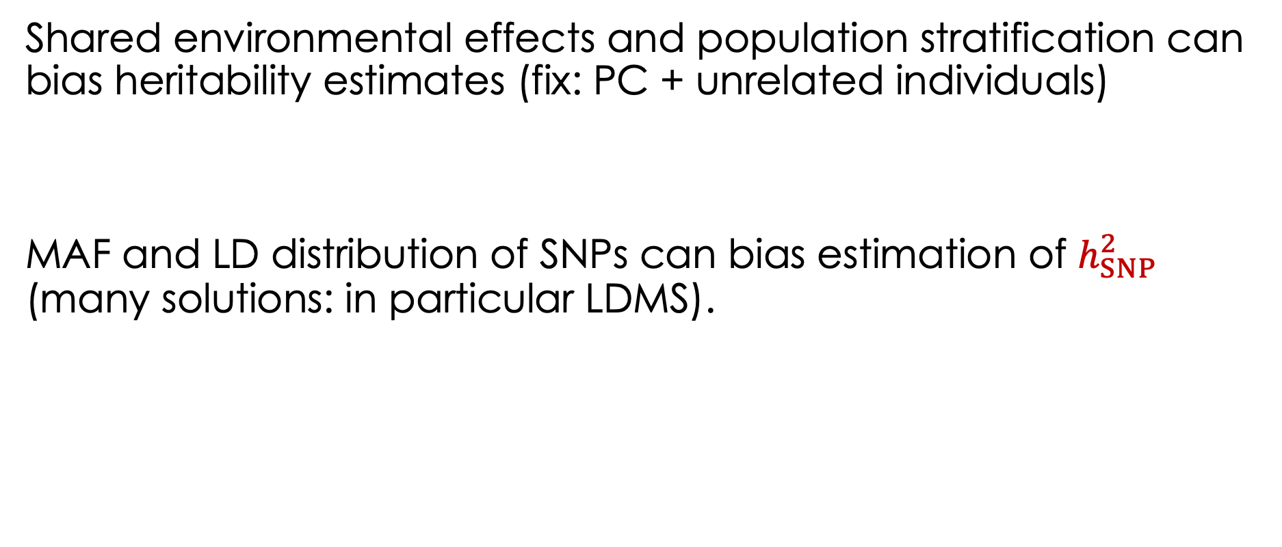
Summary
Shared environmental effects and population stratification can bias heritability estimates (fix: PC + unrelated individuals)
MAF and LD distribution of SNPs can bias estimation of $h_{SNP}^{2}$ (many solutions: in particular LDMS).

Slide 45
Examples of active research in heritability estimation
Part 5

Slide 46
What are people researching in this area (individual-level data)?
Computational efficiency (biobank scale methods)
Incorporate biological information (functional annotation)
Estimation of non-additive genetic variance (e.g., dominance)
Estimation of SNP-based heritability using whole-genome sequence data (integrating rare and ultra-rare variants)
The impact of assortative mating on heritability estimates

