Slide 1
Acknowledgement of Country
The University of Queensland (UQ) acknowledges the Traditional Owners and their custodianship of the lands on which we meet.
We pay our respects to their Ancestors and their descendants, who continue cultural and spiritual connections to Country.
We recognise their valuable contributions to Australian and global society.
Notes:
Guidelines for use:
Use this slide when presenting at UQ or at any site in Australia, when appropriate.
Remember to pause briefly after acknowledging Country as a sign of respect.
If you are more familiar with acknowledging Country you may add a statement about the event, meeting or forum’s connection with Country. For example; at a higher education event you might acknowledge that the campus has always been a space for teaching, learning, research and collaboration tens of thousands of years before it was established as a university campus, and continues today.
When to use longer version:
If you are the main speaker at the event/gathering
If you are the first person to present.
When to use a shorter version:
If you are not the first person to acknowledge Country
In a more informal setting
Thanking a Traditional Owner for welcoming people to Country.
Longer version
I acknowledge the Traditional Owners and their custodianship of the lands on which we meet today. (On behalf of *) I pay our respects to their Ancestors and their descendants, who continue cultural and spiritual connections to Country. We recognise their valuable contributions to Australian and global society.
* If you are hosting an event, meeting or seminar, you might say something like “On behalf of the event organisers or your section….”
Shorter version
I (too,) acknowledge the Traditional Owners and their custodianship of the lands on which we meet today and pay my respect to their Ancestors and their descendants.
Slide last updated June 2019 – content owner is PVC(IE)/ATSISU (contact Nell Angus).

Slide 2
Introduction to Mendelian Randomization Using genes to tell us about environmental exposures to inform causality
Genetics & Genomics Winter School 2023
Module 4 Genetic Epidemiology
Dr Daniel Liang-Dar Hwang
Institute for Molecular Bioscience, The University of Queensland
(Slides adapted from Prof David Evans’ Lecture)

Slide 3
Outline
Problems with observational data
Randomized controlled trials
Mendelian randomization (MR)
How it works
Core assumptions
Calculating causal effect estimates
MR example
Limitations of MR

Slide 4
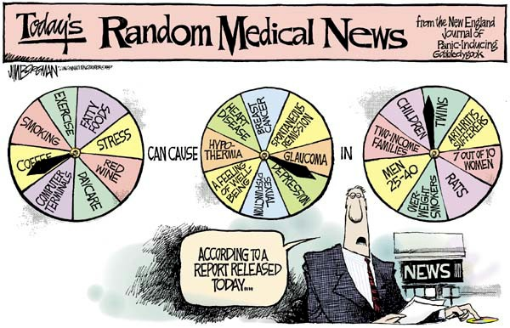
The problem with inferring causality in observational studies

Slide 5
Coronary Heart Disease risk according to duration of current Vitamin E supplement use compared to no use
Relative Risk
Rimm et al. NEJM 1993; 328: 1450-6

Slide 6
Use of vitamin supplements by US adults
Percent
Millen AE, Journal of American Dietetic Assoc 2004;104:942-950

Slide 7
Vitamin E supplement use and risk of Coronary Heart Disease
1.0
Relative Risk
Observational
(Stampfer et al.,
NEJM 1993)
Observational
(Rimm et al.,
NEJM 1993)
RCTs
(Eidelman et al.
Arch Intern Med 2004)

Slide 8
Many other examples What’s the explanation?
Vitamin C, vitamin A, hormone replacement therapy (HRT), many drug targets…
Notes:
And there are many other examples…So what is the explanation for these?
Menopausal hormonal therapy (MHT), formerly called hormone replacement therapy (HRT), is when hormones are used to treat the symptoms of menopause, especially hot flushes and night sweats.
During menopause, hormone levels go up and down, resulting in symptoms such as hot flushes and night sweats. MHT helps restore hormone levels, which may improve some menopause symptoms.

Slide 9
Vitamin E levels and confounding risk factors
Childhood SES
Manual social class
No car access
State pension only
Smoker
Obese
Daily alcohol
Exercise
Low fat diet
Height
Leg length
Women’s Heart and Health Study Lawlor et al., Lancet 2004

Slide 10
Confounding
Smoking, diet, alcohol, socioeconomic position….
Confounders
Exposure
?
Outcome
Vitamin E
Heart disease

Slide 11
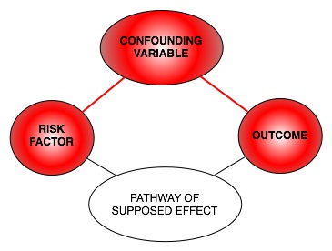
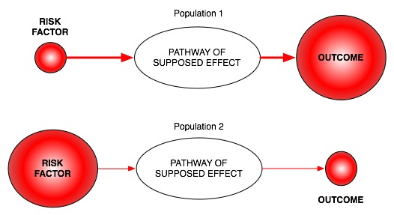
Reverse Causation
Classic limitations to “observational” science
Confounding
Bias

Slide 12
Randomized Controlled Trials (RCTs) The Gold Standard in Inferring Causality
RANDOMISED CONTROLLED TRIAL
Randomization
makes causal inference
possible
RANDOMIZATION METHOD
EXPOSED:
INTERVENTION
CONTROL:
NO INTERVENTION
CONFOUNDERS EQUAL BETWEEN GROUPS
OUTCOMES COMPARED BETWEEN GROUPS

Slide 13
The Need for Observational Studies
Randomized Controlled Trials (RCTs):
Not always ethical or practically feasible, e.g. anything toxic
Expensive, requires experimentation in humans
Should only be conducted on interventions that show very strong observational evidence in humans
Long follow-up times
Observational studies:
Association between environmental exposures and disease measured in observational designs (non-experimental)
e.g. case-control studies or cohort studies
Reliably assigning causality in these types of studies is very limited

Slide 14
Mendelian randomization How can it help observational epidemiology?

Slide 15
Mendelian Randomization (MR)
A technique that uses genetically informative observational data to inform causality
What does MR do?
Assess causal relationship between two variables
Useful in genomics studies
Estimate magnitude of causal effect
Useful in drug development
Useful in public health
How does MR do this?
By harnessing Mendel’s laws of inheritance

Slide 16
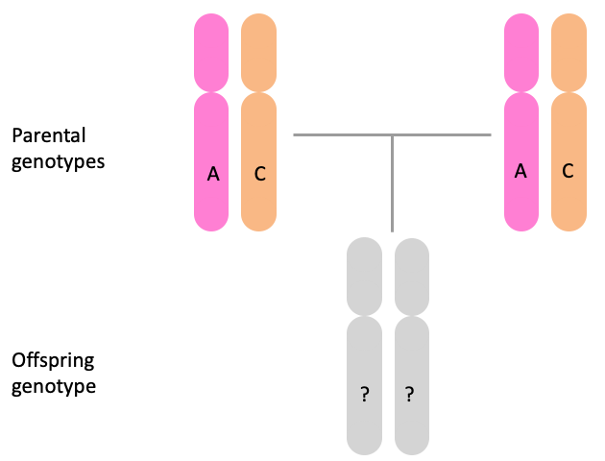
Mendel’s Laws of Inheritance
Segregation: alleles separate at meiosis and a randomly selected allele is transmitted to offspring
2. Independent assortment: alleles at different genetic loci (for different traits) are transmitted independently of one another
Gregor Mendel in 1862

Slide 17
MR vs RCT
MENDELIAN RANDOMIZATION
RANDOMISED CONTROLLED TRIAL
+ independent assortment
RANDOM SEGREGATION
OF ALLELES
RANDOMISATION METHOD
EXPOSED: FUNCTIONAL ALLELLES
CONTROL: NULL ALLELLES
EXPOSED:
INTERVENTION
CONTROL:
NO INTERVENTION
CONFOUNDERS EQUAL BETWEEN GROUPS
CONFOUNDERS EQUAL BETWEEN GROUPS
OUTCOMES COMPARED BETWEEN GROUPS
OUTCOMES COMPARED BETWEEN GROUPS

Slide 18
Mendelian randomization: Smoking and Lung Cancer
MENDELIAN RANDOMIZATION
RANDOMISED CONTROLLED TRIAL
+ independent assortment
RANDOM SEGREGATION
OF ALLELES
RANDOMISATION METHOD
Heavy Smokers:
C/C
Light/Non Smokers:
C/T or T/T
EXPOSED:
SMOKERS
CONTROL:
NON SMOKERS
CONFOUNDERS EQUAL BETWEEN GROUPS
CONFOUNDERS EQUAL BETWEEN GROUPS
LUNG CANCER COMPARED
BETWEEN GROUPS
LUNG CANCER COMPARED
BETWEEN GROUPS

Slide 19
Mendelian Randomization: 3 Core Assumptions
Confounders
2
✕
SNP
1
Exposure
(Smoking)
Outcome
(Lung cancer)
✕
3
Relevance assumption: SNP is associated with the exposure
Independence assumption: SNP is NOT associated with confounding variables
Exclusion restriction: SNP ONLY associated outcome through the exposure

Slide 20
Why are genetic associations special?
Robustness to confounding due to Mendel’s laws:
Law of segregation: inheritance of an allele is random and independent of environment etc.
Law of independent assortment: genes for different traits segregate independently (assuming not in LD)
The direction of causality is known – always from SNP to trait
Genetic variants are potentially very good instrumental variables
Using genetic variants as IVs is a special case of IV analysis, known as Mendelian randomization

Slide 21
Calculating Causal Effect Estimates
Confounders
SNP
β_{SNP-Exposure}
Exposure
? β_{Causal Exp-Outcome}
Outcome
β_{SNP-Outcome}
After a SNP is identified as a good instrumental variable (3 MR assumptions are met):
Two-stage least-squares (TSLS) regression
Wald Estimator

Slide 22
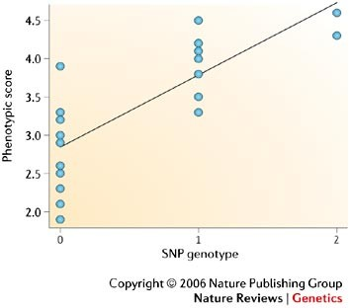
Calculating Causal Effect Estimates: Two-Stage Least Squares
A single sample of individuals with data on the SNP, the exposure and the outcome. Also known as “One sample MR”.
Manual calculation:
Regress exposure on SNP and obtain predicted values
Regress outcome on predicted exposure (from 1st stage regression)
The regression coefficient from the second stage is the estimate of the causal effect of the exposure on the outcome.
This gives you: difference in outcome per unit change in (genetically-predicted) exposure
Genetically determined exposure → “randomized” → can ascribe causality
(if assumptions are met)

Slide 23
R packages for Two-Stage Least Squares
library(sem)
mod1 <- tsls(outcome ~ exposure, ~ allele.score, data=data)
# two-stage least squares with allele score
mod2 <- tsls(outcome ~ exposure, ~ rs123 + rs456 + rs789 + rs1011 + rs1213, data=data)
# two-stage least squares with individual SNPs
library(AER)
mod3 <- ivreg(outcome ~ exposure | allele.score, data=data)
mod4 <- ivreg(outcome ~ exposure | rs123 + rs456 + rs789 + rs1011 + rs1213, data=data)

Slide 24
MR can also be performed using just the results from GWAS
Also known as “two-sample MR”, SMR, or MR with summary data etc
Advantages:
The data is readily available, non-disclosive, free, open source
The exposure and outcome might not be measured in the same sample
The sample size of the outcome variable, key to statistical power, is not limited by requiring overlapping measures of the exposure
Disadvantages:
Some extensions of MR not possible, e.g. non-linear MR, use of GxE for negative controls, various sensitivity analyses

Slide 25
Calculating Causal Effect Estimates Wald Estimator (Wald Ratio)
Confounders
SNP
β_{SNP-Exposure}
Exposure
? β_{Causal Exp-Out}
Outcome
β_{SNP-Outcome}
β_{Causal effect} (Wald estimator) =
(change in outcome per unit change in exposure)
Where there is a linear relationship between SNP, exposure and outcome:
β_{SNP-Outcome} = β_{Causal Exp-Out} x β_{SNP-Exposure}
β_{SNP-Outcome}
β_{SNP-Exposure}

Slide 26
Calculating Causal Effect Estimates Wald Estimator (Wald Ratio)
Confounders
β_{SNP-Weight}
_{(0.5 kg)}
SNP
Exposure
? β_{Causal Weight-BP}
Outcome
β_{SNP-Blood Pressure}
_{(0.9 mmHg)}
β_{Causal effect} (Wald estimator) =
β_{Causal effect Weight-BP} = = 1.8 mmHg/kg
Where there is a linear relationship between SNP, exposure and outcome:
β_{SNP-Outcome} = β_{Causal Exp-Out} x β_{SNP-Exposure}
β_{SNP-Outcome}
β_{SNP-Exposure}
0.9 mmHg/allele
0.5 kg/allele

Slide 27
Calculating Causal Effect Estimates Wald Estimator (Wald Ratio)
Wald estimator can be used in one sample (“One sample MR”) as well as different samples (“Two sample MR”)
Confounders
β_{SNP-Weight}
_{(0.5 kg)}
SNP
Exposure
? β_{Causal Weight-BP}
Outcome
β_{SNP-Blood Pressure}
_{(0.9 mmHg)}
β_{Causal effect} (Wald estimator) =
β_{Causal effect Weight-BP} = = 1.8 mmHg/kg
Where there is a linear relationship between SNP, exposure and outcome:
β_{SNP-Outcome} = β_{Causal Exp-Out} x β_{SNP-Exposure}
β_{SNP-Outcome}
β_{SNP-Exposure}
0.9 mmHg/allele
0.5 kg/allele

Slide 28
MR Example using CRP and BMI
C-Reactive Protein (CRP) is a biomarker of inflammation
It is associated with BMI, metabolic syndrome, CHD and a number of other diseases
It is unclear whether these observational relationships are causal or due to confounding or reverse causality
This question is important from the perspective of intervention and drug development

Slide 29
Using a genetic instrument for proinflammatory CRP
Confounders
CRP genotype
CRP
Cardiometabolic traits
TWO ALTERNATIVES
If CRP DOES NOT causally affect cardiometabolic traits:
CRP gene variant should NOT be related to cardiometabolic traits
If CRP CAUSALLY affects metabolic traits:
CRP gene variant should also be related to these metabolic traits

Slide 30
“Bi-directional Mendelian Randomization” Testing causality and reverse causation
Confounders
?
FTO genotype
BMI
CRP
CRP genotype
?
Timpson NJ et al. Int J Obes (2011) 35(2):300-308
Notes:
So in this example, we are going to do something called bidirectional MR, in which we will test the causality in both directions. We are going to look at the relationship between body mass index and serum C-reactive protein levels, and we are going to do Mendelian randomization in two ways.
First, we are going to look at whether there is a causal effect of BMI on CRP. We are going to proxy BMI using a genetic variant within the FTO gene, which we know is robustly associated with body mass index. And we are going to do MR to see whether BMI causally affects levels of CRP in the serum.
Then we are going to instrument serum CRP levels using a genetic variant in the CRP gene, And we are also going to do MR in the other direction to see whether CRP levels causally affects BMI.

Slide 31
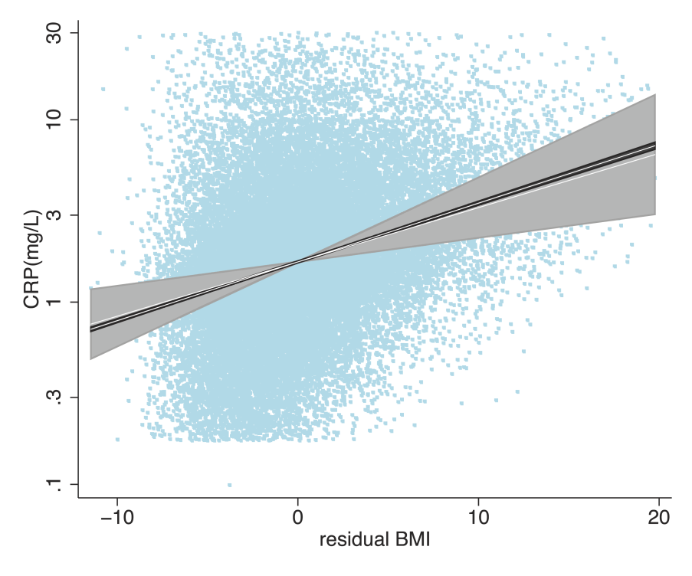
“Bi-directional Mendelian Randomization” Testing causality and reverse causation
 | Effect estimates
Exposure ➜ Outcome | Observational association | Instrumental variable (MR) | P_{IV} | P_{diff} | F_{first}
BMI ➜ CRP | 1.075 (1.073, 1.077) | 1.06 (1.02, 1.11) | 0.002 | 0.6 | 50.2
CRP ➜ BMI | 0.58 (1.53, 1.63) | -0.30 (-0.78, 0.18) | 0.2 | <0.00001 | 78.3
Notes:
So let’s first look at whether BMI causally affects CRP. If we were to do a simple observational regression, we regress CRP levels on BMI. We would get an estimate of about 1.075 with some very tight confidence intervals.

Slide 32
“Bi-directional Mendelian Randomization” Testing causality and reverse causation
 | Effect estimates
Exposure ➜ Outcome | Observational association | Instrumental variable (MR) | P_{IV} | P_{diff} | F_{first}
BMI ➜ CRP | 1.075 (1.073, 1.077) | 1.06 (1.02, 1.11) | 0.002 | 0.6 | 50.2
CRP ➜ BMI | 0.58 (1.53, 1.63) | -0.30 (-0.78, 0.18) | 0.2 | <0.00001 | 78.3
Notes:
So let’s first look at whether BMI causally affects CRP. If we were to do a simple observational regression, we regress CRP levels on BMI. We would get an estimate of about 1.075 with some very tight confidence intervals.

Slide 33
“Bi-directional Mendelian Randomization” Testing causality and reverse causation
 | Effect estimates
Exposure ➜ Outcome | Observational association | Instrumental variable (MR) | P_{IV} | P_{diff} | F_{first}
BMI ➜ CRP | 1.075 (1.073, 1.077) | 1.06 (1.02, 1.11) | 0.002 | 0.6 | 50.2
CRP ➜ BMI | 0.58 (1.53, 1.63) | -0.30 (-0.78, 0.18) | 0.2 | <0.00001 | 78.3
P_{diff} is calculated by conducting a heterogeneity test of the effect estimates from the observational association and instrumental variable analysis.
Notes:
So let’s first look at whether BMI causally affects CRP. If we were to do a simple observational regression, we regress CRP levels on BMI. We would get an estimate of about 1.075 with some very tight confidence intervals.

Slide 34
“Bi-directional Mendelian Randomization” Testing causality and reverse causation
 | Effect estimates
Exposure ➜ Outcome | Observational association | Instrumental variable (MR) | P_{IV} | P_{diff} | F_{first}
BMI ➜ CRP | 1.075 (1.073, 1.077) | 1.06 (1.02, 1.11) | 0.002 | 0.6 | 50.2
CRP ➜ BMI | 0.58 (1.53, 1.63) | -0.30 (-0.78, 0.18) | 0.2 | <0.00001 | 78.3
P_{diff} is calculated by conducting a heterogeneity test of the effect estimates from the observational association and instrumental variable analysis.
F_{first} = R² * (N-1)
(1-R²)
BMI is causal for CRP
R² is the variance explained in exposure by the SNP(s)
N is number of individuals in the study.
Notes:
So let’s first look at whether BMI causally affects CRP. If we were to do a simple observational regression, we regress CRP levels on BMI. We would get an estimate of about 1.075 with some very tight confidence intervals.

Slide 35
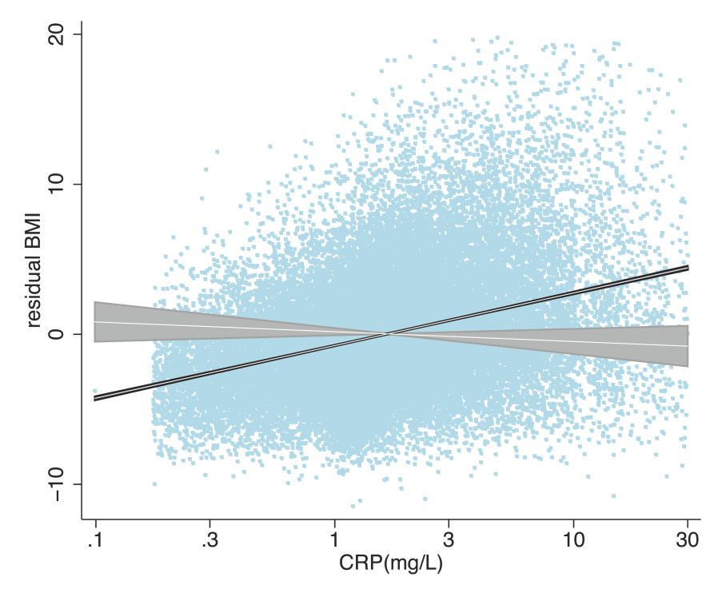
“Bi-directional Mendelian Randomization” Testing causality and reverse causation
 | Effect estimates
Exposure ➜ Outcome | Observational association | Instrumental variable (MR) | P_{IV} | P_{diff} | F_{first}
BMI ➜ CRP | 1.075 (1.073, 1.077) | 1.06 (1.02, 1.11) | 0.002 | 0.6 | 50.2
CRP ➜ BMI | 0.58 (1.53, 1.63) | -0.30 (-0.78, 0.18) | 0.2 | <0.00001 | 78.3
BMI is causal for CRP
Notes:
So let’s first look at whether BMI causally affects CRP. If we were to do a simple observational regression, we regress CRP levels on BMI. We would get an estimate of about 1.075 with some very tight confidence intervals.

Slide 36
“Bi-directional Mendelian Randomization” Testing causality and reverse causation
 | Effect estimates
Exposure ➜ Outcome | Observational association | Instrumental variable (MR) | P_{IV} | P_{diff} | F_{first}
BMI ➜ CRP | 1.075 (1.073, 1.077) | 1.06 (1.02, 1.11) | 0.002 | 0.6 | 50.2
CRP ➜ BMI | 0.58 (1.53, 1.63) | -0.30 (-0.78, 0.18) | 0.2 | <0.00001 | 78.3
BMI is causal for CRP
CRP is not causal for BMI
Notes:
So let’s first look at whether BMI causally affects CRP. If we were to do a simple observational regression, we regress CRP levels on BMI. We would get an estimate of about 1.075 with some very tight confidence intervals.

Slide 37
Limitations to Mendelian Randomization
1. Population stratification
2. Canalisation (“Developmental compensation”)
3. The existence of instruments
4. Power (also “weak instrument bias”)
5. Pleiotropy

Slide 38
Power and Weak Instruments
Power:
Genetic variants explain very small amounts of phenotypic variance in a given trait
VERY large sample sizes are generally required
Weak instruments:
Genetic variants that are weak proxies for the exposure
Results in biased causal estimates from MR
Different impact of the bias from weak instruments:
Single Sample MR: to the confounded estimate
Two-Sample MR: to the null

Slide 39
Using Multiple Genetic Variants as Instruments
Creating allelic scores using multiple genetic variants
Testing multiple variants individually and then meta-analysing individual SNPs
Palmer et al (2011) Stat Method Res

Slide 40
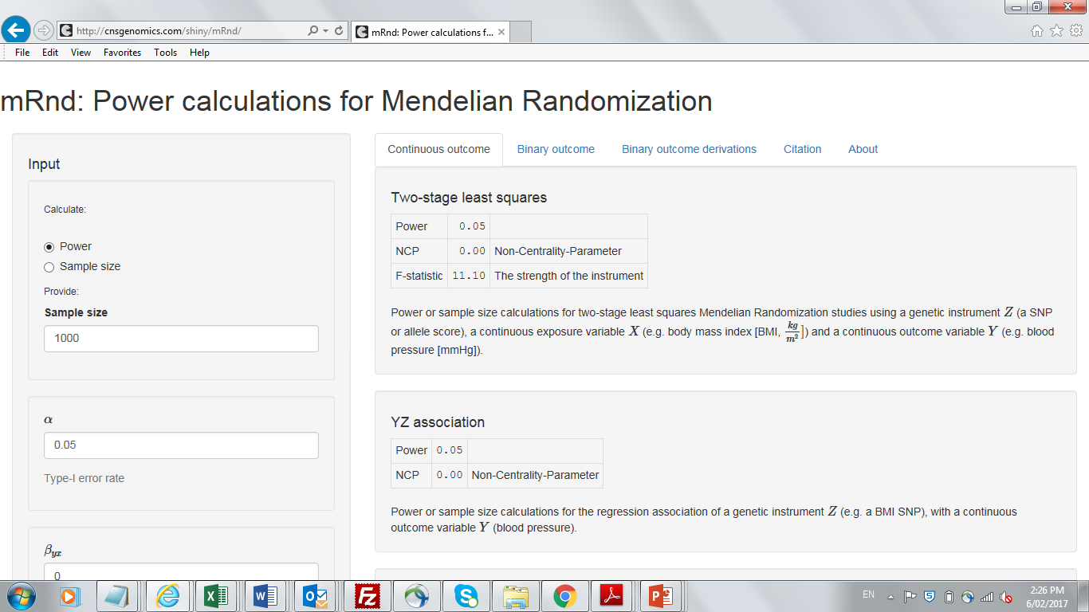
Calculating Power in Mendelian Randomization Studies

Slide 41
Pleiotropy: Genetic variant influences more than one trait
Outcome
Exposure
Outcome
Exposure
SNP
SNP
Vertical pleiotropy
Horizontal pleiotropy

Slide 42
Horizontal Pleiotropy
Pleiotropy only violates MR’s assumptions if it involves a pathway outside that of the exposure and is a pathway that affects your outcome
No violation
Outcome
Outcome
Exposure
B1
Exposure
B1
B2
B2
SNP
SNP

Slide 43
Horizontal Pleiotropy
Pleiotropy only violates MR’s assumptions if it involves a pathway outside that of the exposure and is a pathway that affects your outcome
No violation
Violation
Outcome
Outcome
Exposure
B1
Exposure
B1
B2
B2
SNP
SNP

Slide 44
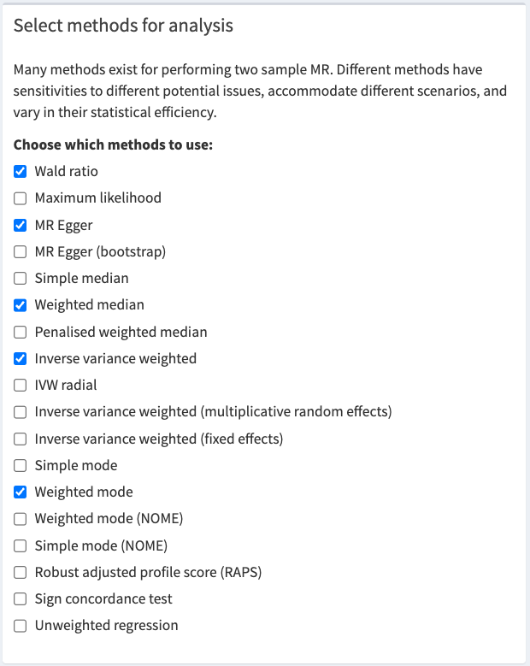
MR Base (http://www.mrbase.org/)

Slide 45
Useful References
Brion et al (2013). Calculating statistical power in Mendelian randomization studies. Int J Epidemiol, 42(5), 1497-501.
Davey-Smith & Hemani (2014). Mendelian randomization: genetic anchors for causal inference in epidemiological studies. Hum Mol Genet, 23(1), R89-98.
Davey-Smith & Ebrahim (2003). “Mendelian randomization”: can genetic epidemiology contribute to understanding environmental determinants of disease? IJE, 32, 1-22.
Davies et al (2018). Reading Mendelian randomization studies: a guide, glossary, and checklist for clinicians. BMJ, Jul 12, 362:k601.
Evans & Davey-Smith (2015). Mendelian randomization: New applications in the coming age of hypothesis free causality. Annu Rev Genomics Hum Genet, 16, 327-50.
Hemani et al. (2018). The MR-Base platform supports systematic causal inference across the human phenome. Elife, May 30, 7, e34408.
Zheng et al. (2017). Recent developments in Mendelian randomization studies. Curr Epidemiol Rep, 4(4), 330-345.

