Slide 1
One-sample Mendelian randomization Practical:
Does C-Reactive Protein causally affect Blood Pressure?
Shannon D’Urso
Institute for Molecular Bioscience
The University of Queensland
Notes:
\

Slide 2
Background
Research Question: Does C-reactive protein (CRP) causally affect blood pressure?
CRP is a biomarker for inflammation
Increased CRP is observationally associated with higher blood pressure
CRP is associated with potential confounder factors

Slide 3
C-Reactive Protein Coronary Heart Disease Genetics Collaboration (CCGC). BMJ2011:342:d548

Slide 4
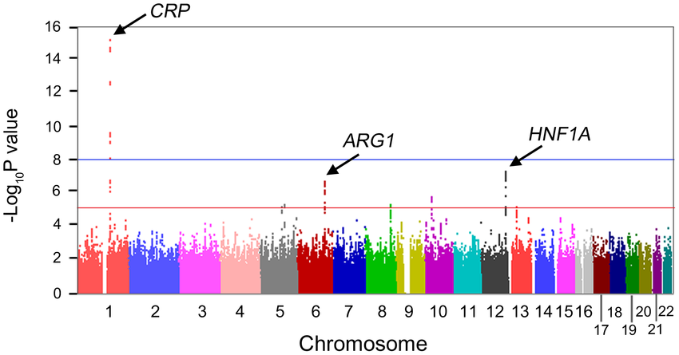
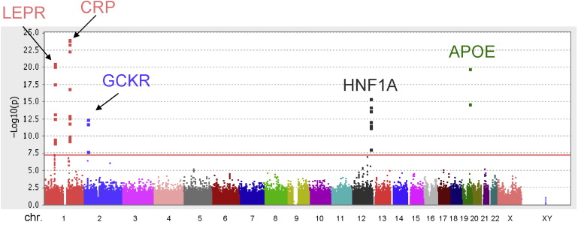
rs3091244
A single nucleotide polymorphism (SNP)
Robustly associated with CRP levels in past genome-wide association studies (GWAS)
rs3091244 is a functional variant within the promoter region of the CRP gene
Explains the greatest proportion of overall CRP variance
CRP levels are best instrumented by variants within the CRP gene region

Slide 5
rs3091244 and CRP GWAS
Risk Allele | P | Freq | OR | Beta | CI | Discovery Sample | Trait Name | PubMed ID
rs3091244-? | 6e-28 | - | - | 0.20 mg/dl increase | - | 6,345 European Women | C-reactive protein | 18439548
rs3091244-? | 1e-10 | - | 0.82 | - | - | 10,798 European Women | Serum C-reactive protein concentration | 32928877
rs3091244-A | 7e-68 | 0.32 | - | 0.33 unit increase | [0.29-0.37] | 8,318 European individuals | C-reactive protein levels | 33227023
rs3091244-A | 9e-134 | 0.48 | - | 0.24 unit increase | [0.22-0.26] | 15,895 Hispanic individuals, 12,817 African American individuals, 1,252 Asian or Oceanic ancestry individuals, 539 Native American ancestry individuals | C-reactive protein levels | 29878111
rs3091244-A | 3e-332 | 0.35 | - | 0.17 unit increase | [0.16-0.18] | 148,164 European Individuals | C-reactive protein levels | 30388399
Past genome-wide significant associations (p< 5e-8) for rs3091244. Table exported from the GWAS Catalog. P = P-value; Freq = risk allele frequency; OR = odds ratio; CI = 95% confidence interval. - indicates authors did not report the given field

Slide 6
Three core assumptions for Mendelian randomisation
Confounders
(2)
X
SNP
Exposure
Outcome
(1)
X
(3)
(1) SNP is associated with the exposure
(2) SNP is NOT associated with confounding variables
(3) SNP ONLY associated with outcome through the exposure

Slide 7
Does CRP causally affect blood pressure?
Confounders
(Income, HDL)
Observational β_{CRP-SBP} =
β_{SNP-INCOME} =
β_{SNP-HDL} =
X
β_{CRP-INCOME} =
β_{CRP-HDL} =
β_{INCOME-SBP} =
β_{HDL-SBP} =
rs3091244
CRP
SBP
β_{SNP-CRP} =
β_{CRP-SBP} =
β_{SNP-SBP} =

Slide 8
Where are the files?
1. Website
https://cnsgenomics.com/data/teaching/GNGWS24/module4/Practice_1_1SMR/)
2. Server
/data/module4/Practice_1_1SMR

Slide 9
What are the files?
Practice_1_1SMR_Questions.docx: Questions to answer in the practical session
data.txt: Genetic and phenotypic dataset
3. Practice_1_1SMR.R: R code to help you (but feel free to code by yourself)

Slide 10
Preliminary Steps
Option 1 (recommended): Run the analyses locally
Copy the folder to your computer
https://cnsgenomics.com/data/teaching/GNGWS24/module4/Practice_1_1SMR/
2. Open the R script in your local Rstudio
3. Update your working directory
setwd("/YOUR DIRECTORY/")
Option 2: Run the analyses on the server and export plots
Log in to the server
ssh <username>@203.101.XX.XXX
Copy the files to your scratch space on the cluster
cp –r /data/module4/Practice_1_1SMR/ /scratch/<username>/
Load R
R
Update your working directory
setwd("/scratch/<username>/")
5. Export plots to visualise them
scp <username>@203.101.XX.XXX:/scratch/<username>/Practice_1_1SMR/Rplots.pdf ./
Notes:
Mac users: Terminal
Windows users: Powershell
Or command prompt
sftp username@hostname:[path_to_file]/test.pdf [local_path_to_save]

Slide 11
Does CRP causally affect blood pressure?
Observational β_{CRP-SBP} =
Confounders
(Income, HDL)
Wald Estimator
β_{IV}= β_{SNP-OUTCOME}
β_{SNP-EXPOSURE}
SE_{IV} = SE_{SNP-OUTCOME}
β_{SNP-EXPOSURE}
95% CI = β_{IV} + 1.96 * SE_{IV}
β_{SNP-INCOME} =
β_{SNP-HDL} =
X
β_{CRP-INCOME} =
β_{CRP-HDL} =
β_{INCOME-SBP} =
β_{HDL-SBP} =
rs3091244
CRP
SBP
β_{SNP-CRP} =
β_{CRP-SBP} =
β_{SNP-SBP} =

Slide 12
Answers
Applied Research Question:
Does having higher proinflammatory CRP causally increase your blood pressure?
No strong evidence.

Slide 13
Graphical Representation
Q1. As you’re running the commands below, fill in the graphical representation of the IV analysis with the appropriate variables and beta-coefficients.
Confounders
(Income, HDL)
Observational β_{CRP-SBP} = 19.1 mmHg/CRP Unit; P < 2x10⁻¹⁶
β_{SNP-INCOME} = 0.0014; P = 0.9
β_{SNP-HDL} = 0.0025; P = 0.07
X
β_{INCOME-SBP} = -0.93; P < 2x10⁻¹⁶
β_{HDL-SBP} = -28.4; P < 2x10⁻¹⁶
β_{CRP-INCOME} = -0.06; P < 2x10⁻¹⁶
β_{CRP-HDL} = -0.57; P < 2x10⁻¹⁶
rs3091244
CRP
SBP
β_{SNP-CRP} = 0.04; P < 2x10⁻¹⁶
β_{CRP-SBP} = -2.4 mmHg/CRP Unit; P = 0.5
β_{SNP-SBP} = -0.10; P = 0.47

Slide 14
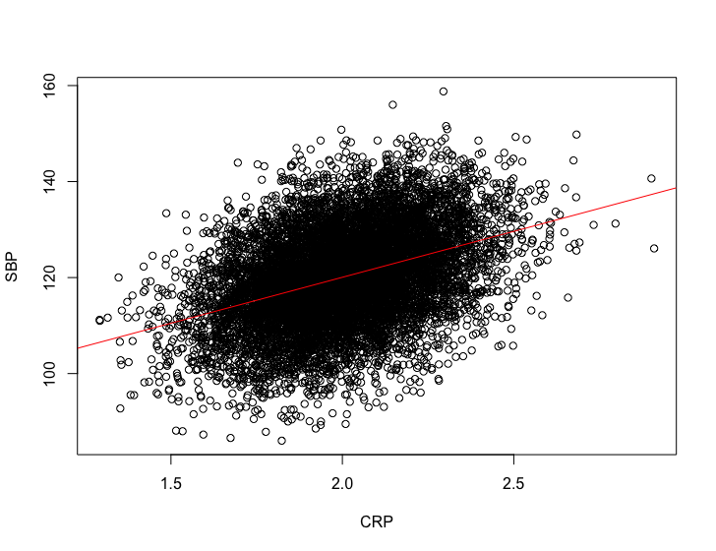
Observational analyses
Q2. What does the observational linear regression of SBP on CRP show?
Increased CRP predicts higher SBP. Every unit increase in CRP is associated with an increase in SBP of 19.1mmHg (0.45SE) p<2x10⁻¹⁶
Coefficients: Estimate Std. Error t value Pr(>|t|)
(Intercept) 81.7846 0.8997 90.90 <2e-16 ***
CRP 19.1372 0.4475 42.77 <2e-16 ***

Slide 15
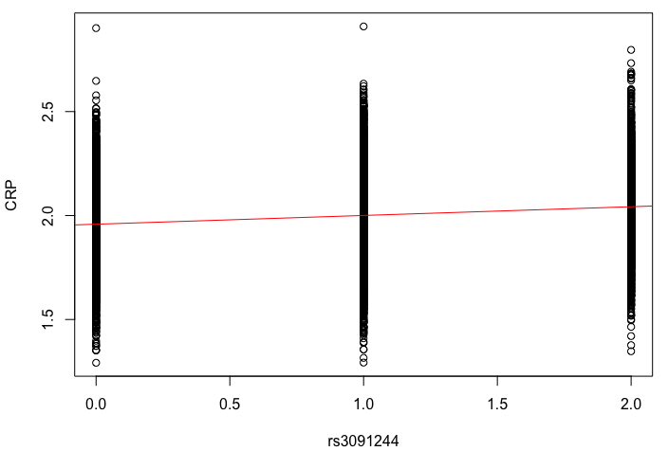
Observational analyses
Q3. What does the OLS regression of the CRP SNP rs3091244 on CRP show?
The rs3091244 SNP is associated with higher CRP. Each copy of the effect allele is associated with an increase in CRP of 0.04 units (0.003 SE) p<2x10⁻¹⁶
Coefficients:
Estimate Std. Error t value Pr(>|t|)
(Intercept) 1.958318 0.003481 562.58 <2e-16 ***
rs3091244 0.041937 0.002838 14.78 <2e-16 ***

Slide 16
Observational analyses
Q4. What do the OLS regressions of potential confounders (income, HDL) show?
That higher income is associated with lower BP and lower CRP, but income is not associated with the CRP-related CRP genotype. Same for HDL: that higher HDL associates with lower BP and lower CRP, but association of HDL with CRP genotype.
Estimate Std. Error t value Pr(>|t|)
SBP~INCOME -0.92975 0.09865 -9.425 <2e-16 ***
HDL~INCOME -0.056469 0.001956 -28.86 <2e-16 ***
INCOME~rs3091244 0.001432 0.014091 0.102 0.919
SBP~HDL -28.4494 0.9566 -29.74 <2e-16 ***
CRP~HDL -0.5695 0.0197 -28.9 <2e-16 ***
HDL~rs3091244 0.002531 0.001399 1.809 0.0704

Slide 17
Observational analyses
Q5. What are the implications for these income and HDL associations for the observational CRP-SBP association?
The observational association between CRP and SBP could be due to confounding by HDL and Income

Slide 18
Observational analyses
Q6. Compare the unadjusted and covariate-adjusted OLS observational regressions. What do they show?
The observational association for CRP and SBP reduces after covariate adjustment for HDL and Income in the regression model. However, an association still remains
# Unadjusted
Coefficients:
Estimate Std. Error t value Pr(>|t|)
(Intercept) 81.7846 0.8997 90.90 <2e-16 ***
CRP 19.1372 0.4475 42.77 <2e-16 ***
# Adjusted
Coefficients:
Estimate Std. Error t value Pr(>|t|)
(Intercept) 107.71279 1.87440 57.465 <2e-16 ***
CRP 16.83413 0.47291 35.597 <2e-16 ***
INCOME 0.20413 0.09293 2.196 0.0281 *
HDL -19.06234 0.93616 -20.362 <2e-16 ***

Slide 19
Observational analyses
Q7. What could explain this?
That there are other unmeasured confounding factors not being accounted for in the OLS regression model,
OR that there is reverse causation of SBP effects on CRP,
OR that CRP has some causal effects, over and above confounding. (Additionally, measurement error in the covariates can also lead to persisting associations after covariate adjustment has occurred).

Slide 20
MR/IV Analyses: Wald Estimator
Obtain the required estimates to compute the causal effect using the Wald Estimator from your dataset. Note, however, that an advantage of the Wald estimator is that you do not need individual level datasets to do the MR analysis. Reported SNP effects from published GWAS is sufficient and you can take the SNP effect on the exposure from one GWAS, and the SNP effect on outcome from a different GWAS sample (“Two sample MR”)
Q8. Run the necessary OLS regressions to compute a Wald estimator
Estimate Std. Error t value Pr(>|t|)
CRP~rs3091244 0.041937 0.002838 14.78 <2e-16 ***
SBP~rs3091244 -0.1014 0.1396 -0.726 0.468

Slide 21
MR/IV Analyses: Wald Estimator
Q9. From the above output, compute the causal effect using the Wald estimator, as well as it’s SE and 95% CI. What do the results show and what do they mean?
Little strong evidence of causal effect of CRP on SBP
Wald estimator causal Beta = -0.1014/0.0419 = -2.42
SE = 0.1396/0.0419 = 3.33
95% CI = -8.95 to 4.11

Slide 22
MR/IV Analyses: Wald Estimator
Q10. Rerun the observational OLS of CRP and SBP and compare with the results from the Wald estimator. What do you notice about the Beta and SEs?
Much larger beta and much smaller SE.
Estimate Std. Error t value Pr(>|t|)
CRP 19.1372 0.4475 42.77 <2e-16 ***

Slide 23
MR/IV Analyses: TSLS
Two-stage least squares (TSLS) MR requires individual level data, and the exposure, SNP and outcome in the one sample (“Single sample MR”).
Q11. What do the TSLS results show, and did it differ to the Wald estimator?
No strong evidence of the causal effect of CRP on SBP. No difference in the beta coefficients between Wald and TSLS, but SE is slightly different.
Estimate Std. Error t value Pr(>|t|)
CRP -2.418 3.398 -0.712 0.477
Why the difference in SEs?
ivreg()” corrects the standard errors from the second-stage regression to account for uncertainty in your predicted exposure, so the SE is slightly larger.
Notes:
(for example, using the sandwich estimator available in standard statistical software).

Slide 24
MR/IV Analyses: Wald Estimator vs TSLS
Q12. Are the results from the manual TSLS the same as ‘ivreg’ TSLS function?
Coefficient is the same but SE is slightly different
Estimate Std. Error t value Pr(>|t|)
Pred_CRP -2.418 3.329 -0.726 0.468

Slide 25
Weak instruments bias
Assessing instrument strength with the F-stat (looking for >10).
For Single SNP MR, the F-statistic is calculated as:
F_{stat} = R² * (N-1)
(1-R²)
where R² is the variance explained in exposure by the SNP, and N is number of individuals in the study. This statistic is available in the output for OLS and TSLS
Q13. Looking at the F-statistic, determine if weak instruments may be an issue
Fstat in both is 218. This is well over the threshold of 10, so no issues with weak instruments
Diagnostic tests:
df1 df2 statistic p-value
Weak instruments 1 9998 218.34 < 2e-16 ***

Slide 26
Discuss:
Q14. How would having weak instruments change the causal estimate of CRP on SBP, in this study (single sample)?
For single-sample MR, weak instruments biases causal IV estimates towards the confounded observational association. So the null IV estimate would increase towards the observational association beta (observational beta = 19.1)

Slide 27
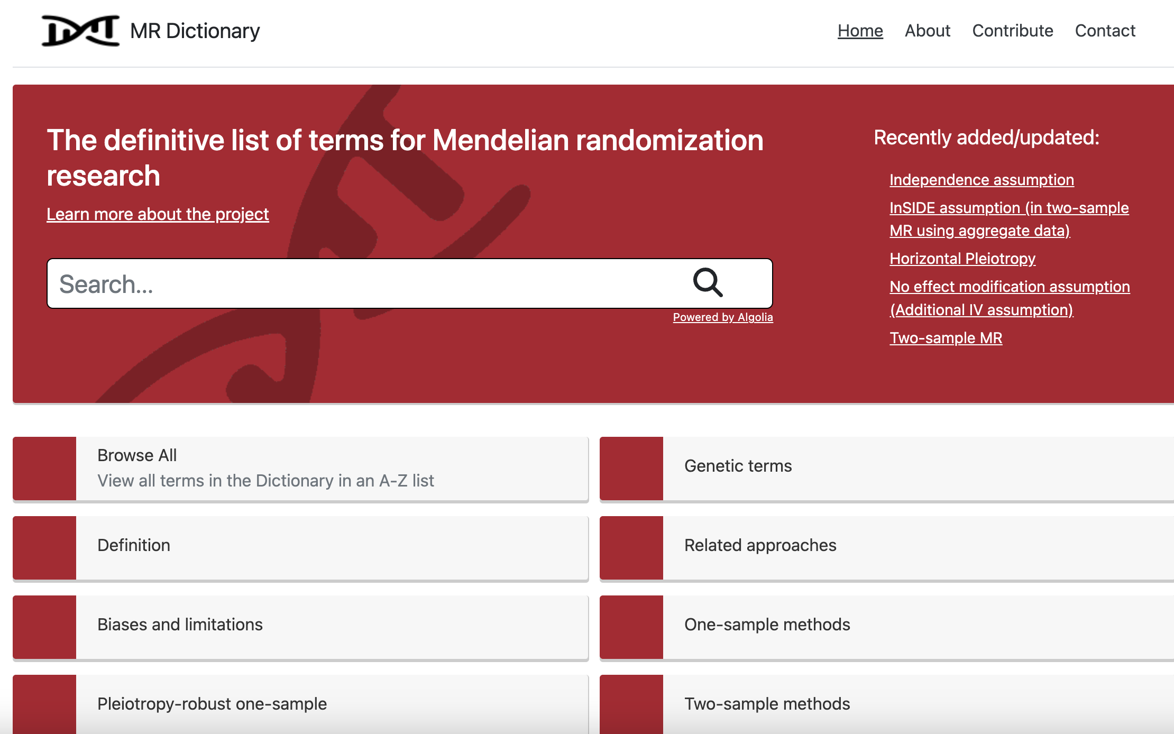
More info:
https://mr-dictionary.mrcieu.ac.uk/

