Slide 1
Functional annotation of GWAS summary data using FUMA

Slide 2
Incorporates 18 biological repositories and tools to process GWAS summary data:
SNP2GENE: mapping of SNPs to genes based on positional, eQTL and chromatin interaction
GENE2FUNC: biological mechanisms of prioritized genes
Helps prioritise SNPs and genes that should be investigated further for their causal role

Slide 3
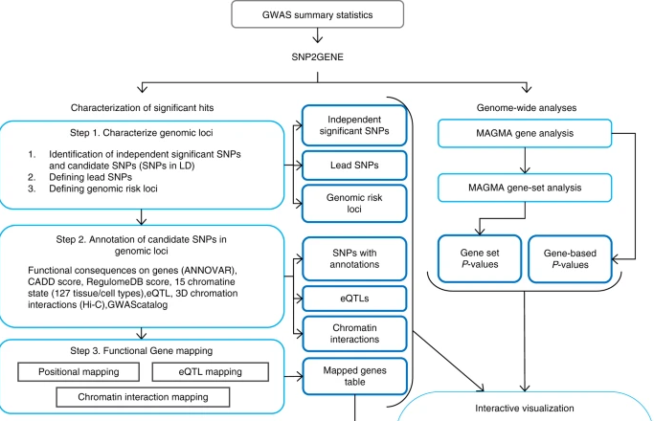

Slide 4
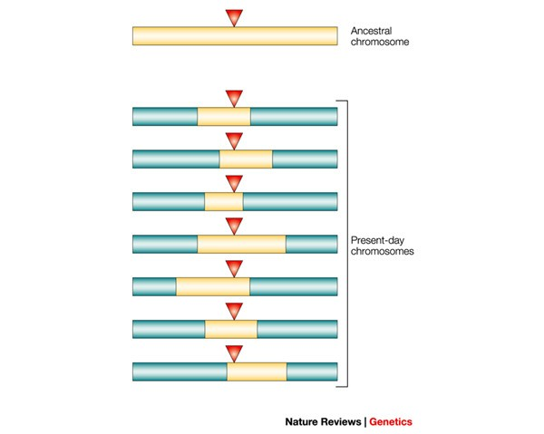
GWAS are based on the principle of linkage disequilibrium (LD)
Particular alleles at neighbouring regions in the genome tend to be co-inherited
A non-causal variant in LD with the causal variant will have a significant association p-value
Causal disease variant
Variant in perfect LD with causal variant

Slide 5
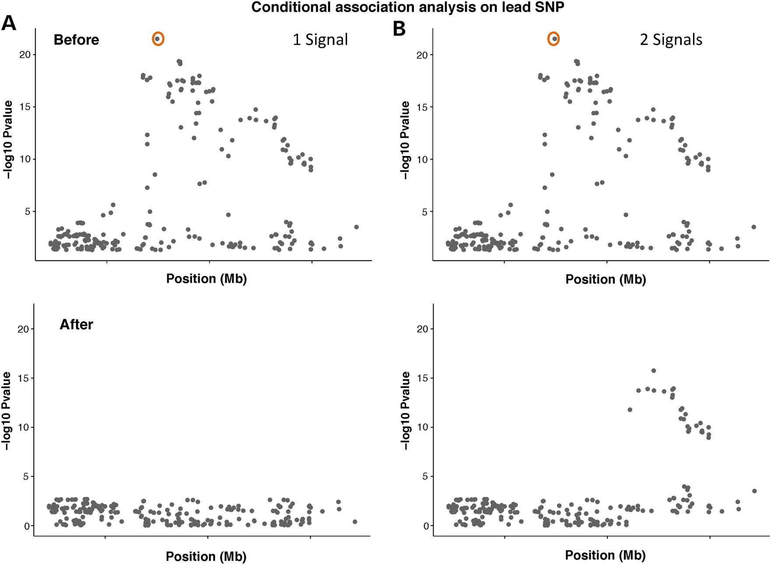
How many risk loci are there are each GWAS association signal?
Spain & Barrett
Hum Mol Genet, 2015

Slide 6
Independent and candidate SNPs
1. Independent significant SNPs
SNPs with P-value < 5e-8 and independent from each other at r ² < 0.6 (FUMA default, can be changed)
You can also provide your own list of SNPs to be the independent significant SNPs
2. Candidate SNPs: For each independent SNP significant, all SNPs (regardless of whether they are in input data) that have r ² > 0.6 are included for further annotation. These candidate SNPs can be filtered based on user-defined MAF (MAF >=0.01 by default)
3. Independent lead SNPs: Independent significant SNPs that have r ² < 0.1. If r² for independent sig SNPs is set to 0.1, the independent lead and independent significant SNPs will be the same.

Slide 7
Integration of Functional Resources
Functional consequence of candidate SNPs on genes using ANNOVAR
Combined Annotation Dependent Depletion (CADD)
Chromatin interaction information
The Genotype-Tissue Expression (GTEx) and other eQTL data
Regulome DB

Slide 8
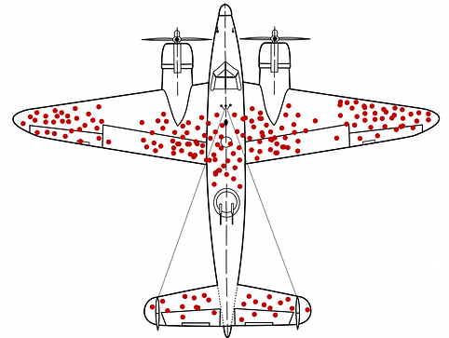
Combined Annotation Dependent Depletion (CADD)
A measure of variant deleteriousness (reduce organismal fitness) (Kircher et al Nature Genetics 2014)
Simulate all possible variants
Compare simulated variants with observed variants.
Deleterious variants — simulated variants that are depleted in observed data because of negative selection

Slide 9
Combined Annotation Dependent Depletion (CADD)
Proxy-neutral variants:
Variants arisen and become fixed in human populations since the split between humans and chimpanzees - mostly neutral given they have survived millions of years of purifying selection
Have allele frequency of 95 –100% in humans but are absent in the inferred genome sequence of the human-ape ancestor
Proxy-deleterious variants:
Simulated de novo variants that would be observed in the absence of selective pressure - may include both neutral and deleterious alleles
Use these two sets of variants to identify genomic features (e.g. conservation, epigenetic modification, functional prediction) that best separates these two sets of variants

Slide 10
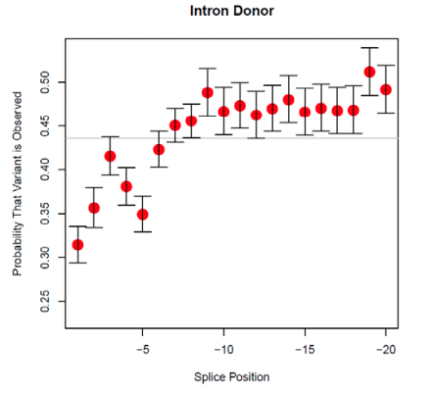
CADD
Genomic features predictive of deleteriousness:
~20-fold depletion of nonsense variants
~2-fold depletion of missense variants
no depletion of intergenic or upstream or downstream variants
Nonsense and missense mutations that occurred near the start sites of coding DNA were more depleted than those occurring near the ends
Variants within 20, and especially within 2, nucleotides of splice junctions were also depleted
Raw c-score: the probability of a variant coming from the simulated vs observed set based on it’s annotation profile
Higher the value more likely to be deleterious.

Slide 11
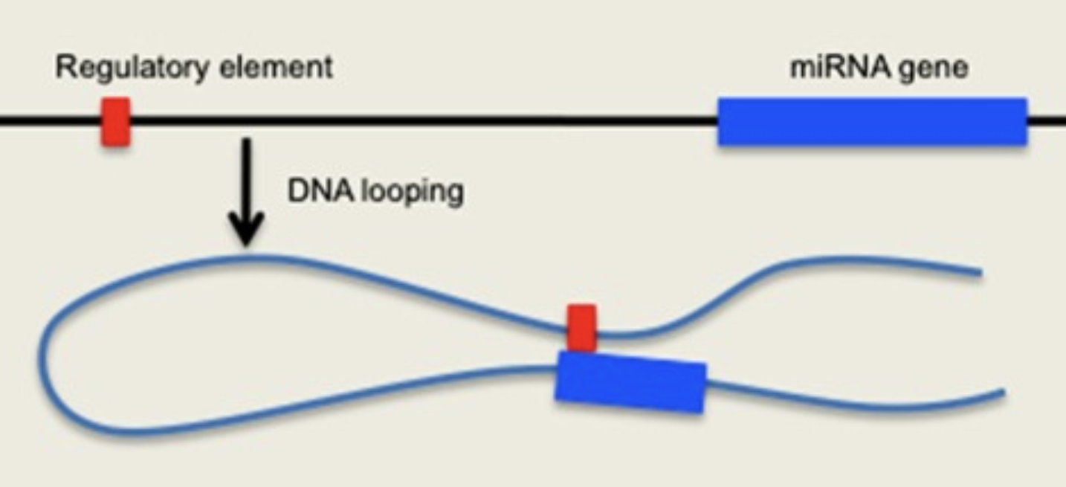
Chromatin interaction
Identifying regions of DNA that physically interact with each other
Interaction between distal regulatory elements with promoters to regulate gene expression
Figure DOI: 10.3389/fnmol.2013.00032

Slide 12
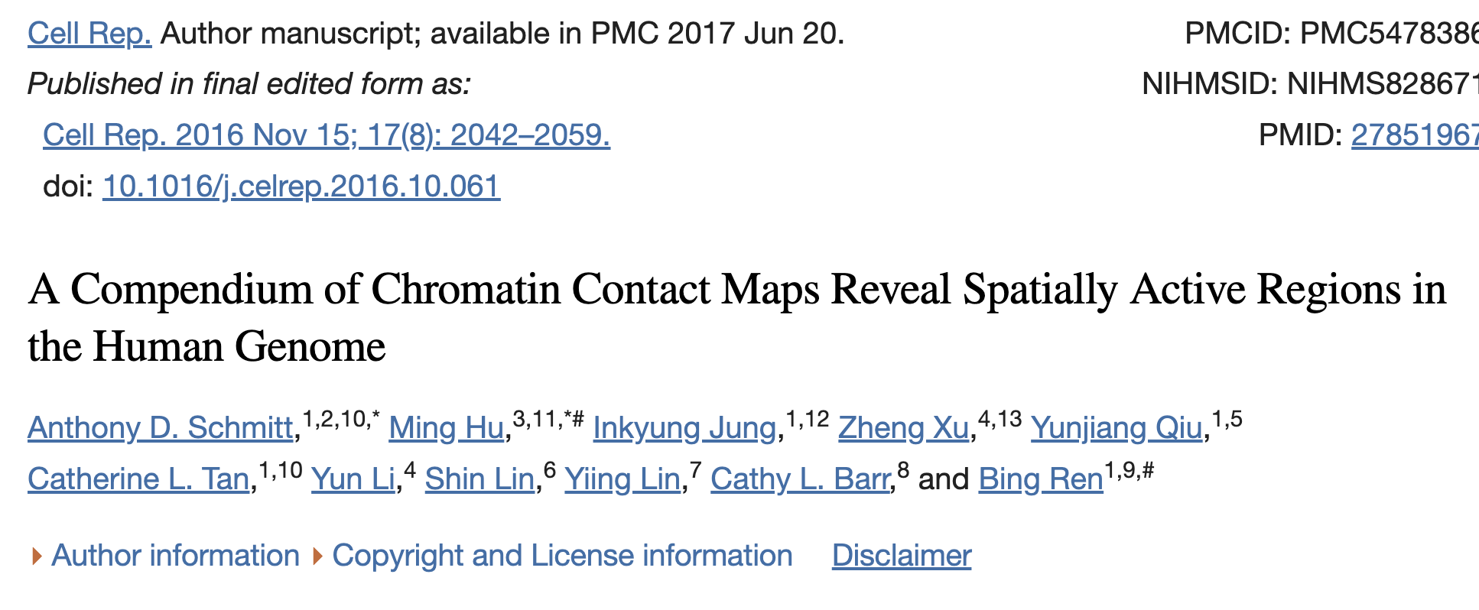
Chromatin interactions maps in 21 primary human tissues and cell types
Identified genomic regions that exhibit unusually high levels of interaction (frequently interacting regions or FIRE)
FIREs enriched for super-enhancers and are near cell-identity genes
FIREs conserved in human and mouse
FIREs enriched for disease-associated GWAS SNPs

Slide 13
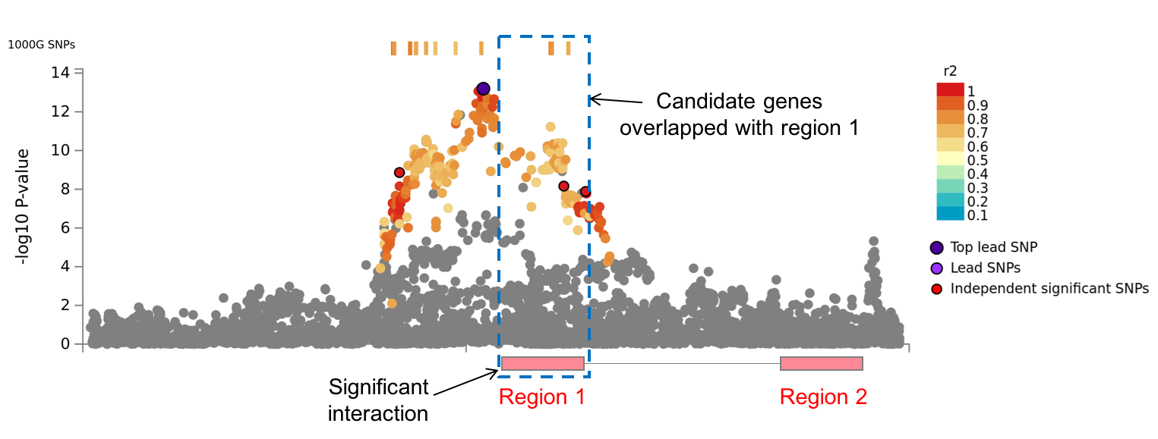
Chromatin interaction
Region 1: One end of the interaction that overlaps with one of the candidate SNPs
Region 2: Other end of the significant interaction. Identifies genes whose promoter region interacts with the region containing the candidate SNPs

Slide 14
eQTL mapping – mostly cis-regulation
GTEx
EyeGEx (retina in 406 individuals)
eQTL catalogue
eQTLGen (~31,000 samples European) http://www.eqtlgen.org/index.html
Blood eQTL Westra et al 2013 (~5300 blood samples from 7 studies)
PsychENCODE (brain data ~1400 samples) http://resource.psychencode.org
BIOS QTL browser (~2000 whole blood healthy adults from 4 Dutch cohorts Zhernakova et al. 2017)
Braineac (Brain expression in 134 controls of European ancestry) http://www.braineac.org/

Slide 15
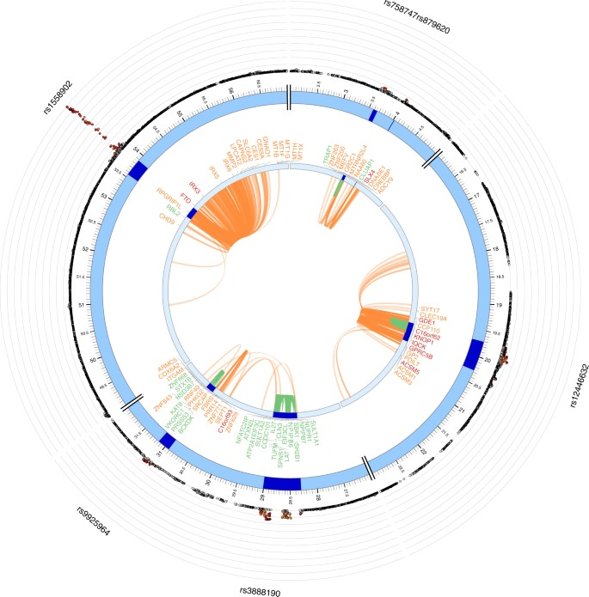
Chromatin interactions and eQTLS of a BMI risk locus on chr16
Genes
Orange: mapped by eQTL data
Green: mapped by HiC data
Red: mapped by both

Slide 16
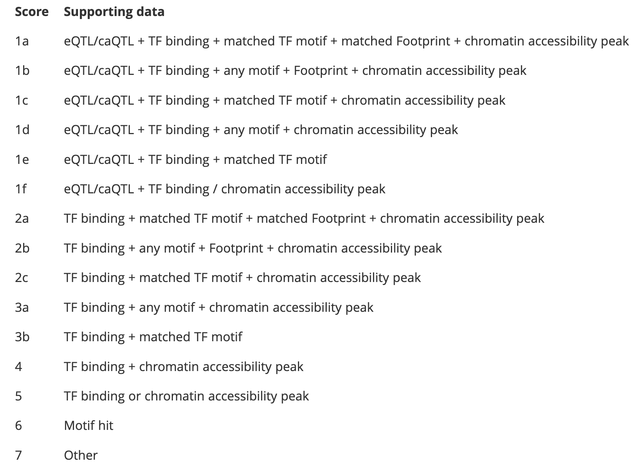
RegulomeDB
Intersects candidate SNPs with known functionally-active regions identified from functional genomic assays e.g. TF ChiP-seq (TF-binding regions), DHS (open chromatin regions)
Scores functional consequence of each SNP based on strength of evidence

Slide 17
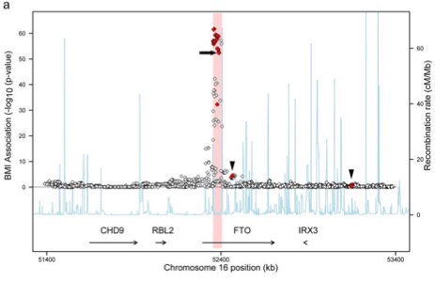
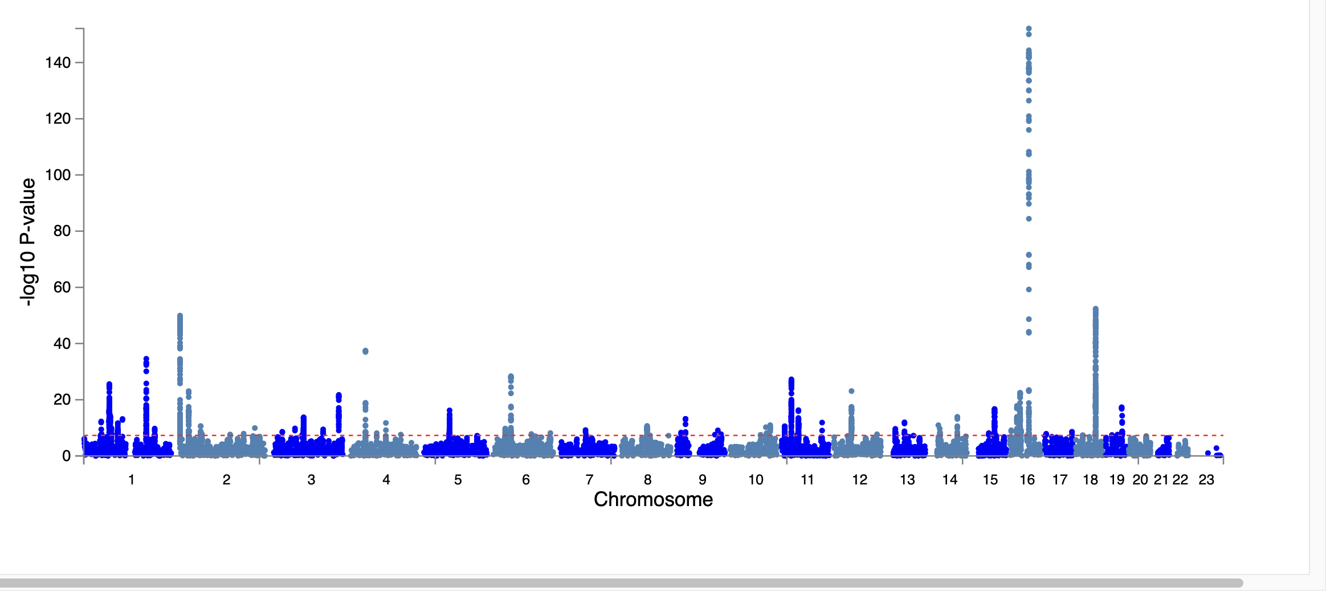
GWAS to mechanism – the FTO story
The FTO locus - first ever GWAS locus to be associated with obesity in 2007
Individuals homozygous for the top risk variant weigh ~3kg more than non-carriers.
Even after 16 yrs we’re unclear how SNPs in the region lead to changes in BMI

Slide 18
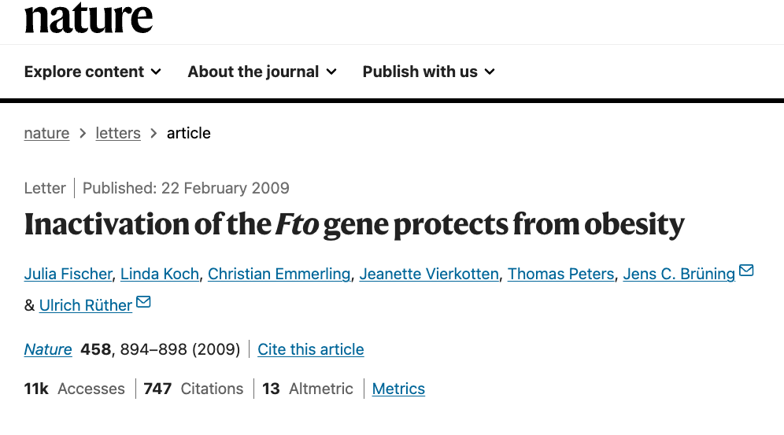
GWAS to mechanism – the FTO story
FTO gene was the primary suspect
Fto knockout mice were stunted and lean, and the leanness was mainly due to burning too much fat.

Slide 19
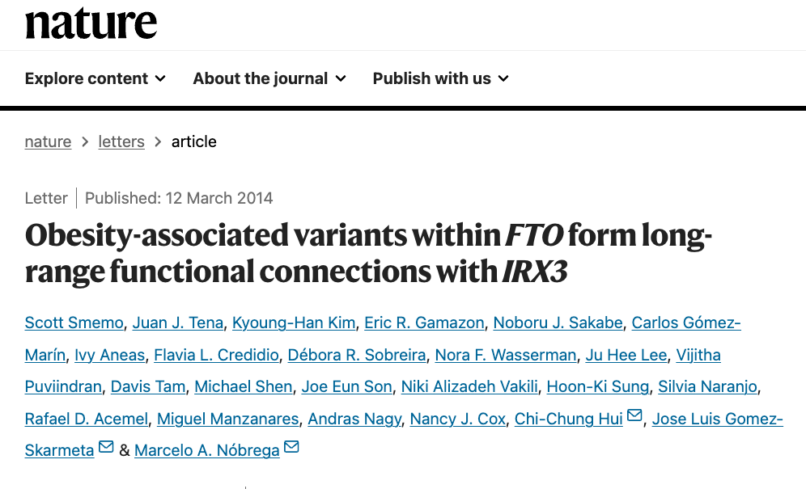
GWAS to mechanism – the FTO story
Chromatin interaction data
Promoter of Irx3 participates in numerous long-range interactions, including with the GWAS region in both mouse embryo and adult mouse brain, as well as MCF-7 cells and zebrafish embryos

Slide 20
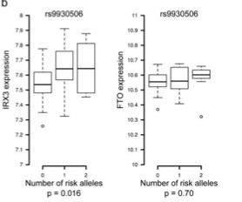
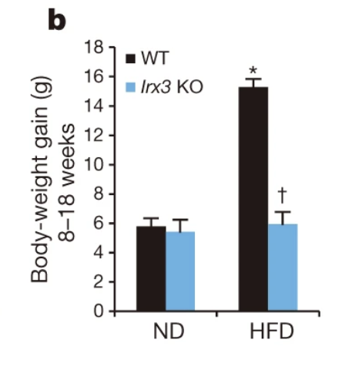
GWAS to mechanism – the FTO story
Irx3-deficient mice are leaner and are protected against diet-induced obesity
BMI-associated SNPs are eSNPs for IRX3, not FTO, expression in human brain

Slide 21
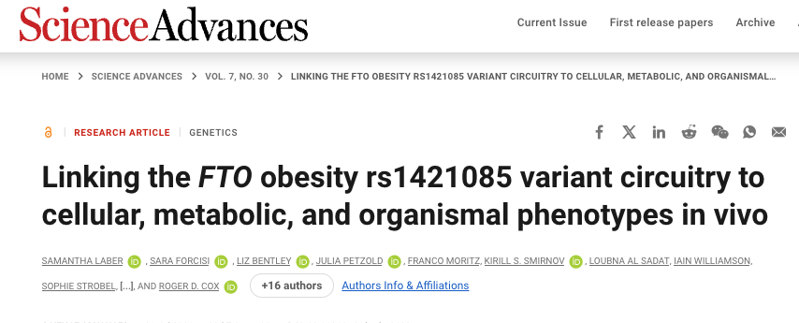
GWAS to mechanism – the FTO story
Instead of knocking out genes, deleted the non-coding region in the FTO gene
Mice don't gain weight when fed with a high-fat diet, and deleting this locus increases Irx3 and Irx4 expression.

Slide 22
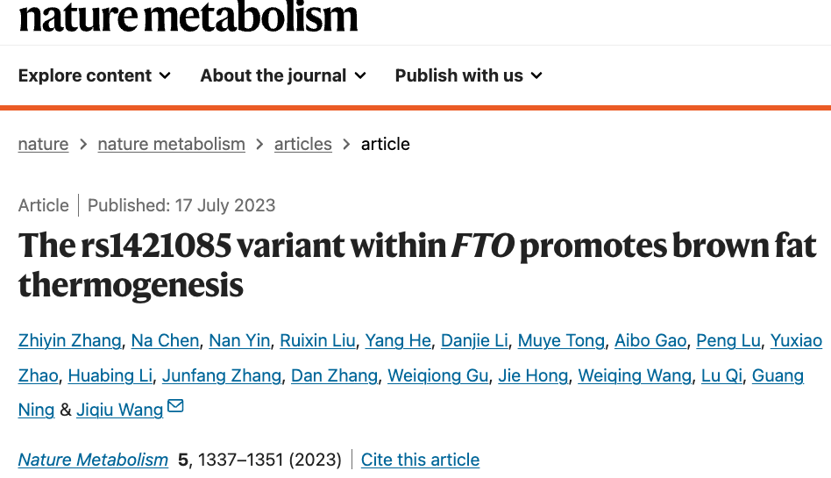
GWAS to mechanism – the FTO story
Recreate the exact genetic variant in mice and study the consequences.
The risk allele, that increased weight in humans, decreased weight in mice.
Effect of variant is temperature-dependent:
At room temperature (22°C, which is ambient for humans but not mice) mice were resistant to high-fat diet (HFD) induced obesity.
At 29–31°C (ambient for mice), the effects of the variant were ameliorated.
rs1421085 T>C has a role in improving survival in cold conditions, as it enhances brown adipose thermogenesis.

Slide 23
Lessons from the FTO story
Extrapolation of findings in animal models to humans
GWAS to mechanism is a long and winding road!
We’re extremely complicated!

Slide 25
Gene-based tests
GWAS focus on a single genetic variant with a trait at a time
Large multiple-testing burden
Gene-based tests - testing joint association of all markers in a gene with the phenotype
Reduced multiple-testing burden (millions of SNPs vs ~22,000 genes)
Detect effects consisting of multiple weaker associations
Several methods available – PLINK, MAGMA (implemented in FUMA), fastBAT
Simplest approach – combine p-values or χ2-statistics estimated for each variant within the region of interest
Need to account for SNP correlation structure
- Summary-based tests require a reference dataset (of similar ancestry) for estimating SNP-SNP correlations

Slide 26
Gene-based association test - MAGMA
Step 1: Mapping SNPs to gene
SNPs that are within protein-coding gene regions
Default gene annotation window = 0Kb (would miss intergenic regulatory regions)
Options available in FUMA = 0, 5, 10, 15, 20Kb
Step 2: Calculating gene p-value
Multiple linear principal components regression model
For each gene:
Project SNP matrix for the gene onto its principal components (uses 1000G phase 3 as reference data), removes redundant information and accounts for SNP-SNP LD
Uses PCs as predictors of phenotype in a linear regression model
Matrix of PCs
genetic effect

Slide 27
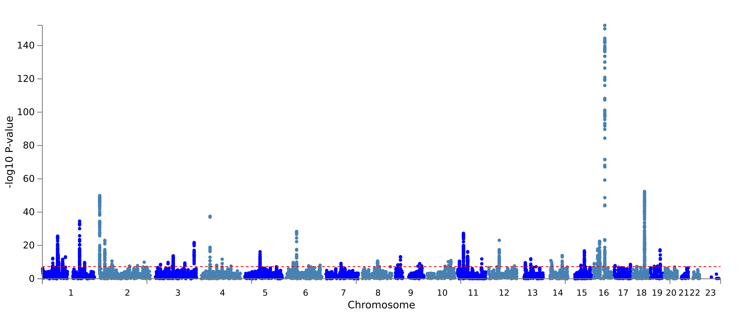
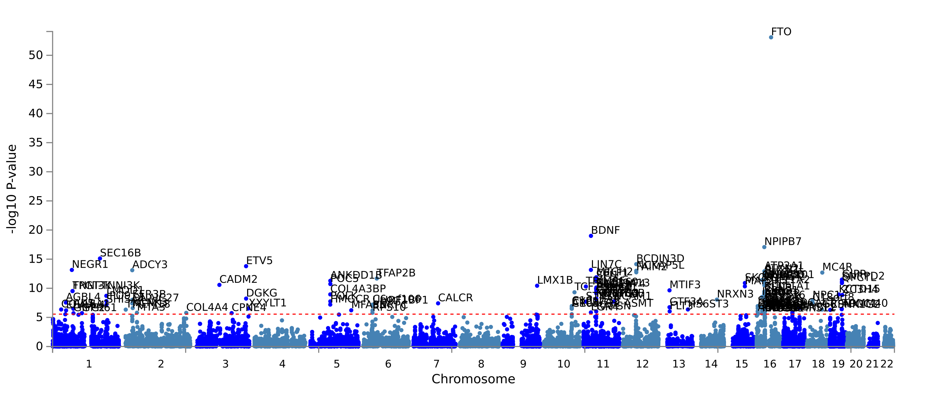
SNP-based
vs
MAGMA gene-based
association for BMI

Slide 28
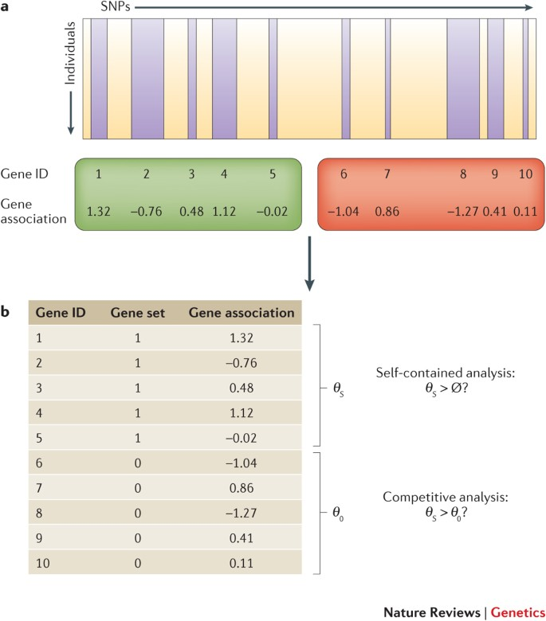
Gene-set analysis
Gene set - any group of genes that share a particular property e.g. sample pathway, same protein family etc
Gene set analysis - determine whether that property of the gene set has a role in the phenotype of interest.
1. Self-contained analysis:
null hypothesis: none of the genes in the gene set are associated with phenotype.
tests if genes in a gene-set are jointly associated with the phenotype of interest
Only considers genes in the gene set
2. Competitive analysis:
tests if genes in a gene-set more strongly associated with the phenotype than other genes
Considers all genes in the data
joint association of genes in the gene set is greater than the association of genes not in the gene set
Leeuw et al Nat Rev Gene 2016

Slide 29
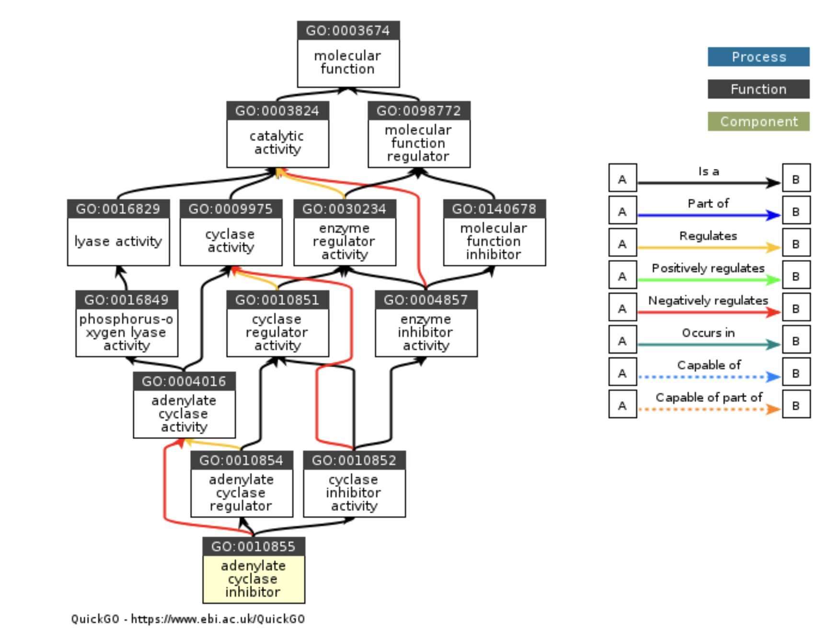
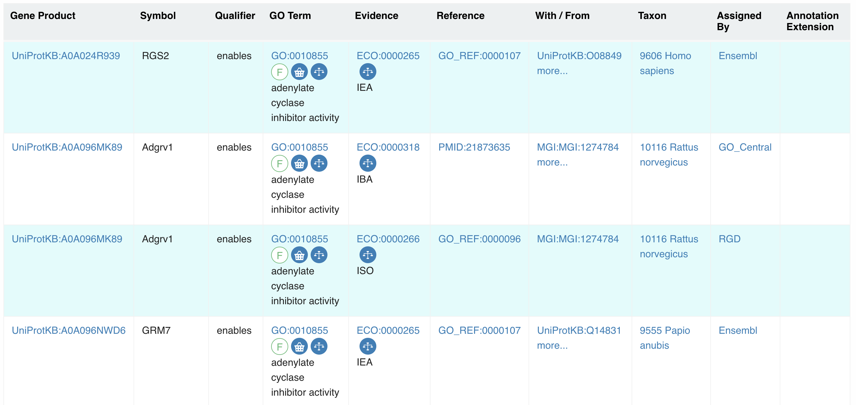
MAGMA gene-set analysis
Competitive gene set analysis for 4728 curated gene sets (including canonical pathways) and 6166 GO terms
The Molecular Signatures Database (MSigDB) is a resource of annotated gene sets
https://www.gsea-msigdb.org/gsea/msigdb
Online pathway databases: KEGG, Biocarta, Reactome, WikiPathwyas
Biomedical literature
Contributed by individual domain experts
Gene Ontology - source of information on the functions of genes

Slide 30
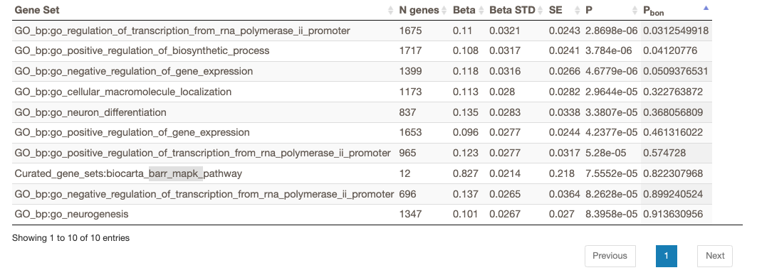
MAGMA gene-set analysis
Are genes in a gene-set more strongly associated with the phenotype of interest than other genes.

Slide 31
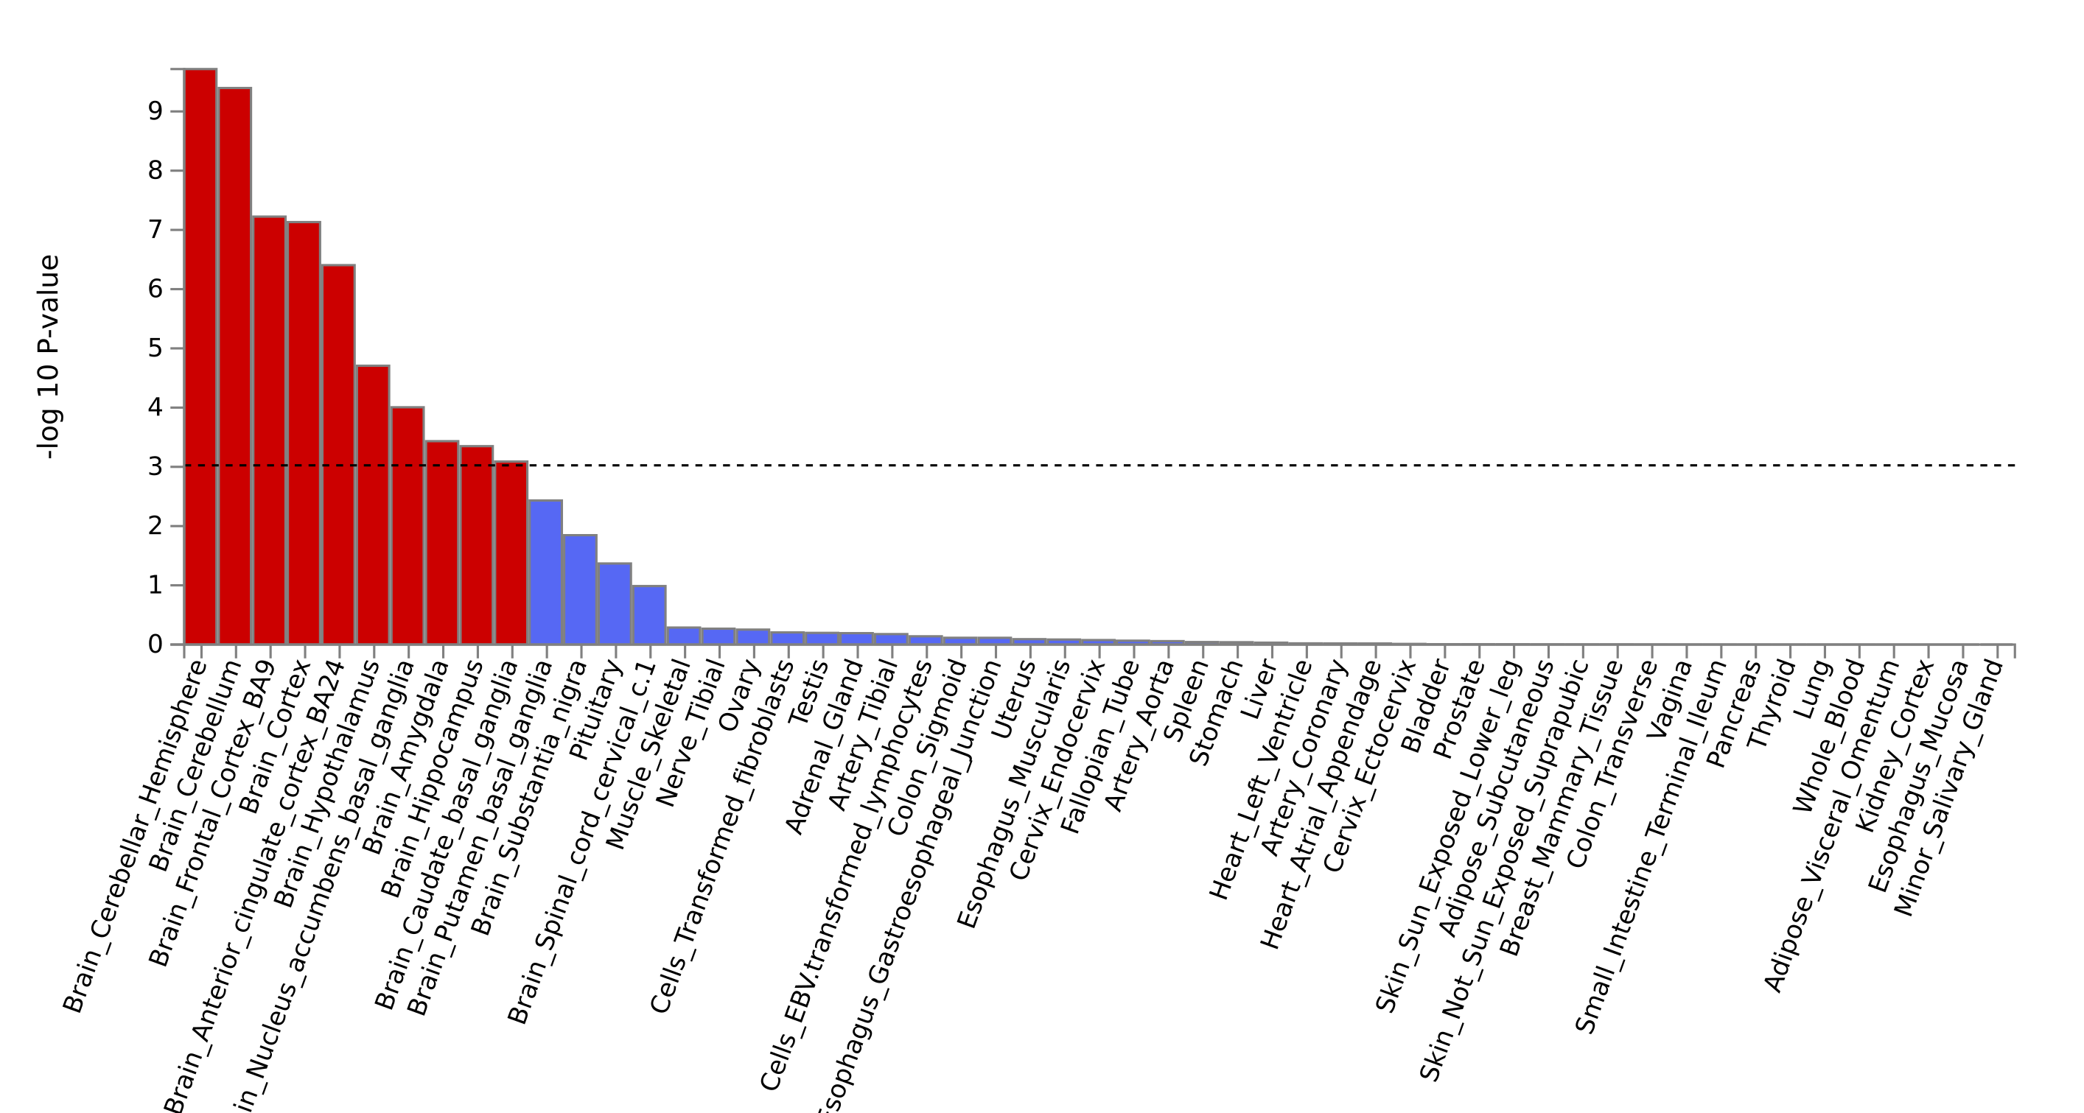
MAGMA tissue expression analysis
Do the genes most strongly associated with the phenotype have tissue-specific expression?
One-sided test if $β_{ε}$ > 0
i.e. testing the positive relationship between tissue specificity and genetic association of genes.

Slide 32
FUMA Output
List of prioritized variants and genes relevant to the trait/disease
Biological pathways or functions relevant to the trait/disease
Tissues/cell types relevant for trait/disease

Slide 33
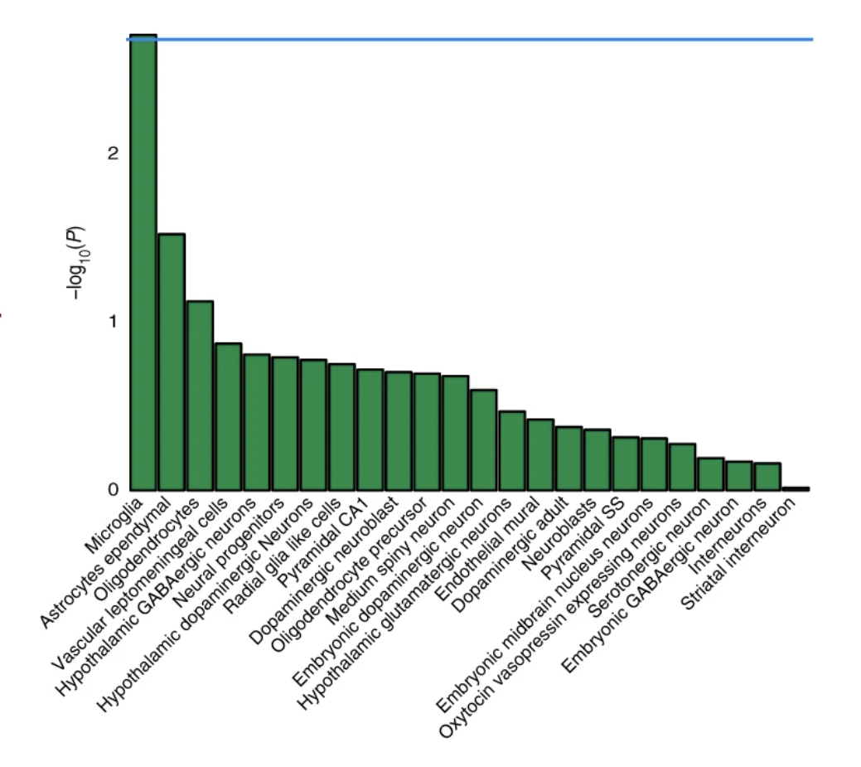
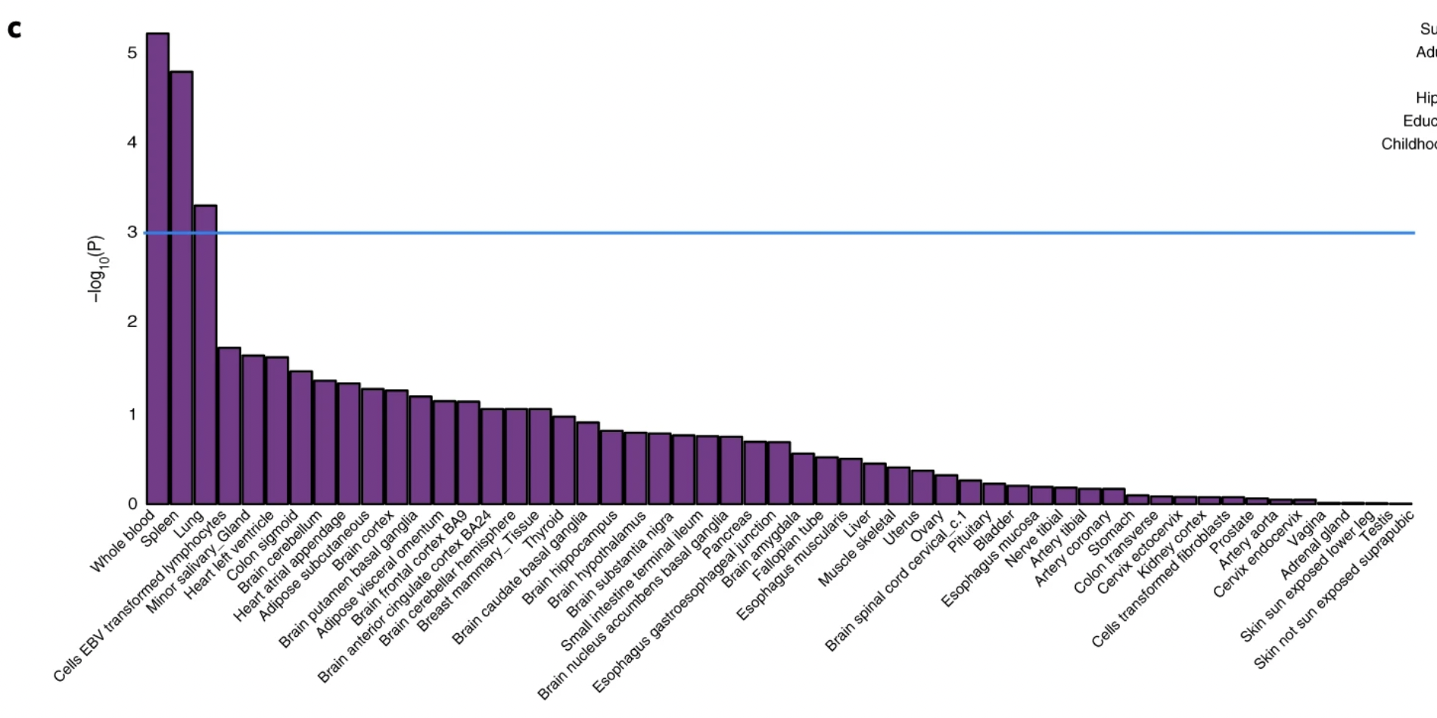
Example: Role of microglia in Alzheimer’s disease
Emphasised the crucial causal role of the immune system —rather than immune response as a consequence of AD

