Slide 1
Module 6 Day 2 From genetic maps to medicine – Using human genomics for preclinical drug target validation and safety evaluation

Slide 2
Pharmacokinetics vs pharmacodynamics
Pharmacokinetics
what the body does to the drug (ADME – absorption, distribution, metabolism and excretion)
Traditionally what the field of pharmacogenetics has been about
GWAS of drug response likely picks up variants that affect drug pharmacokinetics and perhaps heterogeneity in disease aetiology
Pharmacodynamics
What the drug does to the body i.e. what is its mechanism of action and how strongly does it bind to the target
What does modulating the drug target do to the body – predicting drug effects

Slide 3
The drug discovery & development pipeline
Basic research
(3-6 years)
Preclinical studies
(1-2 years)
Clinical Studies
(4 – 7 years)
FDA review and approval
(1 -2 years)
Post-market monitoring
(indefinite)
Disease biology
Target identification
Compound screening
Lead identification and optimization
In vitro and in vivo (in at least 2 different animals) efficacy and toxicology
Phase 1 – drug safety in healthy volunteers <100
Phase 2 – efficacy in patients (100-300)
Phase 3 – efficacy compared to placebo or existing treatments (1000+)
Pharmacovigilance
Observational studies

Slide 4
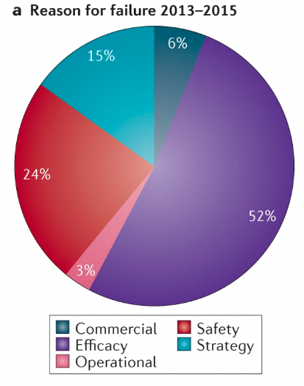
90% of drugs fail in human clinical trials
Lack of efficacy
Unmanageable toxicity
Poor drug-like properties (solubility, stability, in vivo pharmacokinetics
Strategic: lack of commercial interest and change in therapeutic focus
Harrison Nature Reviews Drug Discovery 2016

Slide 5
Extrapolating drug effects in humans
Animal studies and isolated systems (cells, tissue preparations) do not always translate to in vivo effects in humans
Unsuitable drug target in humans
Drug pharmacokinetics (drug metabolism, tissue absorption) – genetic variation may also play a role
Gold standard for testing in humans using a randomised control trial (RCT) – the final step of the process is the most costly and highest risk

Slide 6
Reducing risk of failure
Improved pre-clinical prediction of drug target effects in humans

Slide 7
Using genomics data to predict the effects of modulating a drug target in humans – Mendelian randomisation

Slide 8
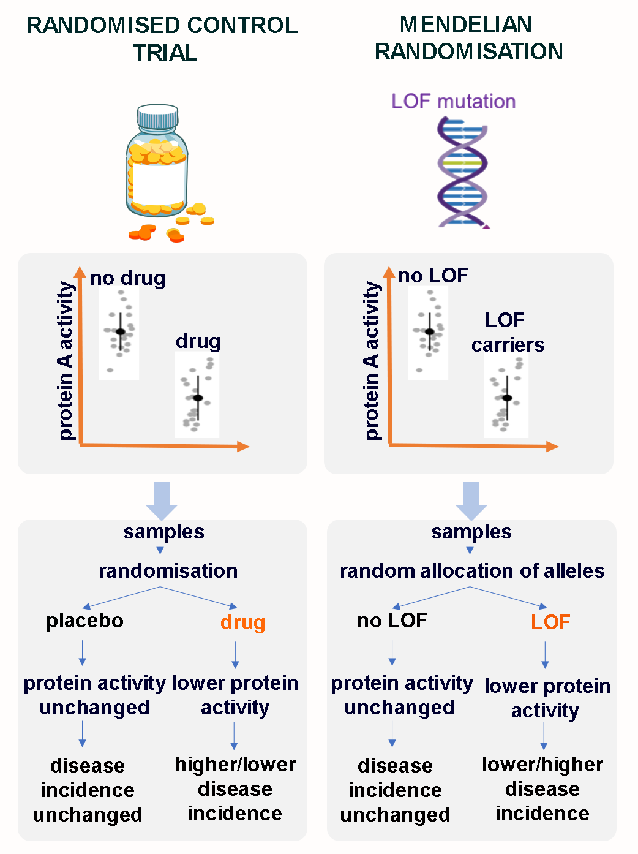
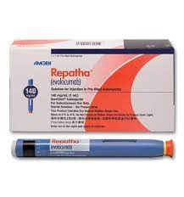
Using genetics for drug target validation - Mendelian randomisation (MR)
PCSK9: Genetic mutation to groundbreaking therapy
2005 Cohen et al Nature Genetics
Loss-of-function (LOF) mutations in PCSK9 gene in African-Americans associated with:
Substantially lower cholesterol
Reduction in risk of cardiovascular disease
No other health problems - safety
2015 first approved PCSK9 inhibitor
lower
lower

Slide 9
LOF/GOF as instruments for MR
Genome Aggregation Database (gnomAD)
Whole exome data in > 125,000 individuals
Predicted LOF (nonsense, essential splice site, and frameshift variants)
Individuals with LOF are very rare
Conclusion at the time – would require sample sizes that are 1000x bigger

Slide 10
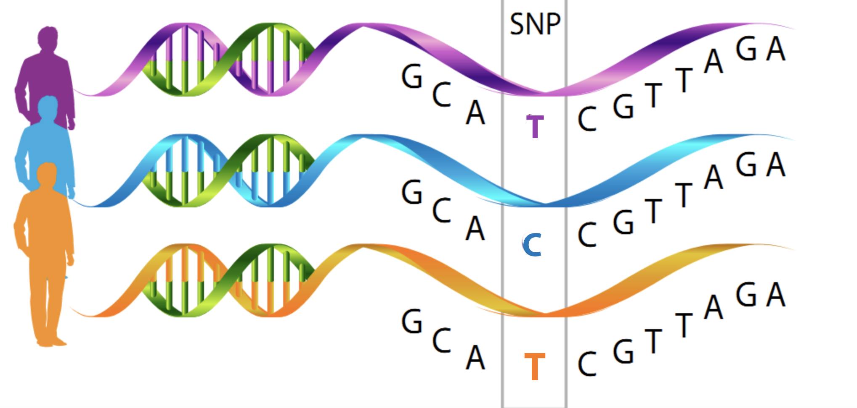
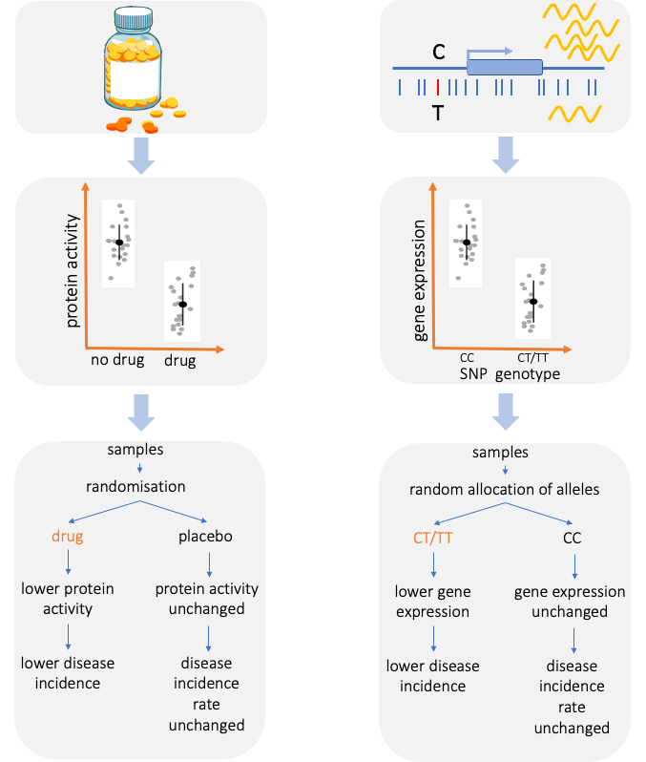
eQTLs as instruments for MR analysis
RCT
MR
cis-eQTLs as proxies for drug exposure.
PROS:
Gene expression easily measured in different tissues
CONS:
Gene expression does not always translate to protein levels or activity
Sonia Shah

Slide 11
pQTLs as instruments for MR analysis
RCT
MR
pQTLs as proxies for drug exposure.
PROS:
Closer phenotype to drug effects
CONS:
Difficult to measure outside of blood
Protein expression
Lower Protein expression
Protein expression unchanged
Sonia Shah

Slide 12
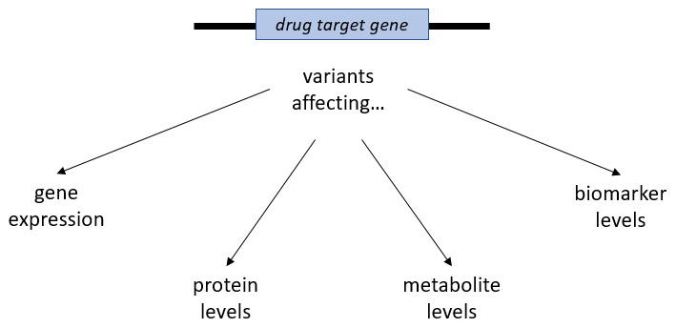
Gill et al Wellcome Open Research 2021

Slide 13
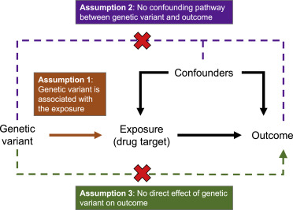
Assumptions of MR
MR assumptions:
1: Genetic variant strongly associates with the exposure (instrument strength: R², F-statistics)
2: Genetic variant does not influence the outcome through a confounding pathway e.g.
3: Effect of genetic variant on outcome is via effect on drug target
Drug target MR tend to use a genetic variants from a single genomic region near the target gene (cis-MR)
Multi-SNP analysis when multiple independent cis-variants exist
Genetic variants need to replicate the effect of the drug
Assumption 3: variant is not associated with outcome though a different pathway
Burgess et al Am J Hum Genet 2023

Slide 14
CAUSAL
PATHWAY
HORIZONTAL PLEIOTROPY – MR ASSUMPTION INVALID
SNP
SNP
Drug target
Drug target
Time sent outdoors
Vitamin-D
Vitamin-D
CVD
CVD

Slide 15
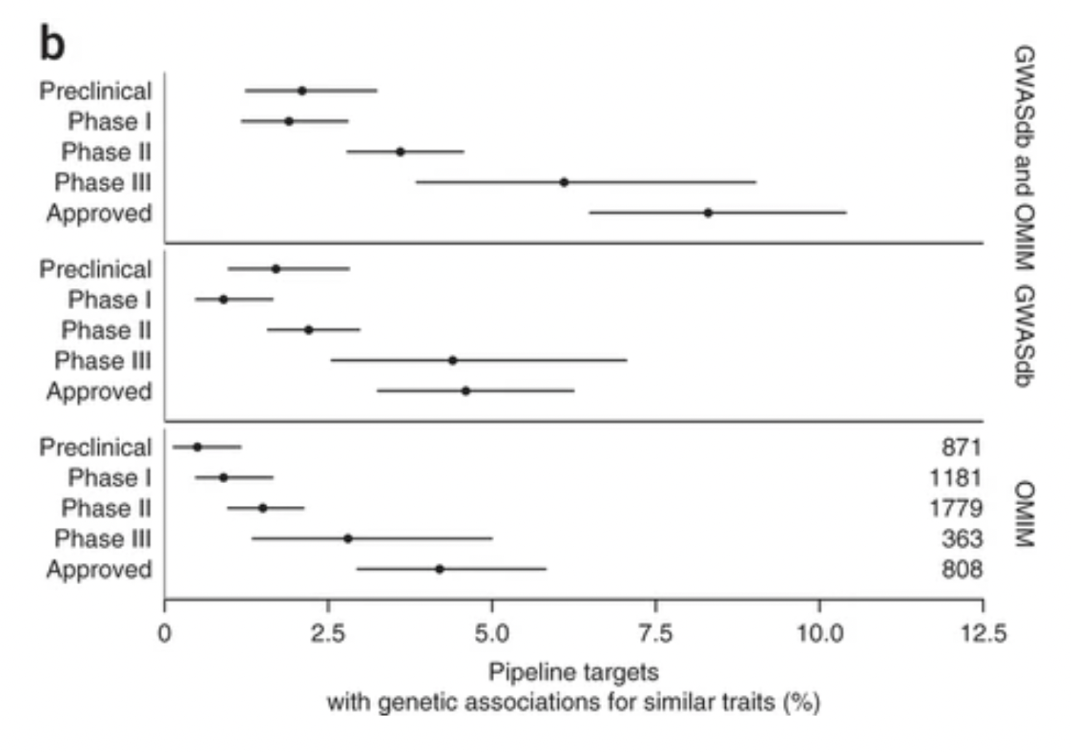
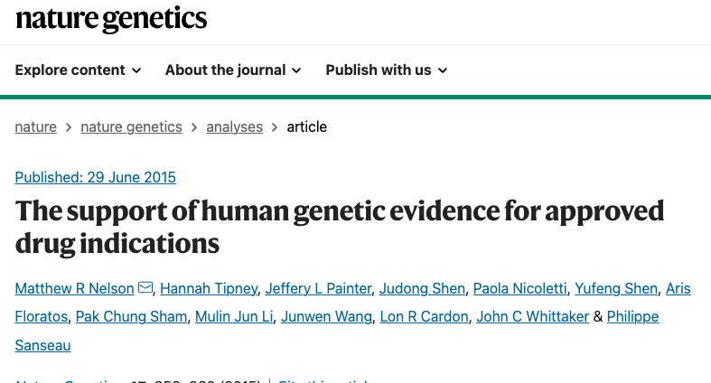
Genetics for drug target validation
Drugs that only progressed until phase I –2.0% had genetic support for target-
Drugs that were approved - 8.2% had genetic support

Slide 16
Example: Darapladib
https://www.fda.gov/media/102332/download

Slide 17
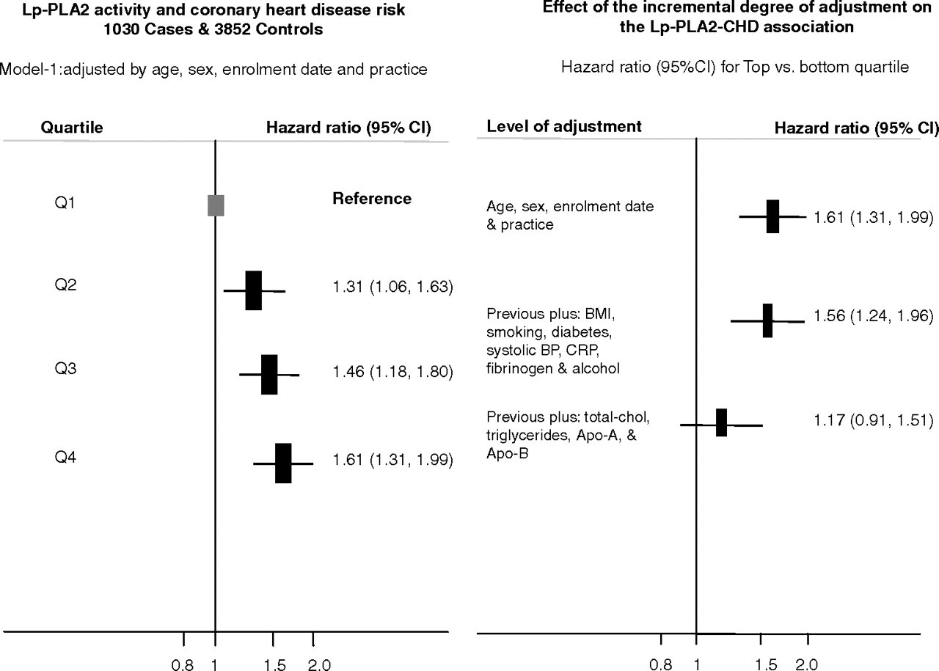
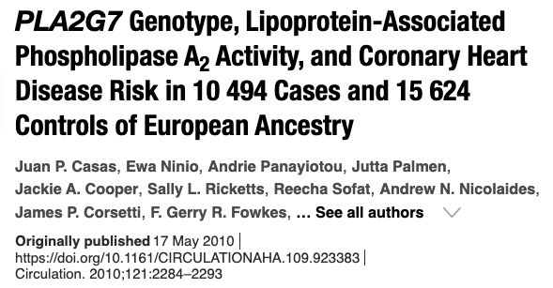
Example: Darapladib

Slide 18
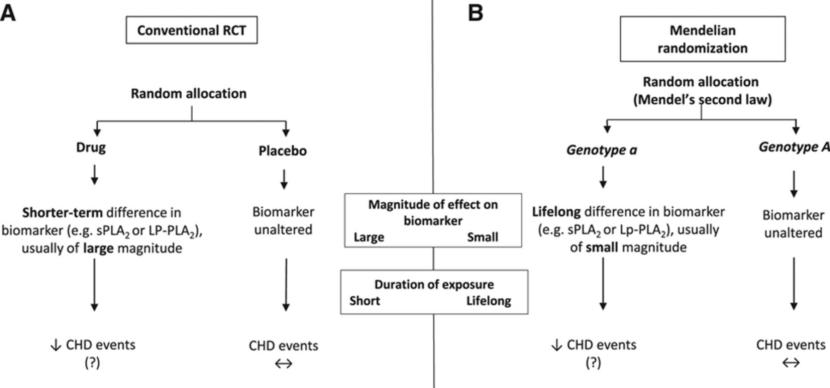
MR to Test Causality of Lp-PLA2

Slide 19
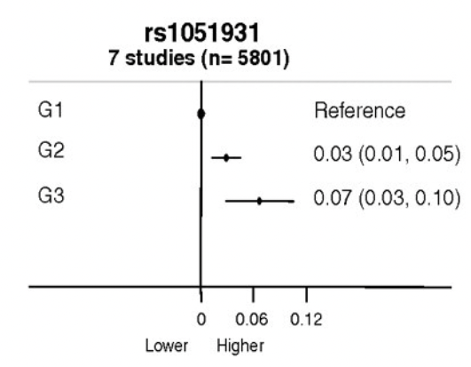
Mean difference (95%C) in log-LpPLA2 activity by PLA2G7 variants
G1: Homozygous common-allele;
G2: Heterozygous;
G3: Homozygous rare-allele

Slide 20
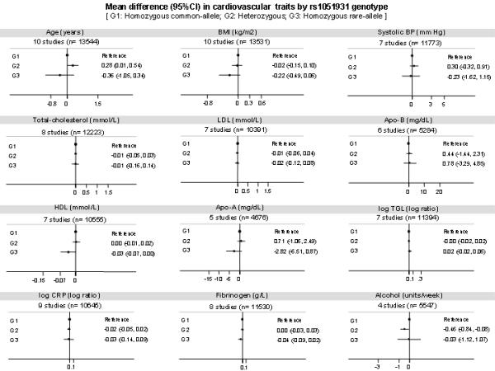
MR instrument not associated with other risk factors

Slide 21
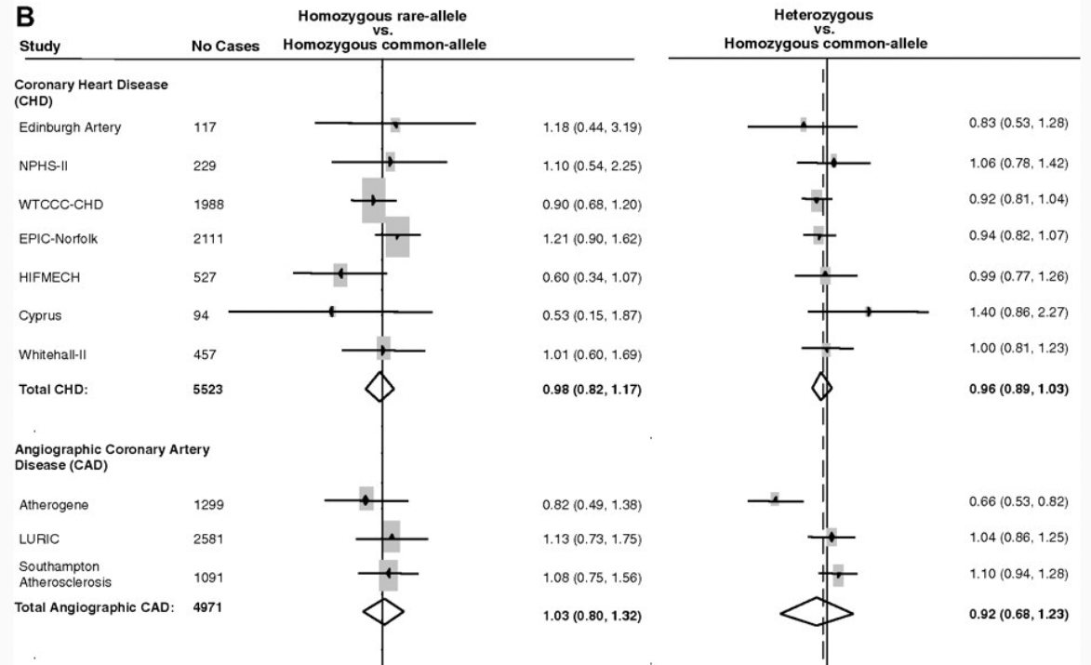
No association of PLA2G7 variant with risk of CHD

Slide 23
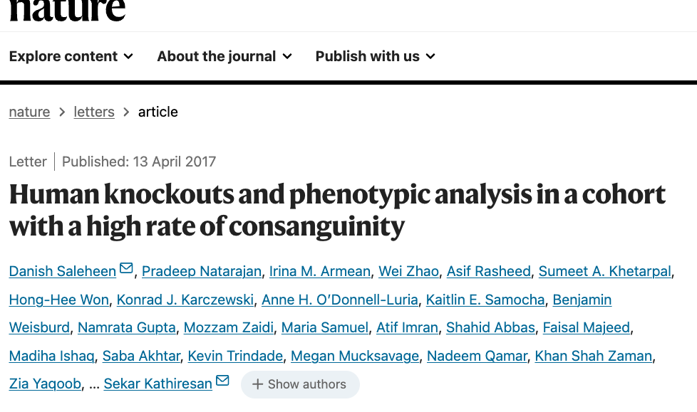
10,503 adult participants in the Pakistan Risk of Myocardial Infarction Study (PROMIS)

Slide 24
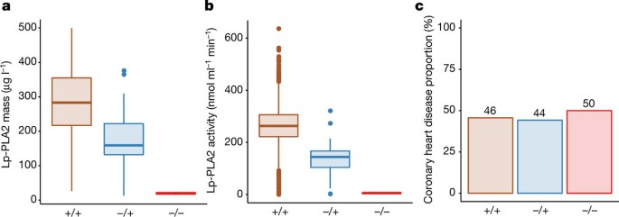
Coming to the same conclusion around Lp-PLA2 inhibition and CAD risk using PLA2G7 rare pLOF in an independent study
Despite substantial reductions of Lp-PLA2 activity, PLA2G7 c.663 + 1G>A heterozygotes and homozygotes have similar coronary heart disease risk when compared with non-carriers (P = 0.87).
Genetic data can help prioritise/de-prioritise drug candidates

Slide 25
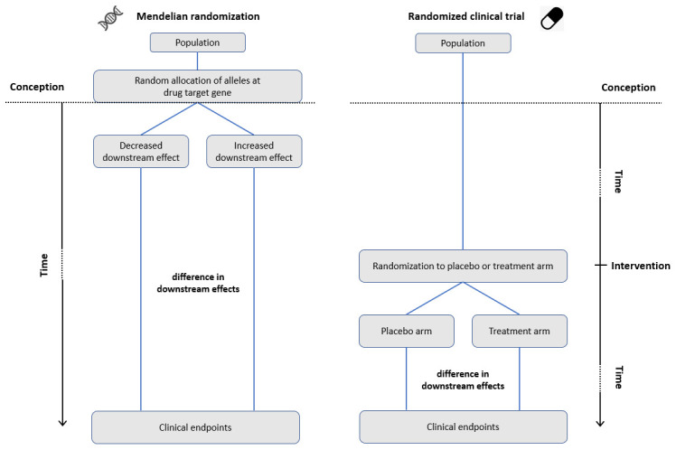
Gill et al Wellcome Open Research 2021

Slide 26
Testing drug safety
RCTs are costly and high risk
Small sample size
Short follow-up time (shorter exposure)
Defined participant criteria (e.g. exclude multimorbid individuals)
Only common and large adverse effects may be observed
Full range of effects (and long term effects) undetected until wider use

Slide 27
Drug safety
FDA announced alerts, warnings, or recalls on about one-third of approved drugs

Slide 28
On- vs off-target effects
Toxicity
Importance of understanding pleiotropic effects of intended drug target – can be explored using MR analyses
Important to understand if the toxic effect is mediated through on- or off-target effects - can be explored using MR if off-targets are known
Pharmacogenetics – differences in drug metabolism and clearance can lead to a higher/lower dose
Image from https://www.semanticscholar.org/paper/Drug-Toxicity.-Taniguchi-Armstrong

Slide 29
MR to assess drug safety – phenome-wide MR
Identifying drug intended and unintended drug targets:
DrugBank
CheMBL
Test causal association using MR on a wide range of phenotypes
And no adverse effects
And no adverse effects

Slide 30
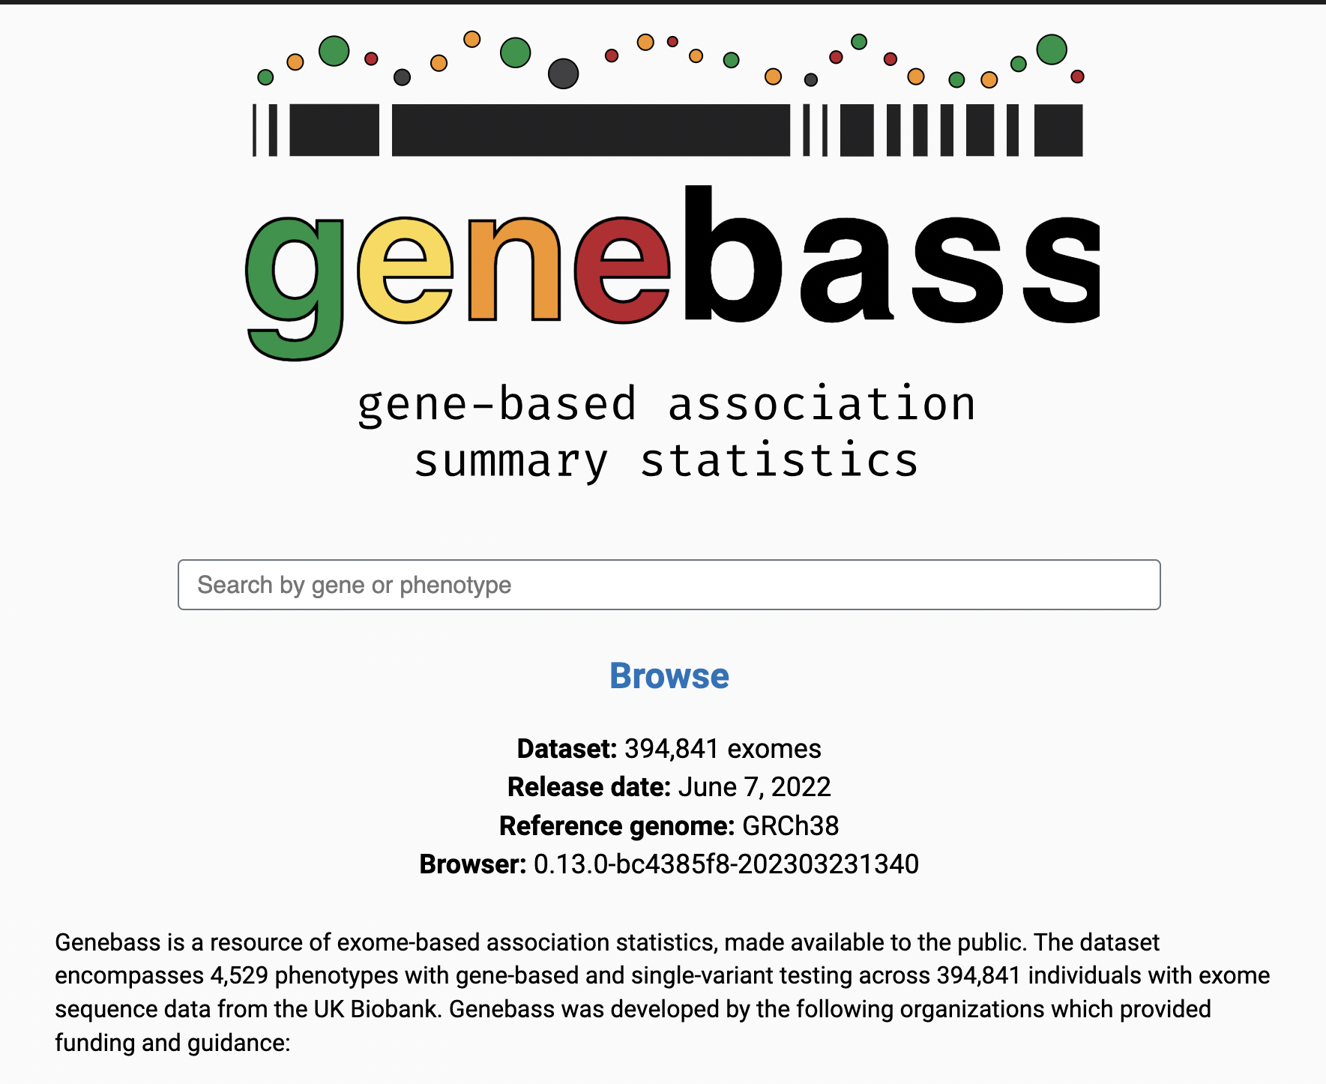
pLOF Gene-based burden test - Genebass

Slide 31
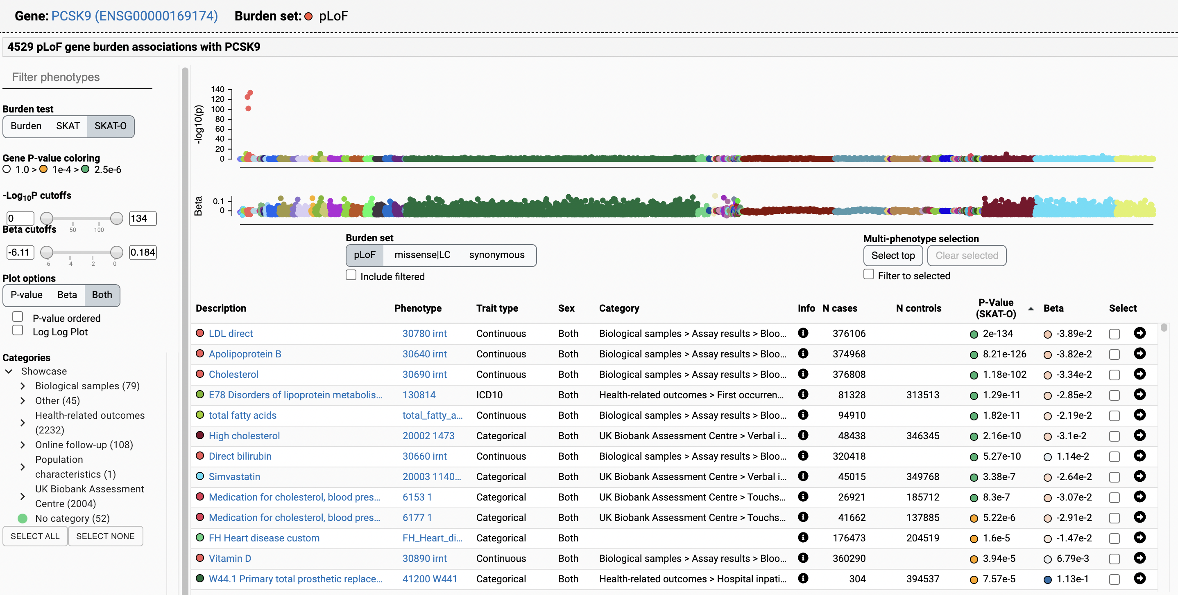

Slide 32
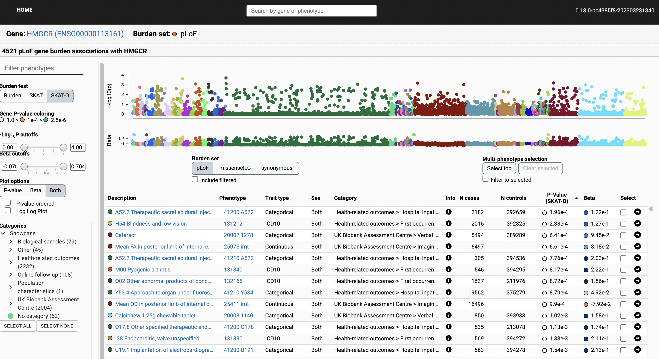

Slide 33
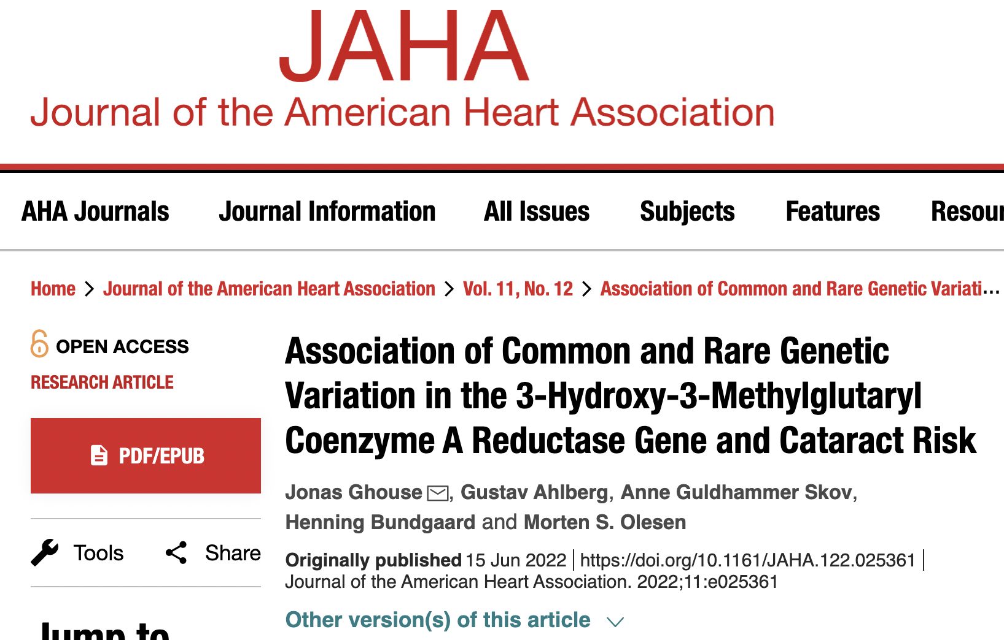
genetically proxied inhibition of the HMGCR gene mimicking long‐term statin treatment associated with higher risk of cataract

Slide 34
MR for drug target validation and safety
MR studies DO NOT replace RCTs, but together with other pre-clinical evidence can be used to prioritise drug targets or perhaps more carefully design RCTs.
Only possible due to large, publicly available GWAS and sequencing studies for 1000s of human traits
Drug target validation - Test for intended effect through intended target
Drug target safety - Test for unintended effects through intended target

Slide 35
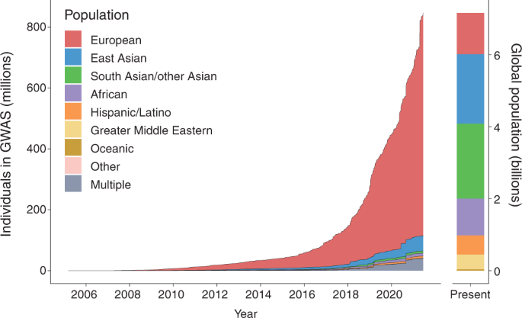
Ancestry-specific considerations
Comparing effects in different ancestral groups
SNPs in ALDH2 allow powerful analyses to investigate effect of alcohol consumption in East Asians. No genetic variants in Europeans that explain a similar proportion of variance in distribution of alcohol consumption.
Need matched ancestry LD reference when doing MR analyses
Need more GWAS data in non-European population
Fatumo et al Nature Medicine 2021

Slide 36
Importance of pharmacogenetics and diversity in clinical trials

Slide 37
Reducing risk of failure
Improved pre-clinical prediction of drug target effects in humans
Genetic support for gene-trait association
Repositioning of approved drugs - reduces risk of failure due to safety concerns

Slide 38
Summary-based MR analysis (SMR)

