Slide 1
Gene expression signature matching for identifying drug candidates

Slide 2
Lecture Overview
Part 1
Gene signature matching
A database of compound gene signatures – CMap
Part 2
Generating a disease gene signature
Querying CMap
2

Slide 3
GWAS to medicine
Genetic variants
Disease genes
Drug candidates
Are GWAS-significant genes targets of existing drugs (identify drug repurposing candidates)
  Repurposing FDA-approved compounds – better safety profile, lower risk, shortest path to approval
  Screening failed drugs against new indications - benefit–risk profile may vary depending on the unmet medical need e.g. thalidomide has been approved for use in multiple myeloma
  But…
    Identifying the causal gene from GWAS is not trivial
    Drugs with unknown mechanism of action (MoA) will be missed with this approach
    Important disease biology may be lost under stringent p-value thresholds

Slide 4
Gene expression signature matching
4

Slide 5
Gene expression signature matching
If we have a database of gene expression signatures for drugs, we can:
Identify disease drug candidates
Compounds that ‘reverse’ gene expression changes associated with disease
Does not require knowledge of the drug’s MoA
Requires gene expression signatures for disease of interest
Understand MoA of a compound including potential adverse effects
Assumption: compounds with similar gene expression responses have common MoA.

Slide 6
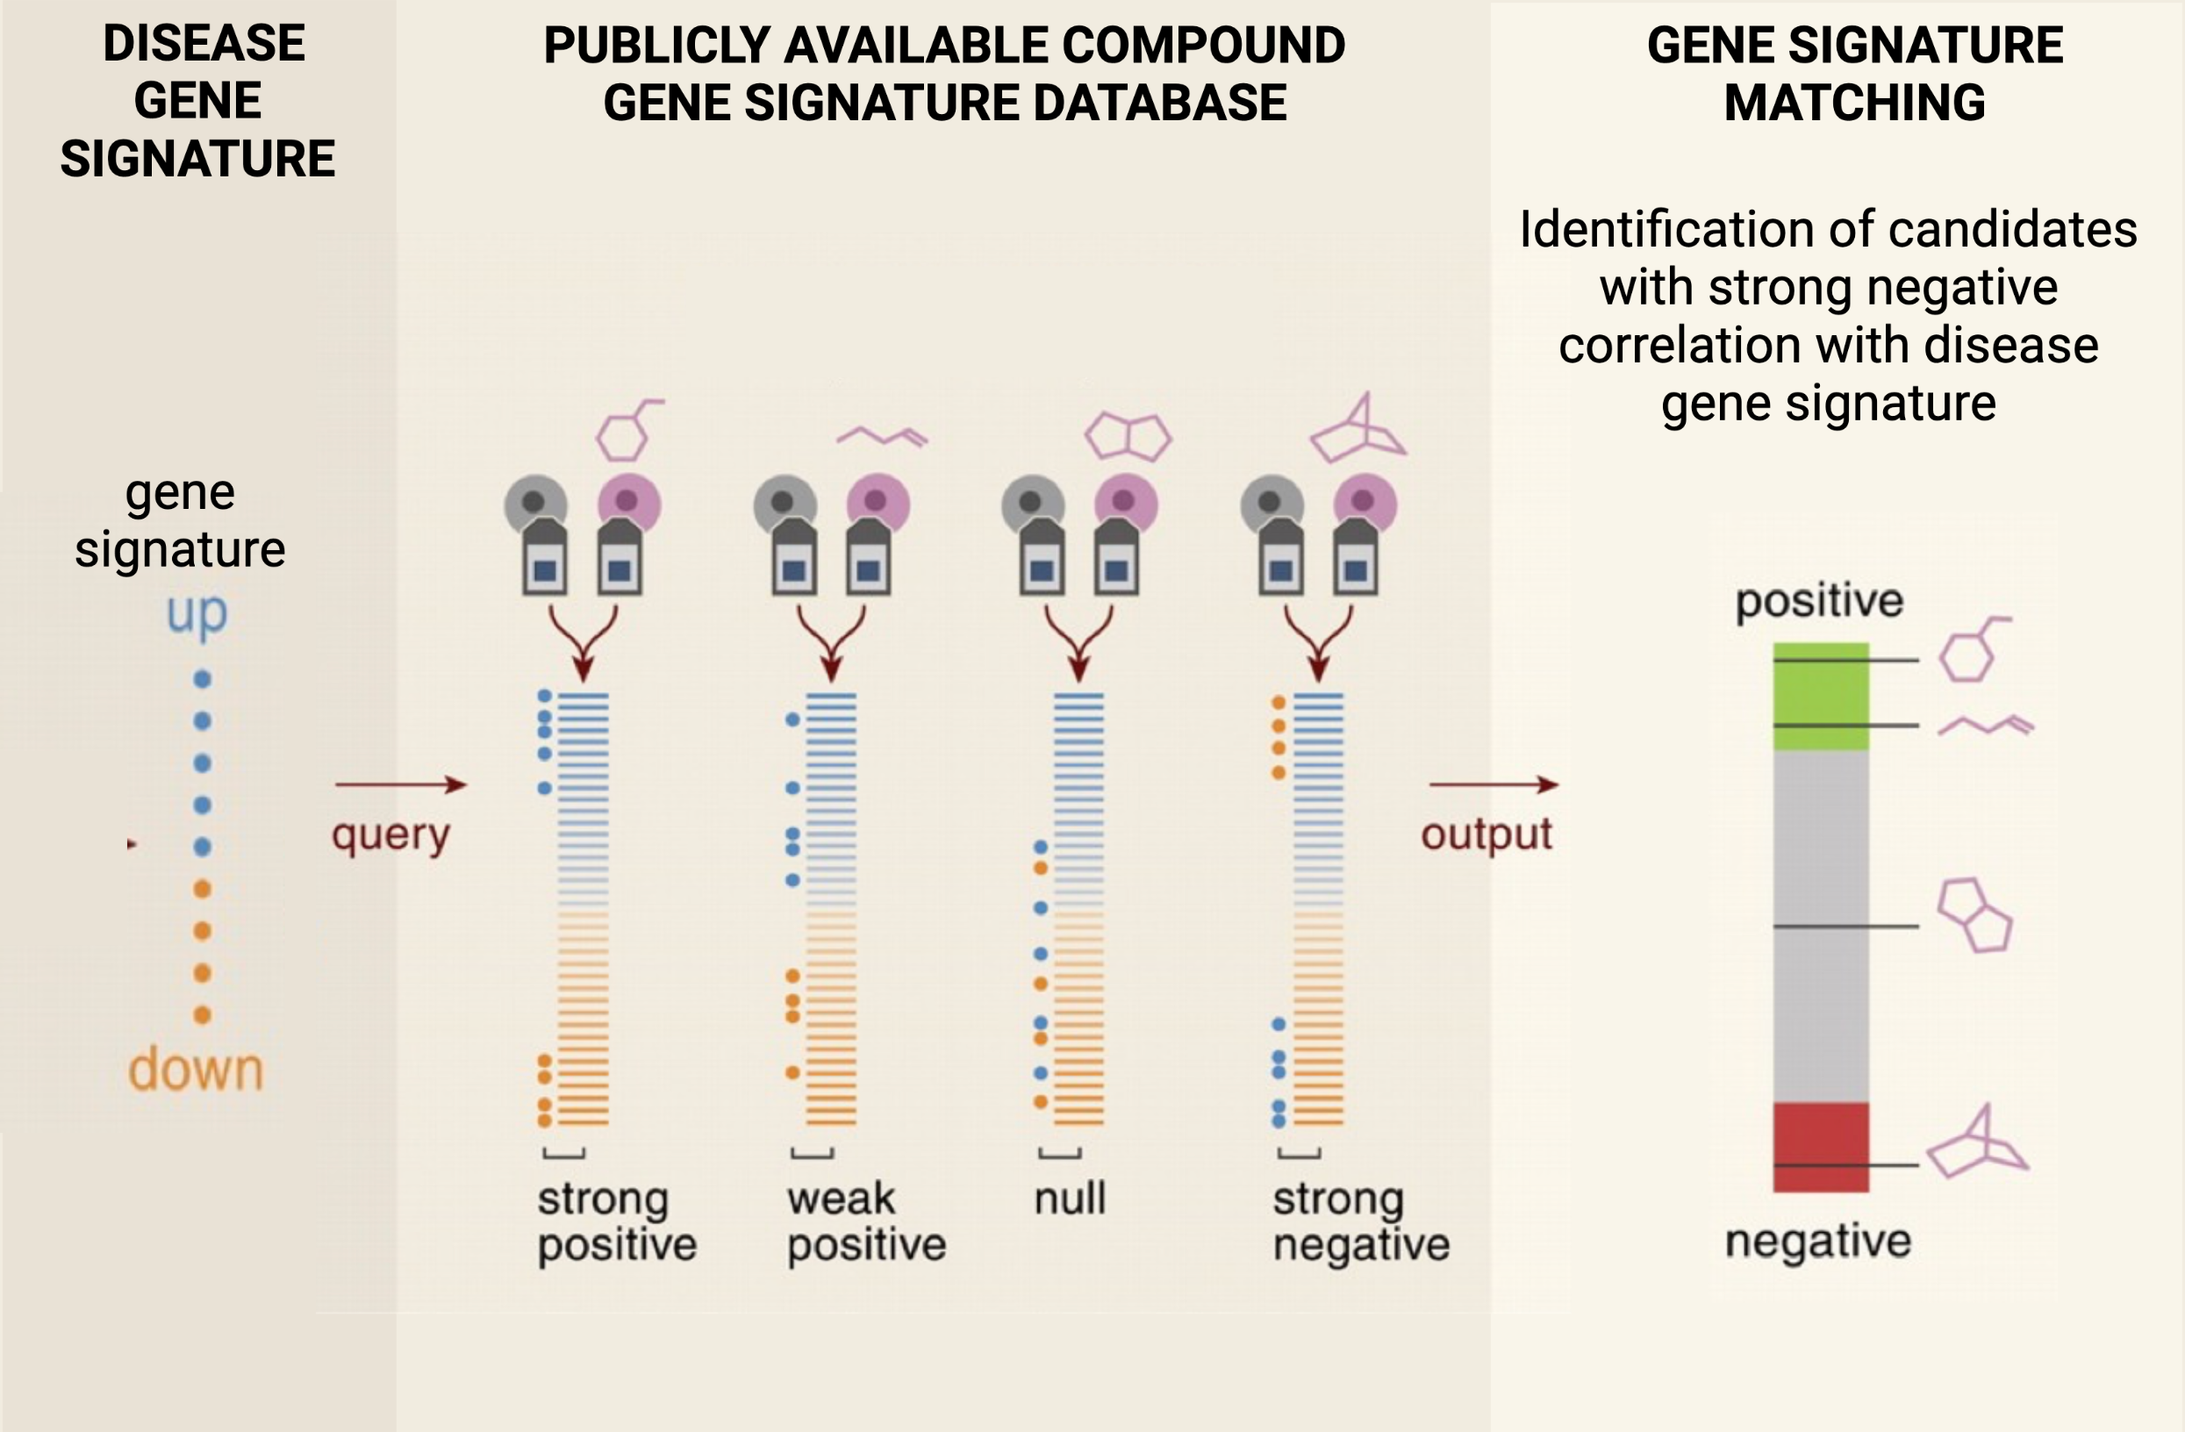
NOVEL COMPOUND OR DISEASE GENE SIGNATURE
COMPOUND RANKING
Potential MoA for novel compound: Compounds with strong positive correlation with query signature
Compound signature
Disease drug candidates:
Compounds with strong negative correlation with disease signature

Slide 7
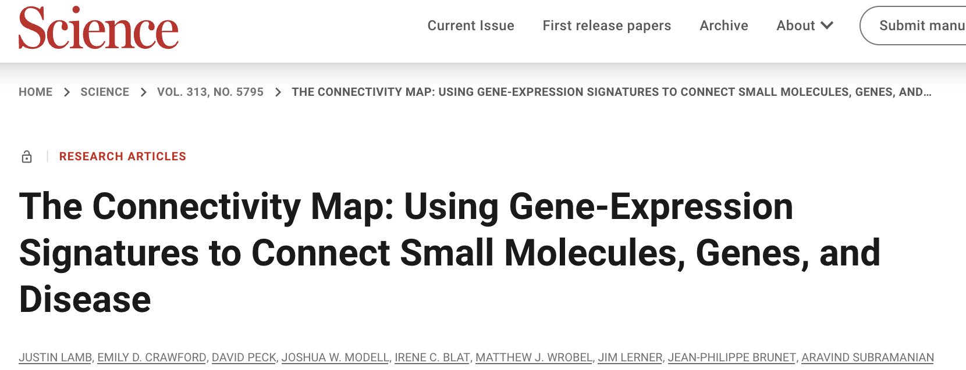
Connectivity Map (CMap)
Library of gene expression signatures in response to chemical and genetic perturbation.
>1 million gene expression profiles
~50 different cell lines
~20,000 compounds (chemical perturbation)
~5,000 knockdown/overexpression (genetic perturbations)
https://www.broadinstitute.org/connectivity-map-cmap

Slide 8
1st Generation CMap - Lamb et al Science 2013
Need to establish the relation among diseases, physiological processes, and the action of small-molecule therapeutics.
Previous compound and genetic perturbation studies in yeast and rats
  Translation to humans
  High cost of animal studies
Mammalian cells
  Generalisable, systematic and biologically relevant
  BUT…a large number of parameters would need to be optimized for each perturbation – cell type, dose, duration
Pilot study demonstrated the feasibility of this approach

Slide 9
1st Generation CMap - compounds
164 distinct small-molecule perturbagens, selected to represent a broad range of activities:
FDA–approved drugs
nondrug bioactive ‘‘tool’’ compounds
multiple compounds sharing molecular targets (test if they share gene signatures e.g. HDAC inhibitors)
compounds with the same clinical indication (test whether compounds with different MoA that treat the same disease generate similar gene signatures e.g. antidiabetics)
Molecules that are proximal (e.g. selective estrogen receptor modulators) and distal to gene expression
Molecules whose targets are not expressed in the cell types being tested (COX2 inhibitors)

Slide 10
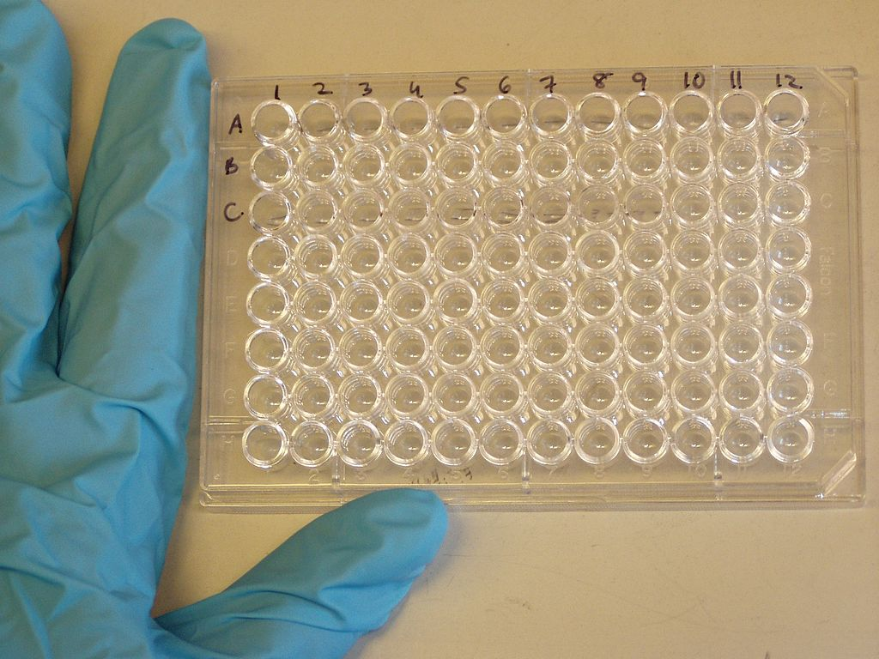
1st Generation CMAP – cell lines
Stably grown over long periods of time
Amenable to culture in microtiter plates
breast cancer epithelial cell line MCF7
  extensively molecularly characterised,
  used as a reference cell line
prostate cancer epithelial cell line PC3
nonepithelial lines HL60 (leukemia) and SKMEL5 (melanoma)
Assess degree to which gene signatures are context-dependent

Slide 11
1st Generation CMAP – dose and duration
10uM – optimal concentration is not known for many compounds
  Toxicity studies required for proper optimisation of dose
6 and 12 hrs post-treatment
  Profiles obtained too early might not yield robust signals—esp for perturbations that do not directly modulate transcription
  Profiles obtained too late may reflect secondary and tertiary responses
  obtain signatures related to direct mechanisms of action
Dose and duration dependent on question of interest, but difficult to optimise in such high-throughput experiments.

Slide 12
Compound gene signature generation
Control perturbations for each treatment (cells grown on the same plate treated with vehicle only)
  minimize the impact of batch-to-batch
  biological and technical variation
Replicates
Data were collected in multiple batches over a period of 1 year by Affymetrix GeneChip microarrays.
DEG analysis – compound-treated gene expression vs intra-batch vehicle-treated control
For each treatment ~22,000 genes rank-ordered according to differential expression

Slide 13
Can gene expression signature matching a) identify MoA of a compound? b) identify drug candidates for disease?

Slide 14
Connectivity score - metric for signature similarity
Rank-based pattern-matching strategy based on the Kolmogorov-Smirnov statistic
Determine if the most significant DEGs in query gene set are randomly distributed in the reference compound signature
Enrichment score - reflects the degree to which your query gene set is overrepresented in the extremes of the ranked reference gene signature

Slide 15
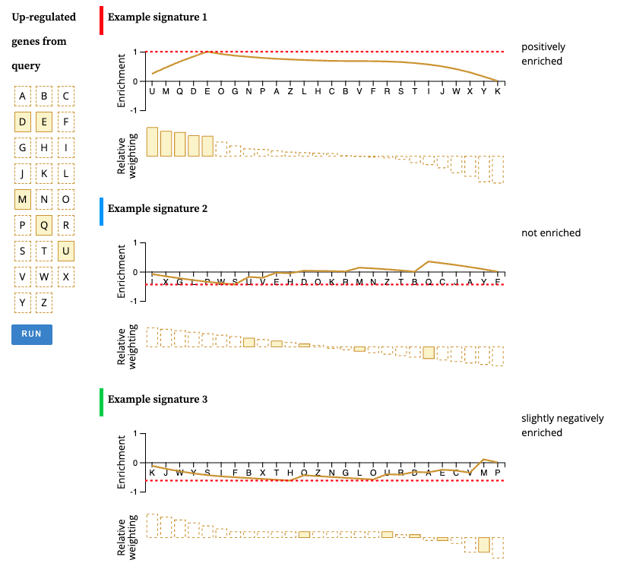

Enrichment score
1. Walk down the ranked gene list for reference signatures
2. increase a running-sum statistic if the gene is in query gene list and decrease the sum if not - magnitude of the increment depends on the gene z-score
3. The enrichment score is the maximum deviation from zero encountered in the random walk
3. Calculate score for up-regulated and down-regulated genes separately.
https://clue.io/connectopedia/cmap_algorithms

Slide 16
Connectivity score - metric for signature similarity
Measures of confidence:
Nominal p-value - comparing similarity of query and reference signature to null distribution of random queries, using KS enrichment statistic
Tau score – compares an observed enrichment score to all others in the database - a standardized measure ranging from -100 to 100. A Tau of 90 indicates that only 10% of signatures in the database had a stronger connectivity to the query than the compound in question.

Slide 17
Example results – HDAC inhibitors
HDACs – remove acetyl groups on histones and regulate gene expression
Query HDAC signature derived from independent study:
  response of bladder and breast cancer cells treated with 3 HDAC inhibitors (vorinostat, MS-27-275, trichostatin)
  13-gene (8 up and 5 down-regulated) signature
Determine if a query signature can recover compounds from the same class (same MoA).

Slide 18
Compounds with HDAC inhibitory effects shown by black lines
Despite differences in cell lines used to generate query signature, the approach identifies HDAC inhibitors as the top scoring compounds.
Not highly sensitive to concentrations
Strong connectivity with two structurally distinct compounds, valproic acid (developed as an antiseizure drug) and HC toxin, both now known to have HDAC-inhibitory activity
(green, positive; gray, null; red, negative

Slide 19
Example - Estrogens
Estrogen – modulates nuclear hormone signaling by binding to estrogen receptor.
Query signature from an independent experiment – MCF7 cells treated with 17beta-estradiol
  129-gene signature (40 up and 89 down-regulated)

Slide 20
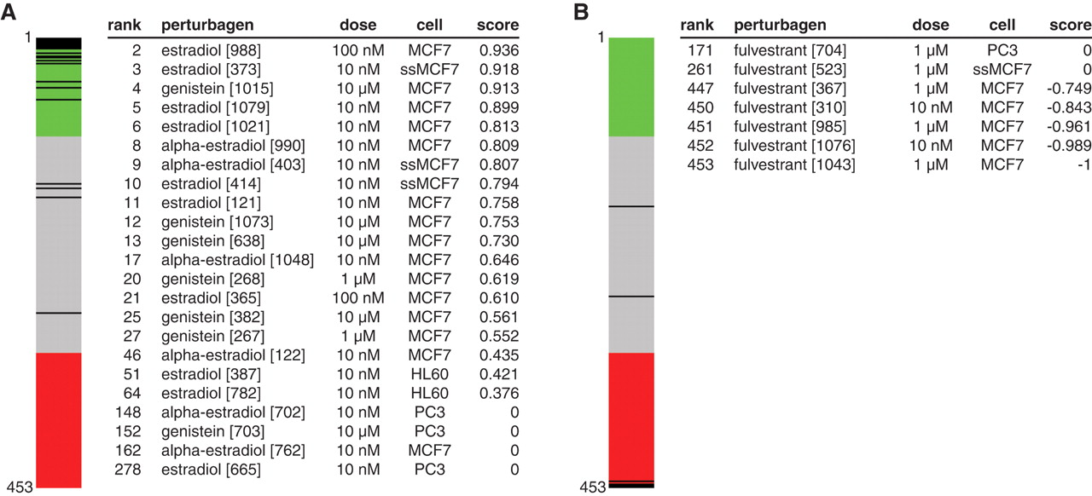
no robust connections recovered in PC3 or HL60 cells, neither of which expresses ER.
highest negative connectivity scores came from fulvestrant, a known anti-estrogenic drug

Slide 21
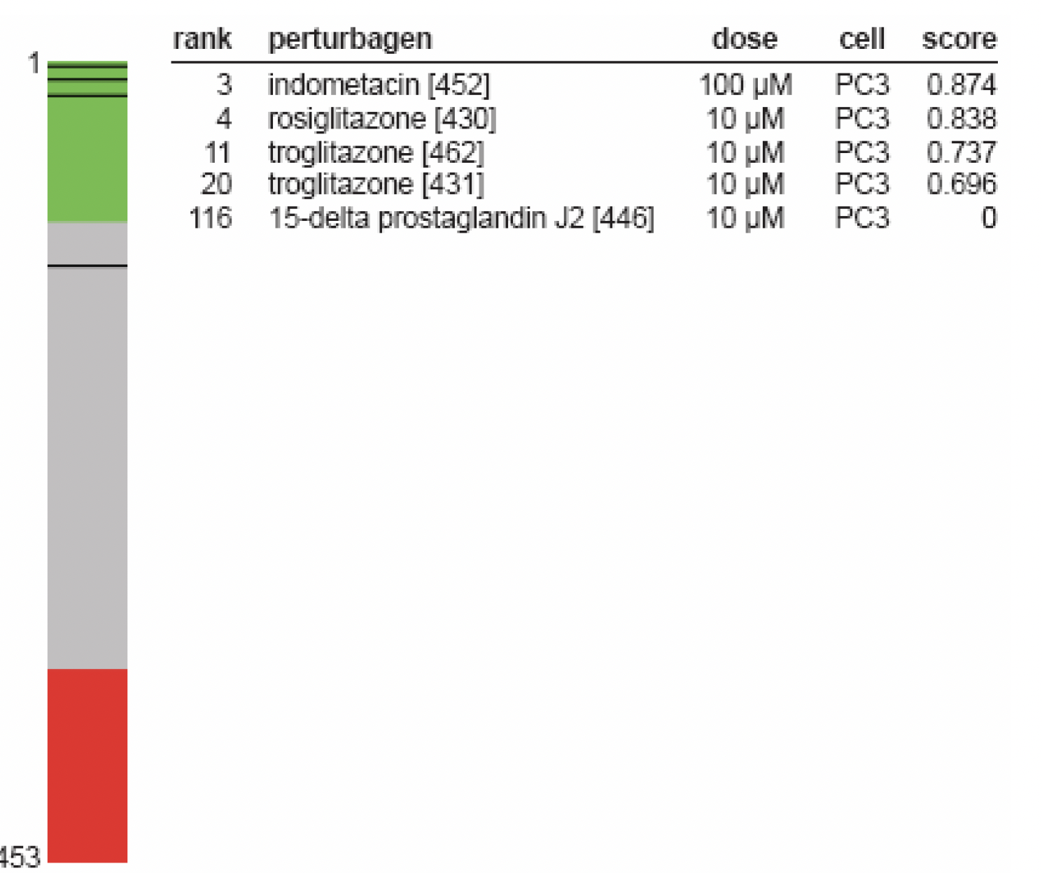
Connections with Disease States
Query – DEGs from a rat model of diet-induced obesity
Several differences in exp design:
  Species: Rat vs human,
  Exposure duration: 65 days vs 6 hrs
  Tissue: adipose vs cancer cell line
3 PPAR-gamma agonists identified
PPAR-gamma agonists are known potent inducers of adipogenesis in vitro
Troglitazone and rosiglitazone are anti-diabetic treatments, with weight-gain as a known major side effect
BUT…null or negative scores in non-PC3 cell lines, (only PC3 expresses PPAR-gamma)

Slide 22
Findings from CMap pilot study
Gene expression signatures can
Identify drugs with common MoA
Identify unknown MoA of drugs
Identify potential new therapeutics for disease
Are often conserved across diverse cell types and settings
  Drug target needs to be expressed in that cell line
Not highly sensitive to the precise concentration of drug

Slide 23
2nd Generation CMAP - LINCS1000
Library of Integrated Network-Based Cellular Signatures
1000-fold scale up of the CMAP – more compounds and cell lines plus genetic perturbations.
Gene arrays and RNAseq not suitable for large-scale profiling
  High cost
  RNAseq cannot detect low abundant transcripts without deep sequencing which is costly

Slide 24
2nd Generation CMAP - LINCS1000
Capture cellular state at low cost by measuring a reduced representation of the transcriptome.
Analysed 12K Affy HGU133A expression profiles in GEO
  Identified the optimal number of informative transcripts (“landmark” transcripts)
  Cost vs information captured
  1000 landmarks enough to capture 82% of full transcriptome
Tested ability of different number of landmark genes to recover connections observed in pilot data (for 25 signatures)
No substantial enrichment of particular protein class or developmental lineage in landmark list (some generic classes enriched e.g. enzyme binding, ATP binding).

Slide 25
Comparison of L1000 with RNAseq
strong degree of similarity of profiles across L1000 and RNA-seq platforms

Slide 26
CMap-L1000v1
19,811 compounds profiled in triplicate (at 6 and/or 24 hrs)
Genetic perturbation (KD or overexpression) of 5075 genes measured after 96 hrs (triplicates)
77 cell lines
470K gene signatures from ~42K perturbagens – 1000-fold increase of CMap pilot dataset.
All data (at multiple processing levels) available in GEO (GSE92742)
Web-based tool to query database http://www.ilincs.org/ilincs/signatures/main

Slide 27
CMap-L1000v1
37% of compounds showed no evidence of connection to their expected targets
  Incomplete inhibition of the target
  Off-target effects of compounds and genetic perturbations
  Missing information in the L1000 readout
  Incorrect literature-based annotations of compounds
  Existence of unknown, true connections - novel connections may be stronger than known connections

Slide 28
Generating disease gene expression signatures for querying CMap
28

Slide 29

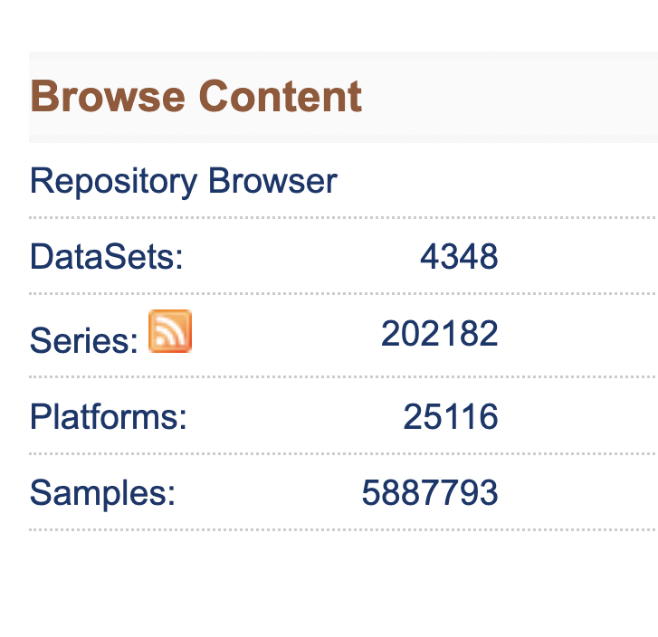
1. Gene Expression Omnibus
https://www.ncbi.nlm.nih.gov/geo/
Public repository of microarray, next-generation sequencing, and other forms of high-throughput functional genomic data
Allows differential gene analysis of data
  Select significance threshold, fold change threshold, multiple correction method
Provides R-script for analysis

Slide 30
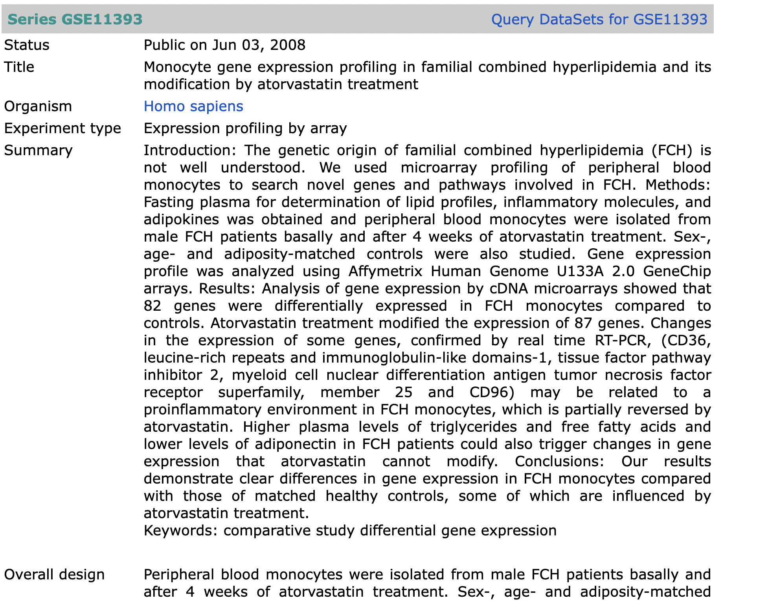

Slide 31
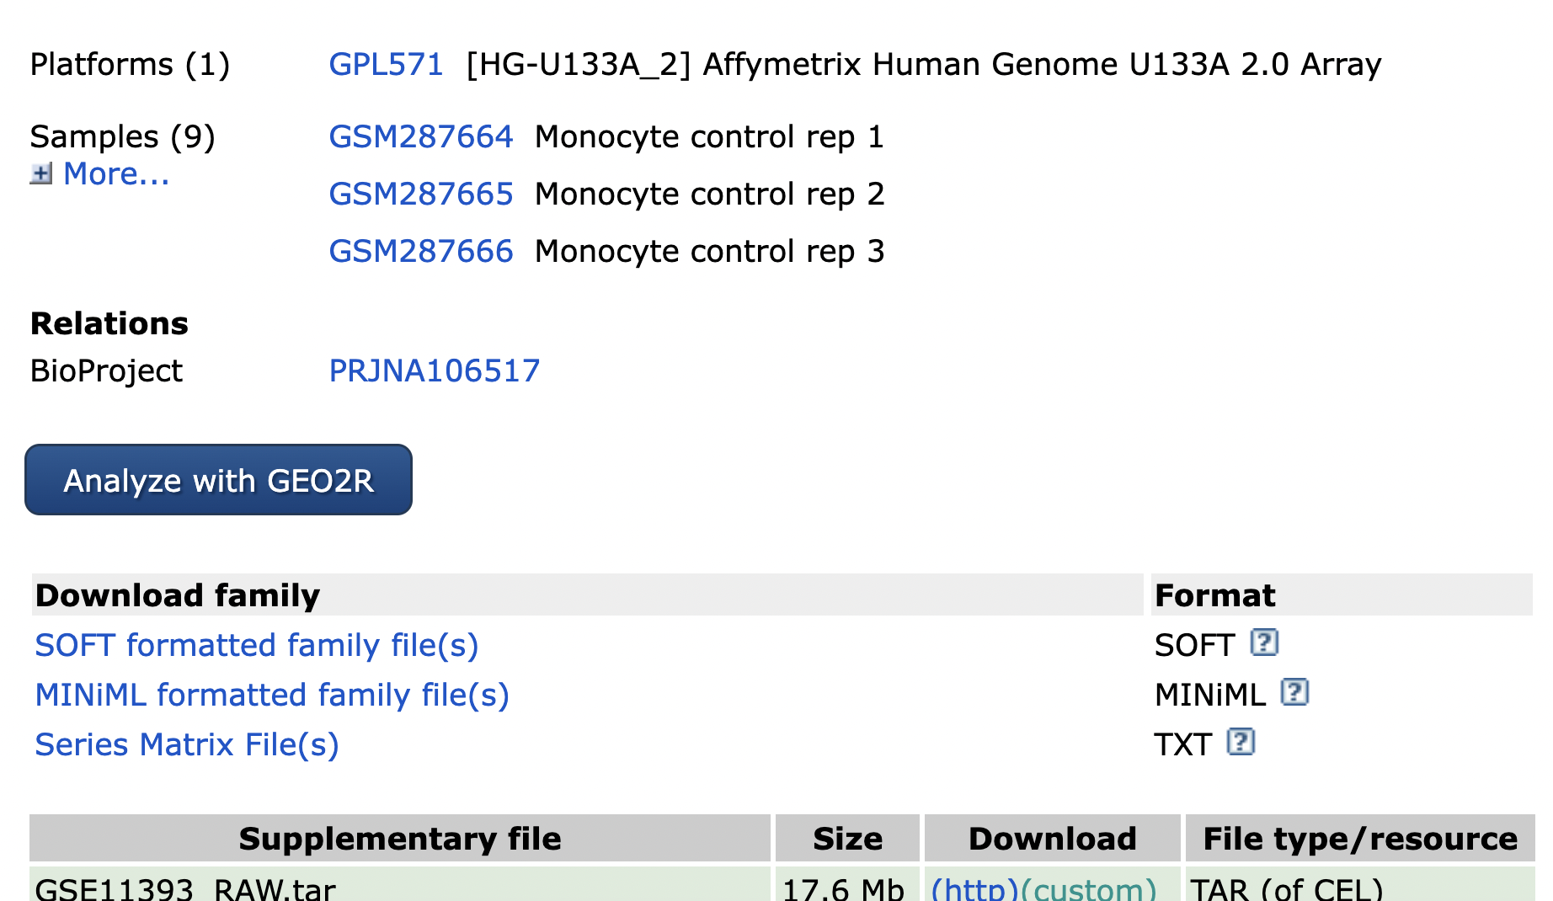

Slide 32
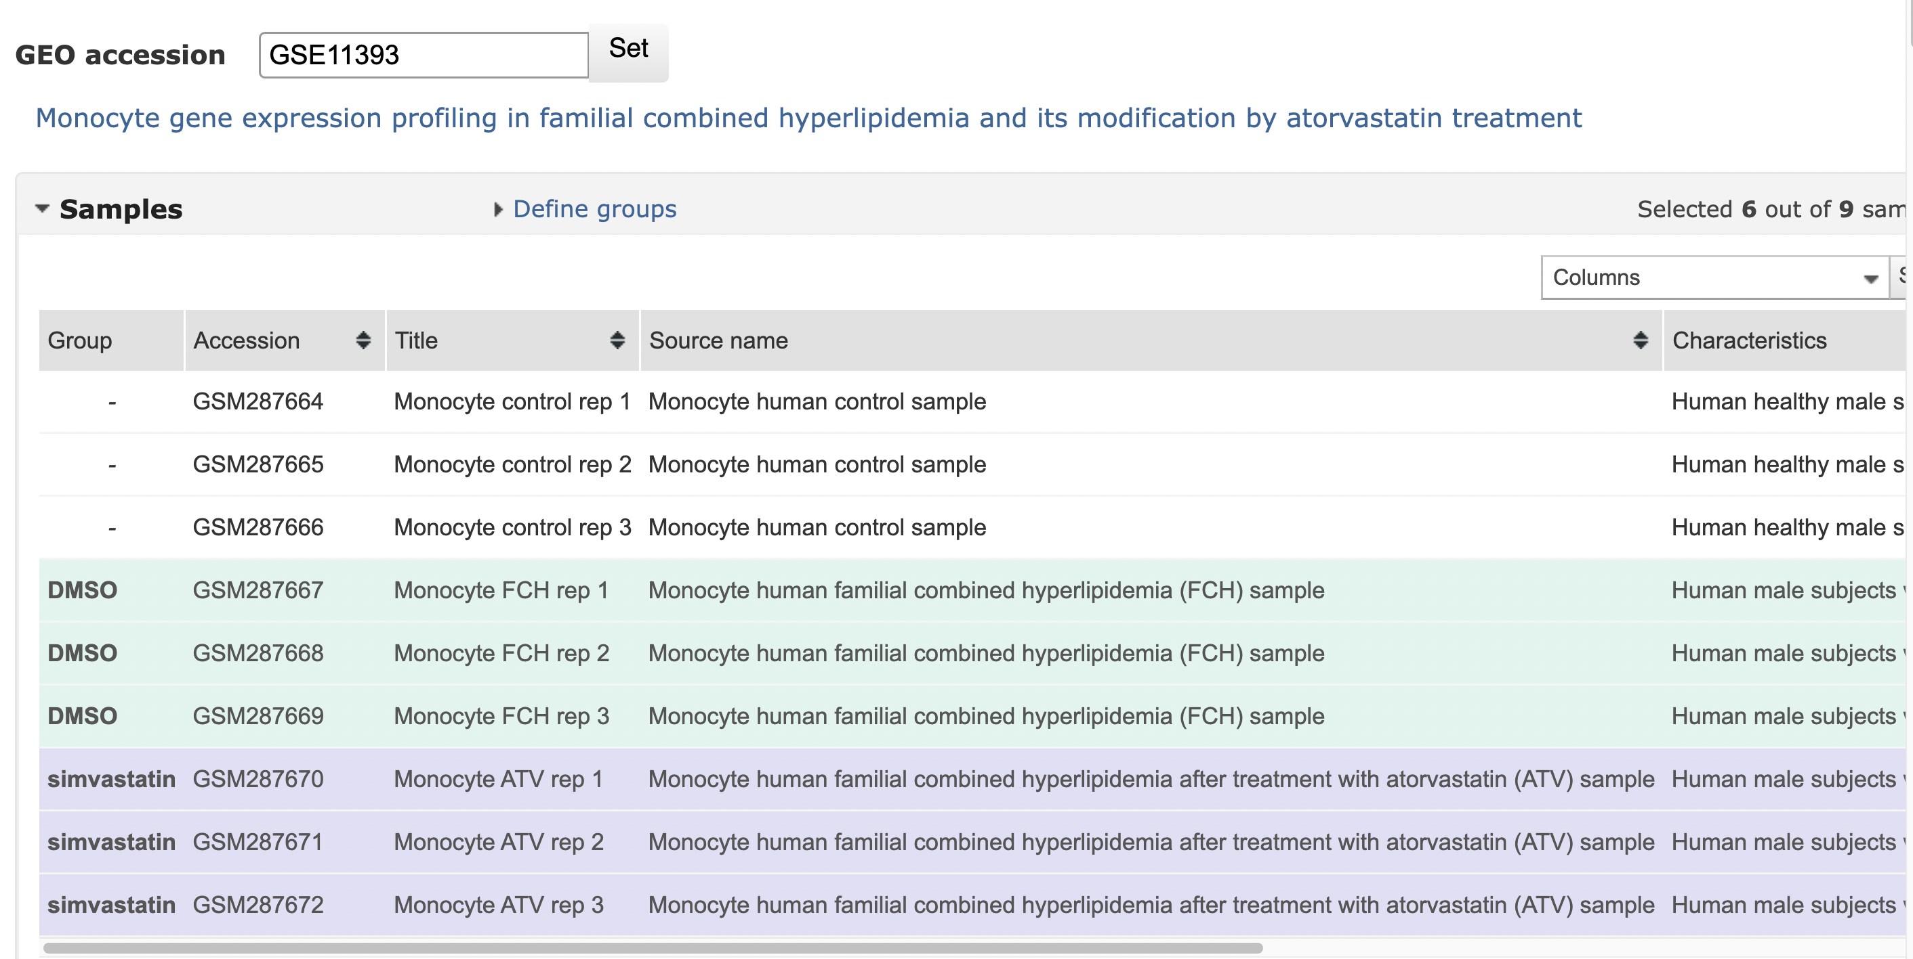

Slide 33
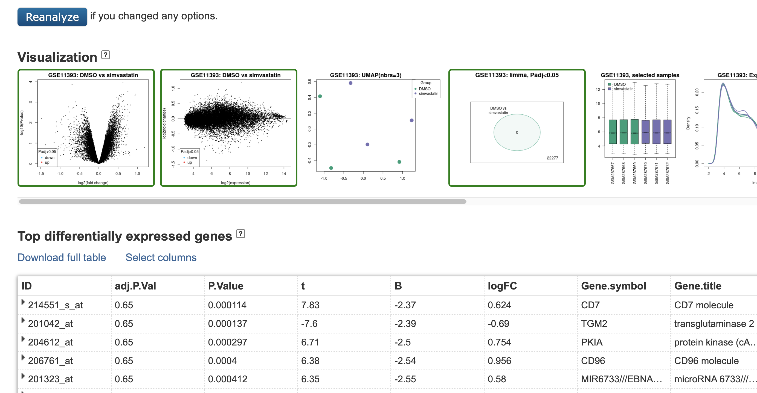

Slide 34
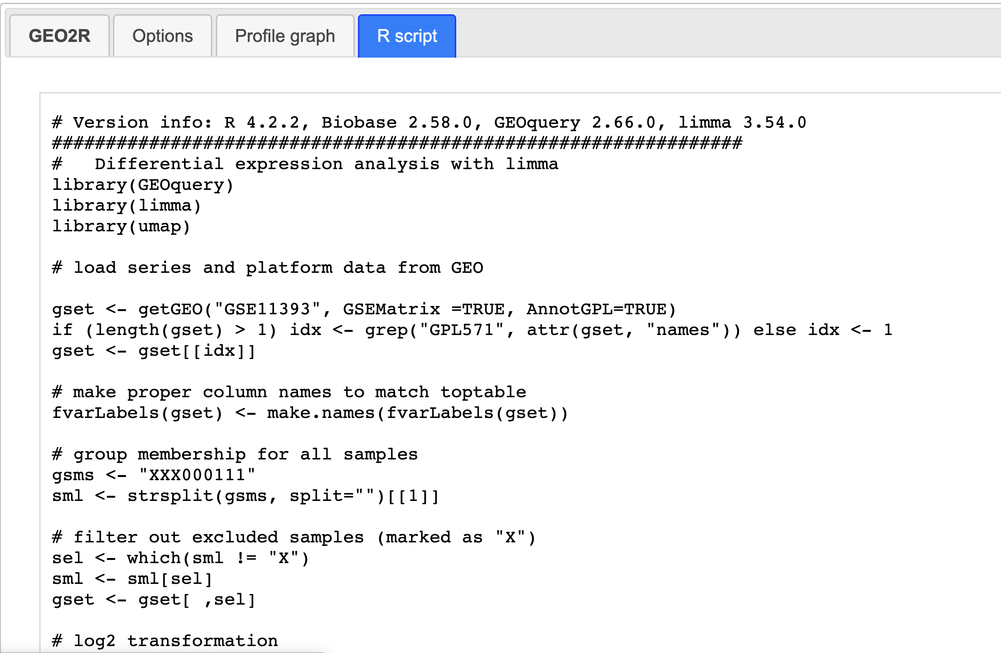

Slide 35
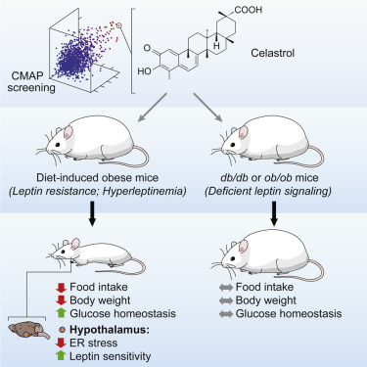
2. Your own experiments
Liu et al 2015 Cell
Aim: Identify potential drug candidates for reducing ER stress and obesity
Endoplasmic reticulum (ER) stress tightly linked to obesity.
Gene signature - Induced ER stress in mice and measured transcriptional response in the livers of these mice.
Query CMAP - Celastrol (extract from Thunder god vine plant)
Validation in mice studies - Celastrol increases leptin sensitivity to suppress food intake in mice.
ERX Pharmaceuticals (founded in 2014) currently testing leptin sensitisers in Phase I clinical trials.

Slide 36
2. Your own experiments
Gene expression differences in cases vs controls
dataset1 | Trait | g1 | g2 | g3
ind1 | 1
ind2 | 0
ind3 | 1
 | b | se | pval
g1
g2
g3
Differential gene expression between cases and controls – represents both causal and consequential changes

Slide 37
3a. Gene expression signature prediction from individual-level GWAS data - PrediXcan
dataset1 | Trait | g1 | g2 | g3
ind1 | 1
ind2 | 0
ind3 | 1
 | b | se | pval
g1
g2
g3
Gene expression associated with trait
dataset 2
eQTL data, training data for prediction model
dataset1 | Trait | SNP1 | SNP2 | SNP3
ind1 | 1
ind2 | 0
ind3 | 1
 | Trait | ĝ1 | ĝ2 | ĝ3
ind1 | 1
ind2 | 0
ind3 | 1
Genetically-predicted gene expression

Slide 38
3b. Gene expression signature prediction from GWAS summary data using S-PrediXcan
Requires 3 datasets
  GWAS data for phenotype of interest
  Expression QTL training set e.g. GTEx
  Population reference (e.g. 1000 Genomes)

Slide 39

3b. Gene expression signature prediction from GWAS summary data using S-PrediXcan
w_{gi} weight given to each SNP for predicting expression level of g
Precomputed weights derived from a reference eQTL dataset e.g. GTEx
Association of gene g expression with phenotype:
+ve z-score: increased gene expression associated with increased phenotype or risk of disease
Effect size (and SE) of SNP_{i} on phenotype obtained from GWAS
Assuming set of SNP_{1..k} contribute to the expression of gene g
Variance of SNP_{i} (from reference genotype data) and variance of predicted expression of gene g from GTEx

Slide 40
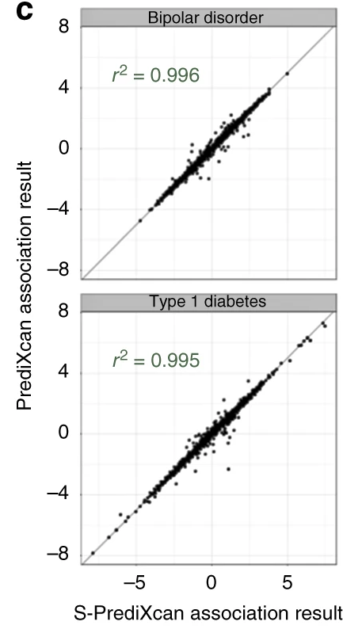
Comparison of PrediXcan and S-PrediXcan gene z-scores
Wellcome Trust Case Control Consortium (WTCCC) data
https://www.nature.com/articles/s41467-018-03621-1

Slide 41
Querying CMap data with iLINCs http://www.ilincs.org/ilincs/
41

Slide 42
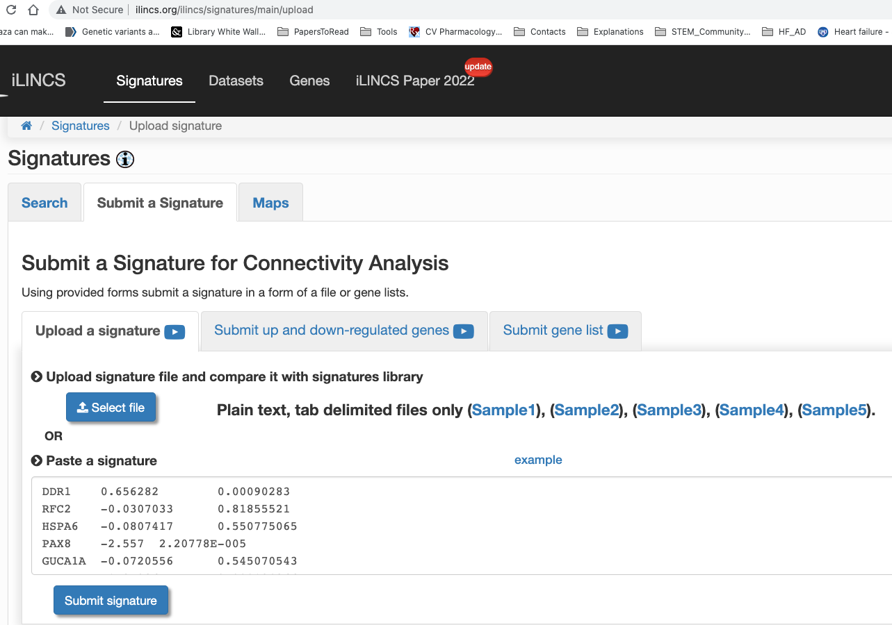

Slide 43
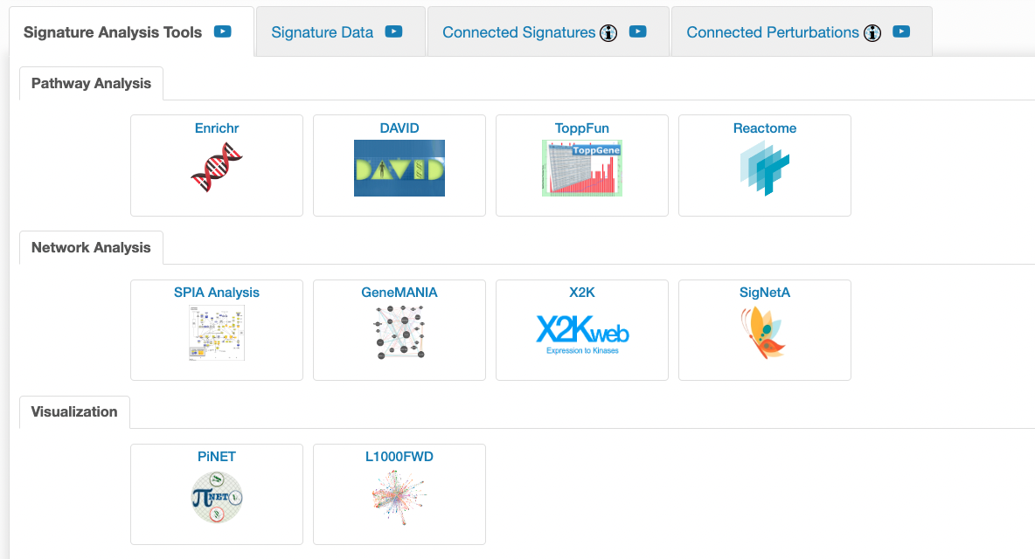
Background gene list very important when doing functional/pathway enrichment analysis.
For CMap data, background list is not all genes in the human genome, rather all genes profiled in CMap (~12,000 genes))

Slide 44
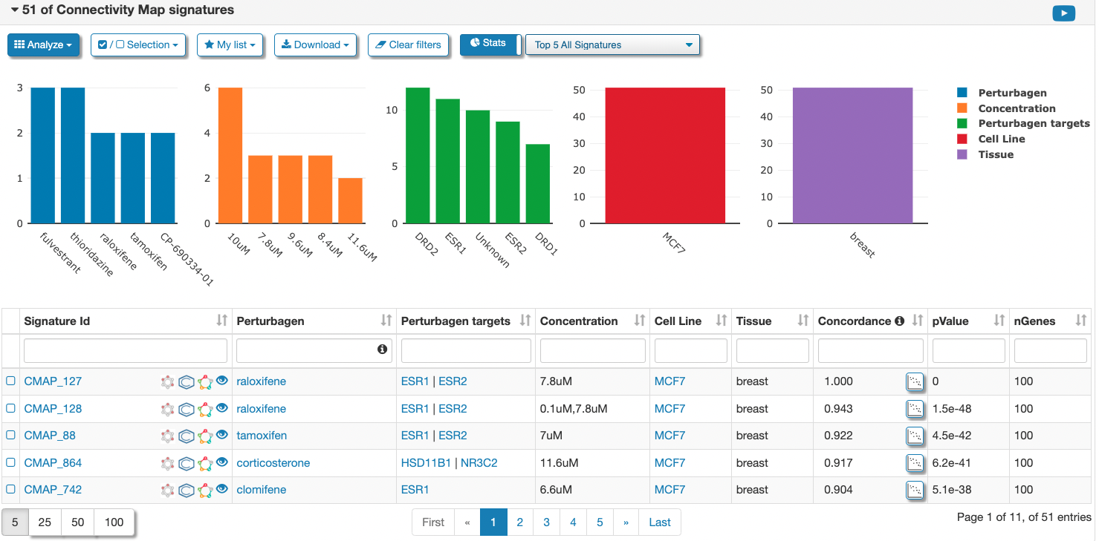

Slide 45
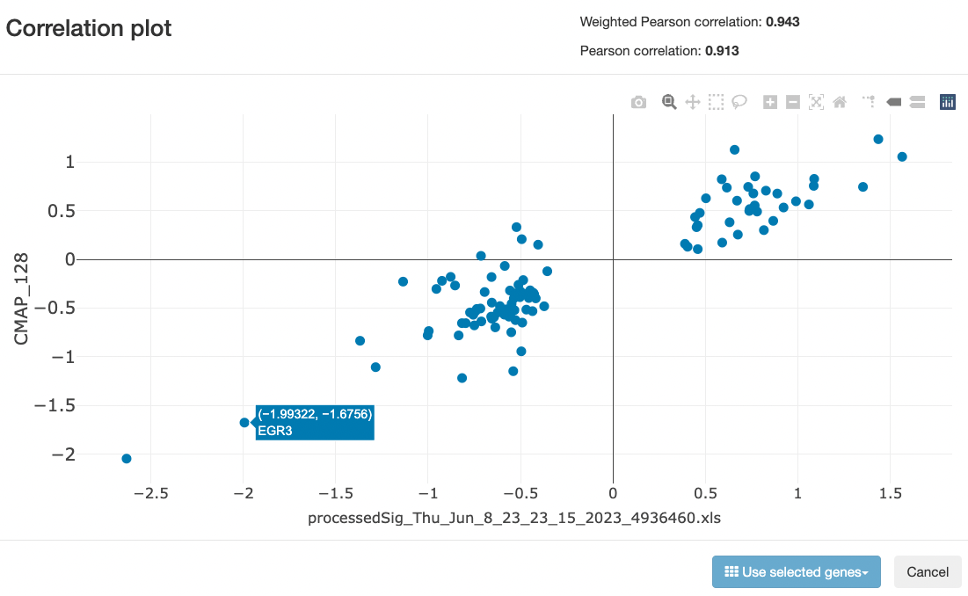

Slide 46
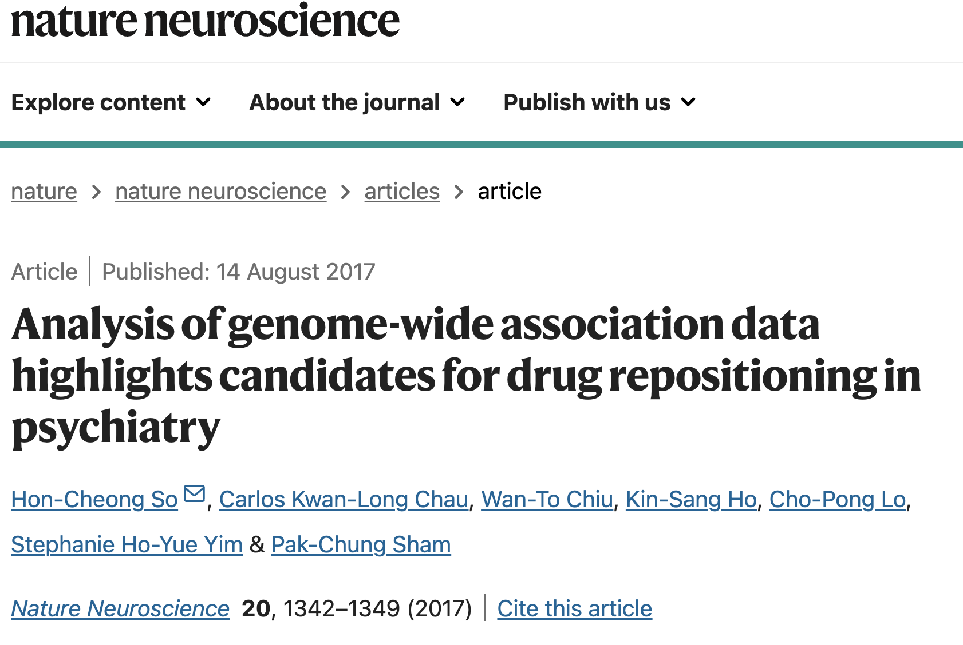

Slide 47
So et al
Brain-based eQTL models to impute disease gene expression
Spearman, Pearson correlation, and KS-test to determine similarity between between disease and drug signature
As there are no consensus methods to define K, they set different values of K (50, 100, 250, 500) and averaged the results for each method.
No selection on cell type

Slide 48
Important considerations for GWAS to drug candidate pipeline using gene expression signature mapping
How many genes to include in your query gene list?
what eQTL model should you use generating a disease gene signature?
  Single-tissue model (disease tissue-specificity) vs multi-tissue model (greater power to predict gene expression)
What cell lines should you query in iLINCs?
  Most relevant cell type vs summary across cell lines
How does the power of the GWAS affect identification of drug targets?

Slide 49
Other considerations
iLINCS is a useful resource but requires careful manual curation
  Check connectivity between gene knockdown/overexpression and drug
  Check specificity of the gene signature
  Check connectivity between compounds with same MoA
  Compare genetic vs chemical perturbation signatures (e.g. statin vs HMGCR KO)
  Check connectivity across cell lines
  Drugs may not be in an active form. Need to check this from other sources e.g. DrugBank
  Check if target is expressed in cell line before interpreting results (human protein atlas)

Slide 50
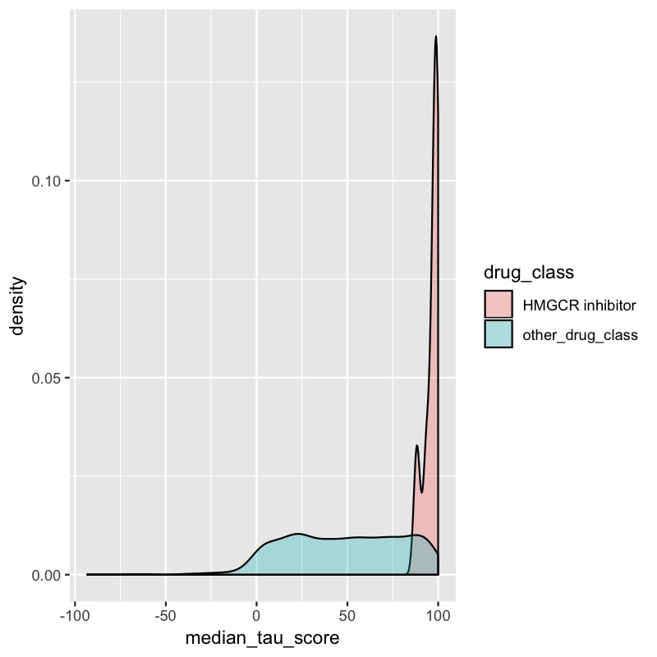
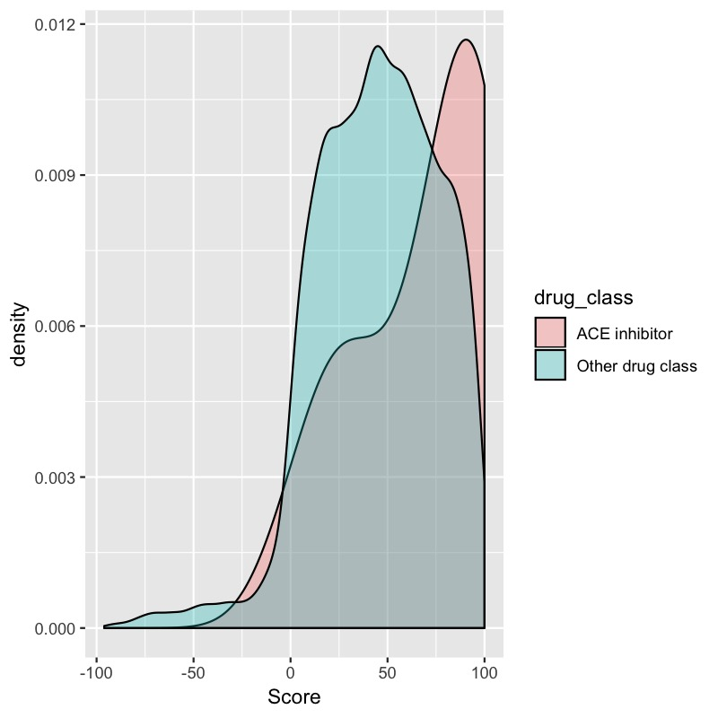
Connectivity of rosuvastatin with other HMGCR-inhibitors and all other compounds
Connectivity of enalapril with other ACE inhibitors and all other compounds

Slide 51
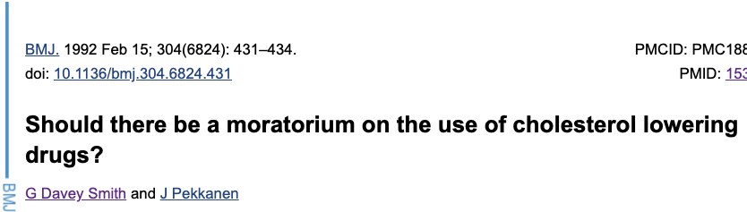
Statins and depression
2012 Psychology Today
2019 The Times
Do statins have any effects on depression?

Slide 52

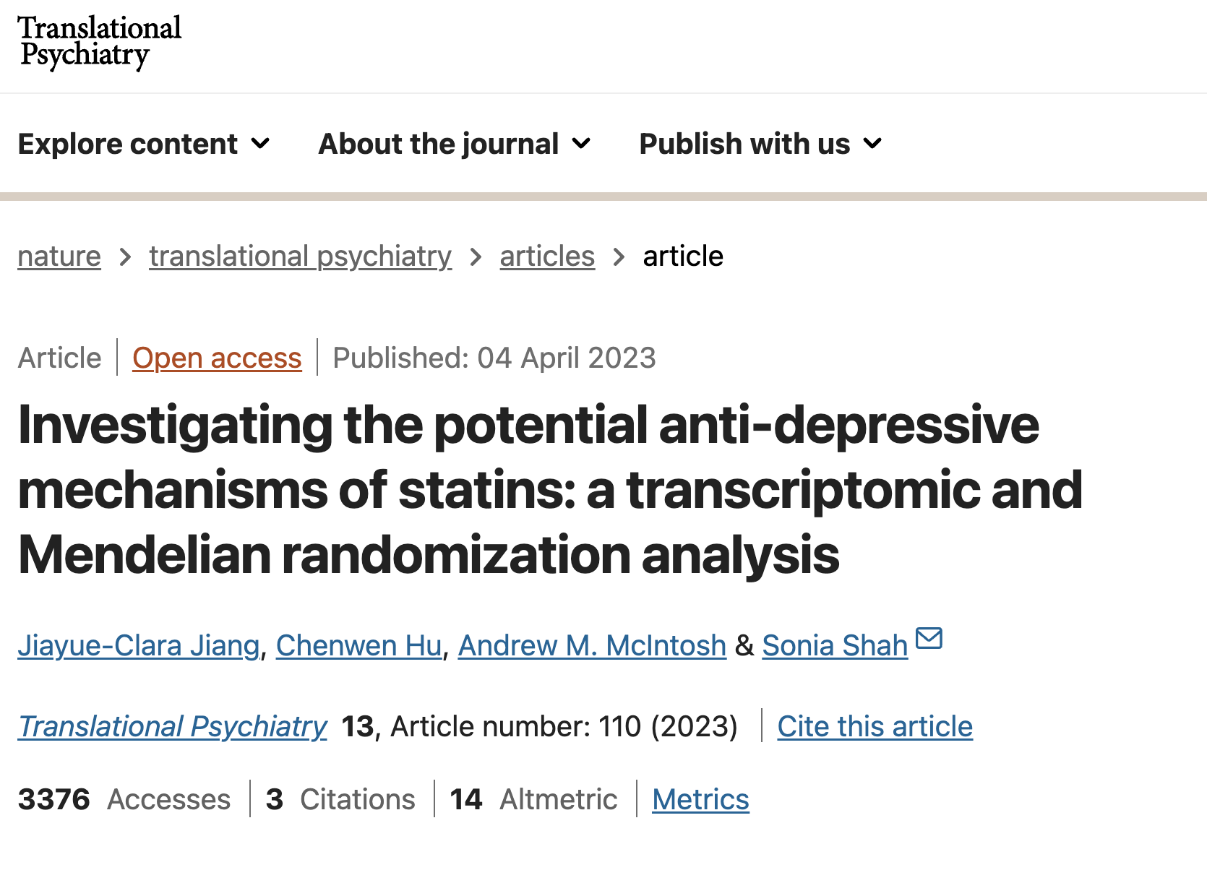
Chenwen Hu
Jiayue Clara Jiang
1. Connectivity map (CMap) analysis
2. Mendelian randomisation analysis

Slide 53
Within-statin gene expression signature correlation
statin-statin tau scores > 95

Slide 54
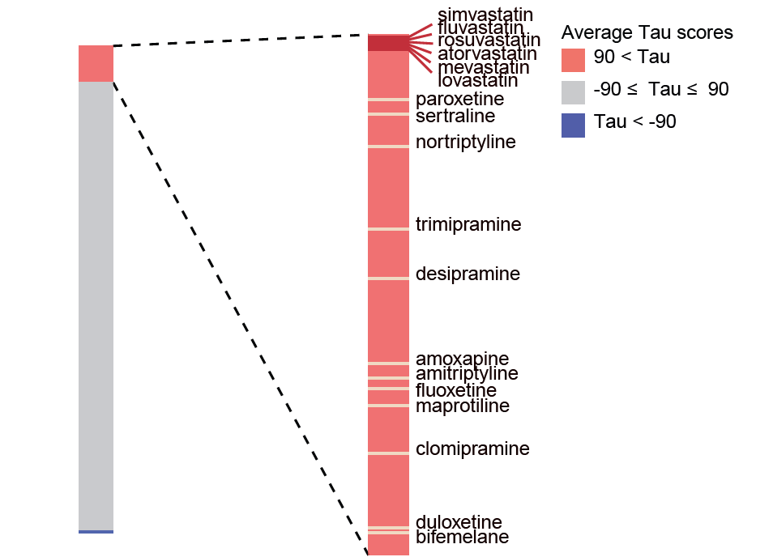
Enrichment of antidepressants amongst statin-connected compounds
Antidepressants are significantly enriched amongst compounds that have high connectivity (tau > 90) to statins

Slide 55
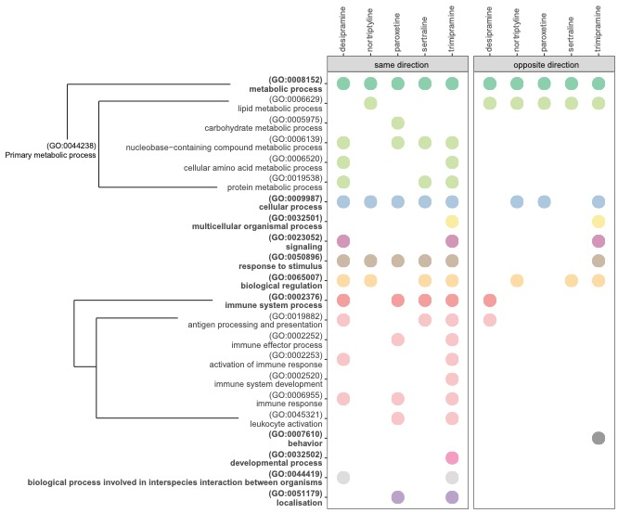
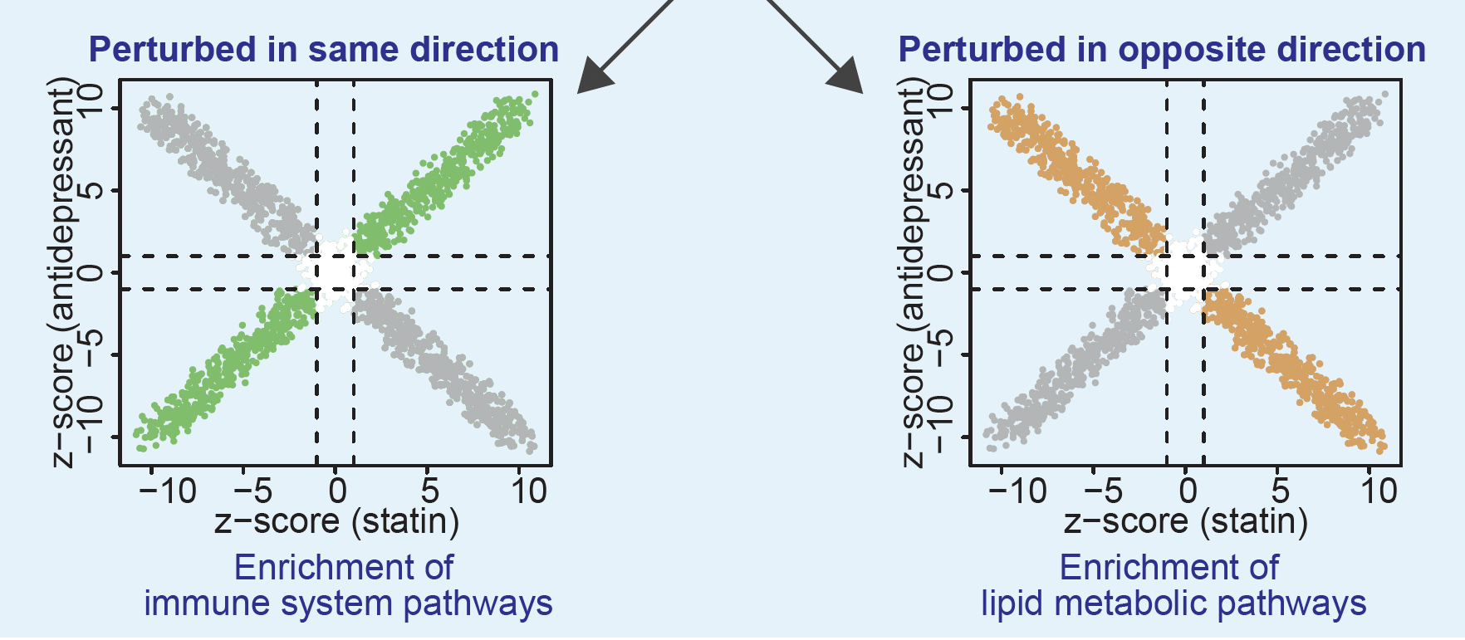
Gene-set enrichment analysis of shared genes
Functional terms enriched amongst genes perturbed in the same and opposite direction by both statins and antidepressants

Slide 56
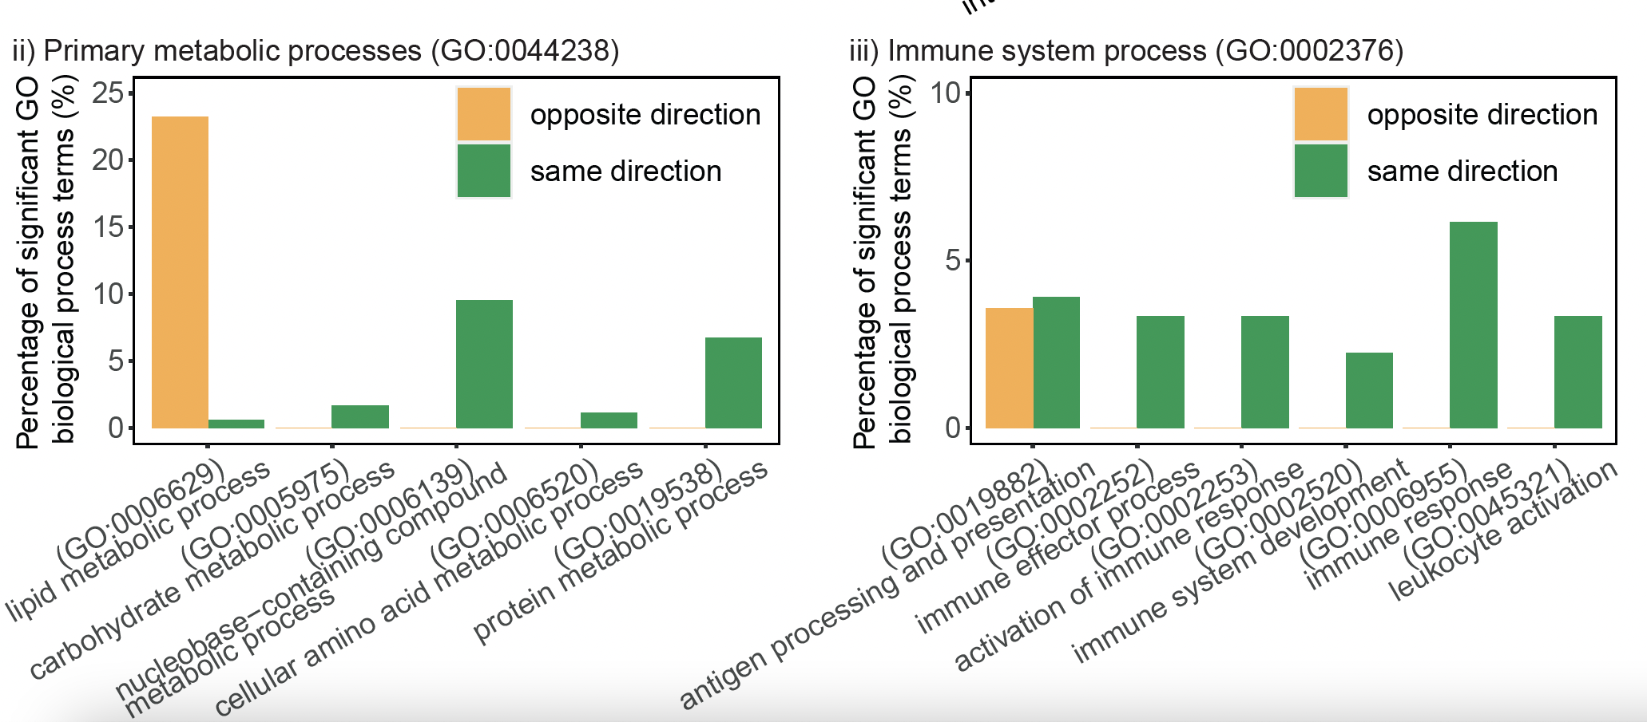
Gene-set enrichment analysis of shared genes

Slide 57
MR analysis HMGCR/ITGAL/HDAC2 gene expression
Statin | Gene targets
simvastatin | HMGCR, ITGAL, HDAC2
atorvastatin | HMGCR, DPP4, AHR, HDAC2, NR1I3
rosuvastatin | HMGCR, ITGAL
lovastatin | HMGCR, ITGAL, HDAC2
fluvastatin | HMGCR, HDAC2
mevastatin | HMGCR
cerivastatin | HMGCR
pitavastatin | HMGCR, ITGAL
pravastatin | HMGCR, HDAC2
Drug bank database

Slide 58
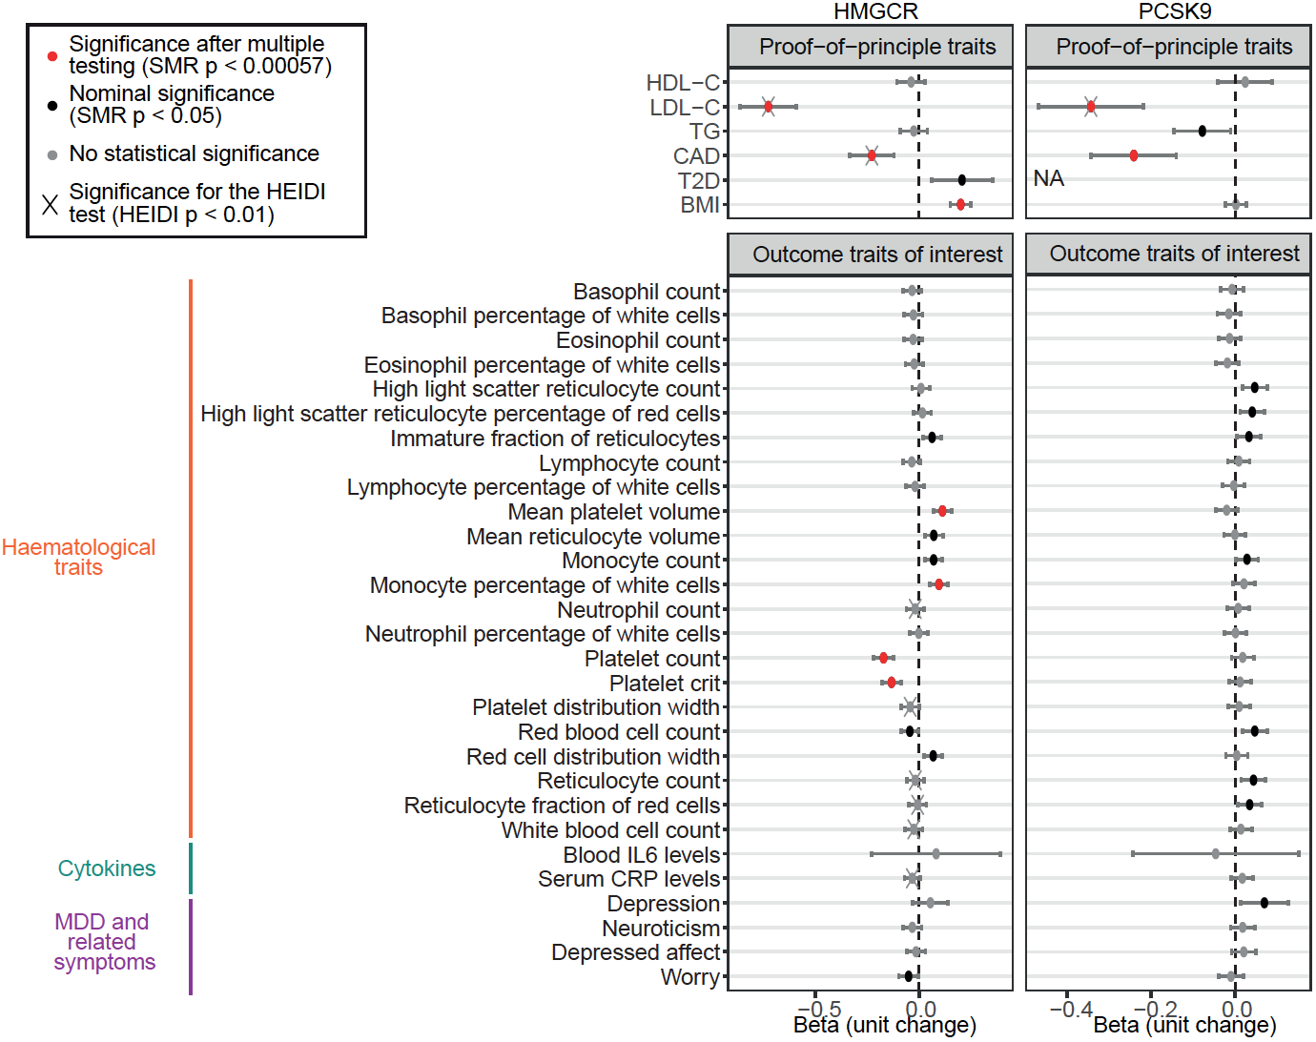
Lower HMGCR expression associated with platelet measures

Slide 59
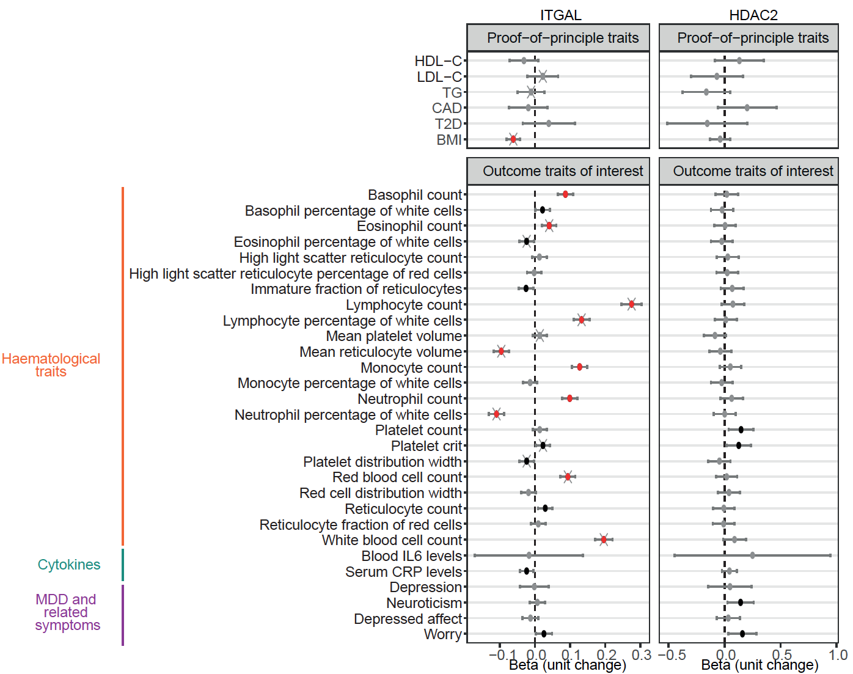
Lower ITGAL expression associated with white blood cell counts

Slide 60

Your feedback would be greatly appreciated so we can improve on our content next year
Things you enjoyed and why
Things you didn’t enjoy and why
Suggestions on how we could improve
Anything you were hoping we would cover but we didn’t?

