Slide 1
Let’s talk about variance
G&G Winter School 2026
L. Yengo

Slide 2
What does variance mean?
What does variance teach us about the distribution of trait?
Is variance always interpretable regardless of the distribution (ordinal / binary / categorical -- multimodality)?
What does “variance explained” mean? – e.g., sex and height. => what about when the mean is the same between sexes but the variance is different? Can you think of any transformation of that trait that would lead sex to explain some variance?
Can a variance be negative? If so why?

Slide 3
Genetic variance: single locus model
Model with 1 gene, 2 alleles and additive gene action
genotype BB Bb bb
effect a 0 -a
frequency p² 2pq q² (p + q = 1)
mean = a *p² + 0*2pq - a*q² = (p - q)*a
V(genetic effect) = genetic variance = V_{G}
= E(effect²) – E(effect)²
V_{G} = a² *p² + 0*2pq + a²*q² – [(p - q)*a]² = 2pqa²
NB Practical #1

Slide 4
Model with dominance
Model with 1 gene, 2 alleles and additive and dominant gene action
genotype BB Bb bb
effect a d -a
frequency p² 2pq q² (p + q = 1)
mean = a *p² + d*2pq - a*q² = (p - q)*a + 2pqd
V(genetic effect) = V_{G} = E(effect²) – E(effect)²
V_{G} = a² *p² + d²*2pq + a²*q² – [(p - q)*a + 2pqd]²
= 2pqα² + (2pqd)², where α = a + (q - p)d
NB Practical #1

Slide 5
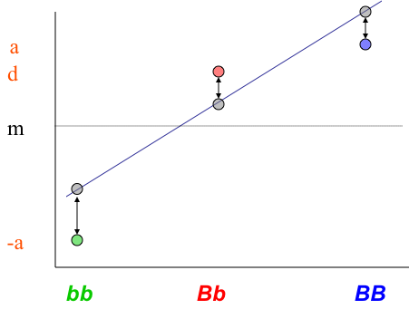
Model with dominance
Decompose the genetic value as:
g = mean + additive effect + dominance deviation
g = mean + paternal allele effect + maternal allele effect + interaction of alleles
Genotype BB Bb bb
effect a d -a
frequency p² 2pq q² (p + q = 1)
mean (p-q)a + 2pqd (p-q)a + 2pqd (p-q)a + 2pqd
additive 2qα (q-p)α -2pα α = a + (q - p)d
dominance dev. -q²d 2pqd -p²d
mean(additive effect) = 0, mean(dominance deviation) = 0
cov(additive effect, dominance deviation) = 0
genetic variance = V_{G} = 2pqα² + (2pqd)² = V_{A} + V_{D}

Slide 6
Online app used in Practical #1
https://shiny.cnsgenomics.com/Falconer2

Slide 7
Questions
Find a configuration where V_{A}/V_{G}>0.9 despite a large dominance deviation.
Is V_{A} always 0 when a=0? Why? Find a configuration such that V_{A}=0 but d>0.
Notes:
What can we expect the contribution of rare variants to dominance variance to be?

Slide 8
Conclusions
Additive genetic variance account for dominance (deviation) effects.
Unless substitution effects are large, rare alleles are not expected to explain a lot of variance

Slide 9
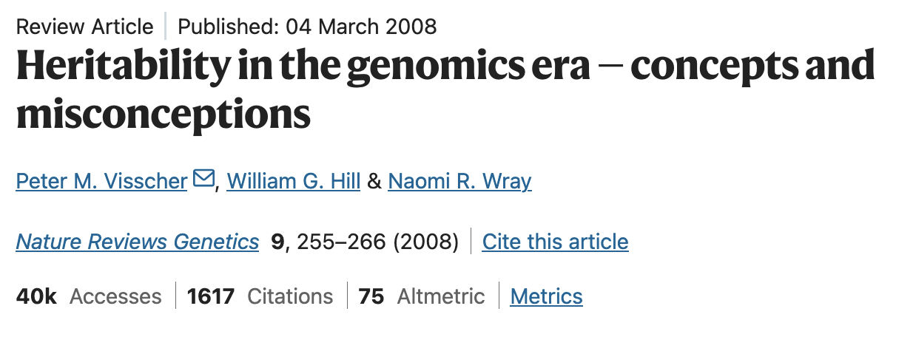
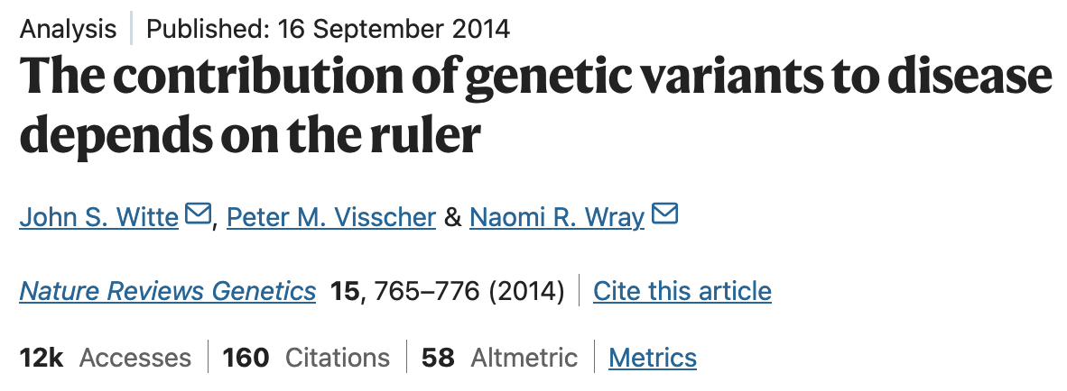
Important papers

