Slide 1
Heritability of disease
Prof Loic Yengo
Genetics & Genomics Winter School
Group Leader – Statistical Genomics Group
Institute for Molecular Bioscience
The University of Queensland

Slide 2
Aim of this lecture
In this lecture, we will show why these statements are consistent :
If a disease affects 1% of the population and has heritability 80% then
If an individual is affected ~8% of his/her siblings affected
If an MZ twin is affected ~50% of their co-twins are affected
Notes:
In this lecture we will aim to understand why these statements are consistent.

Slide 3
How do we know that there is a genetic contribution to disease?

Slide 4
Disease traits: Some disease traits have a clear pattern of inheritance
There are thousands of single gene disorders (OMIM database Online Mendelian Inheritance in Man) but each is very rare
Most common diseases do not have a clear pattern of inheritance yet there is increased risk associated with family history

Slide 5
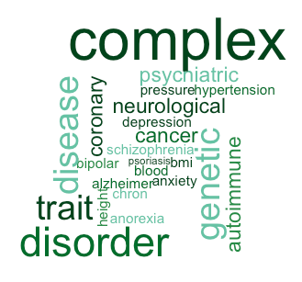
Complex genetic diseases
Unlike Mendelian disorders, there is no clear pattern of inheritance
Tend to “run” in families
Few large pedigrees of multiply affected individuals
Most people have no known family history
Common diseases > 0.5% are complex genetic diseases

Slide 6
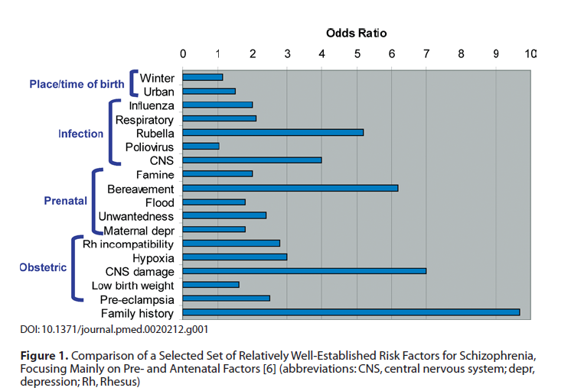
Risk Factors for Schizophrenia
Sullivan, PLoS Med 05

Slide 7
Evidence for a genetic contribution comes from risks to relatives

Slide 8
Affected Probands
13/30 are affected;
Risk = 0.433
Unaffected Probands
Relative Risk (RR) = 0.433 / 0.267 = 1.63
In siblings of affected compared to unaffected probands
8/30 are affected;
Risk = 0.267
Slide credit: Dale Nyholt

Slide 9
Relative risk to relatives
Recurrence risk to relatives
How much more likely are you to be diseased if your relative is affected compared to a person selected randomly from the population?
Relative risk to relatives (λ_{R}) = p(affected|relative affected) = K_{R} p(affected in population) K
How to estimate p(affected|relative affected) ?
Collect population samples – cases infrequent
Collect samples of case families and assess family members
How to estimate p(affected in population) ?
Census or national health statistics
  Is definition of affected same in population sample as family sample
Collect control families and assess family members
If disease is not common λ_{R} = p(sibling affected|case family) p(sibling affected |control family)

Slide 10
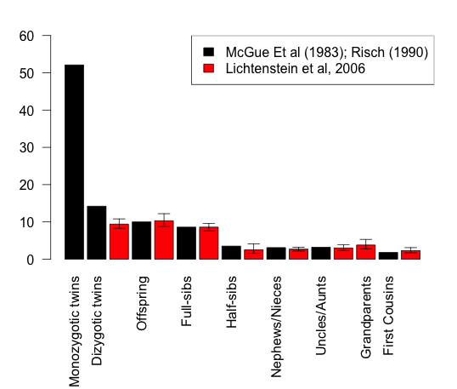
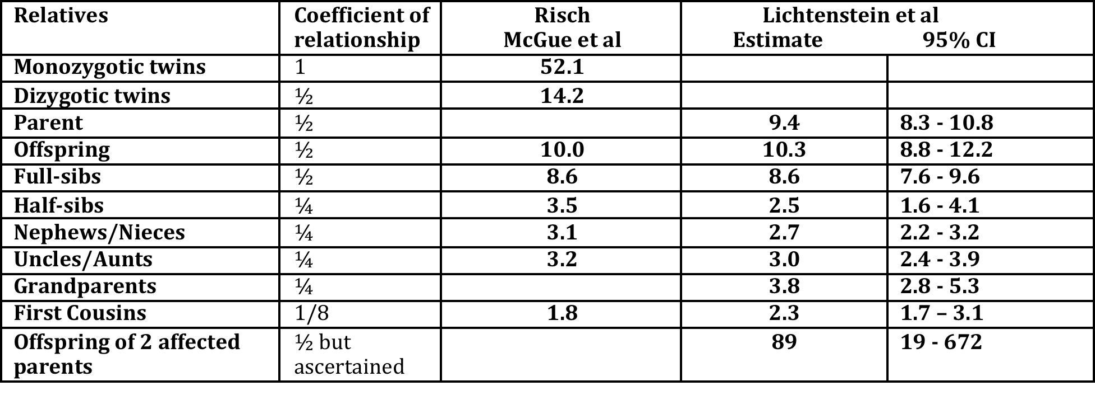
Schizophrenia risks to relatives
Baseline risk, K = 0.85% McGue et al
= 0.407% Lichtenstein et al
0.5 0.25 0.125 coefficient of relationship
Risch(1990) Linkage Strategies for Genetically Complex Traits AJHG
McGue et al (1983) Genetic Epidemiology 2: 99
Lichtenstein et al (2006) Recurrence risks for schizophrenia in a Swedish National Cohort.Psychological Medicine

Slide 11
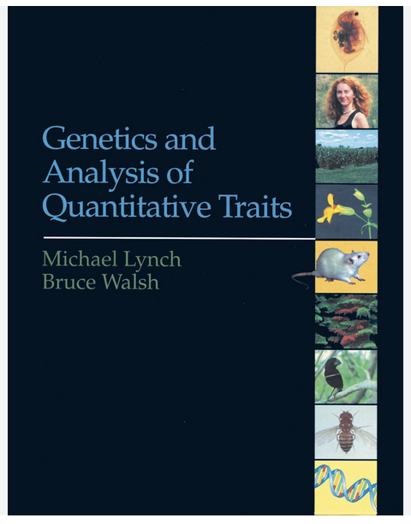

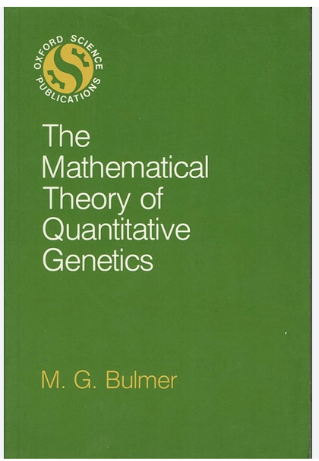
Books to check out
Lynch & Walsh
Falconer & MacKay
Bulmer

Slide 12
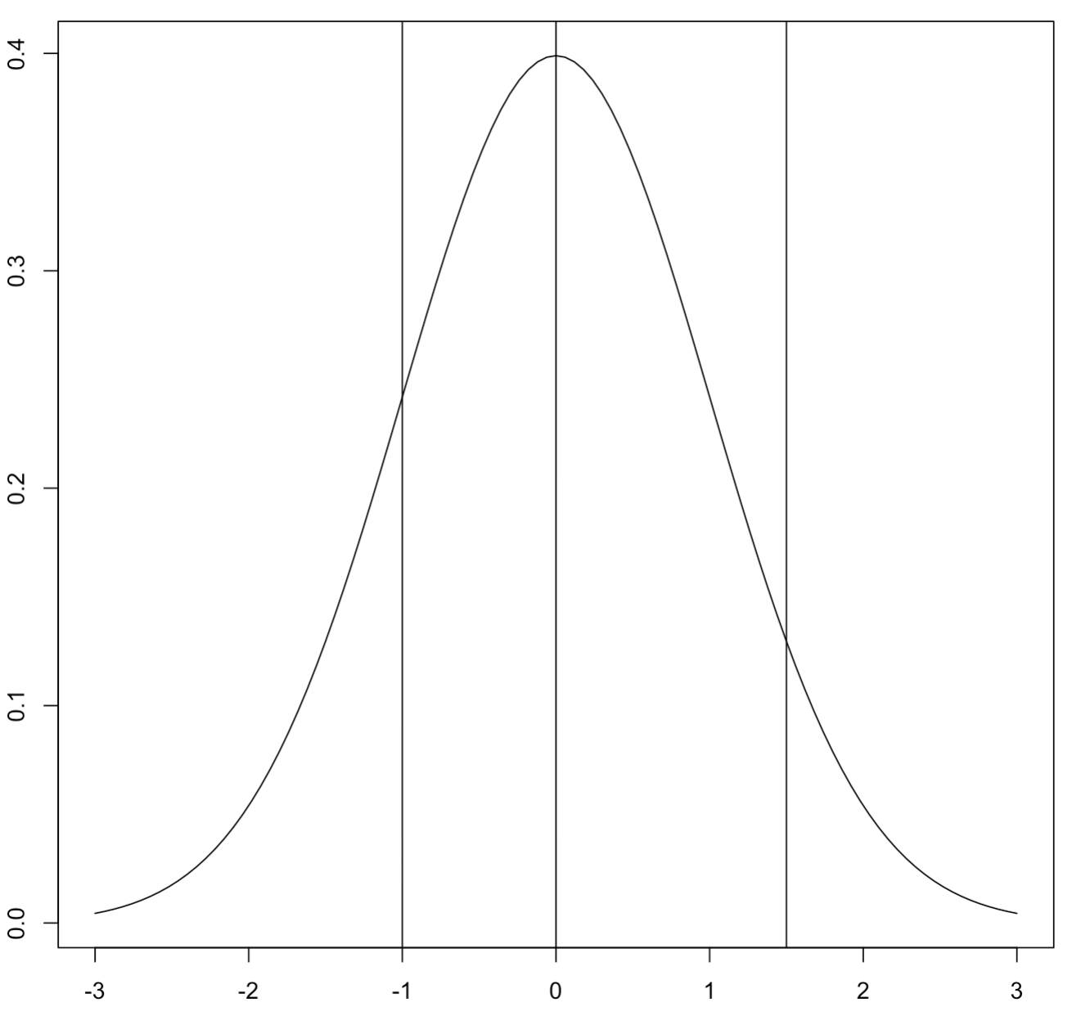
Generalization to character traits
-Same approach
-Multiple thresholds

Slide 13
For which disease is the genetic contribution more important?
Lifetime Risk 1%
Relative risk to 1st degree relatives: 10
Absolute Risk to 1st degree relatives 10%
Vs
Lifetime Risk 15%
Relative risk to 1st degree relatives: 2
Absolute Risk to 1st degree relatives 30%

Slide 14
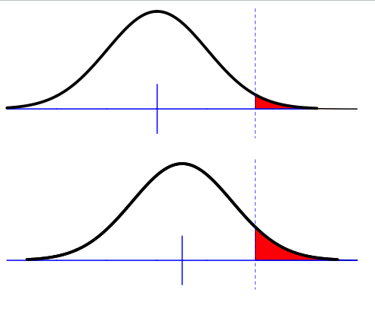
Liability threshold model
Phenotypic liability of a sample from the population
Proportion K affected
Assumption of normality
Only appropriate for multifactorial disease
i.e. more than a few genes but doesn’t have to be highly polygenic
Key – unimodal
Notes:
The liability threshold model is a view of the disease as an extreme expression of a continuous liability.
For diseases like T2D or Hypertension, the liability is observed and the diagnosis is based on the observed scaled.

Slide 15
Does an underlying normality assumption make sense?
Assumes approximately normal distribution of liability
Makes sense for many genetic variants and environmental/noise factors
1 Locus
→ 3 Genotypes
→ 3 Classes
2 Locus
→ 9 Genotypes
→ 5 Classes
3 Locus
→ 27 Genotypes
→ 7 Classes
4 Locus
→ 81 Genotypes
→ 9 Classes
Each Locus has alleles R and r, R = risk alleles.
Each class has a different count of number of risk alleles

Slide 16
Falconer (1965)
Phenotypic liability of a sample from the population
Proportion K affected
Relationship of relatives to affected individuals a_{R}
Phenotypic liability of relatives of affected individuals
Proportion K_{R} affected
Using normal distribution theory what percentage of the variance in liability is attributable to genetic factors given K, K_{R} and a_{R}
Notes:
The theory I’m going to present today has initially been developed by Falconer in 1965

Slide 17
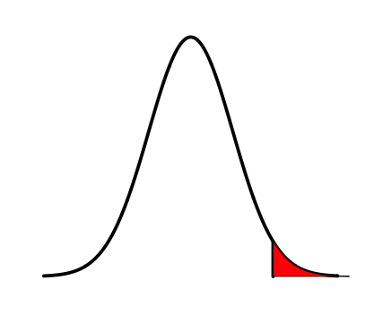
Definitions
z = density at t
K = Proportion of the population that are diseased
Density
Phenotypic liability
i = mean phenotypic liability of the diseased group
t = threshold

Slide 18


Liability Threshold Model
–truncated normal distribution theory
Φ(x) =cumulative density until liability x
standard normal distribution function
ϕ (x) = probability density at x
Phi
z = density at t
z = ϕ (t) = dnorm(t)
Density
K = Proportion of the population that are diseased
Standard
Deviation =1
σ_{p} = 1
K= 1-Φ(t) = 1-pnorm(t)
Phenotypic liability
i = mean phenotypic liability of the diseased group
i= z/K “selection intensity”
Variance in liability amongst the diseased individuals
= ((1-k), where k = i(i-t)
t = threshold
t= Φ⁻¹(1-K) = qnorm(1-K)
Inverse standard normal distribution (probit) function

Slide 19
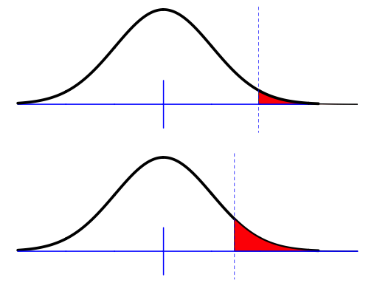
Falconer (1965)
The difference between the means for the same threshold
t
m
The difference between the thresholds when standardised to have the same mean
m_{R}
t_{R}
m_{R}-m = t-t_{R}
Given the difference in thresholds, and given known additive genetic relationship between relatives, what proportion of the total variance must be due to genetic factors
Falconer (1965) The inheritance of liability to certain diseases, estimated from incidences in relatives,
Ann. Hum Genet. 29 51
Crittenden (1961) an interpretation o familial aggregation based on multiple genetic and environmental factors
Ann NY Acad Sci 91 769
Notes:
We previously seen that when a disease has a genetic component, the prevalence among people with affected relatives (Pr) is larger than K.
This is can be expressed in two ways in the liability threshold model:
We could either assume that the liability in Pr has a larger mean but the same threshold; or
That the mean is the same but Pr has a smaller threshold.
Both approaches are equivalent.

Slide 20
Calculate heritability of liability using regression theory
Y = phenotypic liability for individuals
Y_{R} = phenotypic liability for relatives of Y
Y_{R} = a_{R}h²Y + ε
For affected individuals Y = i
Expected phenotypic liability of relatives of those affected
E(Y_{R}|Y>t) = m_{R} = m_{R}-m = t- t_{R}
Substitute t- t_{R}= a_{R}h²i
Rearrange h² =(t- t_{R})/ia_{R}
z
K
m
t
i
Falconer (1965) The inheritance of liability to certain diseases, estimated from incidences in relatives,
Ann. Hum Genet. 29 51
Crittenden (1961) an interpretation o familial aggregation based on multiple genetic and environmental factors
Ann NY Acad Sci 91 769

Slide 21
Assumptions made by Falconer (1965)
Assumption: Covariance between relatives reflects only shared additive genetic effects
Check: Use different types of relatives with different a_{R} and different u_{R}(dominance coefficient) and different shared environment to see consistency of estimates of h²
Assumption: Phenotypic variance in relatives is unaffected by ascertainment on affected probands

Slide 22
Accounting for reduction in variance in relatives as a result of ascertainment on affected individuals
t
Variance in liability amongst the diseased individuals
= ((1-k), where k = i(i-t)
P
m
Variance in liability amongst relatives of diseased individuals
V(Y_{R}|Y>t) = V(Y_{R})-kCov(Y_{R},Y)²
=
P_{R}
m_{R}
Reich, James, Morris (1972) The use of multiple thresholds in determining the mode of transmission of semi-continuous traits. Ann Hum Gen 36: 163.

Slide 23
Reich et al: heritability of liability
The difference between the means for the same threshold
t
The difference between the thresholds when standardised to have the mean 0 and variance 1
m
m_{R}
t_{R}
m_{R}-m = t-t_{R}
Reich, James, Morris (1972) The use of multiple thresholds in determining the mode of transmission of semi-continuous traits. Ann Hum Gen 36: 163.

Slide 24

Reich et al: heritability of liability
t
Y = phenotypic liability for individuals
Y_{R} = phenotypic liability for relatives of those with Y
Y_{R} = a_{R}h²Y + ε
For affected individuals Y = i
Expected phenotypic liability of relatives of those affected
E(Y_{R}|Y>t) = m_{R}-m =
Substitute
Rearrange
Also useful – calculation of t_{R} when K and h² are known

Slide 25
GREML: h²-SNP for disease
Observations are on disease scale but heritability is most interpretable on the liability scale
Case-control samples are ascertained
Differences between case and control samples may reflect artefacts
Use linear regression
Estimate on observed scale
Transform to Liability scale via Robertson Transformation
Up date transformation
Very stringent QC
Lee et al (2011) Estimating missing heritability for Disease from GWAS AJHG
Lee et al (2013) Estimation and partition of polygenic variation captured by common SNPs for AD, MS & Endo, HMG

Slide 26

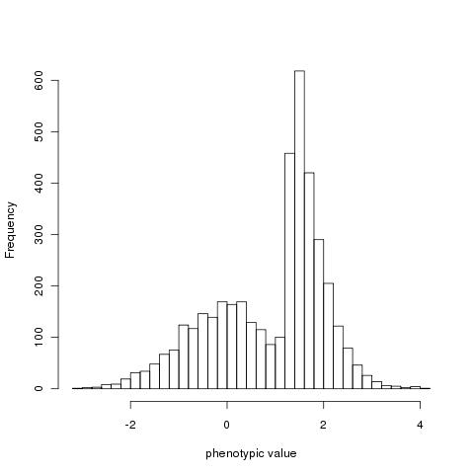
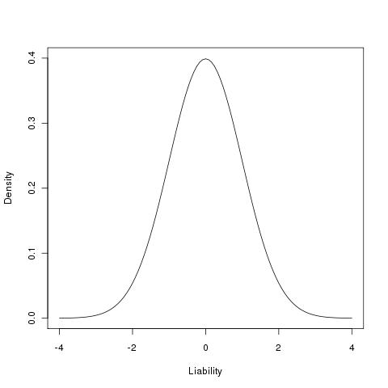

Ascertainment in case-control studies
Estimate of proportion of variance explained by SNP between cases and controls
z
x
t
Unaffected (1-K)
affected (K)
Control (1-P)
Case (P)
Robertson (1950)
Appendix of Dempster and Lerner (1950)
See Lecture 1
Lee et al (2011)AJHG
Zhou & Stephens (2013) Polygenic Modeling with Bayesian Sparse Linear Mixed Models PLoSG Text S3
Golan et al (2014) Measuring missing heritability: Inferring the contribution of common variants PNAS
See Lecture 1

Slide 27
Summary
If a disease affects 1% of the population and has heritability 80%
We have shown why these statements are consistent :
If an individual is affected ~8% of his/her siblings affected
If an MZ twin is affected ~50% of their co-twins are affected

