Slide 1

SBayesR
SBayesS

Slide 2
Sbayes S and Sbayes R
Website: https://cnsgenomics.com/software/gctb/#Overview
GCTB software and BayesS method
Zeng et al. (2018) Signatures of negative selection in the genetic architecture of human complex traits. Nature Genetics, doi: 10.1038/s41588-018-0101-4.
BayesR
Moser et al. (2015) Simultaneous discovery, estimation and prediction analysis of complex traits using a Bayesian mixture model. PLoS Genetics, 11: e1004969.
Lloyd-Jones, L. R. et al. Improved polygenic prediction by Bayesian multiple regression on summary statistics. Nat Commun 10, 5086, doi:10.1038/s41467-019-12653-0 (2019).
Notes:
Moser et al describes the initial development of Sbayes R which was applied to individual data
The citation by Luke Lloyd Jones describes the application of SBayesR to summary level data, which makes it much more useful
The citation by Jian Zeng, describes the development of Sbayes S for summary level data

Slide 3
SBayes R
Tutorial:
https://cnsgenomics.com/software/gctb/#SummaryBayesianAlphabet
Main purpose:
To provide a more accurate list of SNPs with effect sizes that can be used to generate a polygenic risk score – replaces the LD clumping and p-value thresholding steps of the basic process (P + T method) implemented in Plink software.
Also provides a measure of h²(observed)
Notes:
Start with Sbayes R
GCTB has a useful tutorial
Sbayes R is mainly used to develop polygenic risk scores
First step in developing PRS is getting rid of many SNPs based on LD scores using clumping; second step is to get rid of more SNPs by choosing a threshold for the P value and eliminating SNP that don’t meet this threshold
Sbayes eliminates both these steps.
In her review of methods of building PRS Guiyan found it to be most accurate.

Slide 4
BayesR: aimed to improve accuracy of effect sizes
Simple linear regression: assumes every SNP is independent of every other SNP
Linear mixed model: jointly analyzes all SNPs
  For BOLT-LMM, joint analysis limited to GRM of up to 1 million SNPs – remaining SNPs fitted independently
Bayesian multiple regression: extends LMM using a given “prior”, which further improves genomic predictions

Slide 5
The Bayesian approach
Assesses the probability of A, given the prior existence of B
P(A |B) is the probability of the posterior distribution (what we need to find)
  (The probability of the ‘true’ height distribution, given our sample height distribution)
P(A) is the probability of the prior distribution – the certainty of our beliefs prior to seeing any data
  (How certain we are about our understanding of the ‘true’ height distribution?)
P(B) is the probability of the observed data, ignoring any prior expectation (often ignored or treated as a normalizing parameter)
  (How certain are we that our sample distribution is true?)
P(B |A) is the likelihood distribution – our understanding of the observed data, given our beliefs
  (How likely is the sample height distribution, given our understanding of the ‘true’ height distribution?)

Slide 6
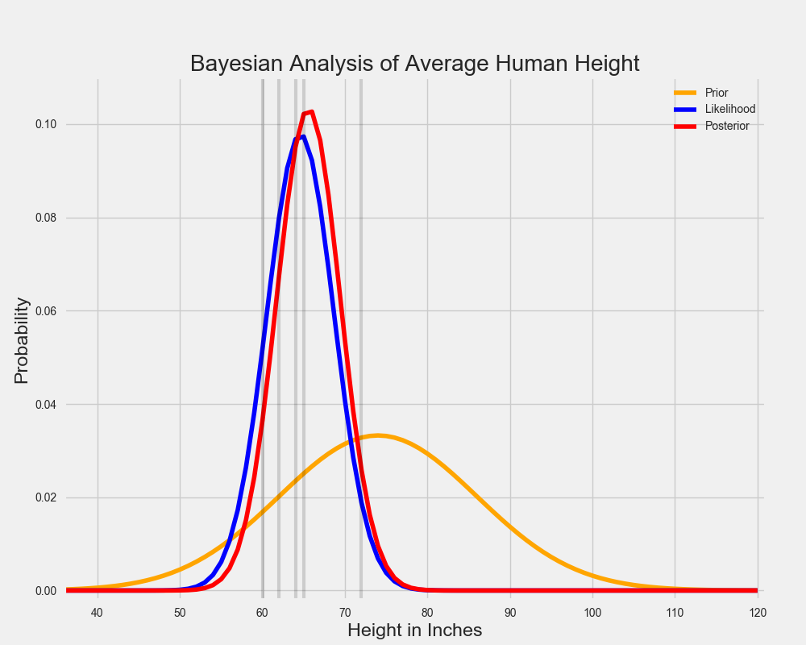
Bayesian example
P(A|B)~P(B|A)*P(A)
https://towardsdatascience.com/a-zero-math-introduction-to-markov-chain-monte-carlo-methods-dcba889e0c50
Notes:
The orange plot represents the prior, which is that people are tall, but we don’t have a very strong certainty that this is right
The blue plot represents the likelihood that our sample is true – people are shorter than we expected, but we know it was a good sample
The red plot represents our posterior, which is the updated understanding of the true height of the population and our updated certainty of this distribution

Slide 7
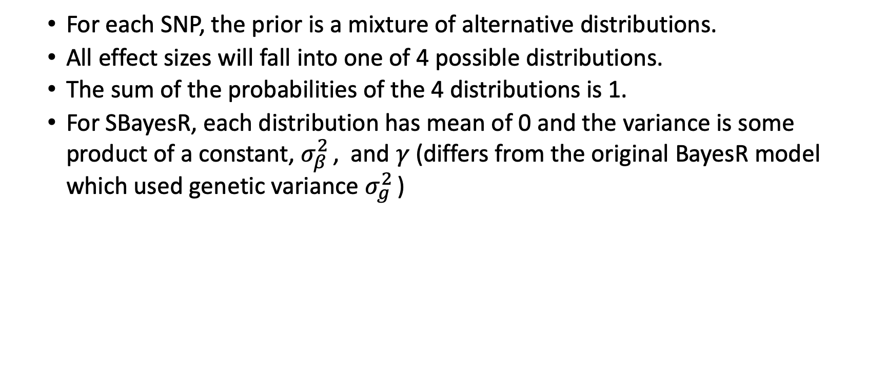
Application to BayesR
  For each SNP, the prior is a mixture of alternative distributions.
  All effect sizes will fall into one of 4 possible distributions.
  The sum of the probabilities of the 4 distributions is 1.
  For SBayesR, each distribution has mean of 0 and the variance is some product of a constant, $σ_{β}^{2}$ , and $γ$(differs from the original BayesR model which used genetic variance $σ_{g}^{2}$ )
Notes:
Before we calculate the true effect of each Snp, we apply some conditional prior
For Bayes R, the conditional prior is that all effect sizes fall into one of 4 possible distributions.
Remembering that probabilities of all the alternative possibilities have to sum to one, the sum of the probabilities of the 4 distributions is 1.
Each distribution is a normal distribution, with mean zero and variance a product of a constant $σ_{β}^{2}$ and gamma

Slide 8
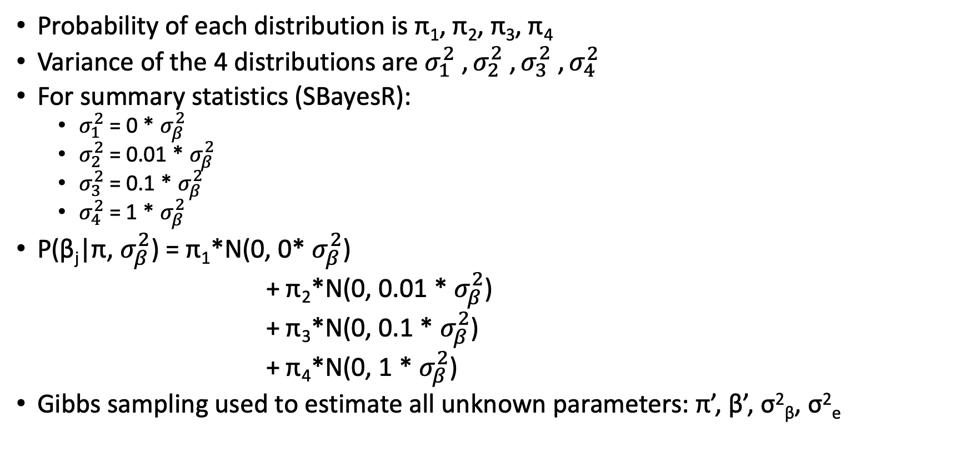
Assumed prior distributions
Probability of each distribution is π₁, π₂, π₃, π₄
Variance of the 4 distributions are $σ_{1}^{2}$ , $σ_{2}^{2}$ , $σ_{3}^{2}$ , $σ_{4}^{2}$
For summary statistics (SBayesR):
  $σ_{1}^{2}$ = 0 * $σ_{β}^{2}$
  $σ_{2}^{2}$ = 0.01 * $σ_{β}^{2}$
  $σ_{3}^{2}$ = 0.1 * $σ_{β}^{2}$
  $σ_{4}^{2}$= 1 * $σ_{β}^{2}$
P(β_{j}|π, $σ_{β}^{2}$) = π₁*N(0, 0* $σ_{β}^{2}$)
+ π₂*N(0, 0.01 * $σ_{β}^{2}$)
+ π₃*N(0, 0.1 * $σ_{β}^{2}$)
+ π₄*N(0, 1 * $σ_{β}^{2}$)
Gibbs sampling used to estimate all unknown parameters: π’, β’, σ²_{β}, σ²_{e}
Notes:
To provide a bit of terminology for the prior distributions
….
Sigma squared 1 is the zero distribution – the distribution of Snps that have zero effect on the phenotype (gamma = 0)
Sigma squared 2 is the distribution of Snps that have the smallest effect on the phenotype (gamma=0.01)
Sigma squared 3 is the distribution that has a slightly larger effect (gamma =0.1)
Sigma squared 4 is the distribution of snps with the largest effect (gamma=1)
σ²_{e} - variation in phenotype due to non-genetic reasons
And if we add the probability of each of these distributions, we get the total probability, which is 1
There are 4 unknown parameters here

Slide 9
Gibbs sampling
An instance of MCMC (Markov Chain Monte Carlo)
MCMC methods are used to approximate the posterior distribution of a parameter of interest by random sampling in a probabilistic space
Random sampling –values for parameter(s) chosen from range of posterior distribution (this is the Monte Carlo part)
Probability of these parameter(s) then computed according to rules of the posterior distribution – build up a chain of probabilities (this is the Markov Chain part)
Thousands of iterations
Looking for convergence – in distributions, not into a point(s), which means entering a region of high probability and a stationary distribution of probabilities

Slide 10
Gibbs sampling applied to SBayesR
There are 4 unknown parameters: π’, β’, σ²_{β}, σ²_{e}
The first set of values are chosen randomly
For each iteration, each parameter is fitted, one after the other, conditional on the current values of the other three parameters
By the end of the iteration, all four parameters will have new values
Initial (default) values for π are {0.95, 0.02, 0.02, 0.01}
The first 5000 iterations are discarded as unlikely to be accurate (“burn-in”)

Slide 11
My summary statistics
For Australian Genetics of Depression Study (AGDS) - women with peripartum depression (PPD)
Sample of 10,298 women (3,246 cases and 7,052 controls)
6,416,847 SNPs
GWAS conducted using Bolt-LMM
Summary statistics formatted:
SNP | A1 | A2 | freq | b | se | p | N
rs10875231 | T | G | 0.231232 | -0.0090362 | 0.00758 | 2.3E-01 | 10297
rs6678176 | T | C | 0.282218 | -0.0101916 | 0.00707 | 1.5E-01 | 10297
rs78286437 | C | T | 0.0507915 | -0.0106852 | 0.01463 | 4.7E-01 | 10297
rs76909621 | T | G | 0.093231 | 0.0061679 | 0.01105 | 5.8E-01 | 10297
Notes:
For my practical example I’m going to describe my use of Sbayes with my research into women with peripartum depression.

Slide 12
Linkage disequilibrium (LD) correlation matrix
Key component of the summary-data based methods
Theoretically, the summary-data based methods are equivalent to the individual data methods if the LD matrix is constructed from all variants and the individuals used in the GWAS.
Computationally prohibitive - a subset of the matrix entries are stored.
Typically, all inter-chromosomal LD is ignored and a within chromosome block diagonal matrix structure is used
Uses a reference population that is similar in ancestry to the GWAS
Notes:
This description is summarised from the GCTB website
You can make your own LDM – the tutorial on the website has instructions for doing so, but you can also use one of 2 LDM’s that we have stored in our data, which is what I did.

Slide 13
Job script:
/gpfs1/scratch/group30days/cnsg_park/jzeng/repo/gctb/scr/gctb --sbayes R \
--ldm /gpfs1/scratch/group30days/cnsg_park/jzeng/proj/sbayes/ldm/ukb/n50k_hm3/ukbEURu_imp_v3_HM3_n50k.chisq10.ldm.sparse \
--gwas-summary /30days/uqjkiewa/ppd_gwas/cojo_ppdSumStats_AGDS \
--pi 0.95,0.02,0.02,0.01 \
--gamma 0.0,0.01,0.1,1 \
--exclude-mhc \
--hsq 0.5 \
--chain-length 25000 \
--burn-in 5000 \
--seed 12345 \
--thread 4 \
--no-mcmc-bin \
--out = /30days/uqjkiewa/ppd_gwas/SBayesS/AGDSdata.log 2>&1

Slide 14
Output
Out.log: provides details of input, MCMC process with results of each of 4 distributions after 25,000 iterations
Out.covRes: not relevant
Out.mcmcsamples.CovEffects: not relevant
Out.mcmcsamples.Par: provides details of MCMC process
Out.parRes: provides summary data – mean and SD of the number of SNPs in each of 4 distributions; Sigma squared; Residual variance; Genetic variance; and observed heritability
Out.snpRes: provides the final distribution of SNPs
Notes:
Check the distribution of per-SNP sample size if the GWAS summary data is from a meta-analysis. Outliers in per-SNP sample size will violate the assumed residual covariance structure and may cause a convergence problem.

Slide 15
Out.snpRes – this is the file that is used with Plink “score” command to create polygenic risk scores
Name | Chrom | Position | A1 | A2 | A1Frq | A1Effect | SE | PIP | LastSampleEff
rs4475691 | 1 | 846808 | T | C | 0.19865 | -0.000028 | 0.000488 | 0.118 | 0
rs7537756 | 1 | 854250 | G | A | 0.205545 | -0.000026 | 0.000401 | 0.105 | 0
rs7523549 | 1 | 879317 | T | C | 0.028164 | 0.000108 | 0.001176 | 0.113 | 0
rs3748593 | 1 | 880390 | A | C | 0.028066 | 0.000083 | 0.00125 | 0.112 | -0.003643
rs2272756 | 1 | 882033 | A | G | 0.247596 | -0.000029 | 0.000388 | 0.107 | -0.000392
rs3748594 | 1 | 886384 | A | G | 0.028503 | 0.000079 | 0.00111 | 0.119 | 0.000265
PIP is the posterior inclusion probability – the probability that the SNP has been included with a nonzero effect in the model during MCMC.
LastSampleEff is the sampled values of SNP effects in the final iteration of MCMC – may sometimes provide better prediction accuracy than the posterior mean across all MCMC iterations.

Slide 16
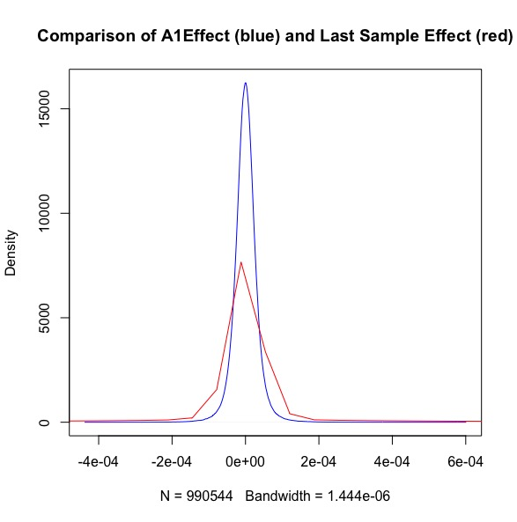
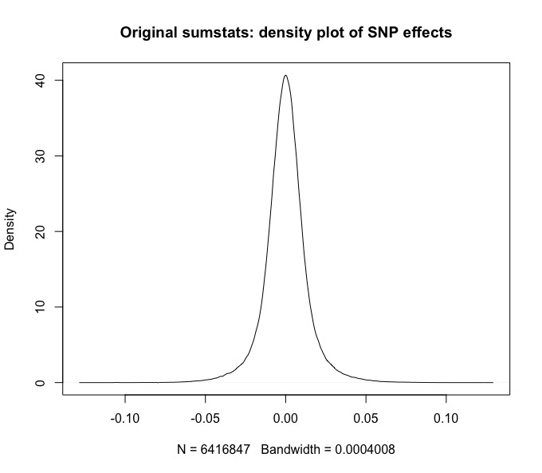
Comparison of Effect Sizes

Slide 17
Sbayes S

Slide 18
Why would we use it?
To find out the S value, which is a measure of the evolutionary fitness of the phenotype
To find the polygenicity of the phenotype in the sample
To get an estimation of the observed heritability of the phenotype

Slide 19
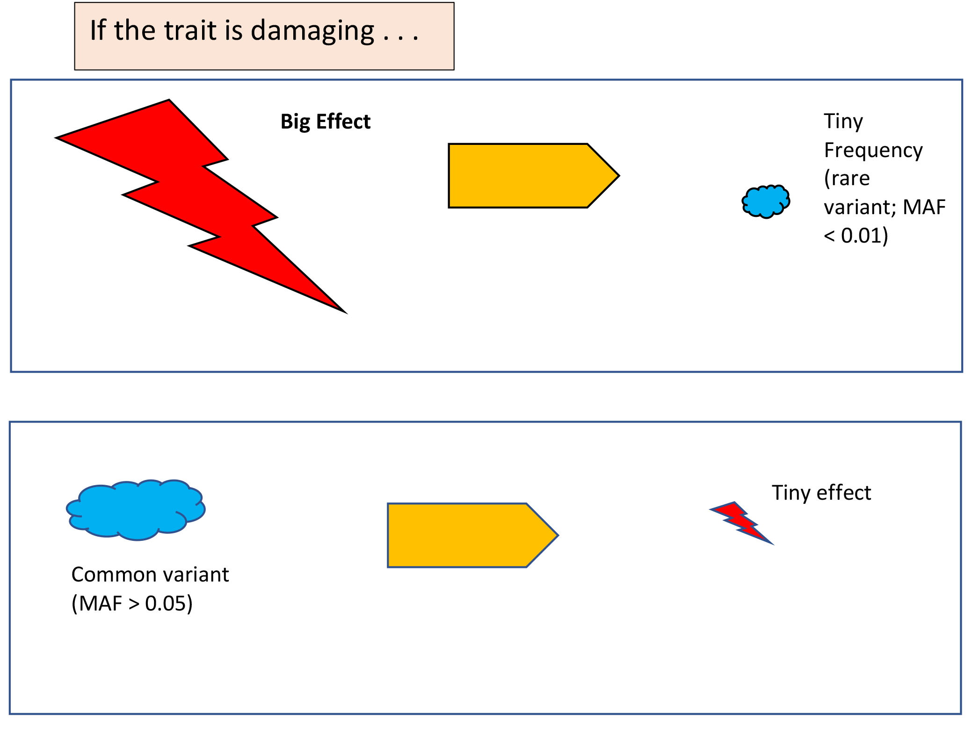
S: a measure of the biological fitness of a phenotype
Negative S
Big increase in phenotype
Effect on phenotype?
Notes:
If the phenotype or trait is damaging – eg a life threatening disease, or some reproductive disorder which decreases the chances of having healthy children, then
If a variant has a big effect, which greatly increases the likelihood of a phenotype, and this phenotype is damaging, then we might expect that there’s not going to be very many of these variants. It’s going to be very rare.
The flip side of this is that if a minor allele is common, it is most likely going to have a very very small effect on the increase of the phenotype.

Slide 20
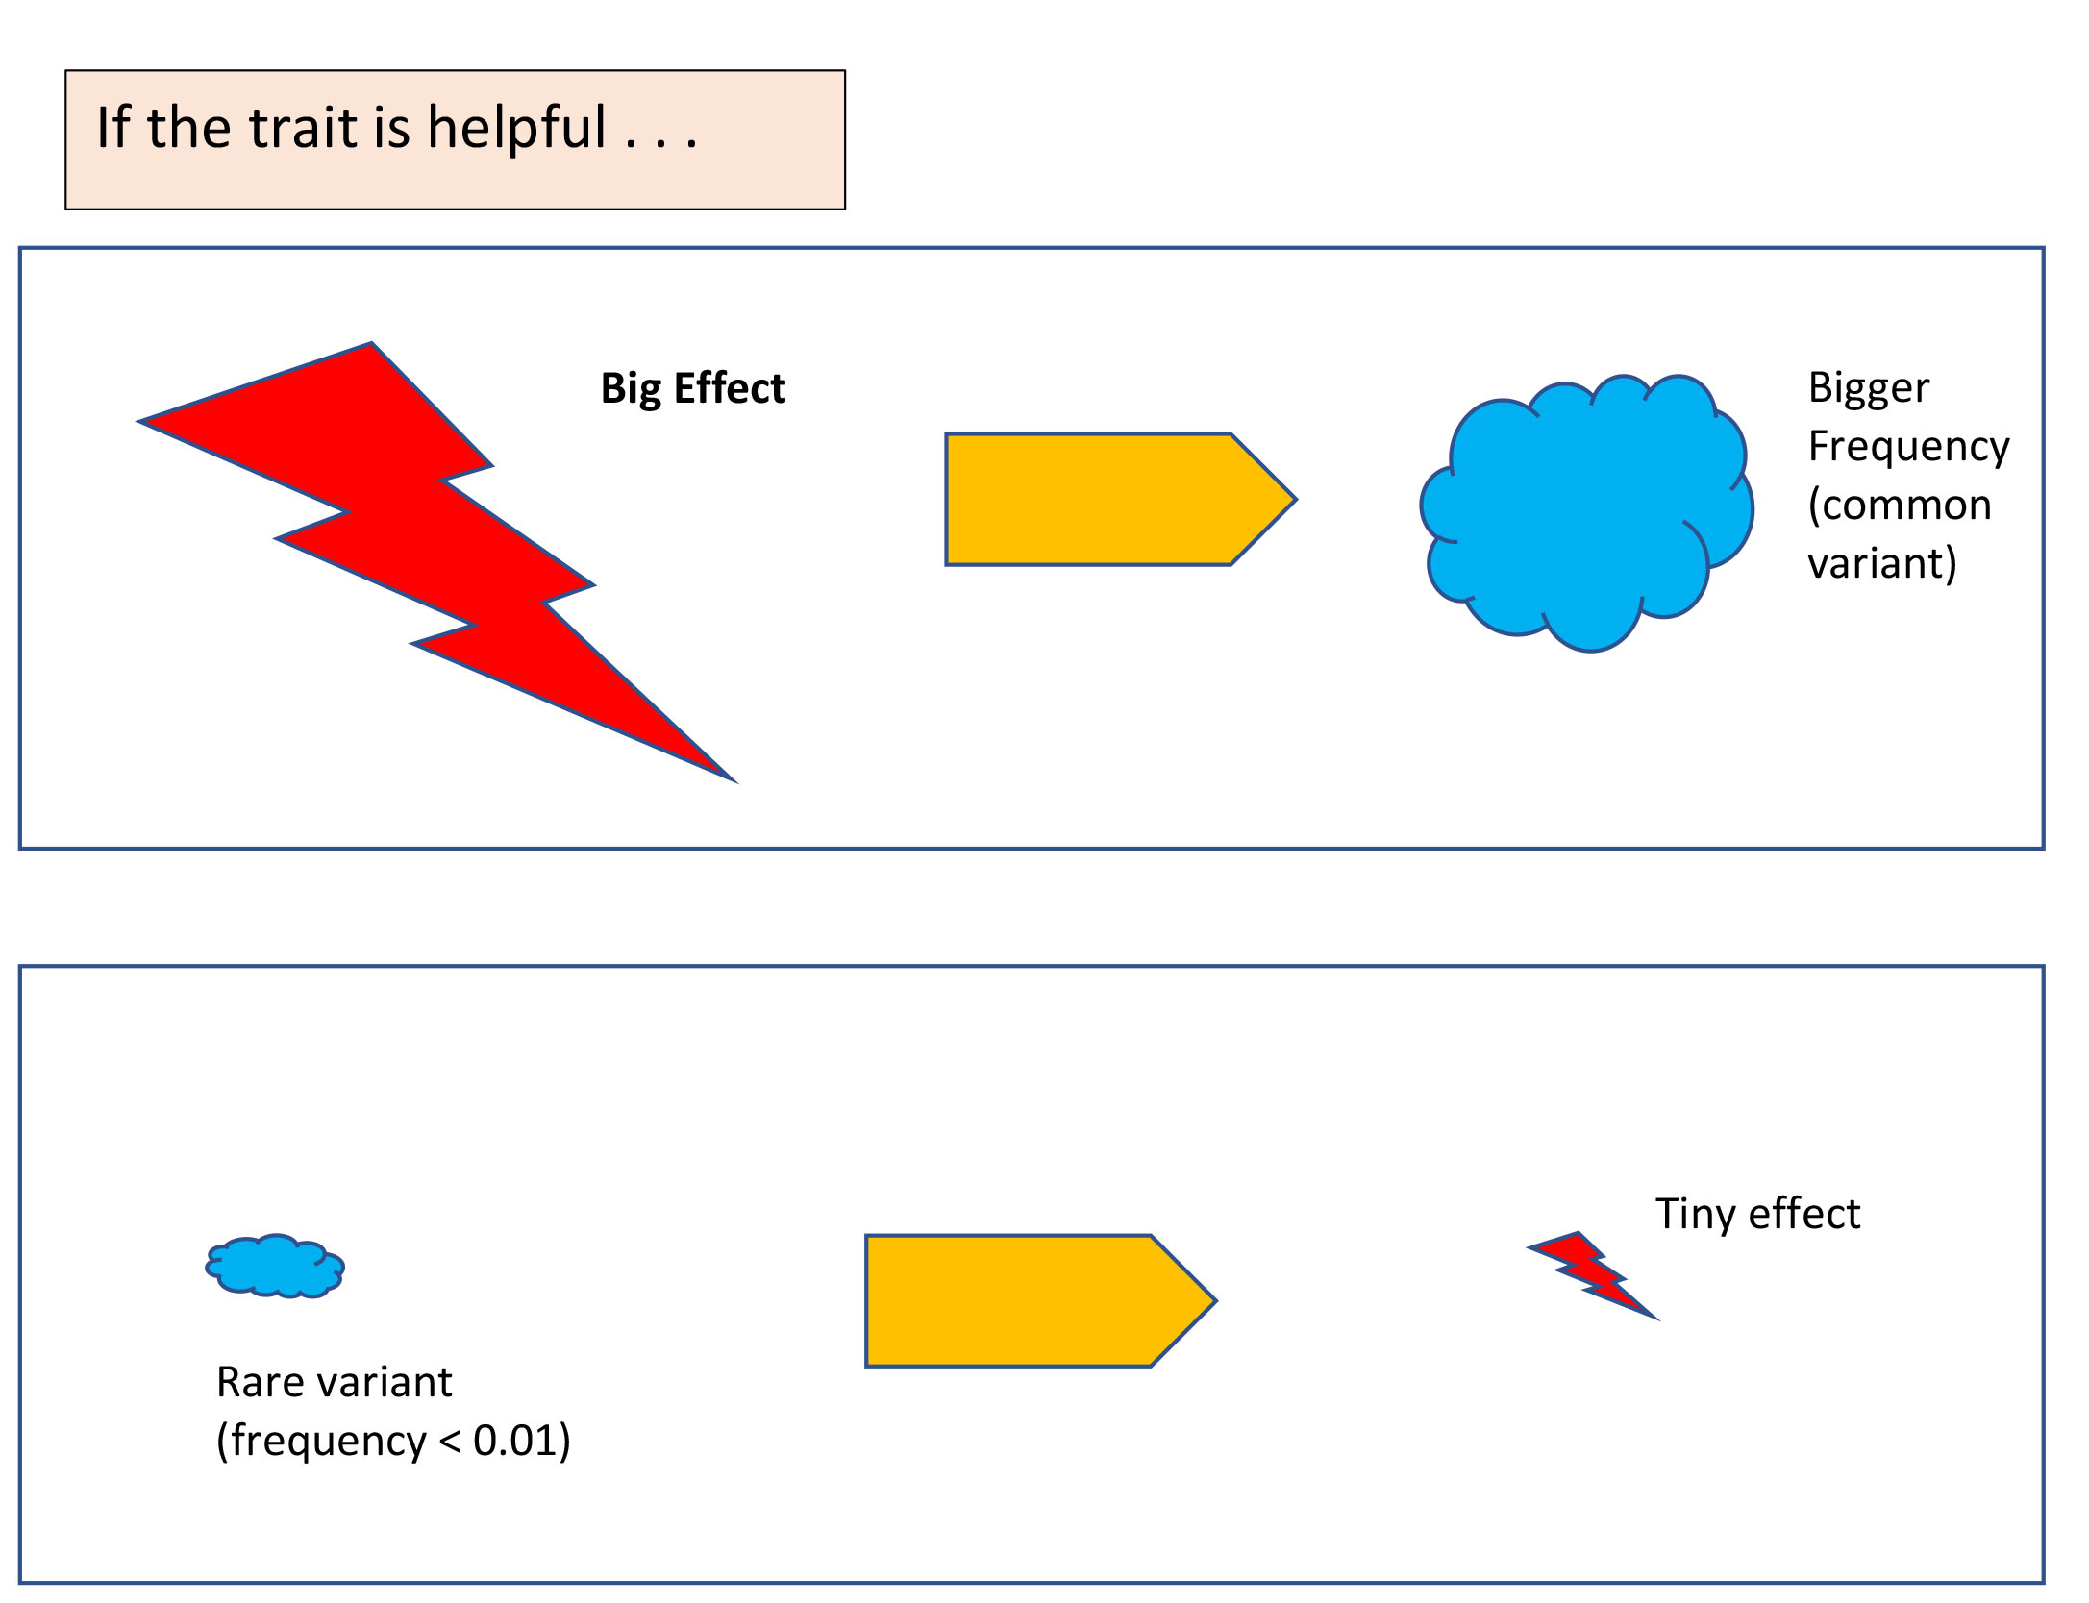
Positive S
Big increase in phenotype
Effect on phenotype?
S is derived from the joint distribution of the effect size and the MAF
Notes:
But, if the phenotype is helpful, such as you live in a place like Darwin and the phenotype is an increase of pigment in your skin so that you don’t develop skin cancers then
If the variant has a big effect, greatly increasing the chance of the phenotype, then it is likely that it will become more frequent in the population
And, on the flip side, it is likely that rare variants will not have much effect on the phenotype.
So, S is derived from the joint distribution of the effect size and the frequency of the minor allele.

Slide 21
Polygenicity
Polygenicity is the proportion of SNPs with non-zero effects
Not to be confused with heterogeneity!
Heterogeneity: different variants (within the same or different genetic locus/loci) can cause the same complex disease or trait

Slide 22
Observed heritability
Like GREML, SBayes analyses the joint distribution of effect sizes (SNPs are not independent)
However, GREML assumes all SNPs have an effect; SBayes assumes many SNPs have zero effect on the trait

Slide 23
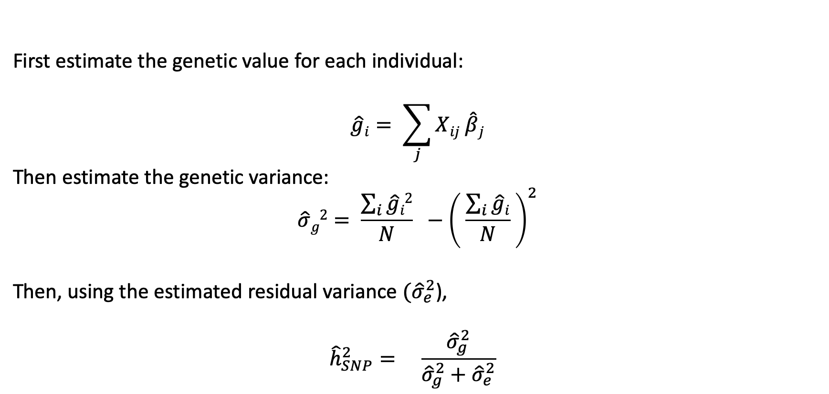
Calculating heritability: 3 steps
First estimate the genetic value for each individual:
$$\hat{g}i= \sum_{j}{Xij \hat{β}j}$$
Then estimate the genetic variance:
$$\hat{σ}g2= \frac{\sum_{i}{\hat{g}i2}}{N} −{\left( \frac{\sum_{i}{\hat{g}i}}{N} \right)}^{2}$$
Then, using the estimated residual variance $({\hat{σ}}_{e}^{2}$),
$${\hat{h}}_{SNP}^{2}= \frac{{\hat{σ}}_{g}^{2}}{{\hat{σ}}_{g}^{2}+{\hat{σ}}_{e}^{2}}$$
Notes:
There are three steps for calculating heritability.
In the first step, the effect size of the variant is multiplied by the number of copies of the minor allele possessed by the individual (which will be 0, 1, or 2).
Then all these products are added to calculate the additive genetic value for the individual.
Next the genetic variance is calculated over all individuals, using this standard equation for calculating variance.
Finally, the estimated residual variance is required, to add to the genetic variance, to create phenotypic variance. Then the genetic variance is divided by the phenotypic variance to produce the measure of heritability.

Slide 24

The conditional prior for SBayesS
A single normal distribution, mean=0, unknown parameter $σ_{β}^{2}$.
β_{j} ~ N (0, [2p_{j} (1−p_{j} )] ^{S} σ_{β}²)π + ɸ(1−π) where
S is the biological fitness of the model
p_{j} is the MAF of the SNP
$σ_{β}^{2}$ is the variance of SNP effects under a neutral model (where S=0)
π is the proportion of SNPs with nonzero effect (polygenicity)
ɸ is the point mass at zero
S is sampled using gradient-based Hamiltonian Monte Carlo
All other parameters are determined using Gibbs sampling
Notes:
So, having glanced at the three measures provided by Sbayes S, we’ll move on to its Bayesian prior.
The conditional prior for SBayesS is simpler than for Sbayes R in that there is only one distribution, a single normal distribution with zero mean and an unknown parameter $σ_{β}^{2}$
So the distribution of the Snp effects is a normal distribution, mean zero and variance equal to a sum of two terms.
The latter term refers to the SNPs that have zero effect, and the first term refers to the SNPs that have an effect
All the parameters are determined using Gibbs sampling, with the exception of S, which is sampled using Hamiltonian Monte Carlo.

Slide 25
The script
/gpfs1/scratch/group30days/cnsg_park/jzeng/repo/gctb/scr/gctb --sbayes S \
--ldm /gpfs1/scratch/group30days/cnsg_park/jzeng/proj/sbayes/ldm/gera/hm3/gera_hm3_maf01_wg.chisq10.ldm.sparse \
--gwas-summary /30days/uqjkiewa/ppd_gwas/cojo_ppdSumStats_AGDS \
--pi 0.01 \
--hsq 0.5 \
--num-chains 4 \
--chain-length 25000 \
--burn-in 5000 \
--seed 12345 \
--thread 4 \
--no-mcmc-bin \
--out = /30days/uqjkiewa/ppd_gwas/SBayesS/AGDSdata.log 2>&1

Slide 26
What it returns
Out.log provides details of input, MCMC process with results of each of 4 distributions after 25,000 iterations
Out.mcmcsamples.Par: provides details of MCMC process
Out.parRes: provides Pi; NnzSnp; Sigma squared; S; Residual variance; Genetic variance; SigmaSqG; and observed heritability
Out.snpRes: provides the final distribution of SNPs

Slide 27
 | Mean | SD | R_GelmanRubin
Pi | 0.034156 | 0.0237 | 1.849
NnzSnp | 34453.4688 | 23907.7148 | 1.849
SigmaSq | 0.000002 | 0.000002 | 1.678
S | -1.305322 | 0.274054 | 1.159
ResVar | 0.148394 | 0.006663 | 1.061
GenVar | 0.063852 | 0.006354 | 1.076
SigmaSqG | 0.063865 | 0.006385 | 1.075
hsq | 0.300824 | 0.029314 | 1.077
Notes:
The parRes file provides the mean results from the MCMC, plus the Standard Deviation, which was found to be equivalent to the standard error, and a calculation called Gelman Rubin, which provides a convergence diagnostic. The closer to 1 the better, but up to 1.2 is okay.
This indicates that my result for polygenicity didn’t really reach an acceptable convergence, though my result for S is okay. However, the value for S is surprising, being less than -1. This is somewhat offset by the large standard error of 0.27, which is likely because of the relatively small sample size.

Slide 28
Convergence issue
Most likely to occur when
  summary data are from meta-analysis
  heritability is high
  LD matrix is too sparse
  the ratio of GWAS and LD ref sample sizes is large
  the GWAS and LD ref samples have different population structure
  fitting millions of SNPs
  MLM GWAS (?)
Notes:
Convergence may be a problem in SBayesR if the perSnp sample size has outliers.
Outliers will violate the assumed residual covariance structure

Slide 29
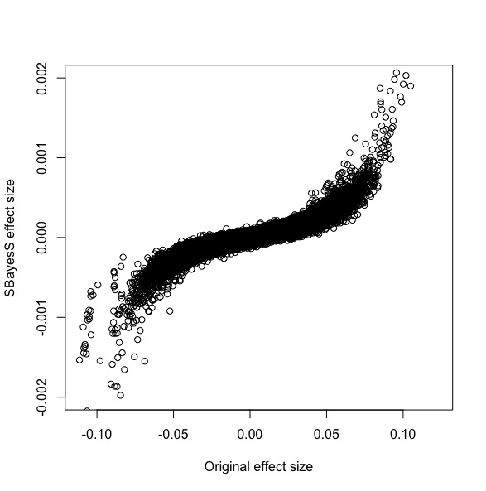
Comparison effect sizes: original sumstats with SBayes

Slide 30
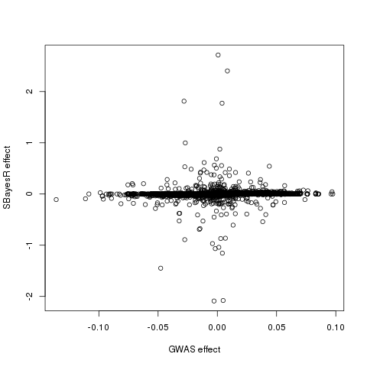
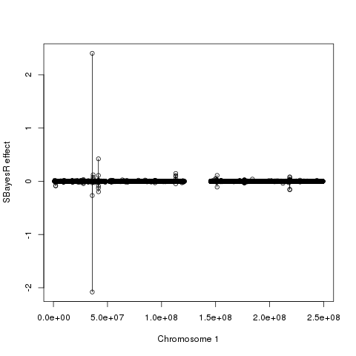

Slide 31
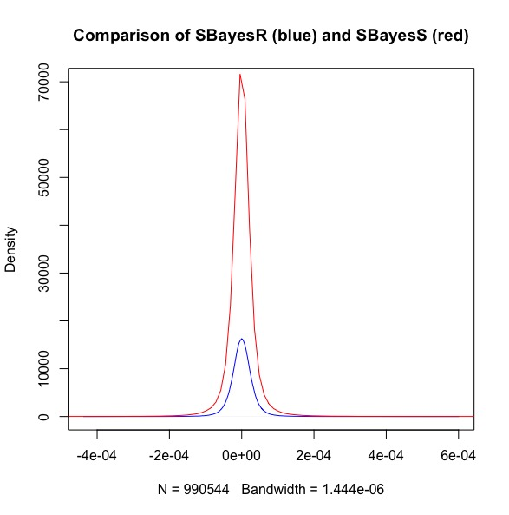
My Results
Notes:
This comparison of Sbayes R and Sbayes S is also surprising – Jian has told me that results are usually the other way around, with Sbayes S having lower density than Sbayes R. He’s suggested that my results are probably because of my very negative S value.

Slide 32
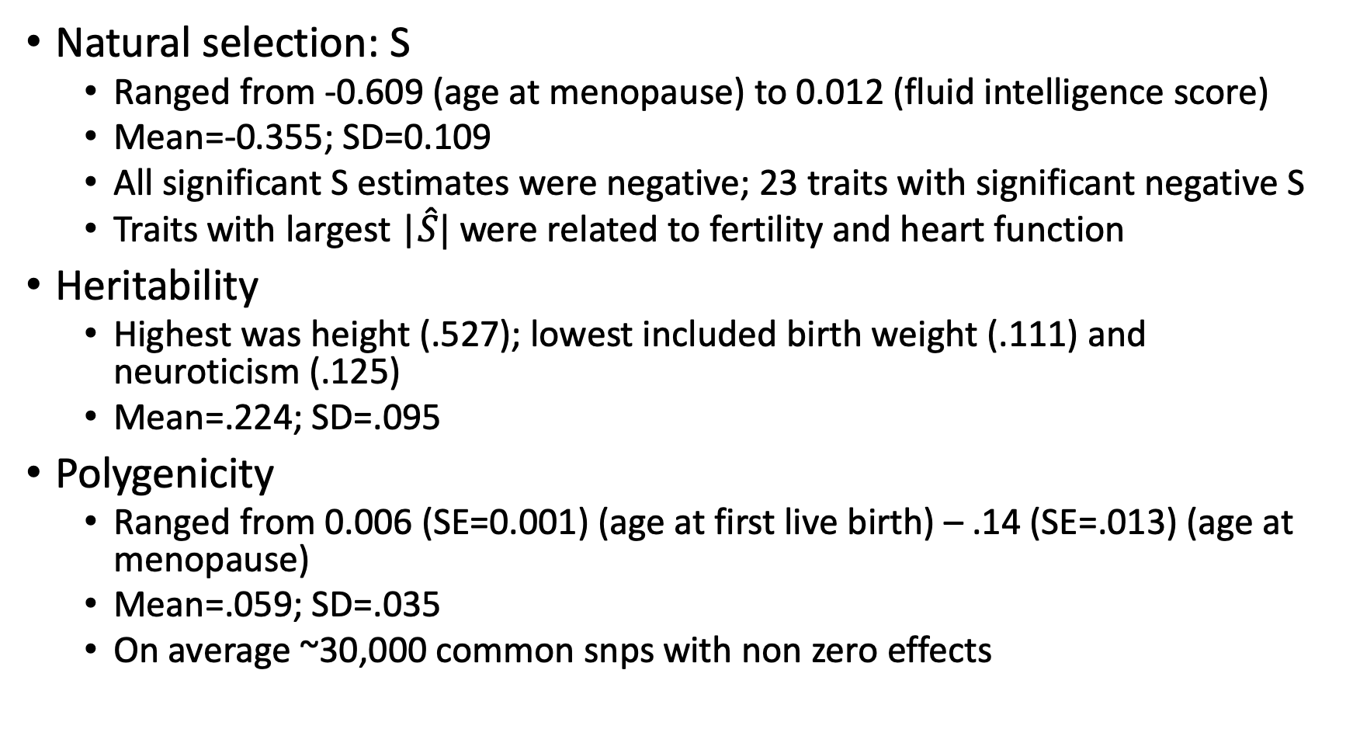
Results from 28 UK Biobank traits
Natural selection: S
  Ranged from -0.609 (age at menopause) to 0.012 (fluid intelligence score)
  Mean=-0.355; SD=0.109
  All significant S estimates were negative; 23 traits with significant negative S
  Traits with largest |$\hat{S}|$ were related to fertility and heart function
Heritability
  Highest was height (.527); lowest included birth weight (.111) and neuroticism (.125)
  Mean=.224; SD=.095
Polygenicity
  Ranged from 0.006 (SE=0.001) (age at first live birth) – .14 (SE=.013) (age at menopause)
  Mean=.059; SD=.035
  On average ~30,000 common snps with non zero effects
Notes:
Given we don’t have any absolutes with the SBayesS results, we have to compare with what has been found already, so here are the results provided in the reference article, from 28 UK Biobank phenotypes.
I was particularly interested in the S values, none of which were as negative as mine.
However, given that the largest absolute S values were related to fertility, as well as heart function, I might argue that peripartum depression is particularly related to the welfare of babies. Children of mothers with severe PPD are very much at risk, physically and emotionally. I’m not totally sure that this argument will stand, and obviously more research needs to be done.

Slide 33
So my final Bayesian analysis of the S value of PPD:
Prior expectation: S would be negative, but between 0 and 1
Observed S = highly negative, < -1
Likelihood (Observed S | expectation of true S) = surprising but possible
Posterior (True S |Observed S) = Significantly negative, but needs more evidence

Slide 34


