Slide 1
Module 10: Statistical and Quantitative Genetics of Disease:
Using Summary Statistics to Assess Population Stratification and How much Variation Explained
John Witte
Lecture #4

Slide 2
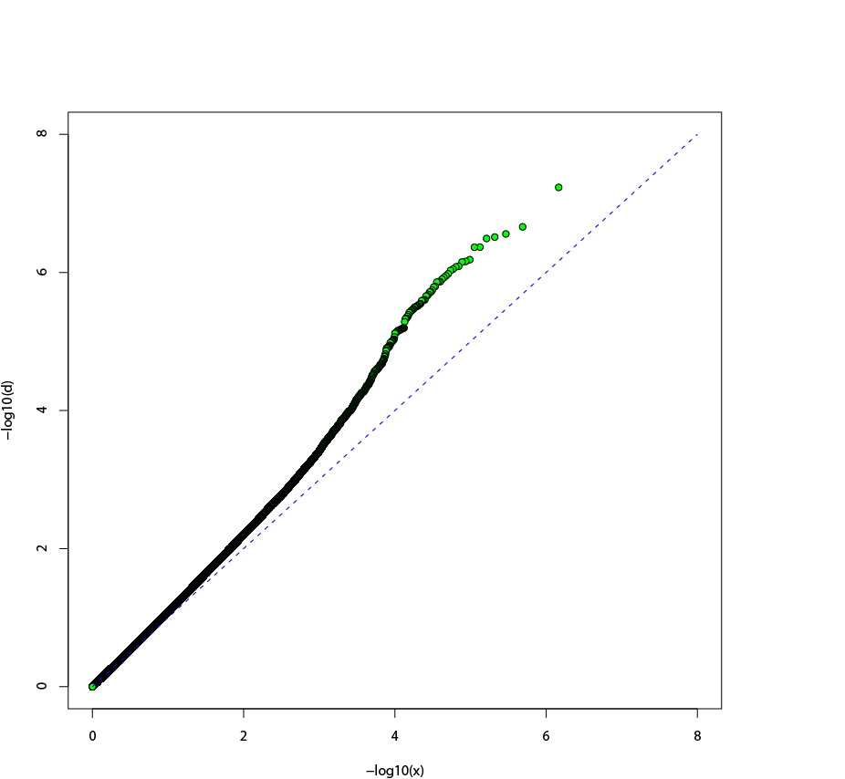
LD Score:
Distribution of Associated SNPs
QQ-Plot
If a proportion of SNPs associated:
observed = expected
(median test statistic)
If observed > expected:
genomic inflation
Due to population stratification?
Observed -log10(p)
Expected -log10(p)
Yang et al (2011). EJHG

Slide 3
Genomic Inflation Expected under Polygenic Inheritance
Under null hypothesis:
Mean test statistic (λ_{mean}) = median test statistic (λ_{median})
Under polygenic inheritance (no population stratification):
λ_{mean} > λ_{median}
λ_{mean} reflects SNP heritability h_{g}²
λ_{median} reflects # causal variants contributing to h_{g}²
Controlling for genomic inflation may remove both pop strat and real effects. How to tell them apart?
Yang et al (2011). EJHG

Slide 4
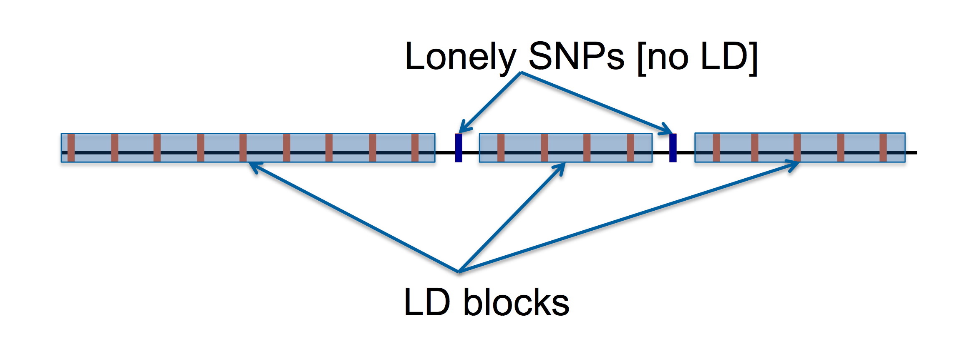
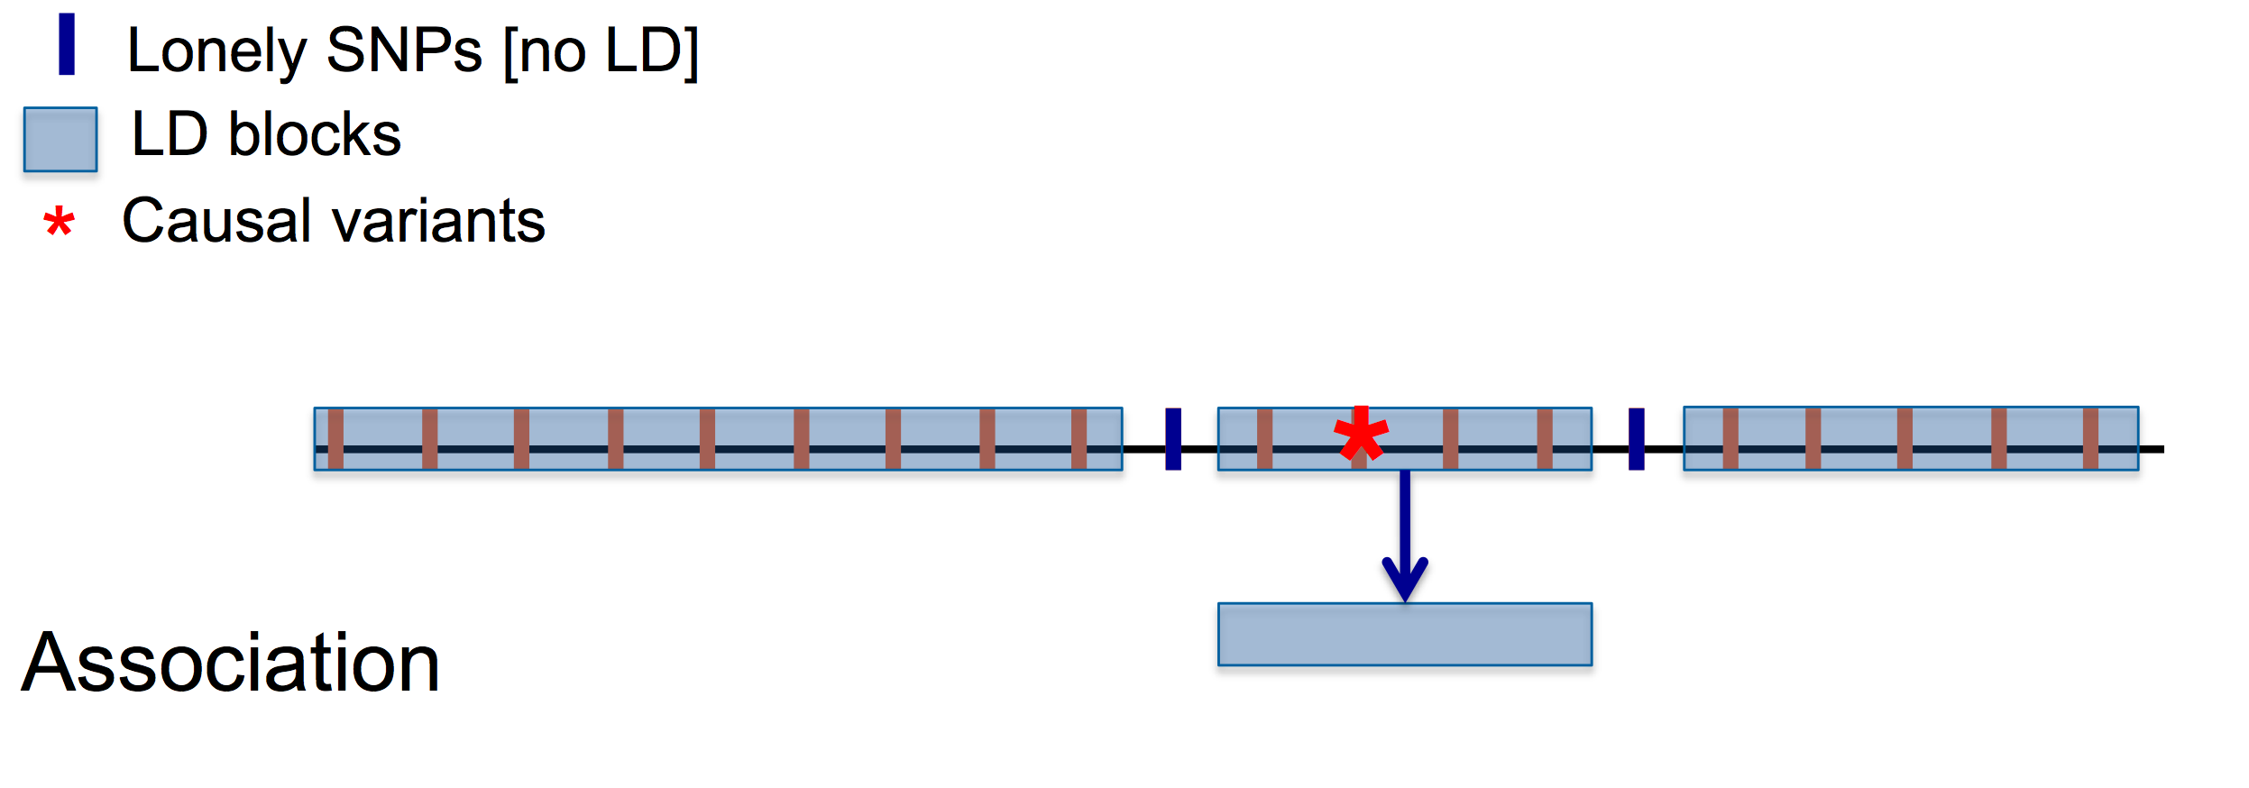
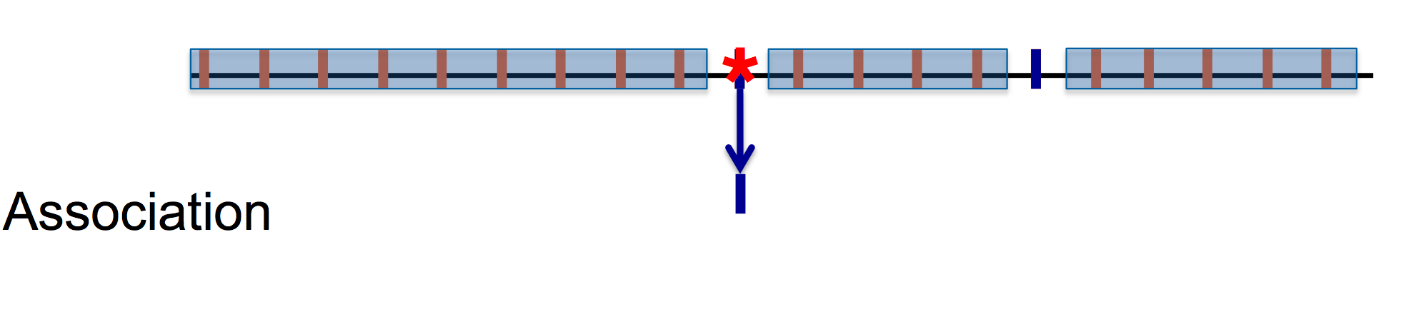
Impact of LD on Association
LD among SNPs:
Consider causal SNPs
All in LD with causal SNP also associated
Lonely SNPs only associated if causal
More tagging of SNPs, more likely to tag a causal variant.
If all SNPs equally likely associated given LD status, expect more association for SNPs with more LD ‘friends’.
This is a reasonable assumption under a polygenic genetic architecture.

Slide 5
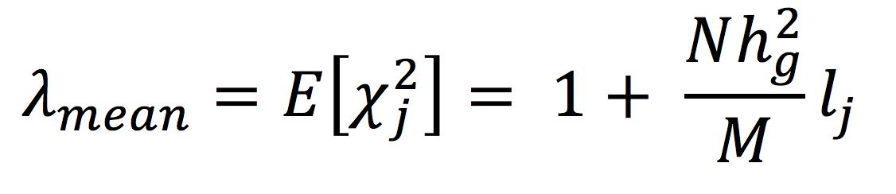
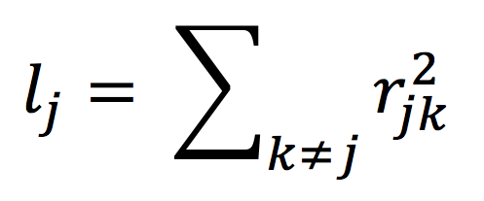
Expected Value of Summary Stats
Sample size
SNP heritability
LD Score of SNP j: amount of genetic variation tagged by j.
Number of SNPs
LD Score:
r² LD between SNP j and neighboring SNPS
But can’t separate out population stratification here.
Bulik-Sullivan, et al. NG 2015

Slide 6
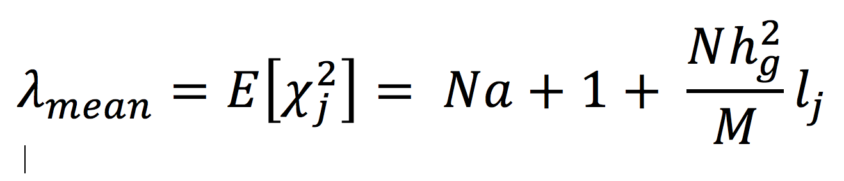
Expected Value of Summary Stats
Separating h_{g}² and population stratification
Population
Stratification factor
Same as before
regression
intercept
slope
Bulik-Sullivan, et al. NG 2015
Notes:
Method used in PGC-SCZ, Nature, 2014

Slide 7
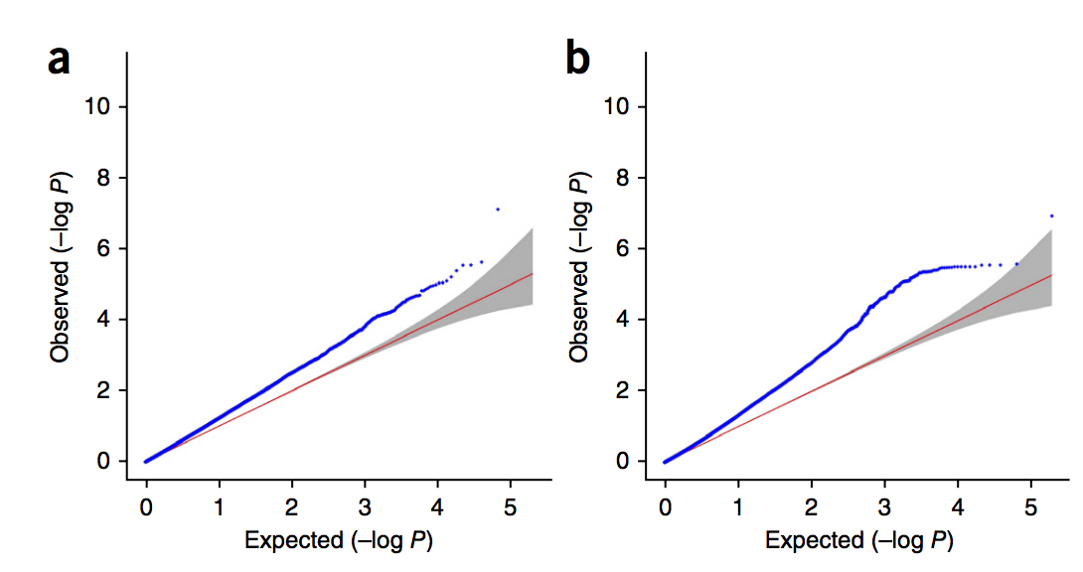
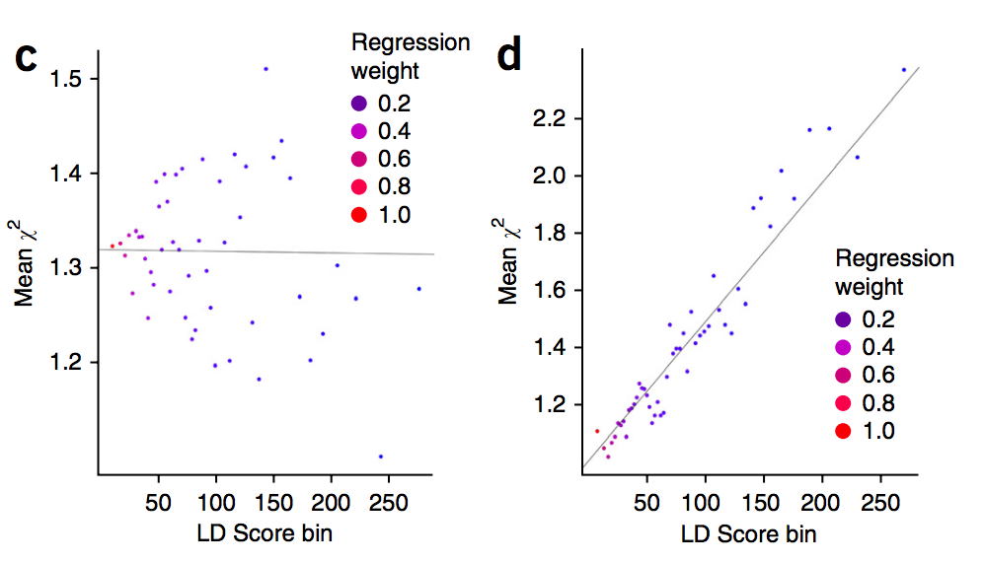
Polygenicity vs Population Stratification
Stratification
Polygenicity
GWAS QQ Plot
Regression of association X² statistic on LD score
Bulik-Sullivan, et al. NG 2015
Notes:
Under strat, due to drift or selection not associated with trait of interest,
expect no relationship between LD score and X².
Applied to many traits and found that most of the QQ inflation is due to polygenicity. So dividing by lambda GC is conservative.
Don’t adjust in meta-analyses (double adjusting). This results in overadjustment.

Slide 8
Measures of Variation Explained
Assume we’ve identified risk variants from single locus models.
Once discovered, what next?
  Search for more risk variants?
  Focus on their biology?
  Probably both!
Depends on their overall impact on disease.
Can assess with a number of measures
  give values between 0 and 100%

Slide 9
Measures to Assess Impact
Heritability explained
Sibling recurrence risk explained
Log RR: familial risk explained
Area under the receiver-operating curve (AUC)
Population attributable fraction (PAF)
Key questions:
How do these measures compare?
Do they provide similar info?
Does genetic architecture of disease impact differences?
Notes:
Measures developed with different goals and within traditionally disparate fields:
Quantitative geneticists: interested in genetic basis underlying trait variability (liability threshold models).
Epidemiologists: estimate associations (log-risk models).

Slide 10
Different Messages?
Results in contrasting and confusing use of these measures.
Example,
  for Crohn’s disease variants in NOD2 reported to explain:
    1-2% of heritability
    ~5% of familial risk
    18% of the PAF

Slide 11
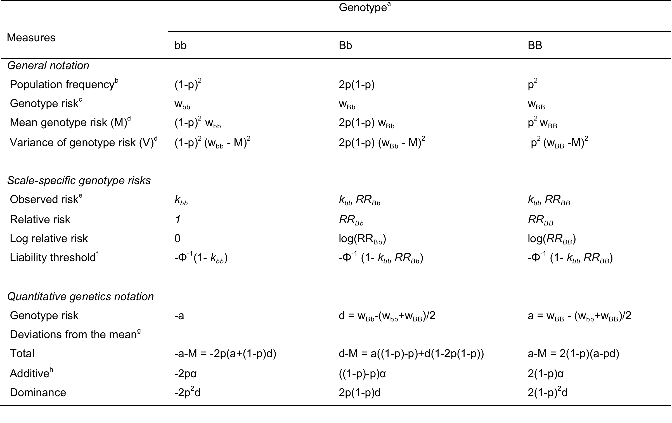
Heritability Explained

Slide 12
Heritability Explained
Heritability: h²_{L[i]} = V_{AL[i]} / V_{PL[i]} =V_{AL[i]} / (V_{GL[i]} + 1)
where
V*L[i] = additive (*=A), phenotype (*=P), genetic (*=G) variance.
V_{A} = (1-p)²4p²α² + 2p(1-p)((1-p)-p)²α² + p²4(1-p)²α²
= 2p(1-p)α²
α = a+d((1-p)-p) (ave effect of replacing a b allele by a B allele).
V_{D} = (1-p)²4p⁴d² + 2p(1-p)4p²(1-p)²d² + p²4(1-p)⁴d²
= (2p(1-p)d)²
V_{G} = V_{A} + V_{D} (Applied to liability risk genotypic values.)
Heritability explained: h²_{L[i]} / h²_{L}
Across multiple variants: h²_{L[i]} / h²_{L} (Falconer & Mackay 1996)

Slide 13
Heritability Approximation
If we can assume small RR and a multiplicative model (RR_{Bb}² = RR_{BB}).
Then, h²_{Lapprox[ i]} = 2p(1-p)(RR_{Bb}-1)²/x²
where
x = the mean liability of cases, approximated as z/K
z is the height of the standard normal distribution at the threshold T that truncates the proportion K, T= Φ⁻¹(1-K)
Heritability explained: h²_{Lapprox[i]} / h²_{L}
Stahl et al., Nat Genet 2012

Slide 14
Sibling Recurrence Risk Explained
Proportion of the total sibling risk explained by the risk variants (observed scale).
Siblings share V_{AO}/2 + V_{DO}/4 of risk.
V_{AO[i]} = k²_{bb}2*p(1-p)(p*(RR_{BB}-RR_{Bb})+(1-p)*(RR_{Bb}-1))²
V_{DO[i]} = k²_{bb}p²(1-p)²(RR_{BB}+1-2*RR_{Bb})²
Sibling risk explained: log(λ_{S[i]}) / log(λ_{S})
Across multiple variants:

Slide 15
Log RR: Familial Risk Explained
More epidemiologic approach.
Genetic variance attributable to the ith locus on the log risk scale:
where M is the mean value of log relative risk,
M= 2p(1-p) log(RR_{Bb}) + p² log(RR_{BB}).
Multiple alleles, log-risk ~N with var=2log(λ_{S})
Variation explained: V_{Glog[i]}/ 2log(λ_{S})
Across multiple variants V_{Glog[i]}/ 2log(λ_{S})
Pharoah et al., Nat Genet 2002

Slide 16

Area Under the Curve
where
x = mean liability among cases
v = -x * K(1-K)
T= population threshold (determined from the disease prevalence K)
Proportion explained: divide risk variant AUC by the maximum attainable AUC for a genetic risk predictor.
[(AUC_{L[i]}-0.5) / (AUC_{Max}-0.5)]²
Wray et al., Plos Genet 2010

Slide 17
Application
Explore how these measures can imply different impacts of genetic variants on disease.
Calculate them across studies of:
  a) Breast cancer
  b) Crohn’s disease
  c) Rheumatoid arthritis
  d) Schizophrenia
Notes:
Go to website, download and run practicum.

Slide 18
Results: Breast Cancer
M=65
K=0.12
SRR=2
h²=0.6
Notes:
GWAS have detected a relatively large number of low-risk, common variants for breast cancer (m=65 from NHGRI catalogue). Based on the literature we assume that the baseline disease risk = 12% and the sibling relative risk (l_{S}) = 2.0¹⁸; these are consistent with heritability of liability = 60%. Benchmarked against these values, almost all of the risk variants explain less than 0.5% of the total variation in heritability, sibling risk, familial risk, and AUC (Figure 2a; Table 1; Supplemental Table 1). As expected, the variant with larger effects on breast cancer (1.3 < odds ratio ≤ 2) explain a larger proportion of these measures (Figure 2a; blue lines). The breast cancer heritability explained is lower than the other measures, and the sibling relative risk is the largest—in agreement with our empirical calculations. All of the breast cancer variants combined are estimated to explain: 13% of the approximate heritability; 18% of heritability; 19% of the AUC; 21% of the familial risk; and 22% of the sibling risk (Figure 2a; Table 1). The similarity among the latter four measures reflects the uniformly low penetrance and high frequency across the risk variants. Moreover, the relatively high proportion of these measures explained reflects the high baseline risk but modest sibling risk for breast cancer in the population.

Slide 19
Results: Crohn’s Disease
rs5743293
RR=3.1, RAF=0.02
rs1120902
RR=2.4, RAF=0.93
M=165
K=0.005
SRR=10.3
h²=0.72
Notes:
Recent research has detected at least 140 modest—and three additional high-risk—variants for Crohn’s disease.¹⁹ We assume that the baseline risk of Crohn’s = 0.5%, the sibling relative risk = 10.3, and the heritability of liability = 72% ²⁰. For the low risk, common variants similar patterns are observed as with breast cancer: heritability < familial risk < sibling risk (Figure 2b, Table 1; Supplemental Table 2). For the high-risk variants (2<RR<15), however, there is more variation in these measures, reflecting different combinations of RRs and RAFs (Figure 2b, red lines). Specifically, the common allele of rs11209026—which is the wild-type allele corresponding to the uncommon IL23R coding variant protective for Crohn’s—has a relatively large effect (RR=2.4) but is extremely common (RAF=0.93) so it explains the most individual heritability (1.4%) but lower sibling risk (0.97%) (Table 1). In contrast, rs5743293 has an even larger effect (RR=3.07) but is less common (RAF=0.02) so it explains slightly less heritability (1.1%) but substantially higher sibling risk (4.0%) (Table 1). Taken together, the 143 Crohn’s risk variants account for approximately 16.4% of the heritability, but explain a larger proportion of the sibling risk (25%), and an even larger proportion of the AUC (33%) (Figure 2b; Table 1). The higher AUC estimates across all of the risk variants reflect in part the low baseline risk of disease (0.5%).

Slide 20
Results: RA
rs6910071, HLA-DRB1E
RR=2.88, RAF=0.22
M=36
K=.01, SRR=6
h²=0.63
Notes:
Here we evaluate 36 risk variants, and assume a RA disease risk = 1% and sibling risk = 6.0, which together are consistent with heritability of liability of 63%.¹⁷ Even with so few risk variants we observe a similar proportion of disease explained as for Crohn’s (Figure 2c, Supplemental Table 3). This is due to the substantial impact of a single variant on all of the measures: rs6910071 at the HLA-DRB1E locus (Figure 2c, red line). This variant has a large effect on RA (RR=2.88) and is common (RAF=0.22), so it accounts for an estimated 8% of the heritability, 16% of sibling relative risk, 11% of familial relative risk, and 14% of the AUC (Table 1). The two-fold range between heritability and sibling relative risk leads to a substantial difference in the overall measures of genetic variation explained: 15% of heritability but 25% of sibling risk. Thus, single common variants of large effect can result in different estimates across these measures.

Slide 21
Results: Schizophrenia
CNVs: 16p11.2, 22q1
RR>25, RAF=0.0003
M=24
K=.01, SRR=8.8
h²=0.8
Notes:
At the time of this investigation there are 24 published GWAS risk variants for schizophrenia^{21,22}. We also consider eight rare copy number variants (CNV) that substantially increase risk of this disease (Figure 2d, Supplemental Table 4).²³⁻²⁶ Here we benchmark using baseline disease risk = 1%, sibling relative risk = 8.8, together consistent with heritability of liability of 81%.²⁷ As above, the common low risk variants explain a small percentage of the measures evaluated here (Figure 2d—green lines). In contrast, the CNVs give extremely different results across these measures (Figure 2d, red and black lines). This is especially apparent for the CNVs at 16p11.2 and 22q11, which both are rare (RAF=0.0003) and have enormous effects on schizophrenia (RRs>25). Due to their rarity these explain a modest proportion of heritability, familiality, and AUC (<0.5%); but their large impact on disease results in much higher proportions of approximate heritability (>5%) and sibling risk (>7.5%) (Figure 2d; Table 1). Thus, when looking at all 32 schizophrenia variants (24 GWAS and 8 CNVs), estimates of the heritability, sibling risk, familial risk, and AUC explained give very different messages about the variants’ impact on this disease. While the variants explain only 2.5-3% of heritability or familial risk, and 5% of AUC, they are estimated to account for up to five-times as much of the approximate heritability and ten-times as much of the sibling risk (Figure 2d; Table 1). The large increase for the approximate heritability was expected since this departs from heritability for large RRs. But it was somewhat surprising to see such a large departure between the sibling and familial risk explained. While the sibling risk is generally always larger than the familial risk, the rarity and extremely large effects for the CNVs results in these two seemingly similar measures giving drastically different results.

Slide 22
What goes into Denominator?
All measures considered here require specification of a denominator.
The apparent impact of genetic variants can hinge on the baseline or overall risks.
Undertake probabilistic sensitivity analyses to explore how results vary across risks.
Final results in terms of benchmarking, not exact estimates.

Slide 23
Population Attributable Fraction
Proportion by which disease reduced in a population if exposure to a risk factor(s) was reduced or removed.
For multiple variants:

Slide 24
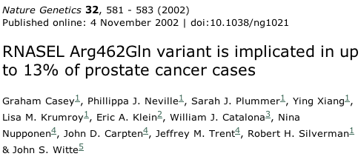
Example of PAF

Slide 25
Population Attributable Fraction
~ Order of magnitude larger than other measures.
As RAF > 0.50, PAF only measure that increases.
When RR and RAF get large, single variant PAF approaches 100%.
Examples:
  Breast cancer variant (rs10771399, RR=1.2, RAF = 0.90) PAF=28%
  Schizophrenia rare variant (CNV at 16p11.2, RR=26, RAF = 0.0003) PAF =1.4%
  Combined PAF > 90% (=100% with ½ Crohn’s variants)

Slide 26
Computational Anomaly in PAF
Apparent impact of each additional risk variant depends on which variants have already been incorporated.
E.g., assume two genetic variants for a disease:
  each with individual PAF=0.50
  combined PAF = 0.75 (=1-(1-0.5)²).
Remove 1 variant disease by ½.
Remove 2nd disease by ½ in remaining popln. Or by ¼ in original population.

Slide 27
PAF curve Depends on SNP Order
Notes:
The combined PAF also exhibits a computational anomaly: the apparent impact of each additional risk variant depends on which variants have already been incorporated into this measure. For example, assume that there are two genetic variants for a disease, and each has an individual PAF of 0.50, and a corresponding combined PAF of 0.75 (=1-(1-0.5)²). An intervention that eliminates the effect of a risk variant at any one of these risk loci would decrease the incidence of disease in the population by half. An intervention at the second locus would further reduce the disease incidence by half in the remaining population, or by a quarter in the original population. That is, the order in which the exposure is removed will impact the magnitude of its apparent effect on the combined PAF. This phenomenon is shown in Figure 3: if we include the known risk SNPs based on increasing or decreasing RRs the combined PAF curves substantially differ. In other words, the apparent impact of a given risk variant on the combined PAF depends on what has already been discovered. Novel variants from less versus more well studied traits will appear to have a larger effect, even if the risk variants have the same magnitude of association and risk allele frequency. Moreover, the combined PAF is not analogous to that obtained by removing an environmental exposure such as smoking from a population. As the number of known risk loci continues to increase—many of which are quite common—essentially everyone in the population will carry a number of risk alleles. Then any preventative treatment directed at countering the risk loci (e.g. a pharmacologic intervention) would have to be applied to the entire population, which seems very unrealistic.

Slide 28
Another Issue with PAF…
Combined PAF not analogous to that obtained by removing an environmental exposure (smoking).
As the number of known risk loci continues to increase, essentially everyone in the population will carry a number of risk alleles.
Then any preventative treatment directed at countering the risk loci would have to be applied to the entire population, which seems very unrealistic.

Slide 29
Take Home…
For common and rare variants of varying penetrance, use heritability explained or the proportion of genetic risk on a log-scale.
Avoid approximation to the heritability and sibling relative risk because they break down for rare, high-penetrance variants (vastly inflated estimates).
Issues with AUC, and PAF has a number of undesirable properties.

