Slide 1
Module 10: Statistical and Quantitative Genetics of Disease:
Hierarchical Modeling / GxE Interactions
John Witte
Lecture 6

Slide 2
I. Hierarchical Model
Efron & Morris, 1974
Witte, 1996
Conti and Witte, 2003
Chen and Witte, 2007

Slide 3
Posterior Estimates
Weighted to reflect precision of ML and prior estimates

Slide 4
Incorporating Additional Info?
  Part of a known pathway?
  Within linkage \ association regions?
  Potentially functional?
  Degree of conservation?
  Tagging other SNPs?
  Copy number polymorphism?
Notes:
Pathways - how to define?
Many websites / companies provide ‘dynamic’ graphic models of molecular and biochemical pathways.
Examples: GO (Gene Ontology), KEGG, BioCarta, Reactome
May be interested in potential joint and/or interaction effects of multiple genes in one pathway.

Slide 5
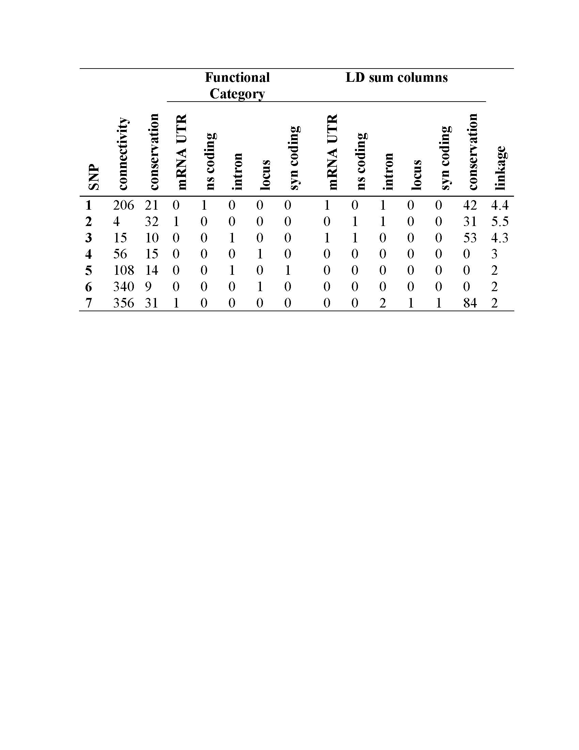
Z matrix

Slide 6
HM Example: SNPs and Expression
Previous result:
  Linkage to chromosome 1, and association between SNP in chitinase 3-like 2 (CHI3L2) promoter and CHI3L2’s expression level
Genoptypes:
  Affy 500K data, unrelated CEPH individuals
Prior information:
  Linkage region (& LOD scores)
  Functionality
  Conservation scores
  Number of SNPs tagged
Cheung et al., Nature 2005; 437:1365-1369.

Slide 7
HM Example Results
Chen & Witte, AJHG 2007

Slide 8
II. GxE Interactions
Conventional approaches
Case-only GxE
Empirical-Bayes case-only / case-control
Two-step approaches
Gene-sets / pathways
Other…
Gauderman et al., submitted 2016

Slide 9
Gene-Environment Interactions
Difference in the magnitude or direction of effect of an environmental exposure on disease risk in people with different genotypes (or vice-versa).
Effect modification
Important because it may:
  Identify populations with environmental exposures at increased risk.
  Increase power and/or statistical accuracy.
  Clarify biological mechanisms of disease risk.
  Explain some of the missing heritability.

Slide 10
1. Conventional Analysis
Assume case-control data.
Logit(Pr(D=1|G,C) = α₀ + β_{G}G + β_{C}C
  D = binary trait or disease outcome
  G = genetic variant (e.g., SNP coded 0, 1, 2)
  C = set of potential confounders
exp(β_{G}) = ‘marginal effect’ of G on D
  averaging (or marginalizing) over the environmental (E) exposure-specific effects of G.
E may or may not be included in C

Slide 11
Conventional GxE Model
Logit(P(D=1|G,E,C))=α₀+ β_{G}G+ β_{E}E+ β_{GxE}GxE+β_{C}C
exp(β_{G}) = main effect of G on D (G=1, E=0)
exp(β_{E}) = main effect of E on D (G=0, E=1)
exp(β_{GxE}) exp(β_{G}) exp(β_{E}) = overall effect (G=1, E=1)
For a cohort study, use a log-linear model to estimate relative risks or a proportional hazards model to estimate hazard rate ratios if time-to disease data are available.
For a quantitative outcome, use linear regression.

Slide 12
Interaction Scale
  Multiplicative
  Departure from multiplicative effects implies odds-ratios associated with one risk-factor varies by the level of the other risk-factor and vice-versa.
  GxE_{Multp} = exp(β_{GxE}) exp(β_{G}) exp(β_{E}) / (exp(β_{G}) exp(β_{E}))
    = exp(β_{GxE}) = interaction effect
Additive
Departure from additivity implies that absolute risk-reduction associated with removal of one risk-factor depends on the levels of another and vice-versa.
GxE_{ADD} = exp(β_{GxE}) exp(β_{G}) exp(β_{E}) - exp(β_{G}) - exp(β_{E}) +1

Slide 13
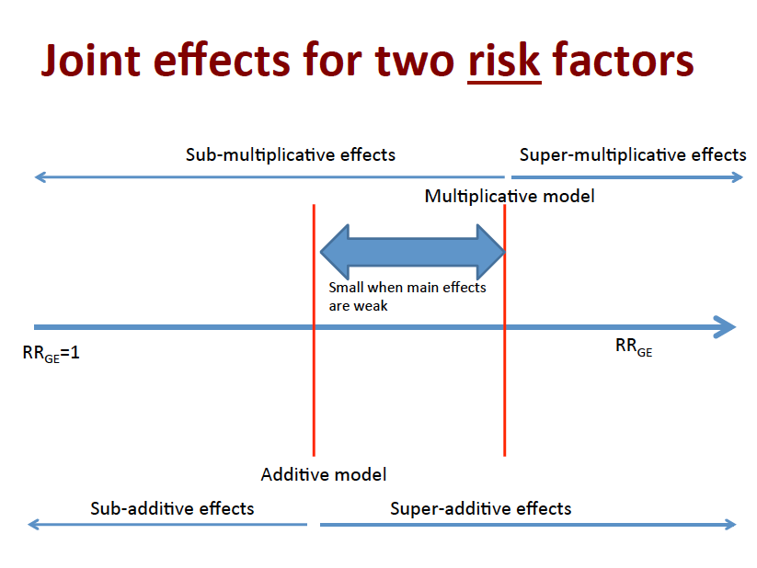
Notes:
If RR_{G+E-}≠1 and RR_{G-E+}≠1, then no interaction on one scale implies interaction on the other!
So different conclusions depending on the scale assumed (multiplicative vs. additive).

Slide 14
Factor V Leiden Mutations, Oral Contraceptive Use, and Venous Thrombosis
Strata
Cases
Controls
OR
G+E+: 34.7
G+E-: 6.9
G-E+: 3.7
G-E-: Reference
G+E+
25
2
OR _{Interaction (mult)}
= OR_{G+E+} / OR_{G+E-} OR_{G-E+}
= 34.7 / 6.9 x 3.7
= 1.4
OR _{Interaction (add)}
= OR_{G+E+} - OR_{G+E-} - OR_{G-E+} +1
= 34.7 - 6.9 - 3.7 +1
= 25.1
G+E-
10
4
G-E+
84
63
G-E-
36
100
Total 155 169
Vandenbroucke et al., The Lancet 1994

Slide 15
Testing for Multiplicative GxE Interactions
Logit(P(D=1|G,E,C))=α₀+ β_{G}G+ β_{E}E+ β_{GxE}GxE+β_{C}C
1 df test. H₀: β_{GxE} = 0.
2 df test. Joint null H₀: β_{G}= β_{GxE} = 0.
2 df often more powerful than 1 df test.

Slide 16
Controlling Confounding
When testing GxE interaction, need to consider inclusion of confounders C in the model, but also G x C and E x C interactions.
GxE interaction effects can themselves be confounded by other interactions.
Potential Confounders: PCAs, etc.
Keller MC. Biol Psychiatry 2014;75(1):18-24.

Slide 17
Why so few GxE Interactions detected?
Limited power.
Challenges measuring E (both for discovery and replication).
Model misspecification.
A number of approaches can increase power.
Notes:
Finally, the models that appear most powerful for detecting GxE interactions in simulation studies may not necessarily find the most interactions in real data. For example, the conventional case-control GxE design appears the least powerful in simulation studies; but in a recent study of colorectal cancer, this approach detected more of the GxE interactions than other putatively more powerful models. This counterintuitive observation may reflect limitations of the simulation studies’ applicability, or false positives in the colorectal study. Understanding what is underlying this conflicting result might help clarify the strengths and weaknesses of different methods for detecting GxE interactions.

Slide 18
2. G-E Interaction: Case-Only
Strata
Cases
Controls
Odds Ratio (OR)
ah / bg
ch / dg
eh / fg
1
G+E+
a
b
G+E-
c
d
G-E+
e
f
G-E-
g
h
OR _{Interaction} = OR_{G+E+} / OR_{G+E-} OR_{G-E+}
= ah/bg / (ch/dg) (eh/fg)
= (ag/ce) / (bh/df)
= ag/ce if no G-E assoc in controls (bh/df = 1).
Piegorsch et al., 1994
Notes:
Assume independence of G-E in source population.
Can’t look at main effects.
Can only look at multiplicative departures.

Slide 19
Case-Only Model
Logit(P(G=g|E,D=1)) = γ₀+ γ_{GxE}E
exp(γ_{GxE}) = GxE interaction effect
H₀: γ_{GxE} = 0.
Wald test asymptotically equivalent to H₀: β_{GxE} = 0 (assuming log-additive coding for g, 0,1,2).
If G-E are associated in source population, then can give high false positive rate.

Slide 20
Overview
Conventional approaches
Case-only GxE
Empirical-Bayes case-only / case-control
Two-step approaches
Gene-sets / pathways
Other?

Slide 21
3. Empirical-Bayes GxE Test
Case-only more efficient than case-control, but can give biased results (e.g., if G-E assumption violated).
Use EB hybrid model to combine case-control and case-only approaches (bias versus efficiency trade-off).
β_{EB} = K(β_{GxE}) + (1-K)γ_{GxE}
where K=θ_{GE}²/(σ_{GxE}²+θ_{GE}²)
θ_{GE} = G-E association
If θ_{GE} ≠ 0 or if σ_{GxE}² is small, larger weight assigned to β_{GxE}.
If θ_{GE} = 0 (G-E independence), γ_{GxE} ≅ β_{GxE}, use γ_{GxE} (more efficient).
H₀: β_{EB} = 0. More power than case-control, helps control type I error from case-only.
Mukherjee and Chatterjee, 2008
Notes:
f there is G-E independence in the population (i.e. θgE=0), g_{gE} and b_{GxE} will be approximately equal, and one should favor the case-only estimate γgE for its increased efficiency. On the other hand, if the data provide evidence of gene-environment association via a value of θgE that is further from zero or if the variance of the standard case-control estimate is already very small (σGxE2→0), larger weight is assigned to βGxE.
The EB-Wald test provides power gain compared to standard case-control test and provides superior (although not perfect) control of Type 1 error compared to a case-only type test in the presence of population G-E association.

Slide 22
4. Two-Step GxE Tests
Step 1 screen: For each SNP, compute screening test statistic T₁ and corresponding p-value p₁.
Step 2 test: Prioritize SNPs based on p₁, and conduct GxE interaction test T₂ with corresponding p-value p₂.
Key requirement: T₁ and T₂ are independent.
Kooperberg and LeBlanc, 2008; Murcray et al., 2009; 2011; Hsu et al., 2012

Slide 23
Two Step GxE: Case-Control Data
Step 1:
Test for marginal D-G association
Logit(Pr(D=1 | G) = l₀ + l_{G}G, and/or
Test for E-G association
Logit(Pr(G | E) = d₀ + d_{E}E
Step 2:
Test for GxE interaction, only using SNPs passing Step 1 threshold (fewer comparisons).
Can use an E Bayes procedure here.
Additional info from Step 1 increases power by up to 50% over conventional approach.
Notes:
Three additional 2-step methods have been proposed, including H2 (22), Cocktail (20), and EDGE (19)

Slide 24
Hybrid 2-Step Approach
Step 1: test DG and EG.
Retain SNPs that pass at least one of these tests.
Step 2: Apply case-control analysis and test GxE, correcting for the number of SNPs retained from step 1.
Murcray et al., 2011;

Slide 25
Cocktail Method
Step 1: If p<threshold for EG, assign SNP that p.
Else, assign SNP from DG (marginal) analysis.
Step 2:
  If p from DG, then test for GxE using case-only model.
  If p from EG, then test GxE using case-control analysis.
  Use weighted hypothesis testing.
Hsu et al., 2012

Slide 26
EDGxE Approach
Step 1: combines the DG and EG tests into single 2 df test.
Step 2: weighted hypothesis testing of case-control analysis.
Gauderman et al., 2013

Slide 27
Power Gains for Two-step
Assume G has MAF = 0.3, and for E 30% exposed
exp(b_{G}) = exp(b_{E}) = 1.0, exp(b_{GxE}) = 1.5.
For a GWAS, 80% power (alpha = 0.05)
For conventional GxE model, N=10,060.
Two-step approaches:
  D-G screening, N=6,630
  E-G screening, N=4,472
  EDGE screening, N=3,994.

Slide 28
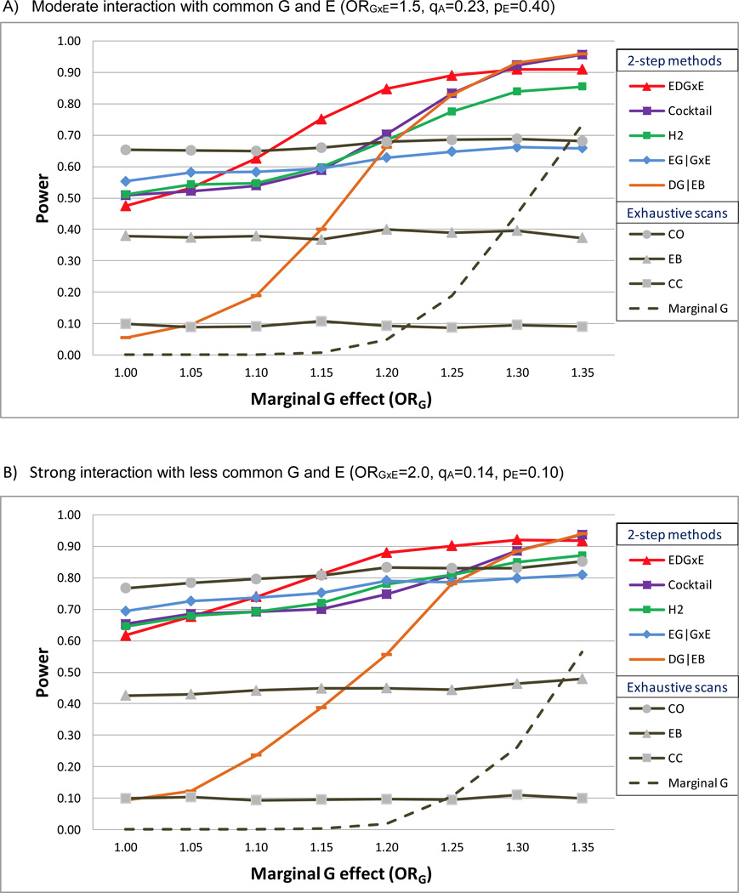
Comparison of GxE Tests
Gauderman et al., 2013

Slide 29
Gauderman et al., 2013

Slide 30
Step 2: Weighted hypothesis testing
Partition SNPs into groups, where higher ranked SNPs have less stringent alpha level.
B most significant SNPs in step 1 tested in step 2 at significance level (α/2)/B, next 2B at (α/4)/2B, next 4B at (α/8)/4B, etc.
Maintains overall GWAS alpha level, but uses larger alpha level for most promising interactions.
Ionita-Laza et al. 2007

Slide 31
Overview
Conventional approaches
Case-only GxE
Empirical-Bayes case-only / case-control
Two-step approaches
Gene-sets / pathways
Other?

Slide 32
5. Gene Sets / Pathways
Burden and variance components tests.
Combination of burden and variance component GxE tests.
Can incorporate GxE term into kernel.
Notes:
Lin et al. (33) extended the random effects model to allow for an exchangeable correlation ρ for GxE effects with ρ=1 corresponding to the burden test and ρ=0 the variance component test. A grid-search approach analogous to Lee et al. (34) is adopted to obtain the optimal ρ. Jiao et al. (35) proposed to combine the screen-informed burden test (28) and the variance-component test for GxE interaction by Fisher's combination. Recently, Su et al. (36) modelled random GxE interaction effects by a hierarchical model that allows for testing both the mean (burden) and variance components simultaneously.
Accounting for GxE interaction in testing the main genetic effect can improve power for detecting associated genetic variants.
Kazma et al. (37) extended commonly used set-based genetic association tests such as min-P test and Sequence kernel association test (SKAT) to jointly test the genetic main effects and GxE interaction effects by incorporating an additional GxE interaction term in the corresponding models.

Slide 33
6. Other…
GxE interactions using Summary Stats
Analyses stratified by E.
Then test for differences in G main effects.
Note: same methods can be applied to GxG interactions.

Slide 34
Epistasis: Gene-Gene Interactions
Similar issues as with gene-environment interaction (e.g., multiplicative vs additive scale)
P(Y=1|g₁,g₂)=₀ + ₁X(g₁) + ₂X(g₂) + ₁₂X(g₁) X(g₂)
Usually test when g₁ is from one gene, and g₂ from another gene (e.g., take GWAS hits)
Feasible to do all pairwise: plink: --fast-epistasis
  “4.5 billion two-locus tests generated from a 100K data set took just over 24 hours to run” (http://pngu.mgh.harvard.edu/~purcell/plink/)

Slide 35
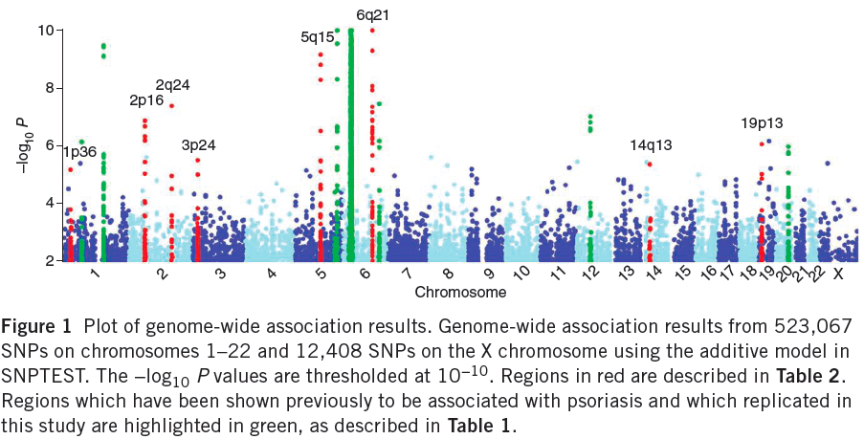
Example: GWAS of Psoriasis
ERAP1
Take the hits, and follow up on gene-gene interaction test --(nextslide)-->
Strange et al. Nature Genetics 2010

Slide 36
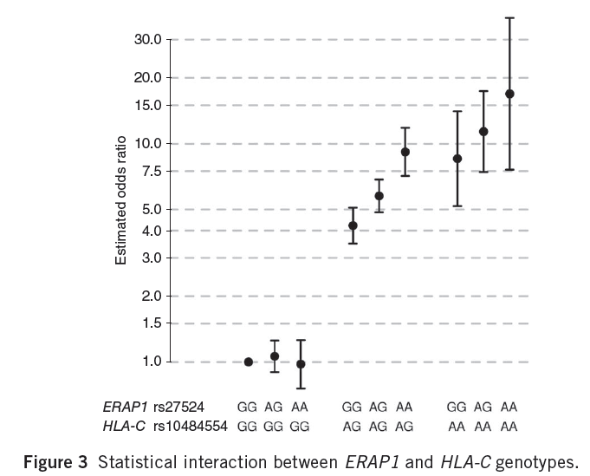
Example of Gene-Gene Interaction
Strange et al. Nature Genetics 2010

Slide 37
GxE Software
Program | GxE | Case-only | EB | 2-Step | Additive models
PLINK | X
GxEScan | X | X |  | X
CGEN | X | X | X |  | X
Notes:
Combine with summary approaches.

