Slide 1

Polygenic risk scoring
Frank Dudbridge
London School of Hygiene and Tropical Medicine
October 2015

Slide 2
Classes of genetic disease
Monogenic
  Clear phenotype
  Mendelian
Oligogenic
  Variable phenotype
  Genetic heterogeneity
Polygenic
  ‘continuous’ phenotype
  Complex traits
  Multifactorial
  extensive heterogeneity
Janssens A. and van Duijn C, Hum Mol Genet 2008
Figure 3. Complete cause models or sufficient causes of disease development.
Complete causal models for (A) Huntington Disease; (B) Phenylketonuria;
(C–F) Hypothetical examples for complex diseases. White areas refer to
genetic factors and grey areas to environmental factors.

Slide 3
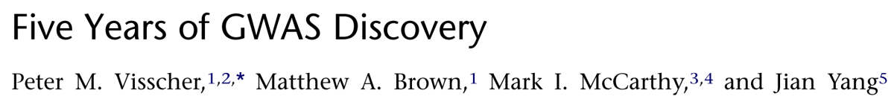
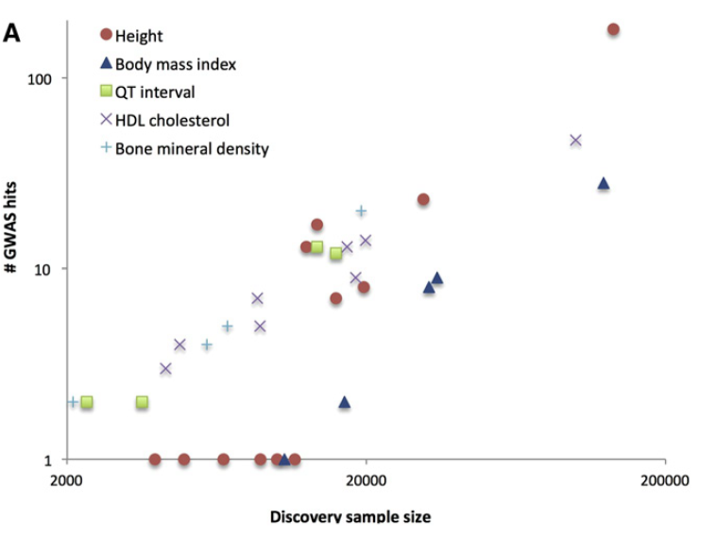
Common diseases are polygenic

Slide 4
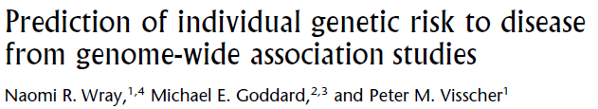

Polygenic scores
The idea of a polygenic score is to combine all the risk due to thousands of variants with small effects into a single “gene score”
This score can be used in a number of ways, as we shall see
In its simplest form, a polygenic score for an individual is the total number of risk-increasing alleles carried by that person

Slide 5
Acronyms, synonyms
PRS
  Polygenic risk score
GPRS
  Genomic profile risk score
PGS
  Polygenic score
GRS
  Genetic risk score
Gene score
Genetic score
Genotypic score
Allele score
Profile score
Linear predictor

Slide 6
Polygenic scores
We build a “gene score” by summing the risk alleles across many SNPs
  Ideally, weighted by their true effect sizes
  Ideally, including all the SNPs affecting the trait, and no other SNPs
Departure from these ideals creates options in building scores
The polygenic score accesses more heritability than individually associated SNPs

Slide 7
Building polygenic scores
We do not know the true effect sizes of SNPs
Estimate effect sizes from
  The data at hand
  External data, eg consortium data
    More precise, but more heterogeneous
  +1 for risk increasing, -1 for risk decreasing: unweighted score
We do not know all the SNPs affecting the trait
Could include
  Genomewide significant SNPs
  Nominally significant SNPs (P<0.05)
  All the SNPs

Slide 8
Polygenic scores
SNPs
Trait 1
Subjects
Training sample
~
β₁, β₂, β₃, ...,
,..., β_{m}
sort
Selected SNPs
Score
Trait 2
P₍₁₎
P₍₂₎
P₍₃₎
...
P_{T}
...
P_{(m)}
β₍₁₎
β₍₂₎
β₍₃₎
...
select
Subjects
Target sample
=
~

Slide 9
Example
Log odds ratios from previous GWAS
0.5 | 0.2 | 0.6 | 0.3 | 0.9 | 0.7 | 0.4
 | SNP1 | SNP2 | SNP3 | SNP4 | SNP5 | SNP6 | SNP7
Case1 | 0 | 2 | 1 | 2 | 0 | 0 | 1
Case2 | 2 | 2 | 1 | 2 | 0 | 2 | 1
Control1 | 0 | 1 | 1 | 0 | 2 | 1 | 2
Control2 | 1 | 1 | 2 | 1 | 1 | 2 | 1
 |  |  |  |  |  |  |  | Score
Case1 | 0×0.5+ | 2×0.2+ | 1×0.6+ | 2×0.3+ | 0×0.9+ | 0×0.7+ | 1×0.4= | 2.0
Case2 | 2×0.5+ | 2×0.2+ | 1×0.6+ | 2×0.3+ | 0×0.9+ | 2×0.7+ | 1×0.4= | 4.4
Control1 | 0×0.5+ | 1×0.2+ | 1×0.6+ | 0×0.3+ | 2×0.9+ | 1×0.7+ | 2×0.4= | 4.3
Control2 | 1×0.5+ | 1×0.2+ | 2×0.6+ | 1×0.3+ | 1×0.9+ | 2×0.7+ | 1×0.4= | 4.7

Slide 10
More synonyms
Discovery = Training
Replication = Target
But we did not necessarily discover anything...

Slide 11
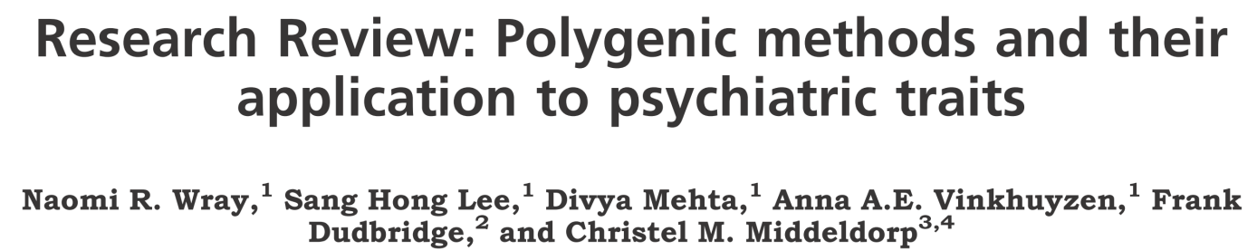

PRS (“profile scoring”) in PLINK
Reduce the SNPs to a set in approximate LD
  Best done using “clumping”: keep the most associated SNP, remove those in LD with it, then keep the next most associated remaining SNP, etc
  Recommend LD threshold of r²<0.1
  plink --clump-p1 1 --clump-p2 1 --clump-r2 0.1 --clump-kb 500
Estimate effect sizes of these SNPs
  plink --assoc

Slide 12
PRS (“profile scoring”) in PLINK
Create a file listing SNPs and their effect sizes
  Take logs of odds ratios
  awk
Create a file listing p-value thresholds to select SNPs into PRS
Generate PRS for subjects in the target sample
  plink --score --q-score-range
Regress target phenotype against PRS
  glm(y~prs, family=binomial)

Slide 13
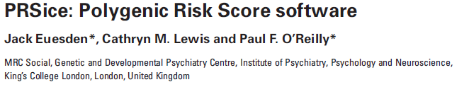
PRSice
R package to simplify calculations of PRS
http://prsice.info
Jack Euesden talk on Saturday

Slide 14
Uses of polygenic scores
Evidence for a polygenic signal
Evidence for a shared genetic basis
Patient stratification and sub-phenotyping
Individual risk prediction
Mendelian randomisation
Estimating the genetic architecture of a trait
NB – for each of these applications, there are potentially better methods available
PRS is relative simple and generally works well enough
A new field of polygenic epidemiology

Slide 15
Find evidence of a polygenic signal
Train the score on one sample
Test for association with the same trait in a second sample
This test should only be significant if there are many associated SNPs within the score

Slide 16
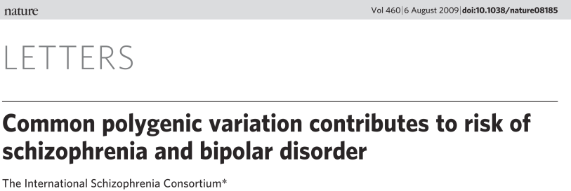
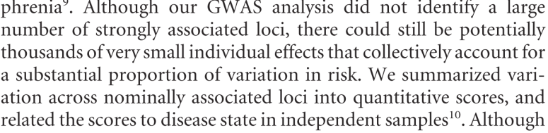
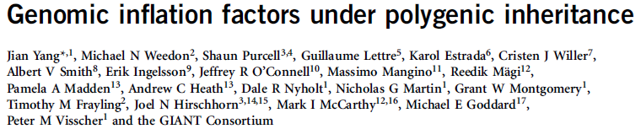
First example – schizophrenia
Purcell noticed that the genomic control λ remained above 1 despite very rigorous QC
Argued that this was due to many small, non-null effects – polygenic effects
The argument since affirmed by theory

Slide 17
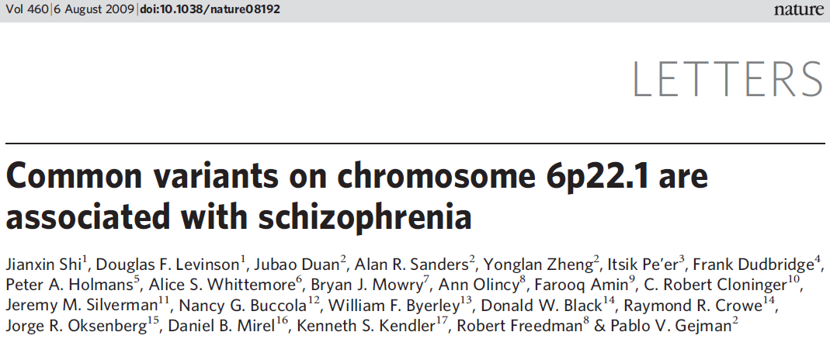
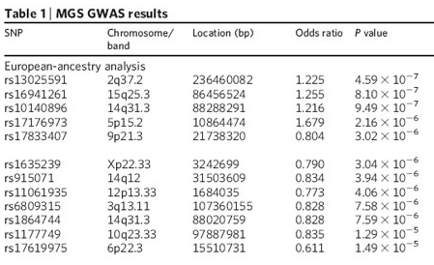
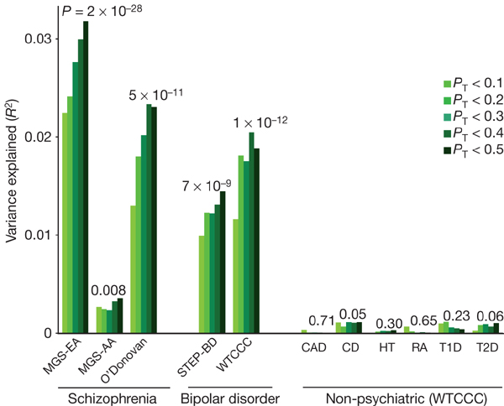
First example – schizophrenia
Training
Target

Slide 18


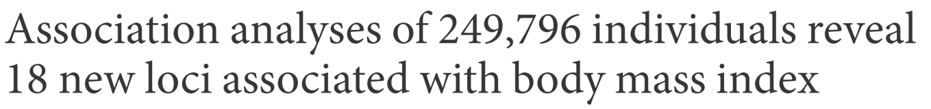
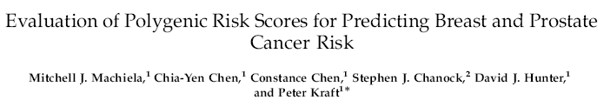
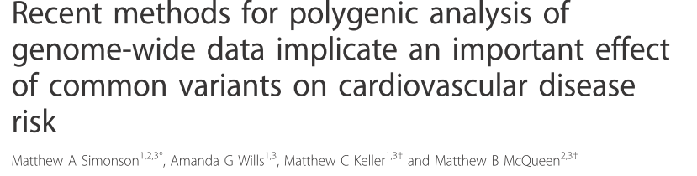

Other early papers

Slide 19
Shared genetic basis between traits
Train the score on one sample
Test association with a different trait in a second sample
This test should only be significant if many SNPs affecting the first trait also affect the second

Slide 20

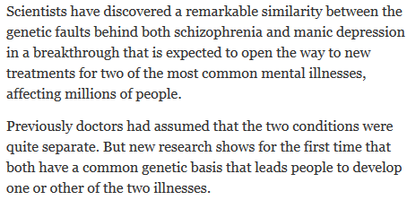
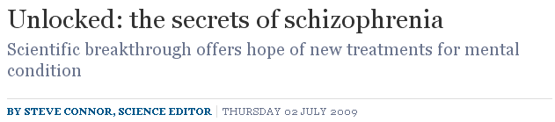
First example – schizophrenia & bipolar disorder

Slide 21
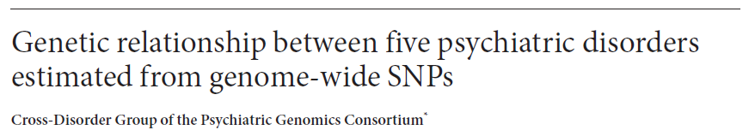

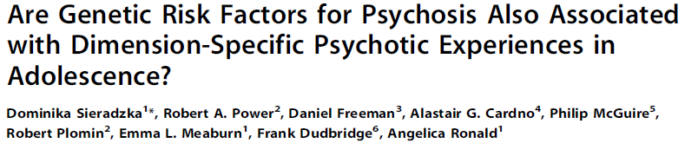
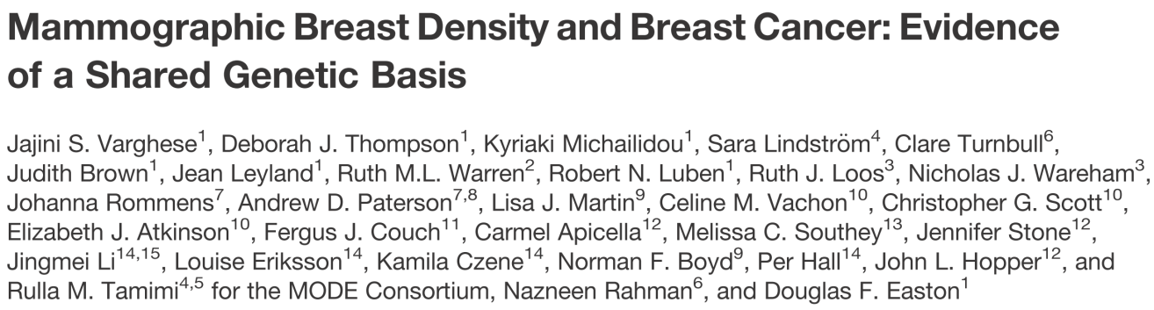
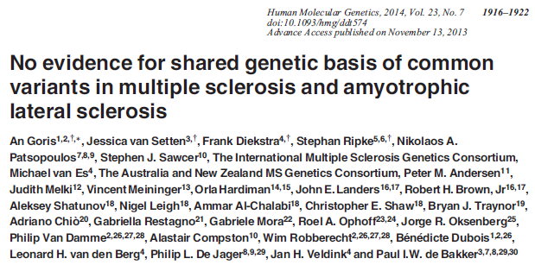
Some other examples

Slide 22


Patient stratification and sub-phenotyping
Subtypes of disease correlate with polygenic score
Schizophrenia PRS distinguished schizoaffective bipolar cases from other bipolar cases
Did not distinguish psychotic bipolar from other cases

Slide 23

Thanks
More applications, and theory, on Saturday

