Slide 1

Theory and applications of polygenic risk scores
Frank Dudbridge
London School of Hygiene and Tropical Medicine
October 2015

Slide 2
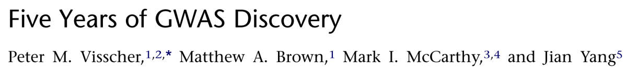
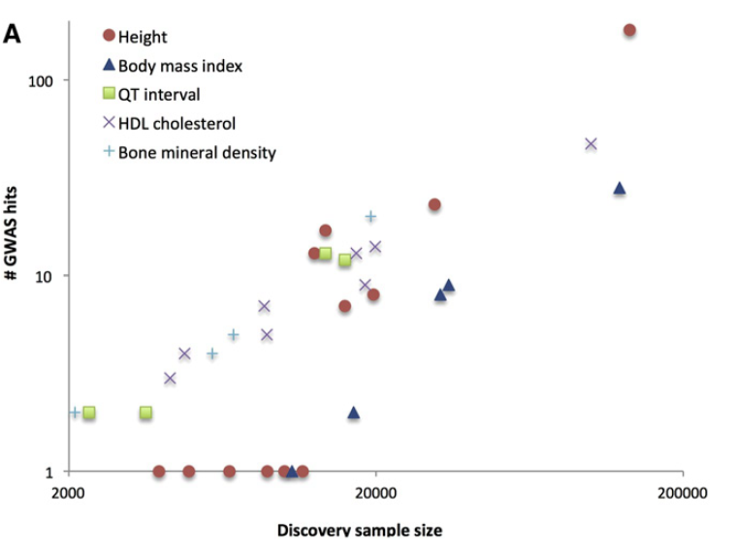

Slide 3
Polygenic scores
To access the missing heritability, a popular approach is to build a “gene score” by summing the number of risk alleles across many SNPs
  Ideally, weighted by their effect sizes
The score could include just the GW significant SNPs, or all SNPs with “small” P-values, or all SNPs on the chip
The score accesses more heritability than individually significant SNPs

Slide 4
Polygenic scores
SNPs
Trait 1
Subjects
Training sample
~
β₁, β₂, β₃, ...,
,..., β_{m}
sort
Selected SNPs
Score
Trait 2
P₍₁₎
P₍₂₎
P₍₃₎
...
P_{T}
...
P_{(m)}
β₍₁₎
β₍₂₎
β₍₃₎
...
select
Subjects
Target sample
=
~

Slide 5
Uses of polygenic scores
Evidence for a polygenic signal
Evidence for a shared genetic basis
Patient stratification and sub-phenotyping
Individual risk prediction
Mendelian randomisation
Estimating the genetic architecture of a trait
NB – for each of these applications, there are potentially better methods available
PRS is relative simple and generally works well enough
A new field of polygenic epidemiology

Slide 6
Uses of polygenic scores
Evidence for a polygenic signal
Evidence for a shared genetic basis
Patient stratification and sub-phenotyping
Individual risk prediction
Mendelian randomisation
Estimating the genetic architecture of a trait
NB – for each of these applications, there are potentially better methods available
PRS is relative simple and generally works well enough
A new field of polygenic epidemiology

Slide 7
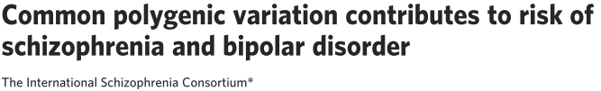


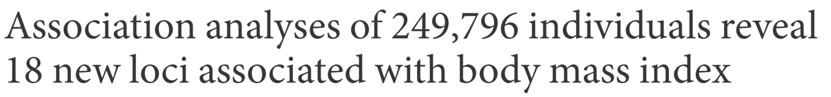
Find evidence of a polygenic signal
Train the score on one sample
Test for association with the same trait in a second sample

Slide 8
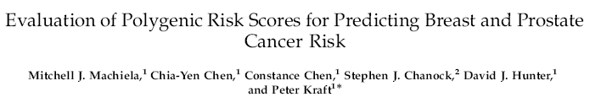
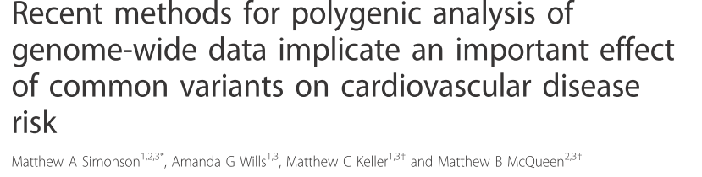

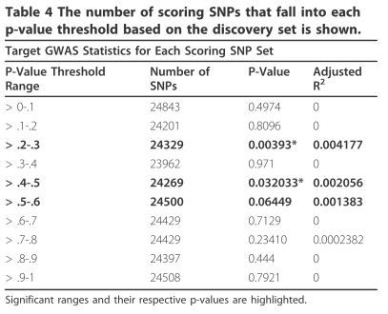
Less successful applications
Are breast cancer, prostate cancer, Framingham risk score not polygenic?
Or were these studies underpowered?

Slide 9
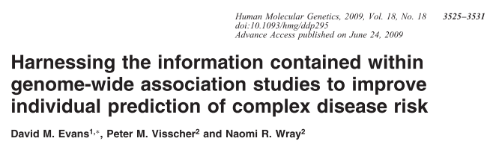
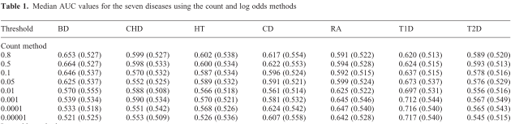
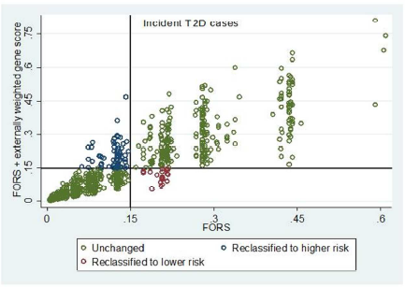
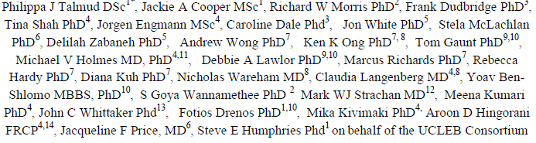
Risk prediction is challenging

Slide 10
Sampling error in the polygenic score
The weights in the gene score must be estimated from finite training data: we have the estimated gene score
The more SNPs in the score:
  The more variation we could explain ☺
  The greater its sampling error ☹
How do we manage the trade-off?
  GW-significant SNPs only, or all the SNPs?

Slide 11

Analysis of polygenic scores
Study design parameters
  Size of training and target samples
  Number of SNPs in GWAS panel
  P-value thresholds to select SNPs into gene score
  (Binary traits) prevalence
  (Case/control) sampling fractions
Genetic model parameters
  Chip heritability in training sample
  Proportion of SNPs with effects in training sample
  Genetic covariance (or correlation) training↔target

Slide 12
Analytic results
In terms of the study design and genetic model, we obtain
Correlation (R²) of polygenic score with replication trait
From which we get
Expected χ² test of association between polygenic score and replication trait
Power of this association test
Expected Area Under ROC Curve when discriminating binary outcomes with estimated score
...and more

Slide 13
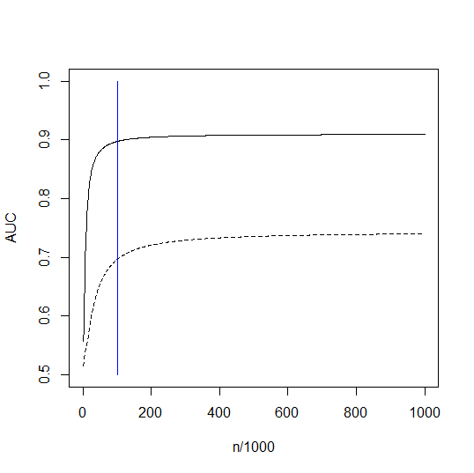
Sample sizes for accurate discrimination
Current SNP chips
Schizophrenia
Schizophrenia heritability = 80%
Depression heritability = 40%
Depression
50,000 cases + 50,000 controls
Assumes 100,000 independent SNPs explaining half the heritability
Assumes 95% of these SNPs are null
P-value threshold on SNPs chosen at each point to maximise AUC

Slide 14
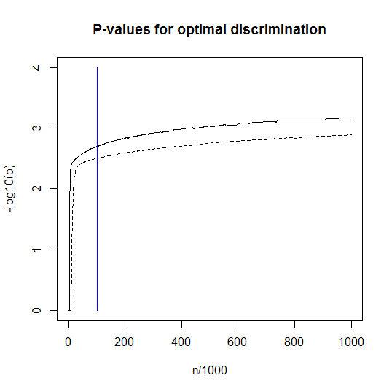
P-value thresholds
When deriving a predictor from finite training data, the most accurate predictor is expected to contain many null SNPs
Clinically useful predictors could be obtained well before all the heritability has been explained
Restricting gene scores to GW-significant SNPs is limiting
Schizophrenia
Depression
50,000 cases + 50,000 controls

Slide 15
Estimating the genetic model
Recall:
Genetic model parameters
  Chip heritability in training sample
  Proportion of SNPs with effects in training sample
  Genetic covariance (or correlation) training↔replication
In terms of the study design and genetic model, we obtain
Expected χ² test of association between polygenic score and replication trait
Conversely:
Given χ² test of association, we can solve for the genetic model parameters under which this result is the expected one

Slide 16
Parameter estimation
Genetic model parameters
  Chip heritability in training sample
  Proportion of SNPs with effects in training sample
  Genetic covariance (or correlation) training↔replication
To estimate multiple parameters, use tests of polygenic scores constructed from different P-value selections in the training data
Cannot match parameters exactly to the observed χ² tests, so we estimate the parameters as those for which the observed χ² tests are most likely
Confidence intervals can be calculated using profile likelihood

Slide 17
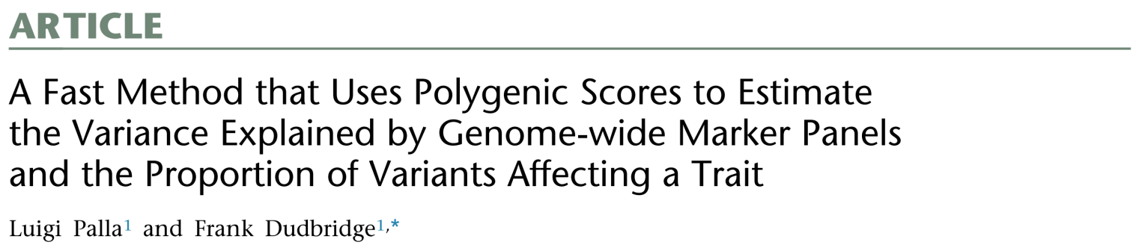
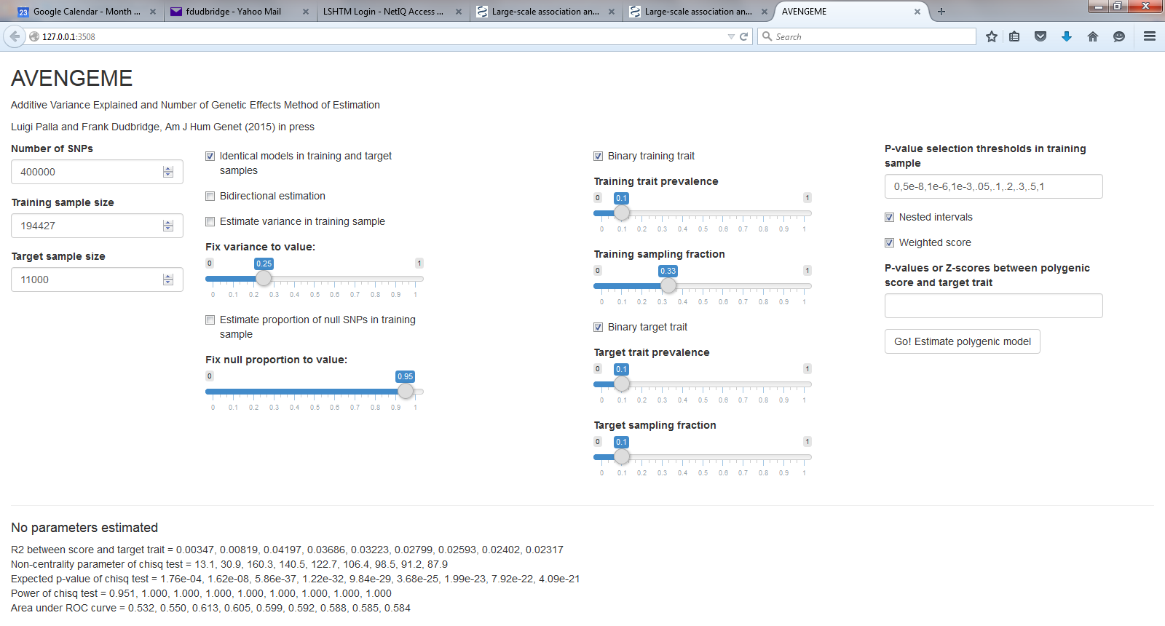
AVENGEME
“Additive Variance Explained and Number of Genetic Effects Method of Estimation”
R code at sites.google.com/sites/fdudbridge/software

Slide 18
Example: schizophrenia
P-values of polygenic score using different SNP selections:
Selection P < | Polygenic score P
5e-8 | 1
1e-6 | 0.003165
1e-4 | 1.951e-10
0.001 | 4.484e-16
0.01 | 3.568e-18
0.05 | 4.078e-22
0.1 | 3.326e-25
0.2 | 7.636e-27
0.5 | 7.718e-26
1.0 | 4.024e-26
χ²=8.7
likelihood contribution Pr(χ²_{NCP}=8.7) where NCP determined by model parameters
Sum log-likelihoods over selection intervals
Estimate two parameters from these data:
Vg1=variance explained by SNPs
π₀=proportion of null SNPs
Vg1=0.30 (0.27-0.33)
π₀ =0.95 (0.94-0.96)
Thanks to Stephan Ripke

Slide 19
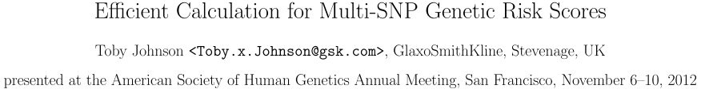
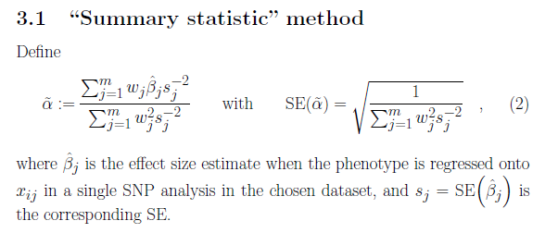
Summary statistics only
http://cran.r-project.org/web/packages/gtx/vignettes/ashg2012.pdf
Odds ratios and SEs in training & target samples are sufficient to reconstruct association test of the polygenic score

Slide 20
AVENGEME pros & cons
Fast and analytic
Needs only summary ORs and SEs
Can estimate chip heritability, genetic correlation and proportion of SNPs with effects
Needs SNPs clumped to about r²<0.1
Assumes normal distribution of genetic effects
Estimate of chip heritability has large variance, unless it is fixed to equal the genetic covariance

Slide 21

Thanks

