Slide 1
Module 10: Statistical and Quantitative Genetics of Disease: Pleiotropy
John Witte
Lecture 8

Slide 2
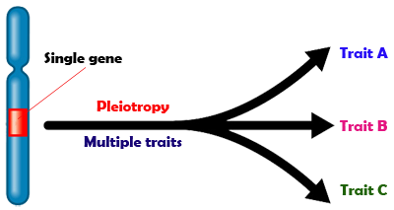
Pleiotropy
From Greek: Pleio (many) and tropic (affecting).
One gene, multiple traits.

Slide 3
Assessing Pleiotropy
1. Pleiotropy ‘look-ups’
2. Meta-analysis (ASSET)
3. Multiphenotype
4. Multilevel pleiotropy
5. Polygenic risk scores
6. Co-heritability

Slide 4
1. Pleiotropy “Look-ups”
Prostate
Breast
Testicular
Melanoma
Colon
Bladder
Lung
Rectum
NHL
Ovary
Cancers
1 | 2 | ... | 100 | 101 | … | 1K | ... | 1M | …
Variants / SNPs

Slide 5
Pleiotropy “Look-ups”
Prostate
Breast
Testicular
Melanoma
Colon
Bladder
Lung
Rectum
NHL
Ovary
Cancers
1 | 2 | ... | 100 | 101 | … | 1K | ... | 1M | …
Variants / SNPs

Slide 6
Pleiotropy “Look-ups”
Prostate
Breast
Testicular
Melanoma
Colon
Bladder
Lung
Rectum
NHL
Ovary
Cancers
1 | 2 | ... | 100 | 101 | … | 1K | ... | 1M | …
Variants / SNPs

Slide 7
Pleiotropy “Look-ups”
Prostate
Breast
Testicular
Melanoma
Colon
Bladder
Lung
Rectum
NHL
Ovary
Cancers
1 | 2 | ... | 100 | 101 | … | 1K | ... | 1M | …
Variants / SNPs

Slide 8
Pleiotropy “Look-ups”
Prostate
Breast
Testicular
Melanoma
Colon
Bladder
Lung
Rectum
NHL
Ovary
Univariate analyses:
logit (Pr(Y=1|G, C)) = α + Gβ + Cγ
One-at-a-time for each SNP / cancer
β, P-values, FDR
Cancers
1 | 2 | ... | 100 | 101 | … | 1K | ... | 1M | …
Variants / SNPs

Slide 9
2. Meta-Analysis Approach
Prostate
Breast
Testicular
Melanoma
Colon
Bladder
Lung
Rectum
NHL
Ovary
Cancers
Single estimate of effect
1 | 2 | ... | 100 | 101 | … | 1K | ... | 1M | …
Variants / SNPs

Slide 10
ASSET
Cycle through different combinations of traits
and maximize meta-analysis test statistic.
Standard fixed-effects
Subset-based
where
where
Bhattacharjee et al. AJHG, 2012
Notes:
standard fixed-effects model: a powerful tool for combining distinct GWAS on a single trait
based on summary level data
weighted combination of the Z statistics
Cycle through different combinations of traits and maximizes meta-analysis test statistic.

Slide 11
3. Multiphenotype Approach
Prostate
Breast
Testicular
Melanoma
Colon
Bladder
Lung
Rectum
NHL
Ovary
Model all traits simultaneously.
Can be more:
consistent with underlying biology;
powerful than univariate.
Power gain due to:
genetic correlations among traits;
fewer tests.
Cancers
1 | 2 | ... | 100 | 101 | … | 1K | ... | 1M | …
Variants / SNPs

Slide 12
Multinomial Regression
logit (Pr(Y_{i}=1|G, C)) = α_{i} + G_{i}β_{i} + Cγ_{i}
Y is multivariate with dimension = # traits
Test different pleiotropic models by specifying assumptions about the β_{i}.

Slide 13
Null Model
Prostate
Breast
Testicular
Melanoma
Colon
Bladder
Lung
Rectum
NHL
Ovary
H₀: β₁=β₂=...=β_{k}=0
Cancers
1 | 2 | ... | 100 | 101 | … | 1K | ... | 1M | …
Variants / SNPs

Slide 14
Alternative Hypotheses
Prostate
Breast
Testicular
Melanoma
Colon
Bladder
Lung
Rectum
NHL
Ovary
At least one β_{i}≠0
Cancers
1 | 2 | ... | 100 | 101 | … | 1K | ... | 1M | …
Variants / SNPs

Slide 15
Alternative Hypotheses
Prostate
Breast
Testicular
Melanoma
Colon
Bladder
Lung
Rectum
NHL
Ovary
All β_{I} are equal and non-zero
Cancers
1 | 2 | ... | 100 | 101 | … | 1K | ... | 1M | …
Variants / SNPs

Slide 16
Alternative Hypotheses
Prostate
Breast
Testicular
Melanoma
Colon
Bladder
Lung
Rectum
NHL
Ovary
A pre-specified subset of β_{I} are non-zero.
Cancers
1 | 2 | ... | 100 | 101 | … | 1K | ... | 1M | …
Variants / SNPs
Notes:
What if we have different types of traits: binary, discrete, or continuous?

Slide 17
Alternative Hypotheses
Prostate
Breast
Testicular
Melanoma
Colon
Bladder
Lung
Rectum
NHL
Ovary
All traits have different effects
Cancers
What if we have different types of traits: binary, discrete, or continuous?
1 | 2 | ... | 100 | 101 | … | 1K | ... | 1M | …
Variants / SNPs

Slide 18
MultiPhen: ‘Inverse Regression’
…
1M
…
1K
…
101
100
…
2
1
Proportional odds logistic regression of genotype on cancers:
log (Pr(G>m|Y)/Pr(G≤m|Y)) = α_{m}+Y’β+Cγ
m = 0,1
Variants / SNPs
Prostate | Breast | Testicular | Melanoma | Colon | Bladder | Lung | Rectum | NHL | Ovary
Cancers
O'Reilly et al.,PLoS One 2012

Slide 19
MultiPhen: ‘Inverse Regression’
…
1M
…
1K
…
101
100
…
2
1
Model selection or shrinkage to detect pleiotropy.
Explore subsets of traits, select ‘best’ model that minimizes expected loss of information penalized by model complexity (e.g., AIC, BIC).
Shrinkage via LASSO (adaptive) to select non-null traits.
Variants / SNPs
Prostate | Breast | Testicular | Melanoma | Colon | Bladder | Lung | Rectum | NHL | Ovary
Cancers
Notes:
Different penalties; Minimize:
-2log(L) + 2k (AIC)
-2log(L) + k*log(n) (BIC)
-2log(L) + k*log(n) + 2γ*log(τ(S_{k-2})) (EBIC)
k = # parameters in model; n=sample size.
γ = tuning parameter for specificity of EBIC.
τ(S_{k-2})=size of the model space w/ k-2 traits.
log(L): log-likelihood of data under model.
(k parameters w/ 2 intercepts, k choose k-2).
AIC tends to choose higher number of traits.
BIC assigns equal prior probability to each possible model, thus induces higher prior for model space with larger K.
EBIC helps address this potential bias, developed to deal with small n large p problem. May be useful as K increases.

Slide 20
Comparison of FDR, ASSET & MultiPhen
Traits simulated under additive model (Galesloot et al. 2014)
Single causal variant with influence on a subset of traits.
Number of traits: 4 - 20
Residual correlation between traits: 0.05 - 0.3
Heritability of trait due to variant: 0 - 0.4%
LD between variant and typed SNP: 0.80, 0.95
MAF at variant and SNP: 0.1, 0.2
Number of individuals: 10K - 30K
Majumdar, Haldar, Witte, Genetic Epi 2016.

Slide 21
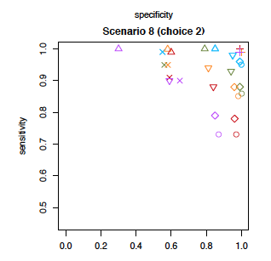
Results
Overall pleiotropy:
MultiPhen > ASSET (power)
Except when all traits associated
& in same direction.
Increases with increasing correlation.
Traits underlying pleiotropy:
FDR > MultiPhen > ASSET (sens /spec)
Except FDR = MultiPhen when weak correlation
MultiPhen = ASSET when strong correlation.
Majumdar, Haldar, Witte, Genetic Epi 2016.
Notes:
Type I error rate @ nominal level.
One possible explanation for this is that MultiPhen models the individual-level data for
multiple phenotypes jointly, and hence is more multivariate in nature than ASSET , which combines
the univariate association statistics. Furthermore, the power and type I error of ASSET decrease as
the phenotypic correlation increases (rE = (0:3; 0:3); (0:5; 0:5)) (Figures 1, S1, S2, and Table 2). This
conservative behavior of ASSET may be due to estimating the p-value of overall pleiotropic association
by using the discrete local maxima (DLM) method [Taylor et al., 2007] to approximate tail probabilities
of a test statistic that is maximized over a grid.
The issue of multi-colinearity may
explain the poor performance of the inverse regression based criteria for strongly correlated phenotypes.
The modied B-H procedure oers overall good specicity as it is designed to keep control over the
expected FDR and lower FDR induces higher specicity.

Slide 22
4. Multilevel Pleiotropy
Prostate
Breast
Testicular
Melanoma
Colon
Bladder
Lung
Rectum
NHL
Ovary
Incorporate additional info into analysis
Pathways
Cancer types
Cancer histology
Other exposures
Cancers
1 | 2 | ... | 100 | 101 | … | 1K | ... | 1M | …
Variants / SNPs

Slide 23
Gene / Pathway Priors
Prostate
Breast
Testicular
Melanoma
Colon
Bladder
Lung
Rectum
NHL
Ovary
Gene A in
Pathway 1
Gene B in
Pathway 2
Cancers
1 | 2 | ... | 100 | 101 | … | 1K | ... | 1M | …
Variants / SNPs

Slide 24
Leverage Individual-level Data
Prostate
Breast
Testicular
Melanoma
Colon
Bladder
Lung
Rectum
NHL
Ovary
Hormonal
Tumor histology
Exposures:
Smoking
BMI
Cancers
Digestive
1 | 2 | ... | 100 | 101 | … | 1K | ... | 1M | …
Variants / SNPs

Slide 25
5. Polygenic Risk Scores (PRS)
Single SNPs not very predictive.
Combining SNPs in a PRS
substantially more predictive.
Prostate
Breast
Testicular
Melanoma
Colon
Bladder
Lung
Rectum
NHL
Ovary
Cancers
where
β_{i} = log(odds ratio) for SNPi from one cancer.
xij = # of alleles for SNP i, person j in diff cancer.
Large number of SNPs (m)
1 | 2 | ... | PRS
Variants / SNPs

Slide 26
Polygenic Risk Score Pleiotropy
Prostate
Breast
Testicular
Melanoma
Colon
Bladder
Lung
Rectum
NHL
Ovary
Cancers
1 | 2 | ... | PRS
Variants / SNPs

Slide 27
PanCancer PRS in UK Biobank
 |  | Risk Score Profile
 |  | Bladder | Breast | Colorectal | Endometrial | Esophagus/Gastric | Lung | Prostate | Testicular
Target Cancer | Bladder | - | 0.008 | 0.20 | 0.27 | 0.17 | 0.09 | 0.67 | 0.03
 | Colon | 0.18 | 0.81 | - | 0.74 | 0.59 | 0.97 | 0.01 | 0.01
 | Kidney | 0.002 | 0.20 | 0.46 | 0.34 | 0.23 | 0.07 | 0.81 | 0.23
 | Lung | 0.39 | 0.66 | 0.46 | 0.54 | 0.03 | - | 0.31 | 0.51
 | Melanoma | 0.32 | 0.99 | 0.40 | 0.04 | 0.39 | 0.99 | 0.54 | 0.70
 | Prostate | 0.21 | 0.63 | 0.003 | 0.00001 | 0.27 | 0.47 | - | 0.02
 | Rectum | 0.72 | 0.89 | - | 0.79 | 0.01 | 0.01 | 0.94 | 0.61
 | Testicular | 0.02 | 0.23 | 0.75 | 0.0002 | 0.57 | 0.21 | 0.10 | -
 |  | Negative Association
 |  | Positive Association
Notes:
The endometrial risk score only contains one variant
Observed p-values by applying risk score profile to target cancer
Only showing pairwise comparisons where profile/cancer had at least one significant associations
196 tests. Multiple test correction = 0.0002

Slide 28
6. Co-heritability
Prostate
Breast
Testicular
Melanoma
Colon
Bladder
Lung
Rectum
NHL
Ovary
Cancers
1 | 2 | ... | 100 | 101 | … | 1K | ... | 1M | h²
Variants / SNPs

Slide 29
Co-heritability
Prostate
Breast
Testicular
Melanoma
Colon
Bladder
Lung
Rectum
NHL
Ovary
Cancers
Prostate | Breast | Testicular | Melanoma | Colon | Bladder | Lung | Rectum | NHL | Ovary
Notes:
Give example from the literature.
Josh Sampson recent results.

Slide 30
Co-heritability
Prostate
Breast
Testicular
Melanoma
Colon
Bladder
Lung
Rectum
NHL
Ovary
Cancers
Prostate | Breast | Testicular | Melanoma | Colon | Bladder | Lung | Rectum | NHL | Ovary
Notes:
Give example from the literature.
Josh Sampson recent results.

Slide 31
Co-heritability with Summary Statistics
Cross-trait
LD Score
Regression
Bulik-Sullivan, et al. NG 2015b

Slide 32
Prediction: Ozzy Osbourne!?
Increased risk of:
Alcohol and cocaine dependence.
Hallucinations while on marijuana.
Slow to metabolise coffee.
Notes:
Detect novel risk variants.
More fully understand the genetic variation and architecture of disease.
"Sequencing and analysing individuals with extreme medical histories provides the greatest potential scientific value.“
Nathan Pearson, Director of Research Knome
“Look, Mr. Osbourne, after studying your history, taking your blood, extracting your genes from the white cells, making them readable, sequencing them, analysing and interpreting the data using some of the most advanced technology available in the world today–and of course comparing your DNA against all the current research in the US National Library of Medicine, not to mention the 18th revision of the public human reference genome–I think I can say with a good deal of confidence why you’re still alive.”
I looked at him. He looked at me.
“Go on, then,” I said. “Spit it out.”
“Sharon,” he replied.
32

Slide 33
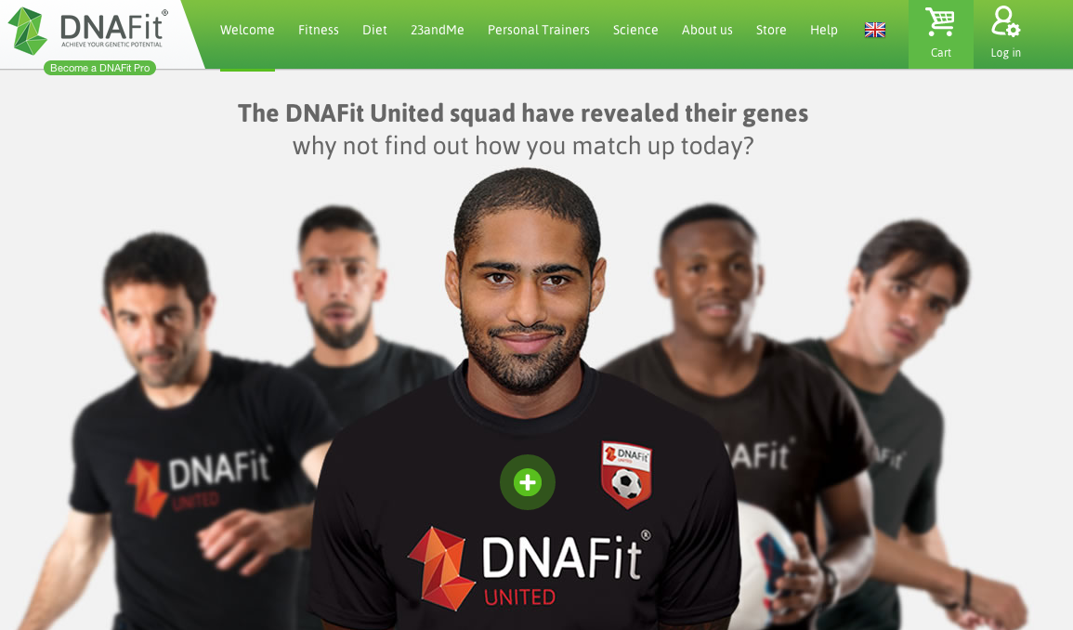
Genetic Prediction
DNAfit

Slide 36
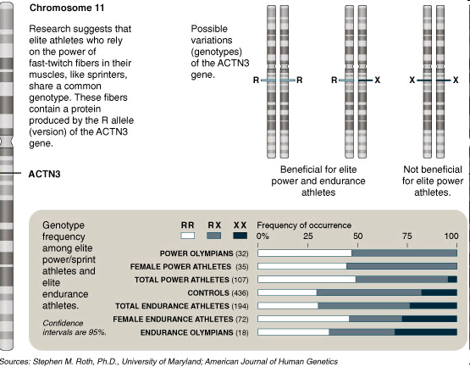
‘Test to Play’
NY Times, 11/30/08

Slide 37
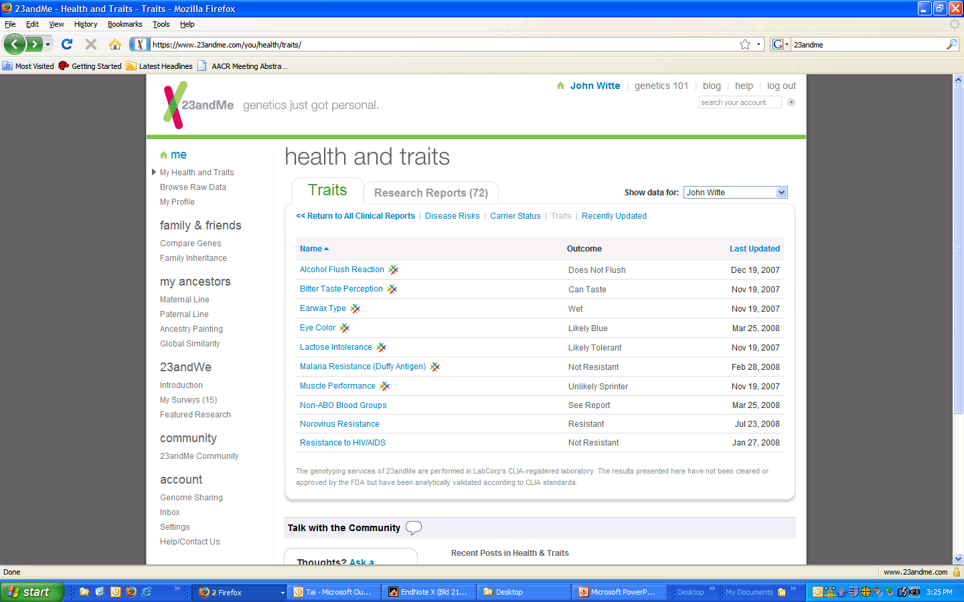
My 23andMe Results for ACTN3

