Slide 1
STAT 3306/7306
Statistical Analysis of Genetic Data
Lecture 1 – Overview of Statistical Genetics Applications

Slide 2
Overview
These lectures will give you an introduction to agricultural genetics and human genetics and what type of statistical problems we can solve
It is likely that many of the words and concepts will be obscure, but they will be explained in the coming weeks
Look for the Glossary of common terms on Blackboard.
<number>

Slide 3
Key Questions
What is the genetic architecture of complex traits?
How much variation in a phenotype in a population is due to genetic variation?_x005F_x000b_
Where are the trait-causing genetic variants (as well as the corresponding genes)?
What are their frequencies and effect sizes?
Agr_x005F_x000b_iculture
Given architecture, how to use genomic information to maximize genetic gain?
How to maintain genetic diversity in target populations?
Human
Can we predict a phenotype or a common disease by genomic data (i.e. genomic risk prediction)?
Can we separate correlated vs causal factors for disease?
<number>

Slide 4
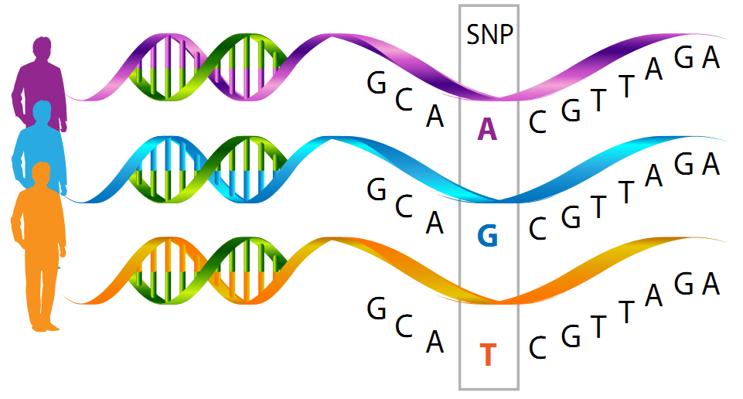
Genetic Variation
<number>

Slide 5
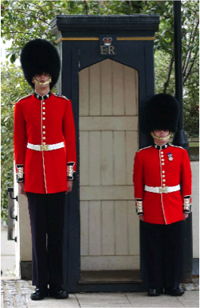
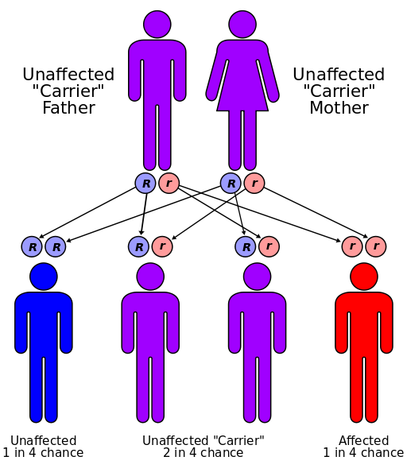

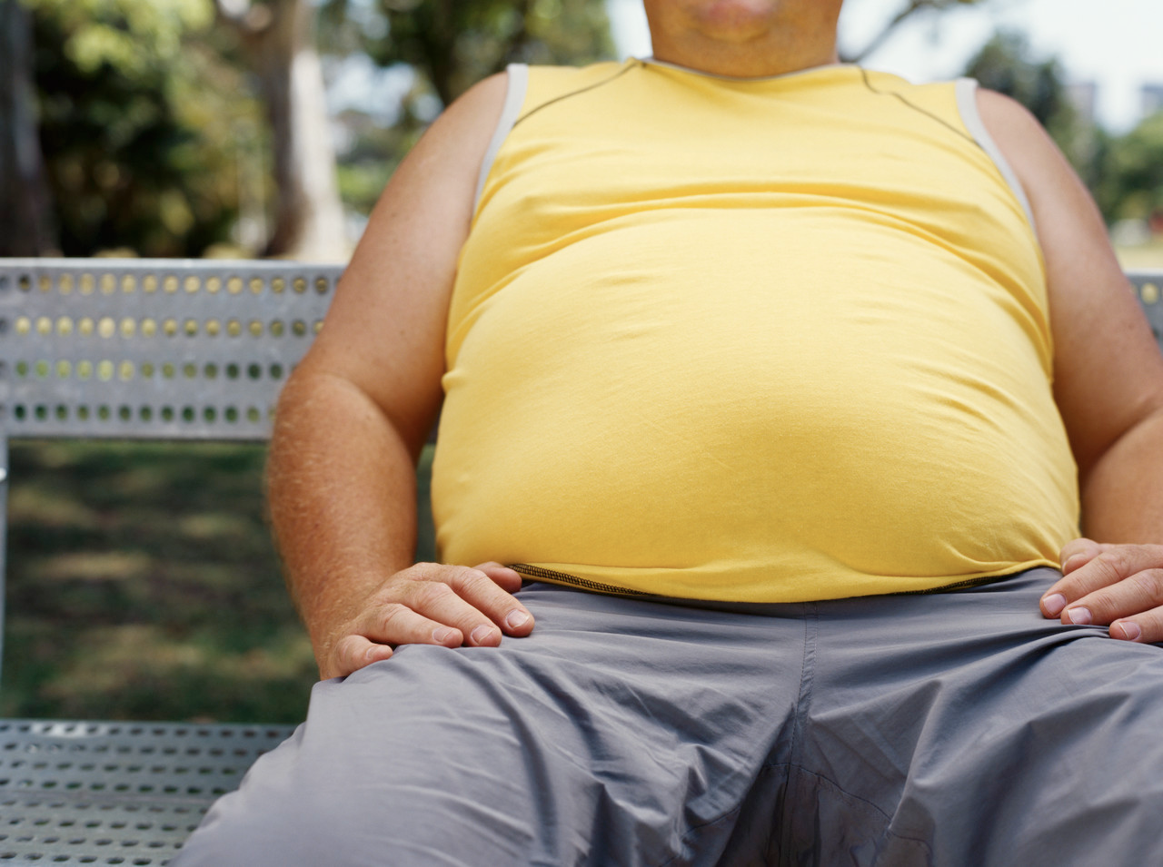
Mendelian vs Complex Traits
Cystic fibrosis
Height
Schizophrenia
Obesity
<number>

Slide 6
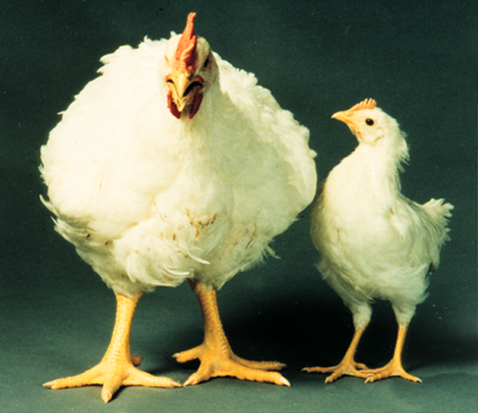
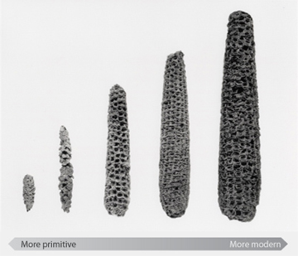
Mendelian vs Complex Traits
Genetic variation observed for many (all?) traits of economic importance in livestock and plant species
One gene or many?
<number>

Slide 7
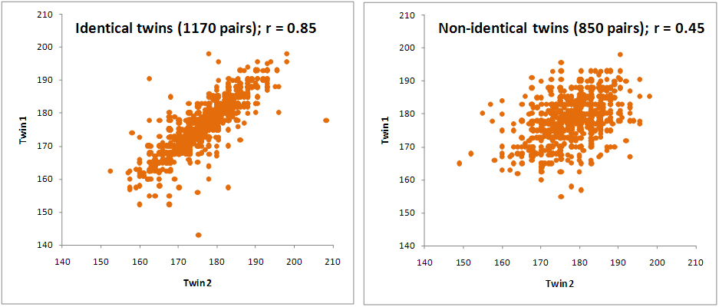
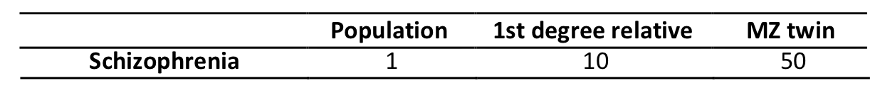
Heritability
Resemblance between twins for human height
Heritability ~80%
Resemblance between twins for human BMI
Full sibs correlation = 0.36
Father-son correlation = 0.28
Heritability ~60%
Risk of schizophrenia
Heritability ~ 80%
<number>

Slide 8

Complex Traits
Infinitesimal model
Assumes that traits are determined by an infinite number of unlinked and additive loci, each with an infinitesimally small effect
This model the foundation of animal breeding theory including breeding value prediction
Spectacularly successful in many cases!
Time to market weight for meat
chickens has decreased from
16 to 5 weeks in 30 years!
<number>

Slide 9
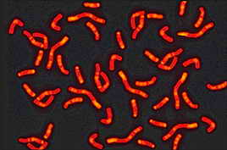
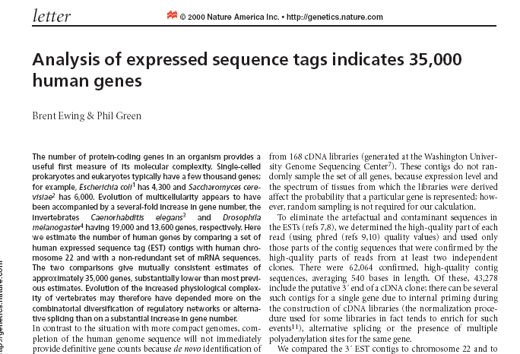
Complex Traits
Finite loci model
While the infinitesimal model is a very useful assumption,
there is a finite amount of genetic material
With a finite number of genes/enhancers etc.……
Define any mutation that contributes to variation in a
quantitative/economic trait as quantitative trait loci (QTL)
Key questions are how many QTL does a quantitative trait have
and what is the distribution of the effects of QTL?
<number>

Slide 10
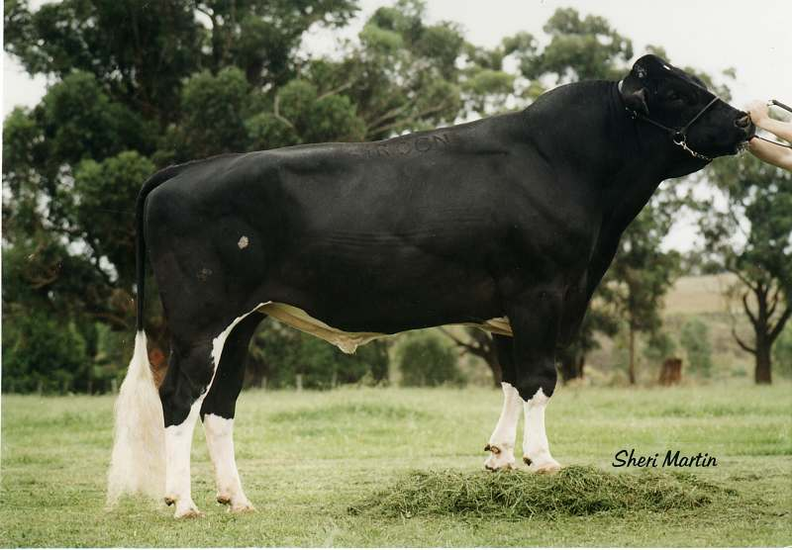
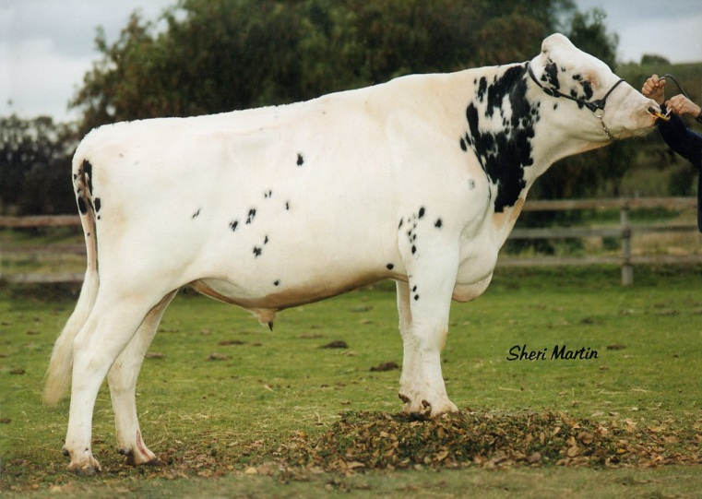
Coat Colour in Cattle
Mainly studied for their association with various disorders
with impacts on animal health and economic effects on
animal breeding
KIT gene
Large number of mutations found in cattle
Can be embryonic lethal
Explains up to 9% of variation in coat colour
<number>

Slide 11
Oil Concentration in Maize
More than 50 QTL required to
explain 50% of the variance
<number>

Slide 12
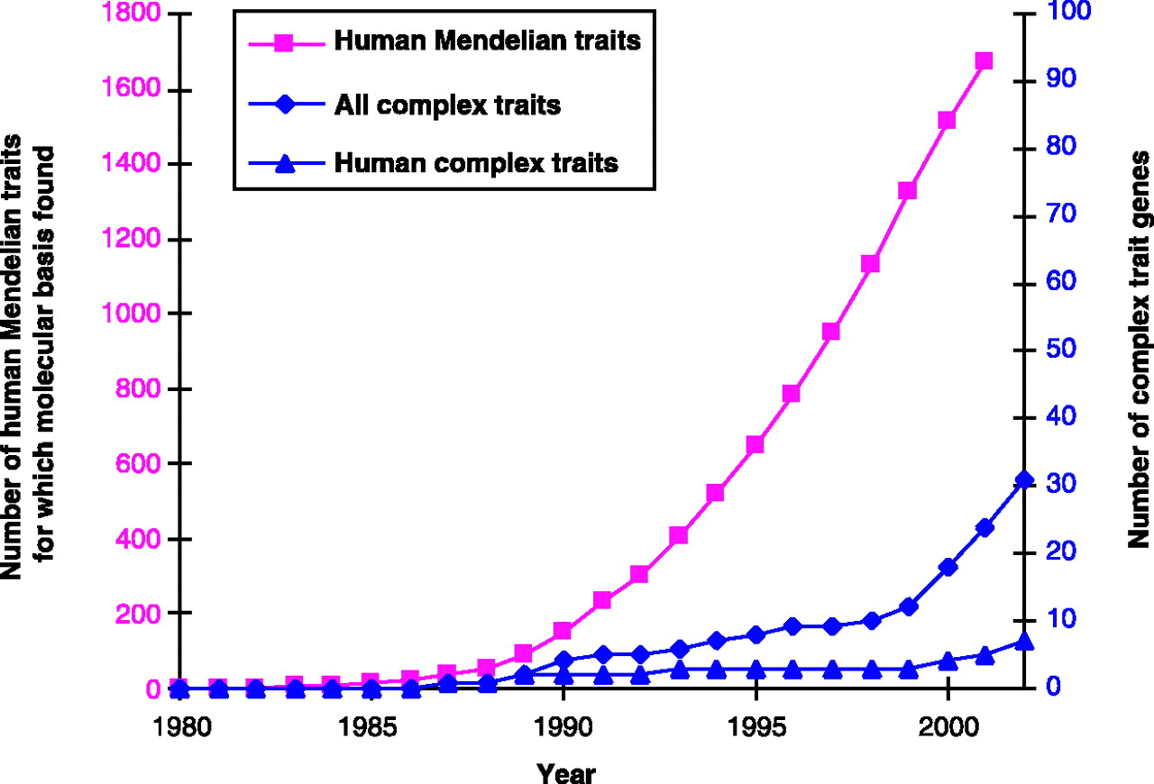
Identifying Genes Underlying Complex Traits
8 genes for human complex traits
before 2002
(Glazier et al. 2002, Science)
<number>

Slide 13
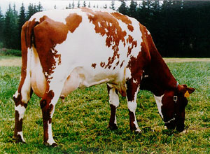
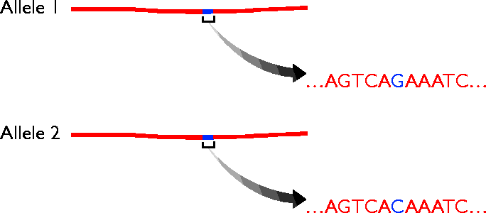
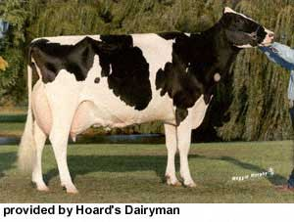
Genetic Variation
As a result of sequencing genomes, we have a
huge amount of information on variation in the
genome
Most abundant form of variation are
Single Nucleotide Polymorphisms (SNPs)
<number>

Slide 14
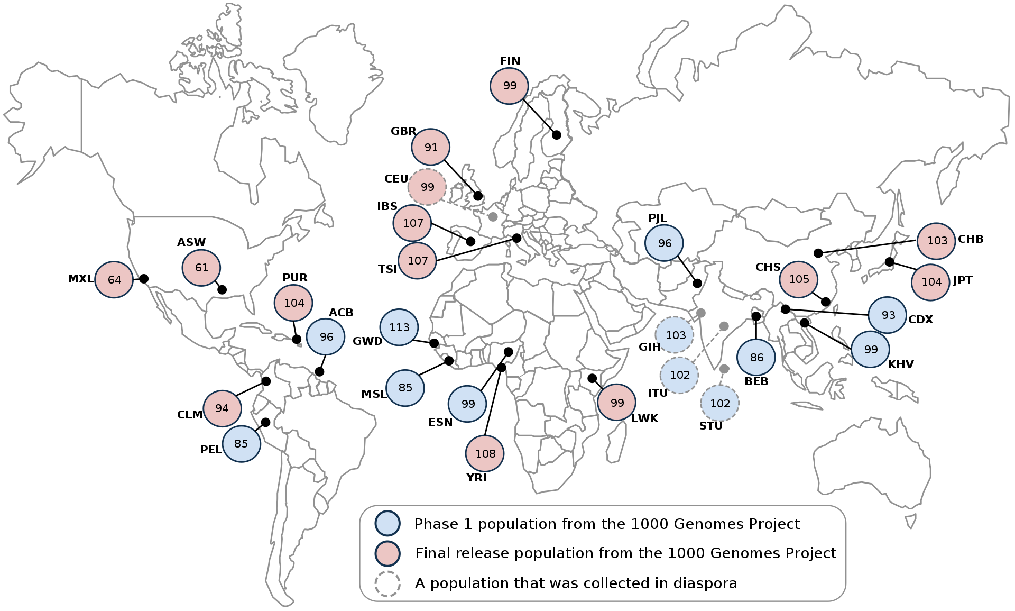
1000 Genomes Project (Human)
2405 genomes from 26 populations
Identified >88 million genetic variants
<number>

Slide 15

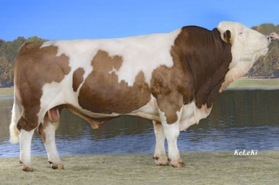
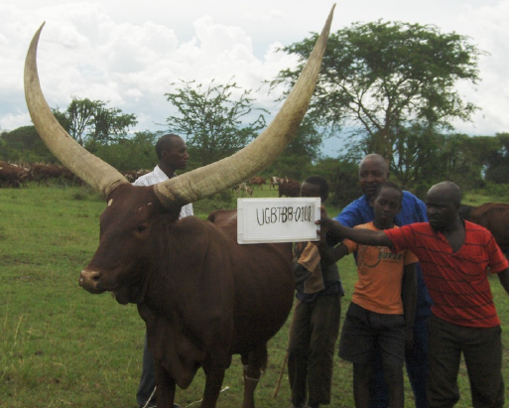
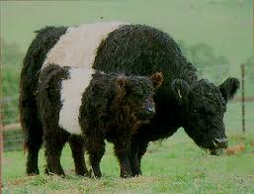
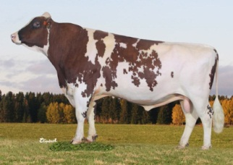
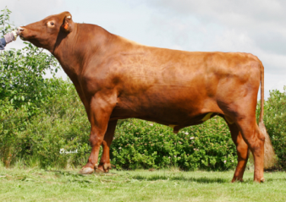
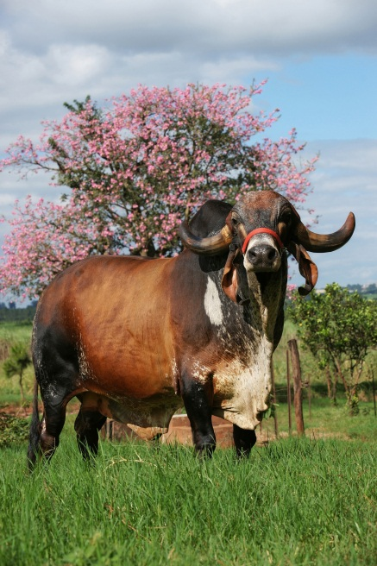
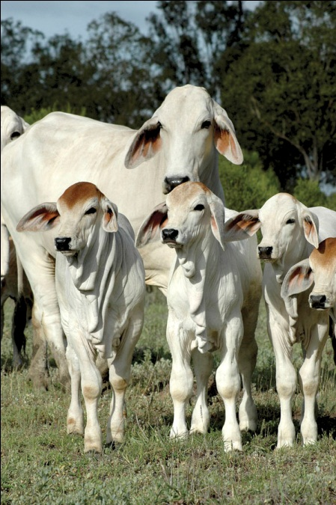
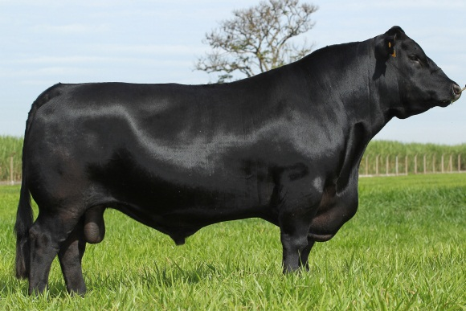
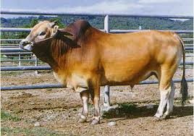
1000 Bull Genomes Project (Run 6)
2703 Sequenced Animals
~55 Breeds:
Dairy
Beef
Dual Purpose
Crosses
Composites
<number>

Slide 16
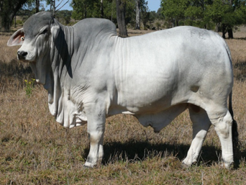
1000 Bull Genomes Project (Run 6)
Taurus Only Taurus Indicus
39.7 million filtered variants 67.3 million filtered variants
38.1 million SNP, 1.7 million Indel 64.8 million SNP, 2.5 million Indel
<number>

Slide 17

SNP Genotyping
SNP arrays are available for:
Human
Sheep, Cattle (50K, 800K), Pigs,
Chickens
Salmon
Horse, Dog, …
Cost ~50-200 USD per sample
Can also genotype by re-sequencing at higher cost
<number>

Slide 18
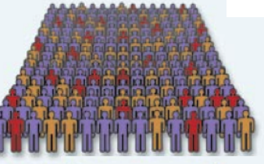
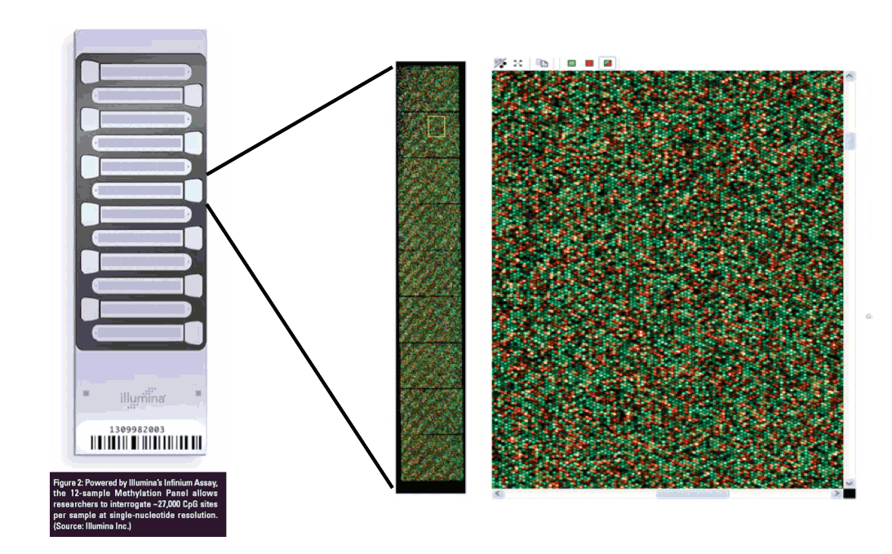
Genome-wide Association Study (GWAS)
Large Cohorts Simple Methodology
Testing correlation between x and y
x = 0, 1 and 2 (GG, AG and AA)
y = trait (e.g. height)
Stringent Statistical Tests
High Throughput Genotyping
<number>

Slide 19
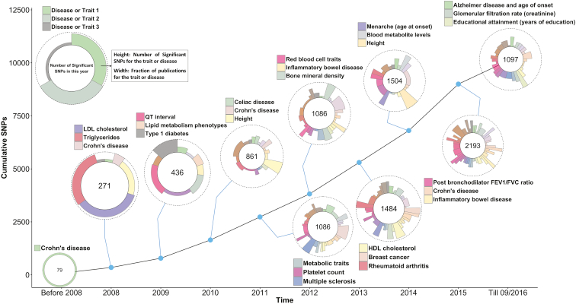
Variant Discovery Post GWAS
(Visscher et al, Am J Hum Genet. 2017)
<number>

Slide 20
Yield in Rice
“Our results suggest that multiple loci with relatively small effects contribute to the phenotypic variance”
<number>

Slide 21
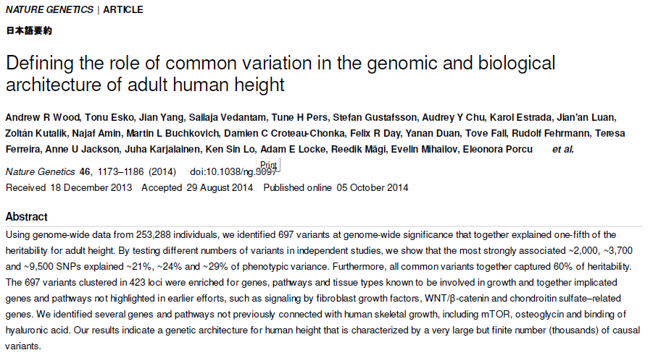
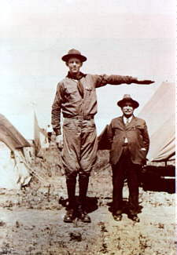
Human Height
<number>

Slide 22
Complex Traits
Large number of causative mutations (quantitative trait loci, QTL) for most complex traits
Variance explained by individual markers will be small
<number>

