Slide 1
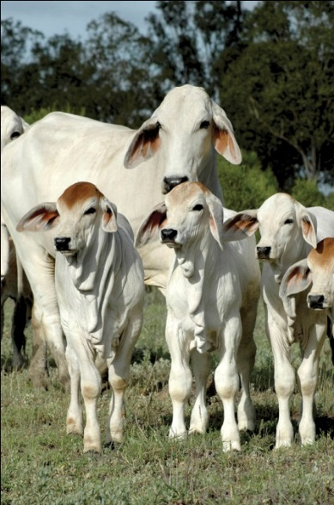
Best linear unbiased prediction
Slide courtesy: Prof. Ben Hayes

Slide 2
Genomic prediction with BLUP
Linear mixed model
BLUP solutions
λ=σ_{e}² / σ$α$²
I = identity matrix (dimensions m x m)
$$y=1_{n}μ+Xα+e$$
$$\left[\begin{matrix}\hat{μ} \\ \hat{α}\end{matrix}\right]={\left[\begin{matrix}1_{n}′1_{n} & 1_{n}^{′}X \\ X′1_{n} & X^{′}X+Iλ\end{matrix}\right]}^{−1}\left[\begin{matrix}1_{n}^{′}y \\ X^{′}y\end{matrix}\right]$$
Notes:
#4,2,8

Slide 3
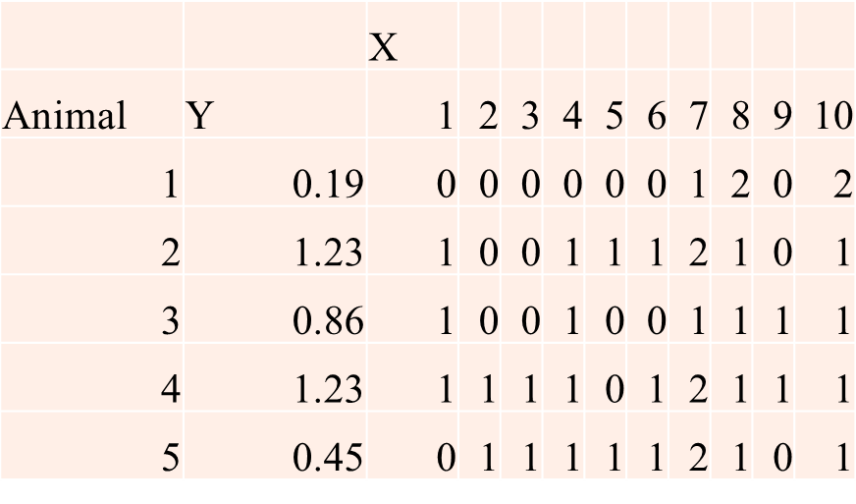
Genomic prediction with BLUP
Example:
Assume value of 1 for λ
1_{n}’ = [1 1 1 1 1]
$$\left[\begin{matrix}\hat{μ} \\ \hat{α}\end{matrix}\right]={\left[\begin{matrix}1_{n}′1_{n} & 1_{n}^{′}X \\ X′1_{n} & X^{′}X+Iλ\end{matrix}\right]}^{−1}\left[\begin{matrix}1_{n}^{′}y \\ X^{′}y\end{matrix}\right]$$
Notes:
#4,2,8

Slide 4
Genomic prediction with BLUP
Now we want to predict breeding value of a group of young animals without phenotypes (GEBV = genomic estimated breeding values).
We have the $\hat{α}$, and we can get X from their genotypes (after genotyping)…………
$$GEBV=X\hat{α}$$
Progeny | X
1 | 1 | 1 | 1 | 1 | 1 | 1 | 2 | 1 | 0 | 1
2 | 1 | 0 | 0 | 1 | 1 | 1 | 1 | 1 | 0 | 1
3 | 1 | 0 | 0 | 1 | 1 | 1 | 2 | 1 | 0 | 1
4 | 1 | 0 | 0 | 1 | 1 | 2 | 2 | 1 | 0 | 1
5 | 0 | 0 | 0 | 0 | 0 | 0 | 1 | 2 | 0 | 2

Slide 5
Genomic prediction with BLUP
An equivalent model (GBLUP)
If there are many QTLs whose effects are normally distributed with constant variance,
Then genomic selection equivalent to replacing the expected relationship matrix with the realised or genomic relationship matrix (G) estimated from DNA markers in normal BLUP equations.
G_{ij} = proportion of genome that is IBD between individuals i and j

Slide 6
Genomic prediction with BLUP
An equivalent model
Rescale X to account for allele frequencies
w_{ij} = x_{ij} – 2p_{j}
Then breeding values are
g = W$α$ ($GEBV=X\hat{α}$)
And
$${G=WW}^{′}/2\sum_{j=1}^{m}{p_{j}(1−p_{j})}$$
Then
Var(g) = G σ_{g}²

Slide 7
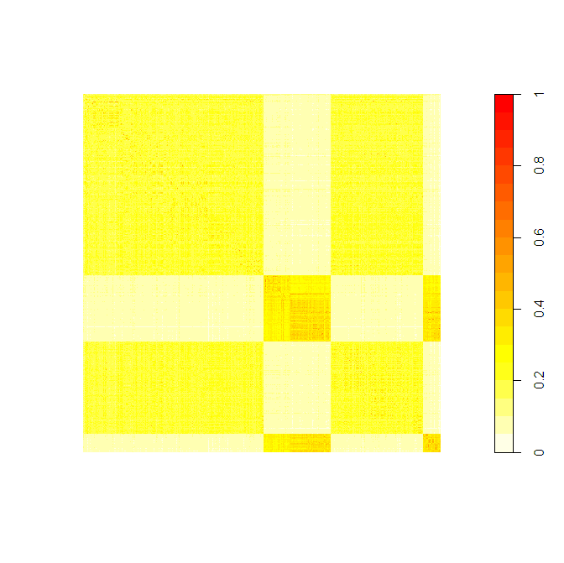
G matrix
Holstein reference n = 781
Jersey reference n = 287
Holstein validation n = 400
Jersey validation n = 77

Slide 8
G off-diagonals in unrelated humans
Yang et al (2010 Nat Genet)

Slide 9
Genomic prediction with BLUP
An equivalent model
Z is a matrix of #records by #individuals
$$y=1_{n}μ+Zg+e$$
$$\left[\begin{matrix}\hat{μ} \\ \hat{g}\end{matrix}\right]={\left[\begin{matrix}1_{n}′1_{n} & 1_{n}^{′}Z \\ Z′1_{n} & Z^{′}Z+G^{−1}\frac{σ_{e}^{2}}{σ_{g}^{2}}\end{matrix}\right]}^{−1}\left[\begin{matrix}1_{n}^{′}y \\ Z^{′}y\end{matrix}\right]$$

Slide 10
Genomic prediction with BLUP
An equivalent model
Model 1.
Model 2.
$$\left[\begin{matrix}\hat{μ} \\ \hat{α}\end{matrix}\right]={\left[\begin{matrix}1_{n}′1_{n} & 1_{n}^{′}X \\ X′1_{n} & X^{′}X+I\frac{σ_{e}^{2}}{σ_{α}^{2}}\end{matrix}\right]}^{−1}\left[\begin{matrix}1_{n}^{′}y \\ X^{′}y\end{matrix}\right]$$
$$y=1_{n}μ+Xα+e$$
$$GEBV=X\hat{α}$$

Slide 11
Genomic prediction with BLUP
An equivalent model
Model 1.
Model 2.
$$\left[\begin{matrix}\hat{μ} \\ \hat{α}\end{matrix}\right]={\left[\begin{matrix}1_{n}′1_{n} & 1_{n}^{′}X \\ X′1_{n} & X^{′}X+I\frac{σ_{e}^{2}}{σ_{α}^{2}}\end{matrix}\right]}^{−1}\left[\begin{matrix}1_{n}^{′}y \\ X^{′}y\end{matrix}\right]$$
$$y=1_{n}μ+Xα+e$$
$$GEBV=X\hat{α}$$
$$\left[\begin{matrix}\hat{μ} \\ \hat{g}\end{matrix}\right]={\left[\begin{matrix}1_{n}′1_{n} & 1_{n}^{′}Z \\ Z′1_{n} & Z^{′}Z+G^{−1}\frac{σ_{e}^{2}}{σ_{g}^{2}}\end{matrix}\right]}^{−1}\left[\begin{matrix}1_{n}^{′}y \\ Z^{′}y\end{matrix}\right]$$
$$y=1_{n}μ+Zg+e$$

Slide 12
Genomic prediction with BLUP
An equivalent model
Why use model 2 (GBLUP).
If number of markers >>> large than number of animals, more computationally efficient
Can be integrated into national evaluations more readily?
Calculate accuracy of GEBV from inverse coefficient matrix (amount of data in estimate!)
Accuracy is correlation of GEBV with true breeding value
Derived from Prediction error variance

Slide 13
Genomic prediction with BLUP
An equivalent model
Why use model 2 (GBLUP).
If number of markers >>> large than number of animals, more computationally efficient
Can be integrated into national evaluations more readily?
Calculate accuracy of GEBV from inverse coefficient matrix (amount of data in estimate!)
Accuracy is correlation of GEBV with true breeding value
Derived from Prediction error variance
${PEV}_{i}=C^{ii}σ_{e}^{2}$
$r_{i}=\sqrt{1−{PEV}_{i}/σ_{g}^{2}}$
$$1_{n}^{′}1_{n}$$ | $$1_{n}^{′}Z$$
$$Z^{′}1_{n}$$ | $Z^{′}Z+\text{G}$⁻¹ $\frac{σ_{e}^{2}}{σ_{g}^{2}}$

Slide 14
Genomic prediction with BLUP
An equivalent model
Why use model 2 (GBLUP).
If number of markers >>> large than number of animals, more computationally efficient
Can be integrated into national evaluations more readily?
Calculate accuracy of GEBV from inverse coefficient matrix (amount of data in estimate!)
Very useful – can calculate how well we predict for individuals without their own phenotype (eg young calves, people)

Slide 15
Alternatives for building G
VanRaden (2008)
Rescale X to account for allele frequencies
w_{ij} = x_{ij} – 2p_{j}
Genotypes are centred but not scaled
$${G=WW}^{′}/2\sum_{j=1}^{m}{p_{j}(1−p_{j})}$$
Notes:
#4,2,8

Slide 16
Alternatives for building G
Alternative is to scale genotypes by allele frequencies
scaling results in less shrinkage towards the mean for low minor allele frequency (MAF) variants compared to variants with intermediate MAF.
$w_{ij}=\frac{(x_{ij}−2p_{i})}{\sqrt{2p_{i}(1−p_{i})}}$
$${G=WW}^{′}/m$$
Notes:
#4,2,8

Slide 17
Alternatives for building G
And account for effect of inbreeding on allele frequencies (Yang et al. 2010)
The element of G for individuals j and k (estimate of genomic relationship between j and k) calculated as:
$$G_{jk}=\frac{1}{N}\sum_{i}{G_{ijk}}=\left\{\begin{matrix}\frac{1}{N}\sum_{i}{\frac{\left(x_{ij}−2p_{i})(x_{ik}−2p_{i}\right)}{\left.2p_{i}(1−p_{i}\right)}, j≠k} \\ 1+\frac{1}{N}\sum_{i}{\frac{x_{ij}^{2}−\left(1+2p_{i}\right)x_{ij}+2p_{i}^{2}}{\left.2p_{i}(1−p_{i}\right)}}, j=k\end{matrix}\right.$$
Notes:
#4,2,8

Slide 18
Alternatives for building G
VanRaden (2008) – assumes common SNP contribute more variance
Yang et al. (2010) – assumes rare SNP and common SNP contribute equal variance
Notes:
#4,2,8

Slide 19
Genomic prediction vs GWAS
Genomic prediction
GWAS (b_{i} effect of i^{th} SNP)
Note that SNP fitted twice, once as fixed effect and once as random effect (in G)
Notes:
#4,2,8

Slide 20
Genomic prediction vs GWAS
Genomic prediction
GWAS (b_{i} effect of i^{th} SNP)
In genomic prediction, can fit principal components of G to remove effect of population structure
Or just leave it in to help prediction……..
$$y=1_{n}μ+Zg+e$$
$$y=1_{n}μ+X_{i}β_{i}+Zg+e$$
Notes:
#4,2,8

Slide 21
Genomic prediction with BLUP
Moving from model 2 to model 1
called Backsolving for SNP effects
Can use in alternative form of GWAS
$${\hat{α}=X^{′}G}^{−1} \hat{g} /\sum_{j=1}^{m}{2p_{j}(1−p_{j})}$$

