Slide 1
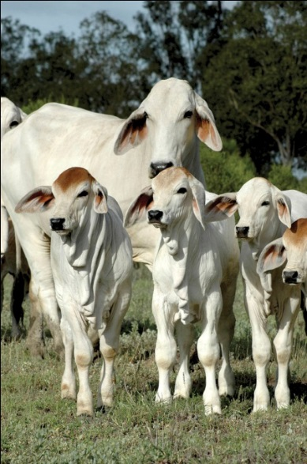


Best linear unbiased prediction
Slide courtesy: Prof. Ben Hayes

Slide 2
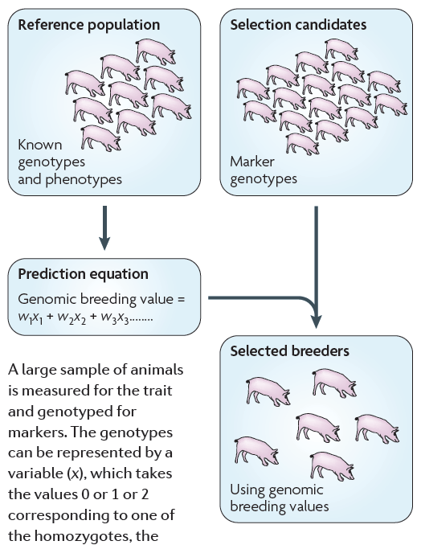
Genomic selection

Slide 3
Genomic prediction
What parameters determine the accuracy of genomic prediction?
Examples of genomic prediction/selection in practise
Notes:
#4,2,8

Slide 4
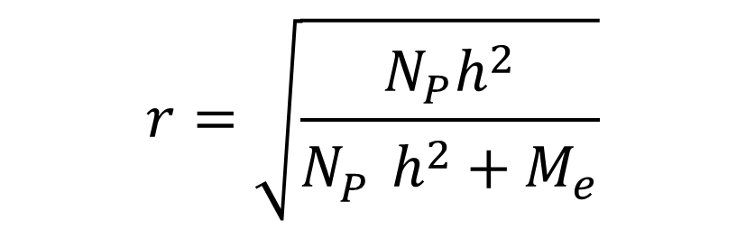
  Factors affecting genomic prediction accuracy
Np Size of reference population
h² Heritability of trait
Me Number of independent chromosome segments
  Daetwyler et al. (2008, 2010), Goddard (2008)
$$r=\sqrt{\frac{N_{P}h^{2}}{{N_{P}^{}h}^{2}+M_{e}}}$$

Slide 5
  Factors affecting genomic prediction accuracy
Np Size of reference population
h² Heritability of trait
Me Number of independent chromosome segments
  Also called effective number of loci for trait

Slide 6
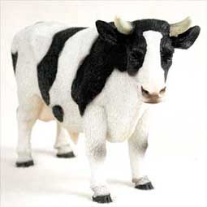
  Factors affecting genomic prediction accuracy
Number of loci affecting the trait
  Conservative assumption - quantitative traits affected by very large number of loci, normal distribution of effects
  = number of independent chromosome segments

Slide 7
  Factors affecting genomic prediction accuracy
Number of loci affecting the trait
  Conservative assumption - quantitative traits affected by very large number of loci, normal distribution of effects
  = number of independent chromosome segments

Slide 8
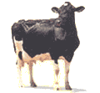
  Factors affecting genomic prediction accuracy
Number of loci affecting the trait
  Conservative assumption - quantitative traits affected by very large number of loci, normal distribution of effects
  = number of independent chromosome segments
  Me = 2N_{e}L
    N_{e} = effective population size, L is genome length in Morgans

Slide 9

  Factors affecting genomic prediction accuracy
accuracy of genomic breeding values
Number of chromosome segments
  Me = 2N_{e}L
$$r=\sqrt{\frac{N_{P}h^{2}}{{N_{P}^{}h}^{2}+M_{e}}}$$

Slide 10
Real Data
Dairy cattle (Holsteins)
    USA results (N=1000-6700) for Net Merit Index (VanRaden et al. 2009)
    Australian results (N=1100-3300) for Australian Profit Ranking
    h²=0.9
    N_{e} = 100
Accuracies r(GEBV,EBV) in validation data sets

Slide 11
Deterministic prediction vs. Holstein data
1
0.9
0.8
0.7
0.6
Accuracy of genomic breeding value
0.5
0.4
0.3
0.2
Predicted Daetwyler et al. (2008)
0.1
US Holstein data
Australian Holstein data
0
0
1000
2000
3000
4000
5000
6000
7000
Number of bulls in reference population
Hayes et al., 2009, AAABG

Slide 12
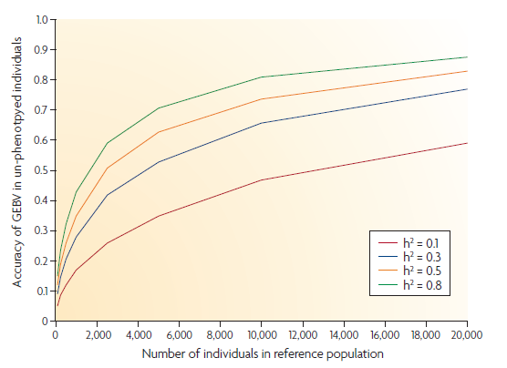
Deterministic prediction

Slide 13
Reference populations for GS
Which individuals/lines?
The relationship of the reference population to the selection candidates affects accuracy of GEBV

Slide 14
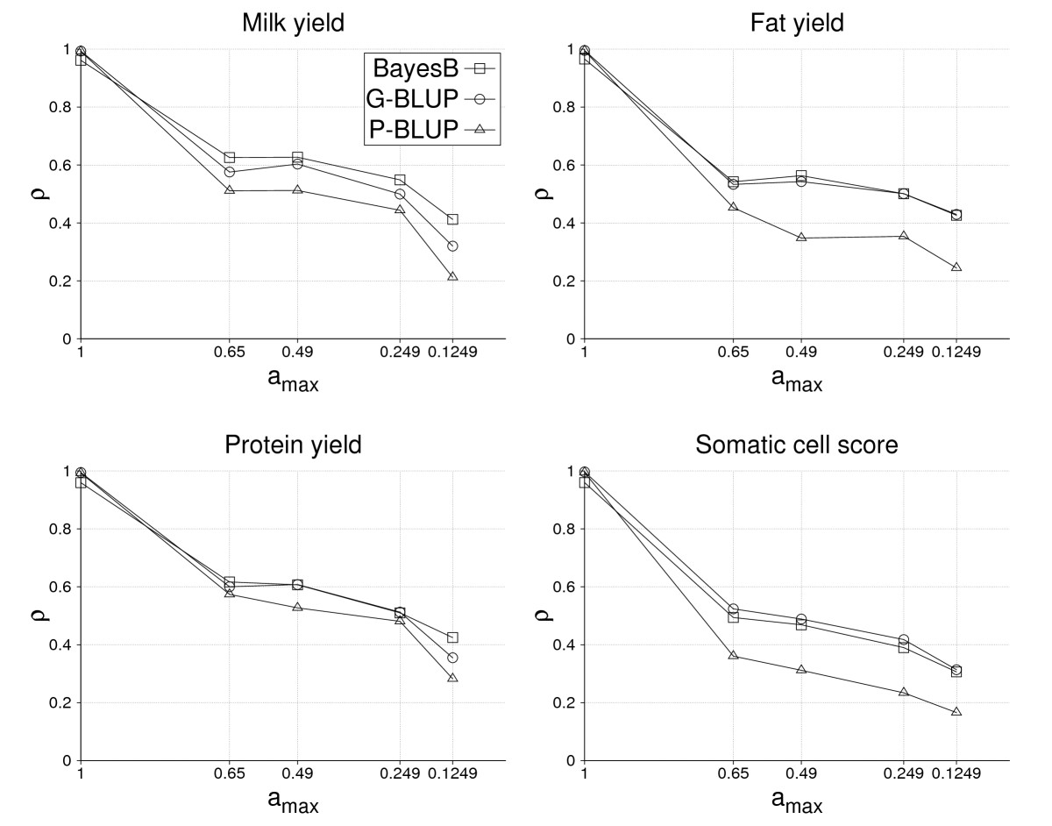
Habier et al. 2010 Gen. Sel. Evol. 42:5

Slide 15
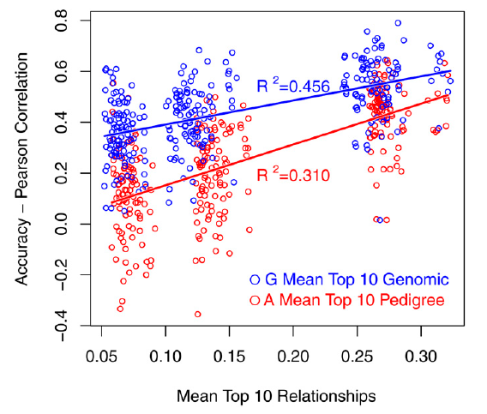
Influence of relationships on GS accuracy
Relationship of validation to reference important contributor to accuracy

Slide 16
Reference populations for GS
Which individuals/lines?
The relationship of the reference population to the selection candidates affects accuracy of GEBV
Need individuals close to those being predicted in reference -> caution, can over-estimate accuracy of real world application
At the same time, as diverse as possible so that many individuals/lines can be accurately predicted
And needs to be large!!

Slide 17
Genomic prediction
What parameters determine the accuracy of genomic prediction?
Examples of genomic prediction/selection in practise
Notes:
#4,2,8

Slide 18

Dairy cattle
Ginfo project – genotype 30,000 cows in commercial dairy herds (main emphasis good fertility records)
Accuracies genomic breeding values for young genomic bulls now quite high
Trait | Accuracy
BPI | 79
Production | 87
Survival | 69
Fertility | 69
Feed efficiency | 54

Slide 19
Dairy breeding program
Old......
Screen ’00s of calves on parental average ebv

Slide 20
Dairy breeding program
Genomic.....
Screen ’000s of calves on genomic breeding value

Slide 21
Dairy breeding program
Genomic.....
Screen ’000s of calves on genomic breeding value
Double rate of genetic gain

Slide 22
Dairy cattle
Double rate of genetic gain
García-Ruiz et al. Proc Natl Acad Sci U S A. 2016 113(28):E3995-4004

Slide 23
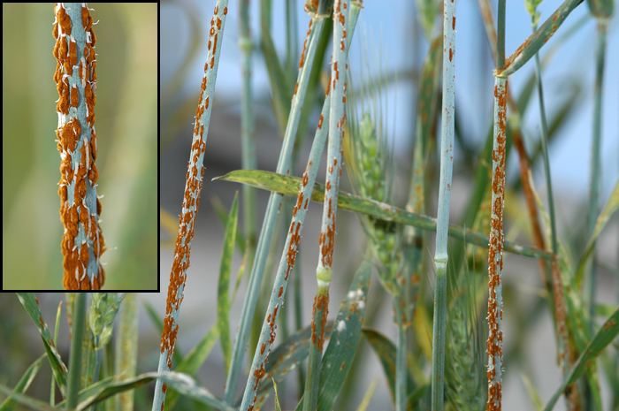
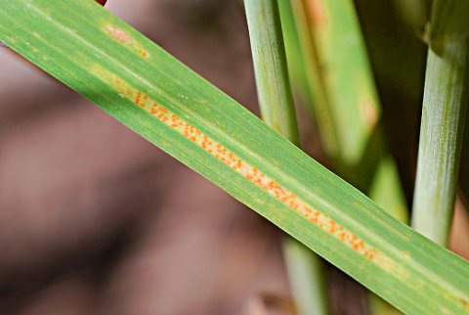
Wheat – rust resistance
Rusts major cause of yield loss in wheat
Three diseases, leaf rust, stem rust, stripe rust
2069 lines phenotyped in four locations, genotyped with Illumina 90K SNP

Slide 24
Wheat – rust resistance
Rust type | Average accuracy
Leaf rust | 0.51
Stem rust | 0.62
Stripe rust | 0.56

Slide 25
Wheat - rust resistance
Rust type | Average accuracy
Leaf rust | 0.51
Stem rust | 0.62
Stripe rust | 0.56

Slide 26
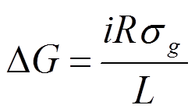
Improving accuracy?
  accuracy =0.6 accuracy=0.8

Slide 27
Humans – Crohn’s disease
Inflammatory Bowel Disease
Affects 2 in every 1000 people (approx.)
Genomic predictions for risk?
Chen et al. 2017. Performance of risk prediction for inflammatory bowel disease based on genotyping platform and genomic risk score method. BMC Medicine 18:94.

Slide 28
Humans – Crohn’s disease
68,000 IBD patients and 29,000 healthy controls from 15 cohorts, European descent
909,763 GWAS SNPs or 123,437 SNPs on the custom designed Immunochip
Prediction methods:
  Genetic profile risk scores (GPRS) constructed using effects of all SNPs from single-marker association analyses
  GBLUP
  Elastic net (EN)
  BayesR - Bayesian method that models SNP effects as a mixture of 4 normal distributions.

Slide 29
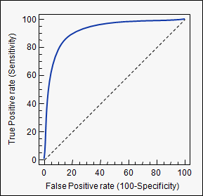
Humans – Crohn’s disease
5 fold cross validation used
Assess value of predictions as “Area Under Curve” (AUC)

Slide 30
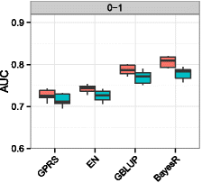
Humans – Crohn’s disease

Slide 31
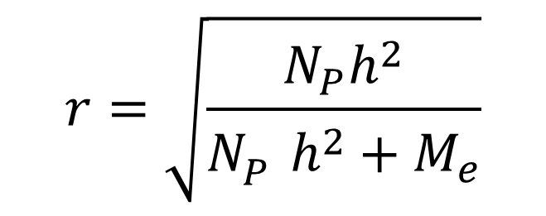
  Conclusion
The accuracy of genomic prediction is
Where
  Np Size of reference population
  h² Heritability of trait
  Me Number of independent chromosome segments (2NeL)
Use to design experiment to get desired accuracy
Relatives in reference improves accuracy, but caution –> may not have relatives in real life application
Genomic selection widely applied in livestock and crops
Promising disease risk predictions in some cases for humans (Crohn’s disease)

