Slide 1
STAT 3306/7306
Statistical Analysis of Genetic Data
Lecture 2 – Overview of Statistical Genetics Applications

Slide 2
Previously, in STAT3306/7306
Multiple lines of evidence point at a large number of causative mutations (quantitative trait loci, QTL) for most complex traits
Variance explained by individual markers will be small
Genome-wide Association Studies (GWAS) have identified large numbers of QTL for complex traits
<number>

Slide 3
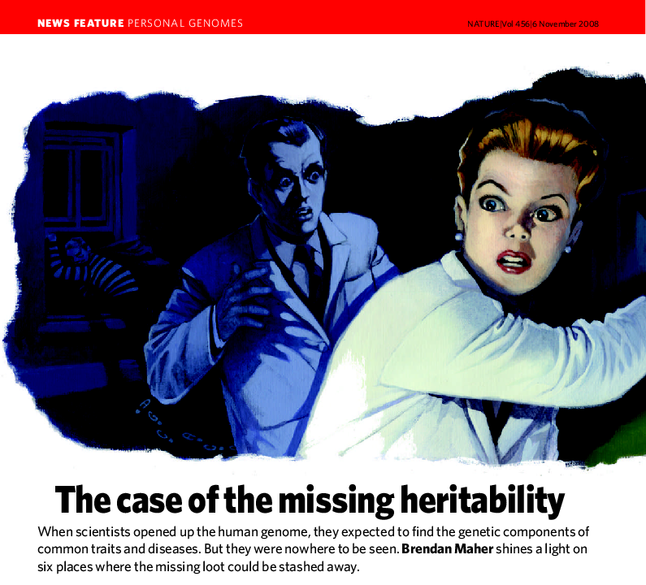
The Missing Heritability Problem
Loci identified through GWAS have captured only a small
proportion of the heritability of complex traits
(Manolio et al, 2009, Nature)
<number>

Slide 4
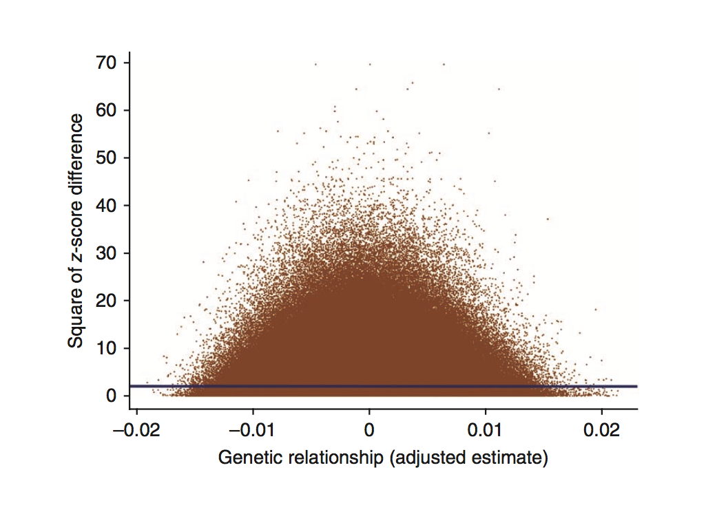
Finding the Missing Heritability
Idea: Use all SNPs together to estimate the heritability from “unrelated” individuals
~45% of variation explained by all SNPs for height
(Yang et al. 2010 Nat Genet)
<number>

Slide 5
Per Chromosome Contribution
Height Schizophrenia
Yang et al. 2011 Nat Genet Lee et al. 2012 Nat Genet
<number>

Slide 6
Finding the Missing Heritability
Implies more genes for complex traits will be found using larger samples sizes.
Yang et al. 2011 Nat Genet
Lee et al. 2012 Nat Genet
Yang et al. 2010 Nat Genet
<number>

Slide 7
GWAS Discovery vs Sample Size
Visscher et al. 2012 Am J Hum Genet
<number>

Slide 8

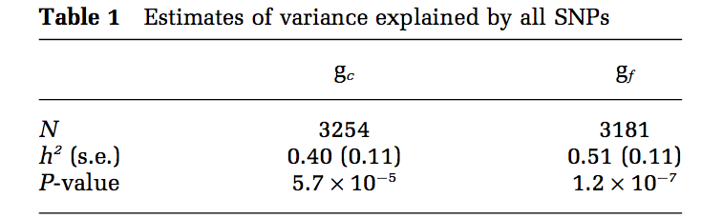
Nature vs Nurture – The Genetics of Intelligence
Davis et al., 2011, Mol Psychiatry
Deary et al., 2012, Nature
<number>

Slide 9
Understanding Polygenicity
0 risk alleles
risk allele
2 risk alleles
An example disease with 100 contributing risk alleles
<number>

Slide 10
Understanding Polygenicity
Not all affected individuals carry the
risk allele at any particular locus
Unaffected individuals carry many risk loci
Each affected person carries a unique portfolio
<number>

Slide 11
Polygeneic Scores (PGS)
<number>

Slide 12
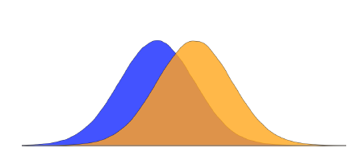

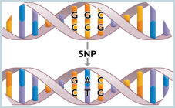
Polygenic Scores
Case-control
Discovery
Case-control
Target
Evaluate
GWAS
association
results
Genome-
wide
genotypes
AUC=0.61
Weighted sum of discovery-sample identified risk alleles
PGC2
32,838
Identify risk loci and estimate effect sizes
PGC1
9,320
ISC
2,615
<number>

Slide 13
Coronary Artery Disease
(Kheera et al., 2018, Nature Genetics) (Torkamani et al, Nat Rev Genetics, 2018)
1 in 21
1 in 46
1 in 61
<number>

Slide 14
Coronary Artery Disease
(Inouye et al., 2018, JACC)
Polygenic risk scores plus all conventional risk factors
Polygenic risk scores alone
<number>

Slide 15
Genomic Selection in Animal Breeding
Traditional Approach
<number>

Slide 16
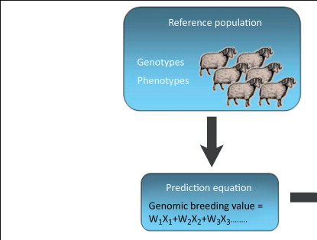
Genomic Selection in Animal Breeding
M M M M M M M M M M
AA = 0
AT = 200g growth
TT = 400g growth
(w1=200)
<number>

Slide 17
Genomic Selection in Animal Breeding
(Hayes et al., Trends in Genetics, 2013)
<number>

Slide 18
Genomic Selection in Animal Breeding
Traditional Approach
(EBV)
Genomic Approach
(GEBV)
Double the rate of genetic gain!
<number>

Slide 19
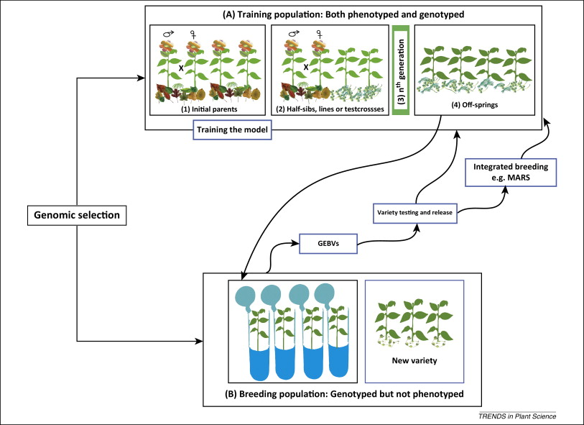
Genomic Selection
Millions of cattle genotyped!
Countries following Genomic Selection:
USA & Canada
Australia
New Zealand
Netherlands
Denmark and Sweden
Brazil
...
Widely used in some crops
<number>

Slide 20
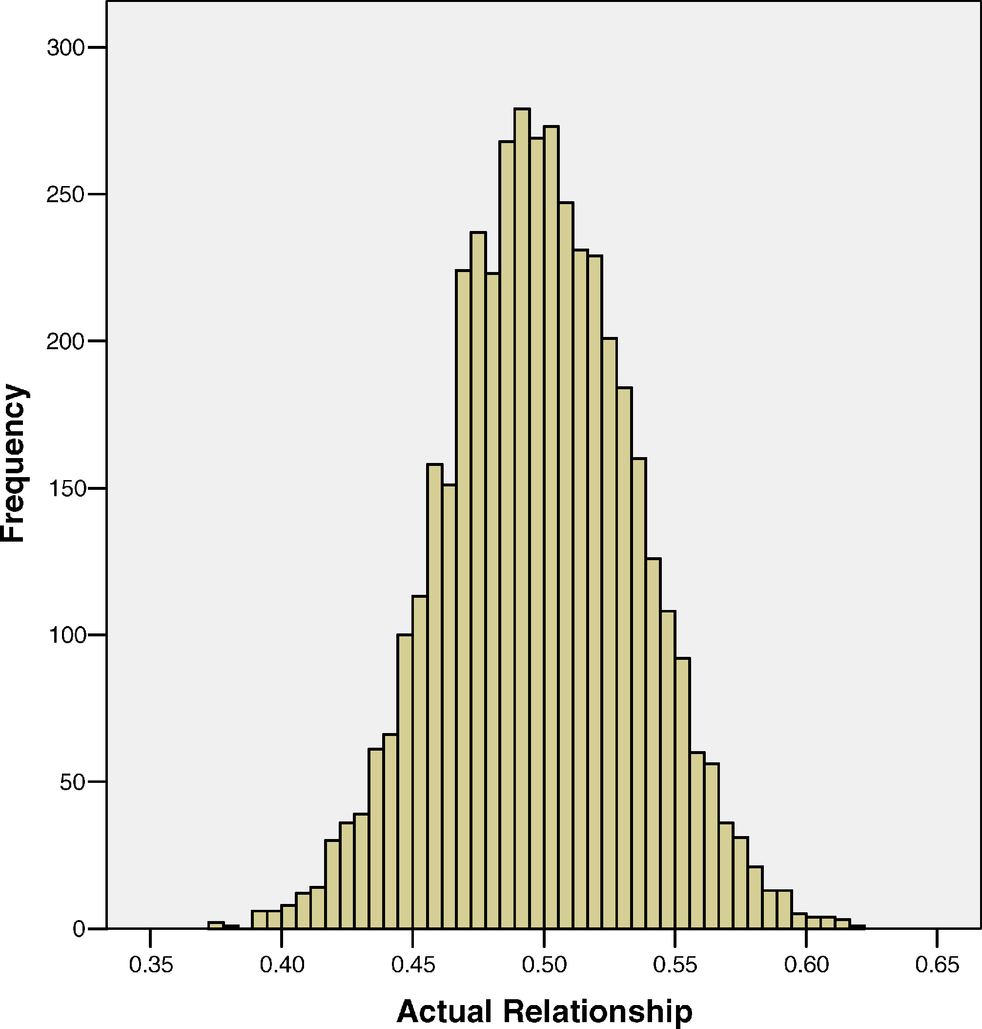
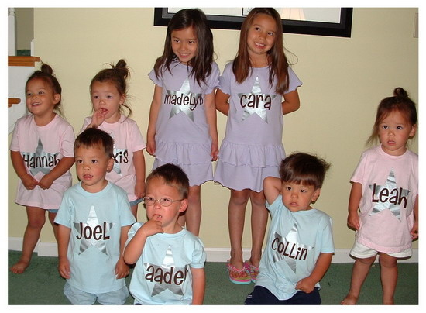
Genomic vs Pedigree Relatedness
Not all sib-pairs are the same
(Visscher et al., PLoS Genetics, 2006)
<number>

Slide 21
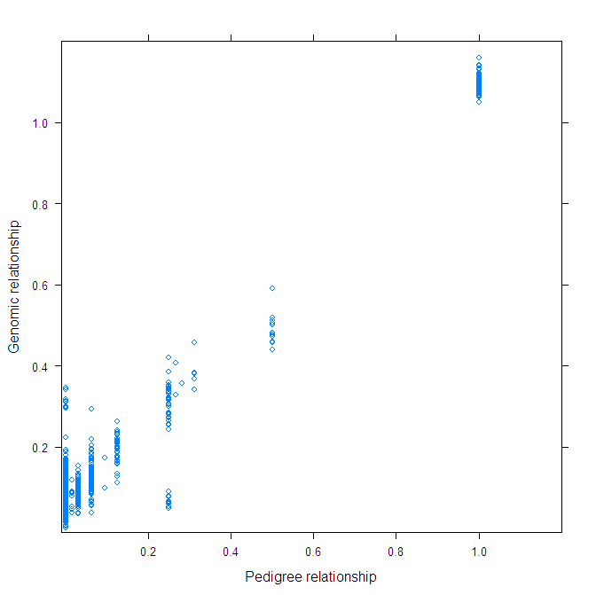
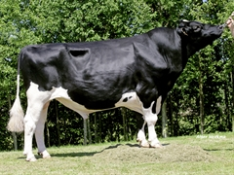
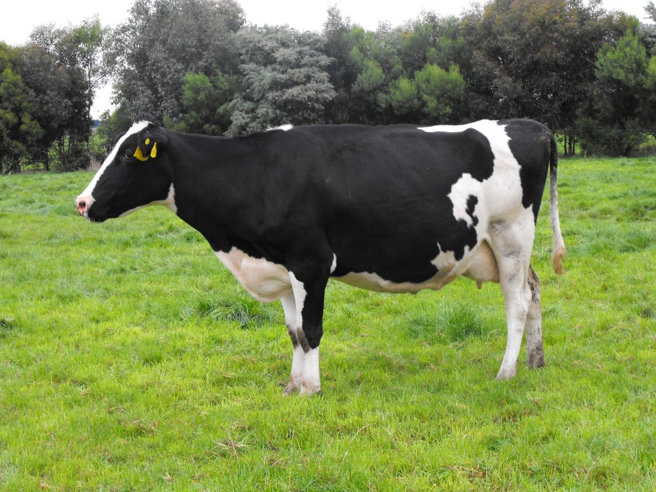
Genomic vs Pedigree Relatedness
Full ET sisters
<number>
<number>

Slide 22
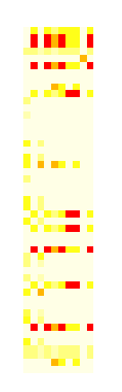
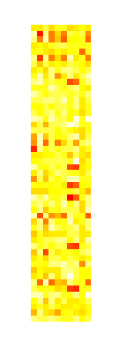
Minimising Inbreeding
Pedigree
Genomics
Each square represents the degree of relationship
Darker orange/red indicates closer relationships
49 heifers
10 sires
10 sires
<number>

Slide 23
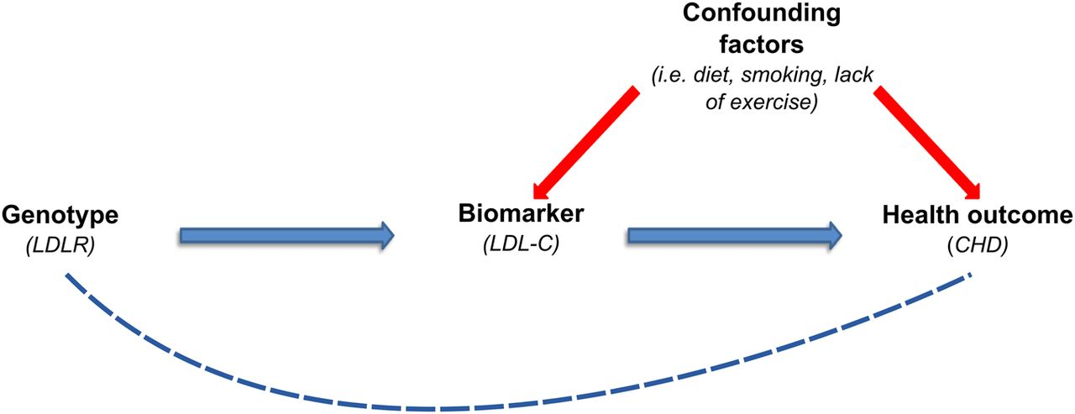
Mendelian Randomisation
<number>

Slide 24
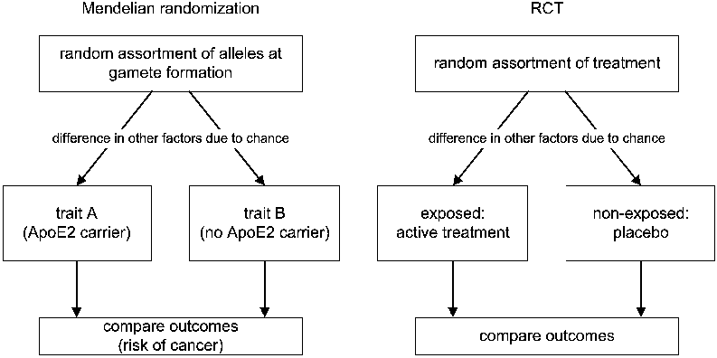
Mendelian Randomisation
<number>

Slide 25
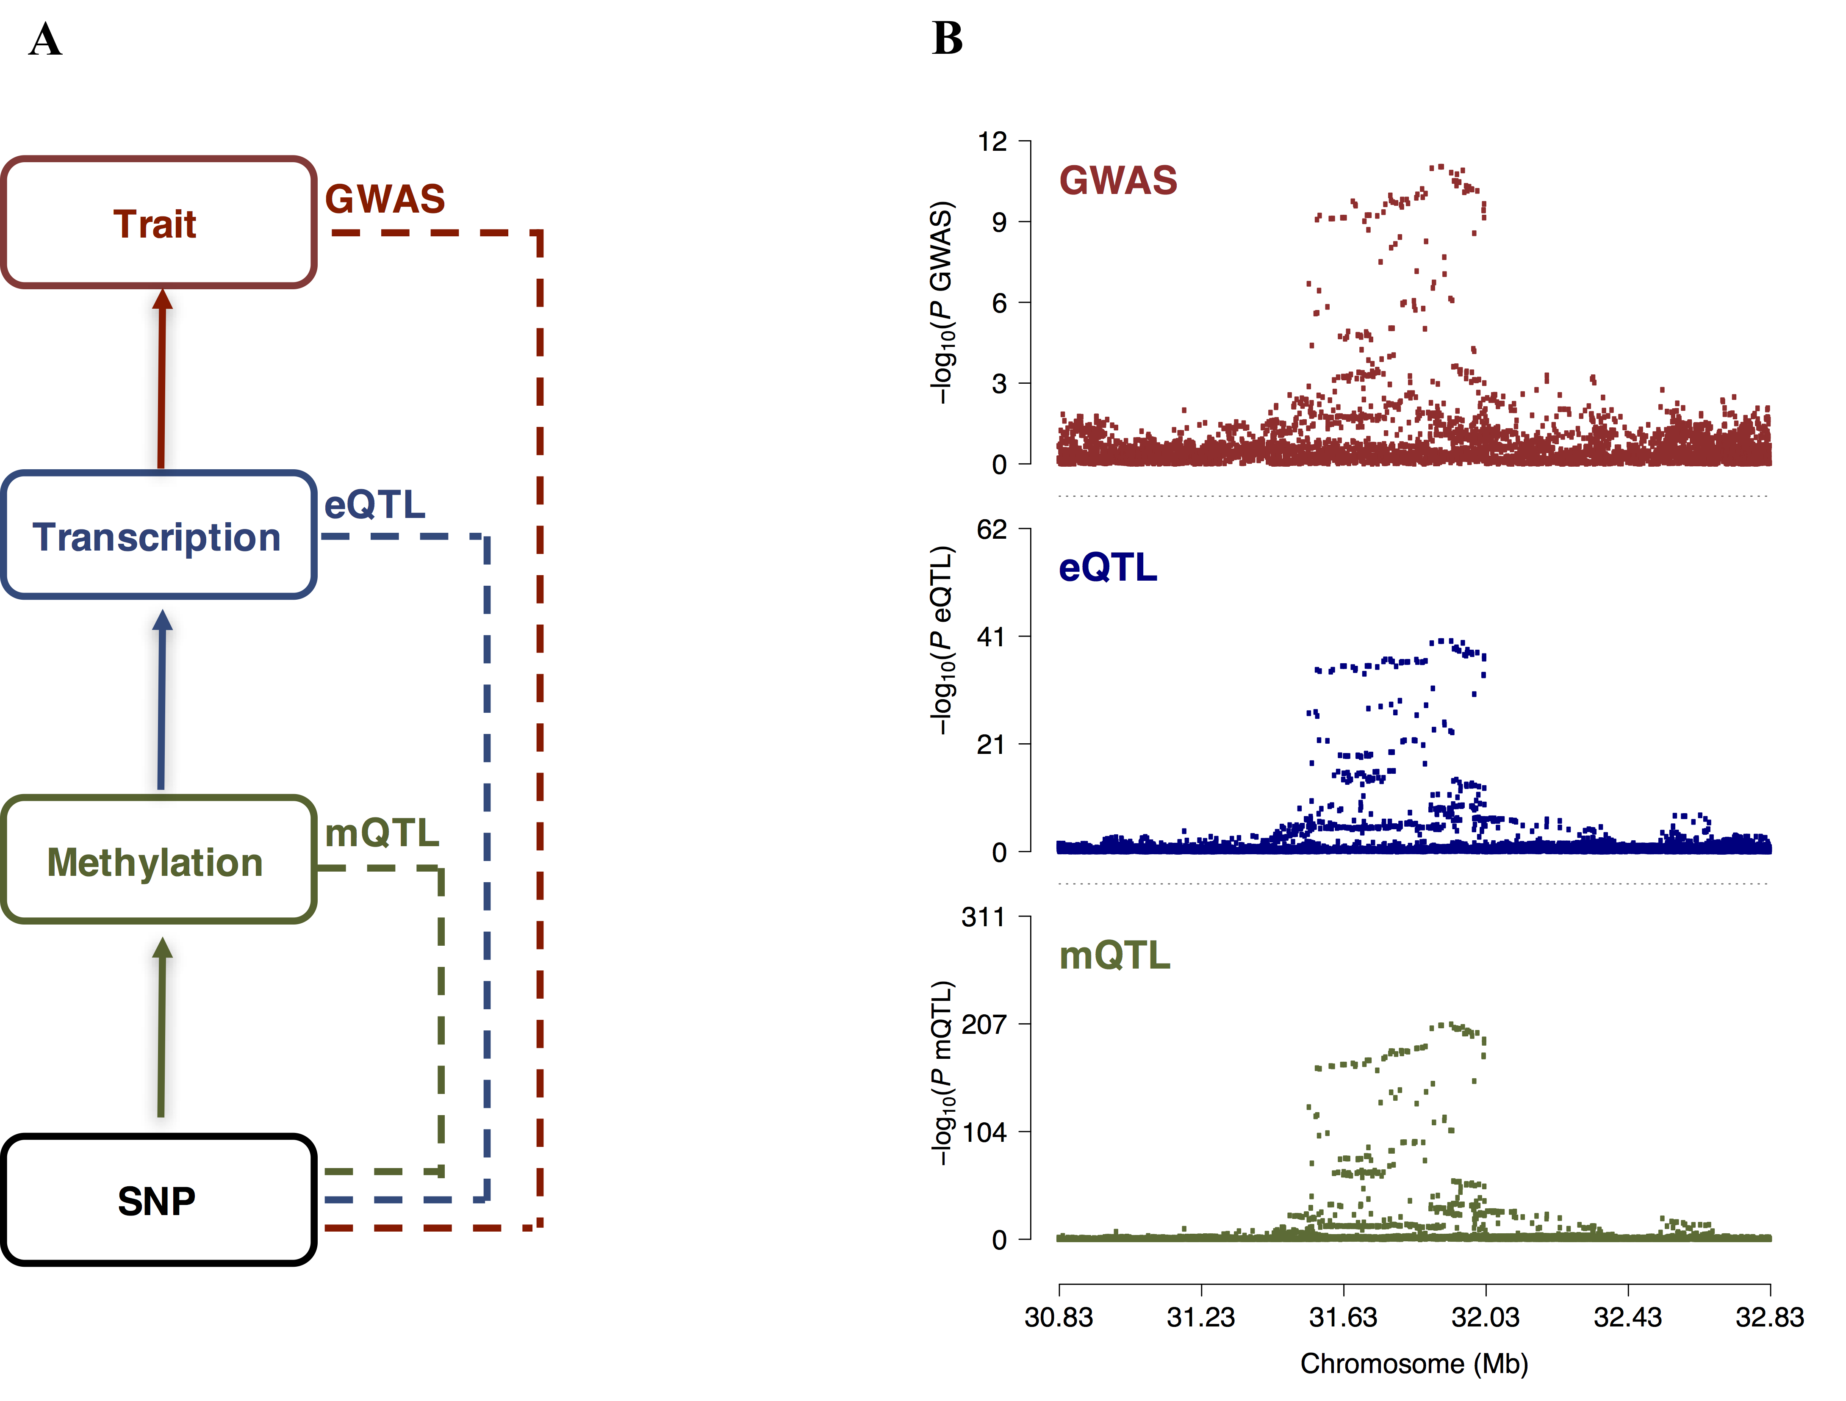
Other Types of ‘Omics Data
(Wu et al., 2018
Nat Comm.)
<number>

Slide 26
Take Home Points
Variation in complex traits result of many mutations of small effects
Genomic information can be used to:
Make predictions of disease risk allowing preventative interventions
Give accurate estimates of breeding value and increase genetic gains in agriculture
...
<number>

Slide 27
Laboratory Session
NO Lab session this week (2019-07-23)
Next week:
Introduction to R, with a focus on linear models and matrix algebra
Basic Linux usage
<number>

Slide 28
Lectures Next Week
Will introduce genetic transmission of information, and how we encode that into a statistical framework.
<number>

