Slide 1
STAT 3306/7306
Statistical Analysis of Genetic Data
Lecture 3 – Encoding of Genetic Information

Slide 2
This Week
Aim: Understand the relevant biological processes and how we might model them
2 x lectures:
The encoding of genetic information
The inheritance of genetic information
<number>

Slide 3
Outline
DNA structure and organisation
Function of DNA
Replication of DNA
Gene expression and its regulation
Variations in DNA
Aka: mutations
We only quantify the differences between people
<number>

Slide 4
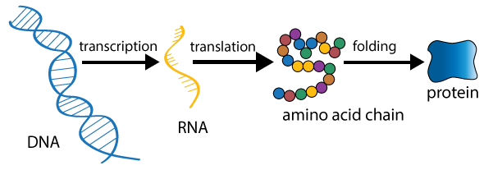
Information flow in biological systems
Proteins have many functions
e.g. enzymes (catalyse reactions), transport (hemoglobin), structural components (hair), messengers (hormones)
Both end-goal & catalyst of gene expression
“workhorse” of cells
<number>

Slide 5
Outline
DNA structure and organisation
Function of DNA
Replication of DNA
Gene expression and its regulation
Variations in DNA
Aka: mutations
We only quantify the differences between people
<number>

Slide 6
What is DNA?
DNA = deoxyribonucleic acid
Two strands of nucleotides form a DNA molecule
Strands are twisted together to resemble a ladder where the sides (made of sugar + phosphate) are connected by ‘rungs’ of bases
Only 4 possible bases; A, G, C & T
DNA is mostly found in the nucleus of eukaryotic cells
<number>

Slide 7
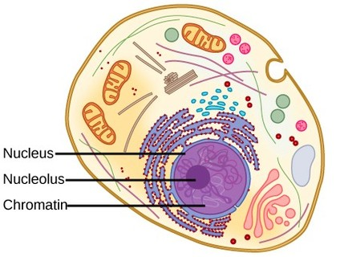
Typical eukaryotic cell
Nucleus: contains the majority of a
cells genetic material
Chromatin: DNA + proteins
<number>

Slide 8
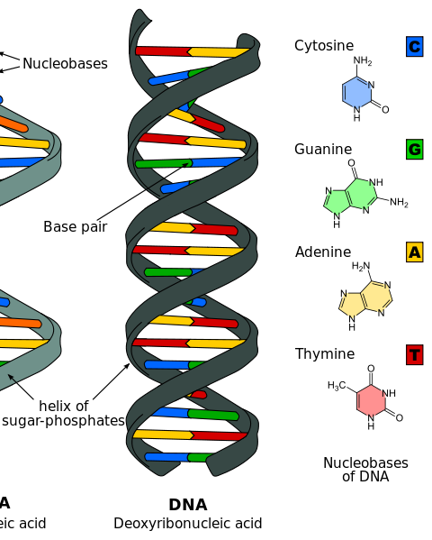
DNA contains 4 types of bases
Very specific bonding between the bases:
A only binds with T
G only binds with C
*Can be represented as string of letters
5’ GTATTCCTT 3’
3’ CATAAGGAA 5’
<number>

Slide 9
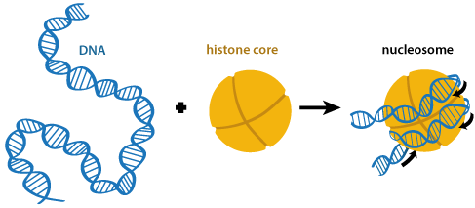
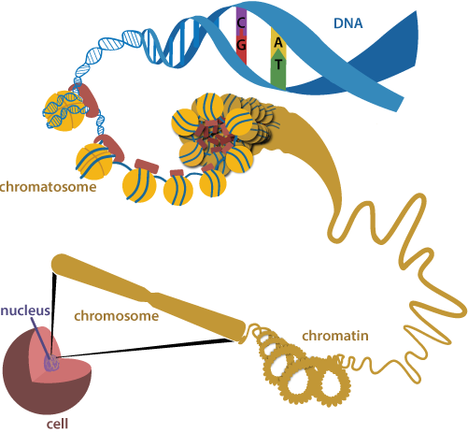
DNA is ‘packaged’ with proteins to form chromosomes
DNA is wrapped around a histone core…
…and coiled…
…and looped...
...and coiled…
…
…
<number>

Slide 10
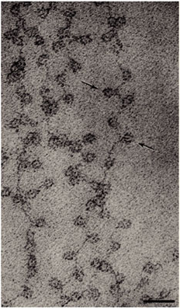
Electron micrograph of chromatin
Chromatin = DNA + protein
DNA ‘packaging’ is important to fit DNA into a cell :-
The human genome has ~3 billion base pairs of DNA
Each diploid cell contains about 2m of DNA
50 trillion cells per person
= 100x10⁹m DNA/person!
Each cell contains its own complete genome
<number>

Slide 11
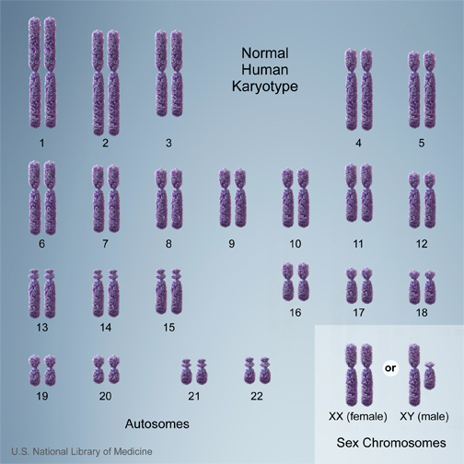
Organisation of DNA
The human genome is diploid (2 copies)
with 23 pairs of chromosomes
22 pairs of autosomes
1 pair sex-chromosomes
X and Y
XX = female, XY = male
Genome = complete set of instructions for
making an organism
Chromosome = thread-like strand of DNA+proteins
<number>

Slide 12
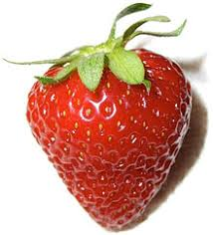
Organisation of DNA
Most mammals are diploid, e.g.
Humans, 23 chromosomes
Cattle, 30 chromosomes
Sheep, 27 chromosomes
Plant genomes are variable...
Maize, diploid with 10 chromosomes
Wheat, hexaploid with 7 chromosomes
Strawberry + hybrids, have a varying number of 7 chromosomes (from 2 and up to 10 sets).
<number>

Slide 13
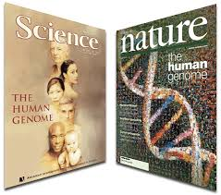
The human genome project (1990-2003)
Feb. 2001: ‘draft’ sequence
90% complete
error rate: 1 in 1000 base-pairs (bp)
150,000 gaps
April 2003: complete ‘full’ sequence
99% complete
error rate: <1 in 10,000 bp
< 400 gaps
Sequencing = determining exact order of all bases in genome
Driver of technology developments
Beginning of large international collaborative research projects in biology
<number>

Slide 14
The human genome project
Genome sequence contains:
Detailed ‘instruction manual’ for building a human
Information on ancestry & human history
Clues for disease etiology
HGP has provided an instruction book, now the challenge is to understand how the genome functions
<number>

Slide 15
Outline
DNA structure and organisation
Function of DNA
Replication of DNA
Gene expression and its regulation
Variations in DNA
Aka: mutations
We only quantify the differences between people
<number>

Slide 16
Function of DNA
There are two primary functions of DNA:
Replication = faithful production of copies
Mitosis, normal cell growth & division
Meiosis, production of gametes (with recombination)
Gene expression = the production of proteins or ‘functional products’ from genetic information
<number>

Slide 17
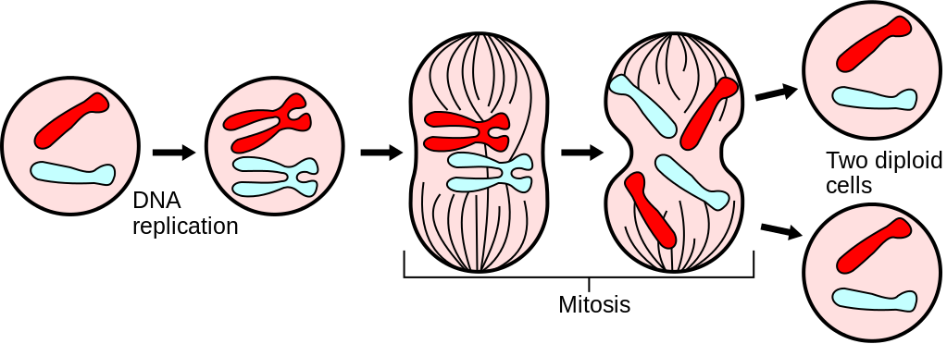
Mitosis
separation of sister chromatids
‘Normal’ cell division & growth
Maternal chromosomes
Paternal chromosomes
Centromere
<number>

Slide 18
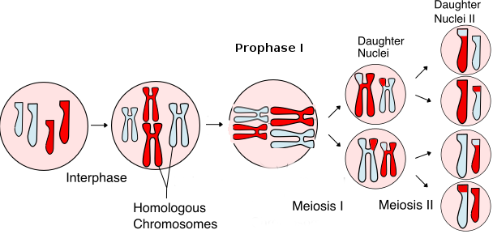
Meiosis (“My-osis”)
n
Meiosis II
Production of gametes
n
2n
Meiosis I
2n
2n
Alignment of chromosome pairs
DNA replication
separation of mat/pat chromosomes
separation of sister chromatids
<number>

Slide 19
DNA replication is first step in mitosis & meiosis
In built repair mechanisms to ensure accuracy
Sometimes mistakes occur leading to a mutation
mutation = altered form of (or variation in) DNA
may or may not be inherited, depending on context
Variation in DNA is the basis of inherited genetic differences between individuals.
All individuals have a handful of new (de novo) mutations that are not found in either of their parents
<number>

Slide 20
Expression of genetic information
Genes are the fundamental ‘units’ of the genome
sections of DNA that encode for protein
There are about 22,000 genes in human genome
Genes make up about 1% of the genome
much of the remainder of the genome has regulatory functions (2012) + ~20% still ‘unknown’
Genes have a defined structure:
nearby and distant regions which control the rate of transcription
translated and untranslated regions
<number>

Slide 21
Eukaryotic gene structure
DNA
long-range regulatory elements
exon
exon
exon
exon
promoter
intron
intron
intron
5’
3’
Transcription & RNA processing
introns are removed (spliced out)
RNA
AUG
AAAA
start codon
<number>

Slide 22
Making proteins from RNA
5’ … AUGAUUCUGGAUUGAUU… 3’
GC
AAAA
RNA
translation
STOP
Protein
MET—LLE—LEU—ASP
RNA is read in triplets (called ‘codons’) during translation
<number>

Slide 23
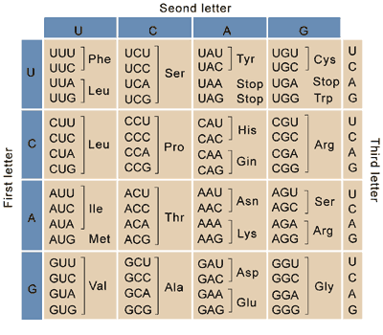
Genetic code
All organisms share the same ‘code’
Degenerate
64 codons code for 20 amino acids
<number>

Slide 24
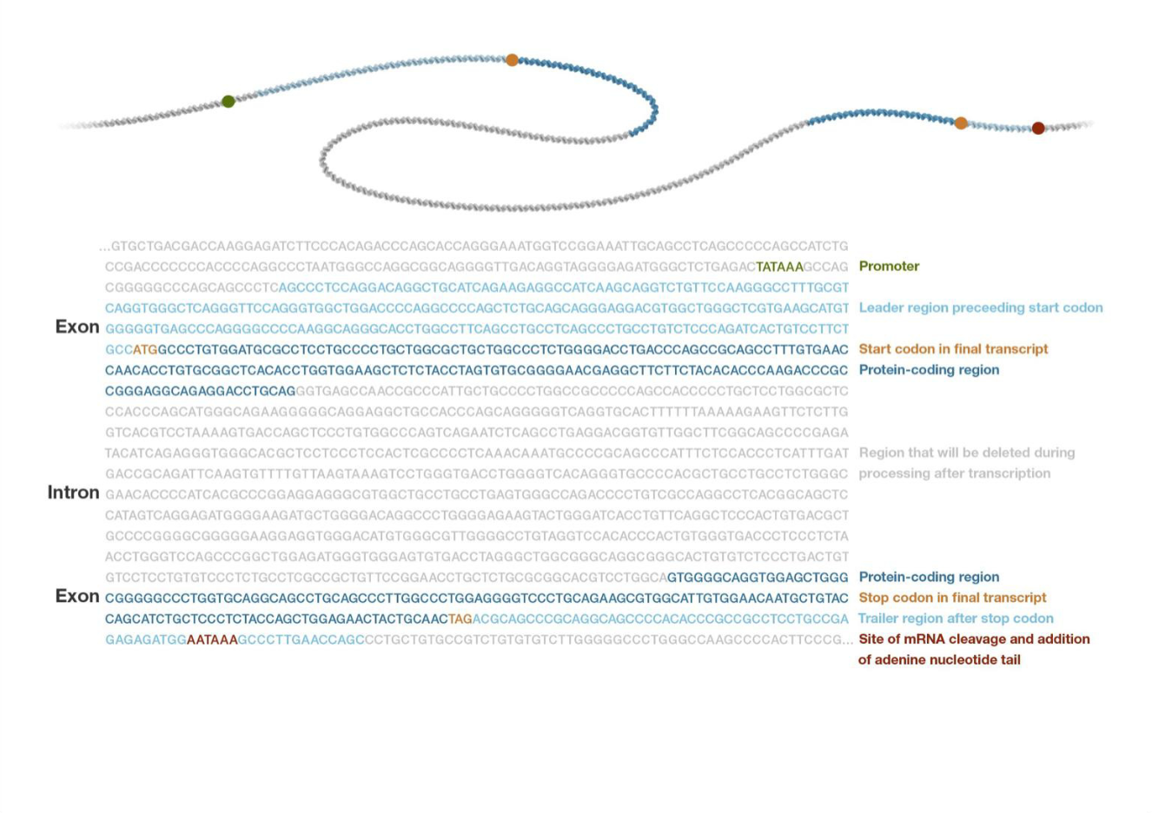
<number>

Slide 25
Gene expression
All cells contain the same genetic information (DNA) but only a subset of all potential proteins
‘Gene expression’ is the primary mechanism by which cells
Differentiate (i.e. become specialized cells)
Respond to environmental cues
Regulation of gene expression is highly complex and tightly regulated to ensure proper expression of proteins at the proper time
<number>

Slide 26
Gene expression
In mammals, gene expression is primarily regulated by initiation of transcription
Can be controlled by accessibility of DNA to the transcription machinery
Can be studied by:
Assessing the quantity of RNA in a cell
Assessing the ‘epigenetic modifiers’ present in a cell, such as DNA methylation (represses expression in promoter regions)
<number>

Slide 27
Outline
DNA structure and organisation
Function of DNA
Replication of DNA
Gene expression and its regulation
Variations in DNA
Aka: mutations
We only quantify the differences between people
<number>

Slide 28
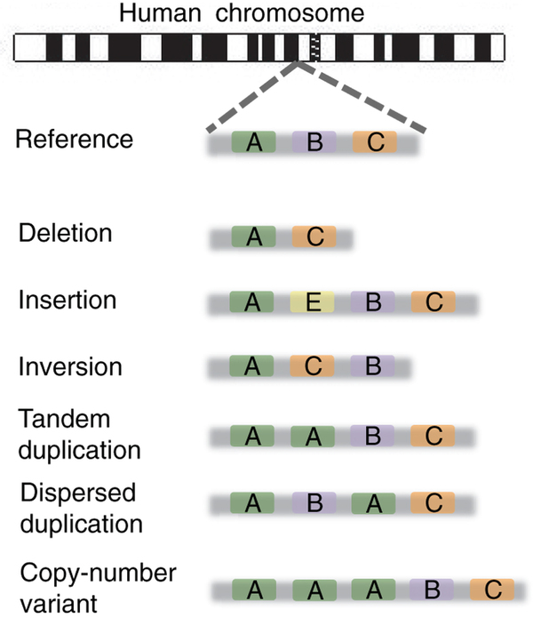
Variations in DNA
Different types:
structural variants (deletions, inversions, insertions)
...
SNP (single nucleotide polymorphism)
<number>

Slide 29
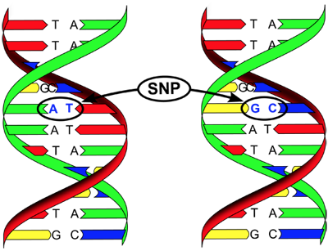
SNP = single nucleotide polymorphism
Chromosomes pairs have the same genetic
information (genes & structure) but may
be slightly different
I.e. have different alleles
Pair of chromosomes
e.g. T/C SNP
<number>

Slide 30
Representing a SNP
5’ GTATTCCTT 3’
3’ CATAAGGAA 5’
5’ GTATCCCTT 3’
3’ CATAGGGAA 5’
Reference Strand
Identify Differences
Count number of ‘C’ alleles
Genotype = 1
5’ GTATTCCTT 3’
5’ GTATCCCTT 3’
<number>

Slide 31
What does ‘genetic data’ look like?
Can assay ~1M SNPs
per individual with ‘SNP chips’
Genotype file:
Map file:
 | SNP1 | SNP2 | SNP3 | SNP4
Bob | 0 | 1 | 0 | 1
Fred | 1 | 2 | 0 | 0
Jose | 1 | 2 | 2 | 2
Andy | 2 | 1 | 1 | 1
 | chr | position | ref | alt
SNP1 | 1 | 52196307 | A | T
SNP2 | 1 | 52462094 | C | T
SNP3 | 1 | 52736008 | A | G
SNP4 | 1 | 53010891 | T | C
<number>

Slide 32
Important terms to describe genetic data
Locus: a particular location on a chromosome
Genotype: genetic constitution of an individual
Heterozygous: a locus that has different alleles (i.e. 1)
Homozygous: a locus that has identical alleles (i.e. 0 or 2)
Heterozygote: an individual that is heterozygous at a locus
Homozygote: an individual that is homozygous at a locus
<number>

Slide 33
Effect of mutations
Mutations outside gene regions
Maybe cause no detectable effect
Could influence gene expression (if in promoter or enhancer region)
Mutations in gene regions
Can change proteins if in translated regions
    effect depend on properties of amino acid substitution
    e.g. could introduction of STOP codon
Might not change proteins due to degenerate code
Most mutations affecting ‘normal’ variation are likely to effect gene expression rather can cause changes to proteins
<number>

Slide 34
‘Omics’
Study of complete set of biological molecules, e.g.
 | study of… | molecule | e.g. technology
Genomics | Genomes | DNA | Seq-based: short read sequencing Array-based: SNP chips
Transcriptomics | Transcripts (gene expression) | RNA | Seq-based: RNAseq Array-based: microarrays
Proteomics | Proteins | Protein | mass spectrometry
Metabolomics | Metabolites (small molecules) | e.g. lipids, amino acids, peptides | various, e.g. mass spec
Epigenomics | Epigenetic modifications | e.g. methylation, histone modification | Seq-based: ChiP-Chip, ChIP-Seq Array-based: methylation arrays

Slide 35
Key Points
The human genome is organised into 23 pairs of chromosomes
Chromosomes within a pair have the same gene content but may be slightly different
(i.e. have different alleles)
The most common form of genetic variant is a SNP
Genetic variants can occur anywhere in the genome
The effect of a variant is determined by its location
Most variants effecting complex traits are thought to be located in regions controlling gene expression
<number>

Slide 36
Other Resources
Video of DNA packaging and Replication
https://www.youtube.com/watch?v=OjPcT1uUZiE
<number>

