Slide 1

Quantitative Genetics of Disease Pt1
Loic Yengo
(slides Prof. Wray)
STAT3306/7306
imb
Institute for
molecular bioscience

Slide 2
Aims
Lecture 1
Single locus disease model
Association analysis for disease
Power calculations for association analysis of disease
Genetic Epidemiology – risk to relatives
Lecture 2
Heritability of liability
Multi-locus models of disease
SNP-heritability for disease traits

Slide 3
Single locus disease model
Single locus disease model:
G = genotype; D=disease; K = overall disease risk in population;
p = risk allele frequency;

Slide 4
Single locus disease model
Single locus disease model:
G = genotype; D=disease; K = overall disease risk in population;
p = risk allele frequency;
f₀ = baseline risk for homozygote non-risk allele – UNKNOWN
R = relative risk for heterozygote; assume risk is multiplicative (on this scale)

Slide 5
Single locus disease model
Single locus disease model:
G = genotype; D=disease; K = overall disease risk in population;
p = risk allele frequency;
f₀ = baseline risk for homozygote non-risk allele – UNKNOWN
R = relative risk for heterozygote; assume risk is multiplicative (on this scale)

Slide 6
Single locus disease model
Single locus disease model:
G = genotype; D=disease; K = overall disease risk in population;
p = risk allele frequency;
f₀ = baseline risk for homozygote reference allele – UNKNOWN
R = relative risk for heterozygote; assume risk is multiplicative (on this scale)

Slide 7
Allele Frequency in Cases
Single locus disease model:
G = genotype; D=disease; K = overall disease risk in population

Slide 8
Allele Frequency in Controls
Single locus disease model:
G = genotype; D=disease; K = overall disease risk in population

Slide 9
Single locus association analysis
Measure cases and controls for single nucleotide polymorphism (SNP)
Simple Chi-square contingency test for genotype (AA vs Aa vs aa) counts or allele counts (A vs a)
Logistic regression
  Allows inclusion of covariates
Regression coefficient is log(Odds Ratio)
Practical: we will look at odds ratio vs relative risk
http://faculty.washington.edu/tathornt/SISG2017.html Session 1

Slide 10
Using the single locus disease model to calculate power in an association study

Slide 11
What is power?
When we set up a statistical test
The null hypothesis is EITHER
  true
  false
With the data available we EITHER
  reject the null hypothesis
  fail to reject the null hypothesis
Power = probability of rejecting the null hypothesis when the null hypothesis is false
=1 –probability of failing to reject the null hypothesis when the null hypothesis is false
= 1- probability(Type II error)
 | Null hypothesis is true | Null hypothesis is false
Reject the null hypothesis | Type I error False positive | Correct Outcome True positive
Fail to reject the null hypothesis | Correct Outcome True negative | Type II error False Negative
Power depends on statistical test, effect size to be detected, sample size, acceptable level of Type I error
Non-centrality parameter depends on statistical test, effect size to be detected, sample size

Slide 12
Power
Null
True
β = probability of rejecting the null hypothesis when the alternative hypothesis is true
𝛂 = probability of rejecting the null hypothesis when the null hypothesis is true
Variance about mean values depends on sample size

Slide 13
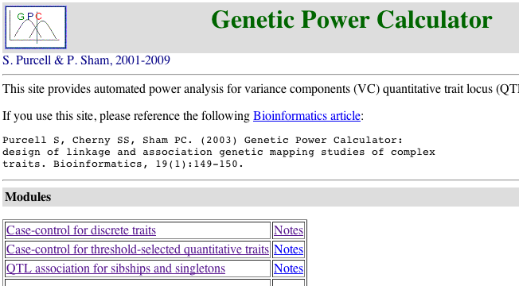
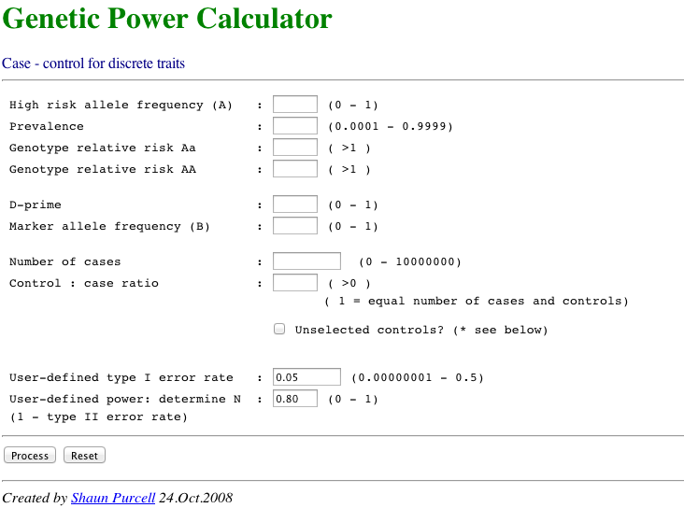
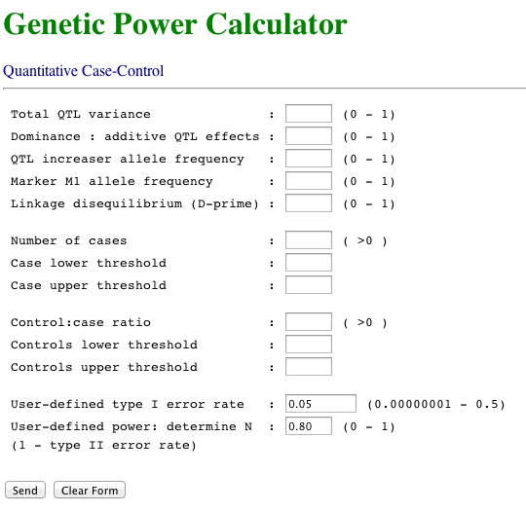
Genetic Power Calculator
Yang

Slide 14
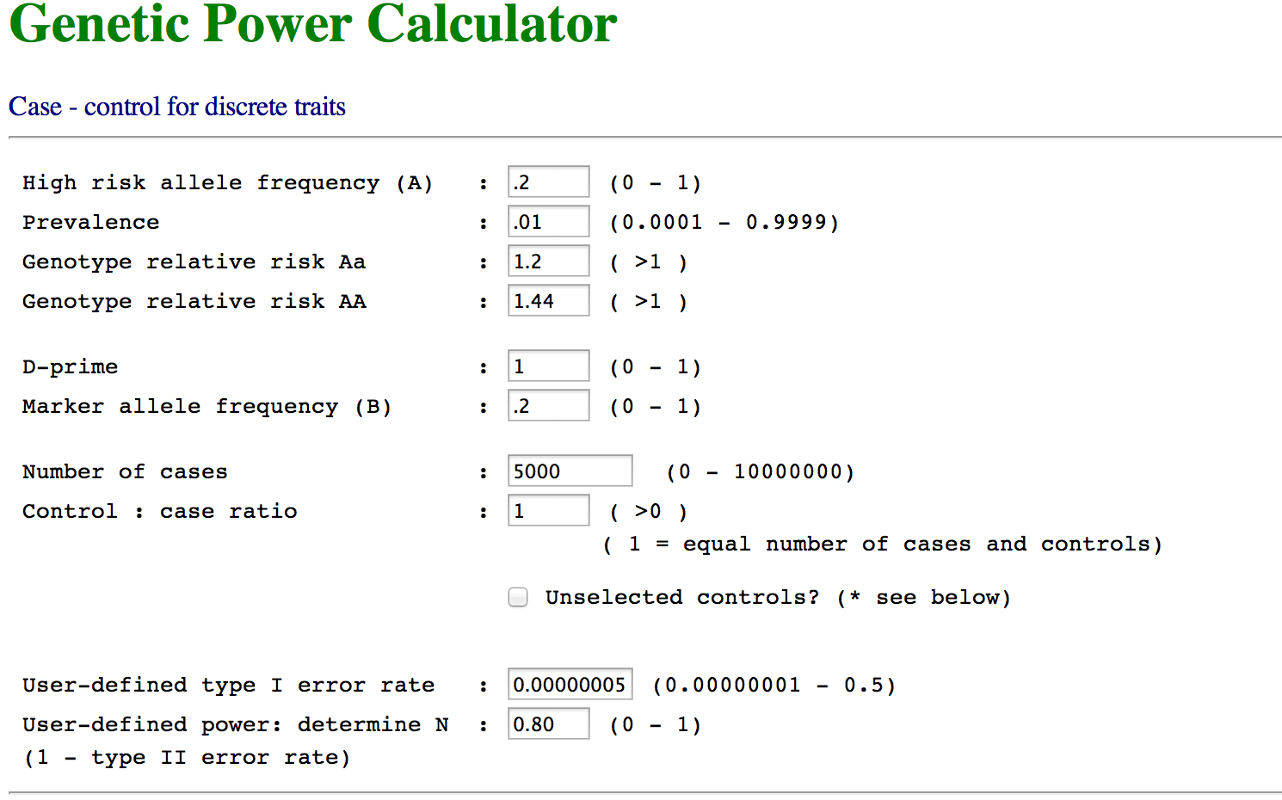
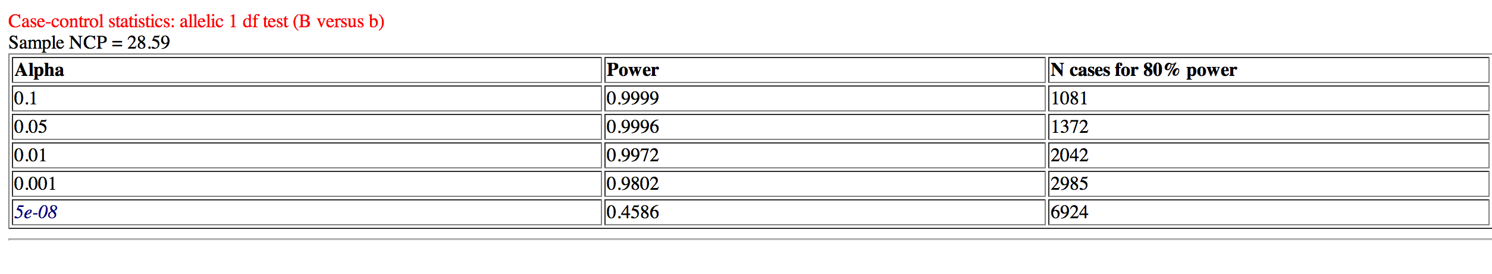

Slide 15

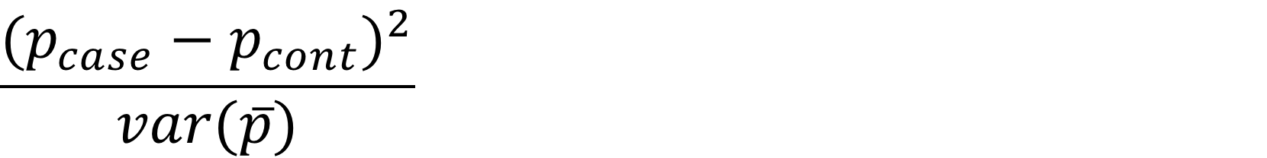
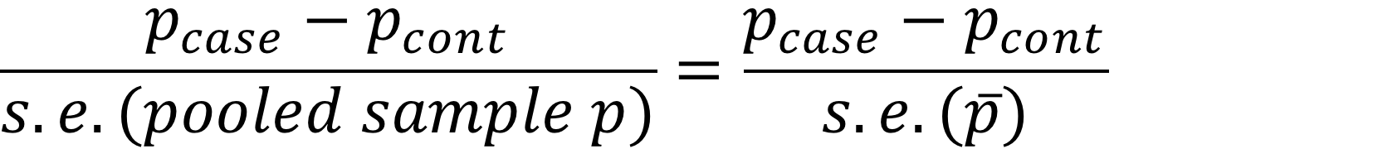
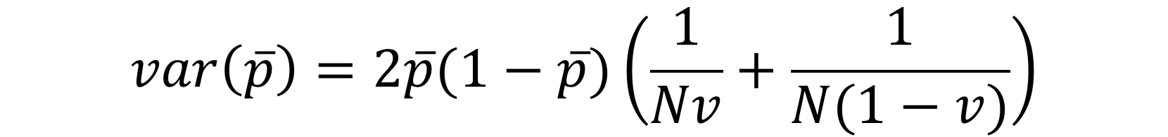
Power of a case-control study
Power of a disease trait
p = frequency of risk allele in population
p_{case} = frequency of risk allele in cases
p_{cont} = frequency of risk allele in controls
v = proportion of a sample of N that are cases
= mean allele frequency across cases and controls
= v p_{case} + (1-v) p_{control}
Z-Test statistic of association = test of difference of two proportions =
χ² non-centrality parameter = NCP₀₁ =
Yang et al (2009)

Slide 16
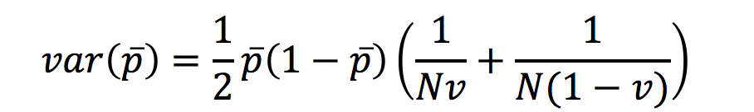
Power of a case-control study
Power of a disease trait
p = frequency of risk allele in population
p_{case} = frequency of risk allele in cases
p_{cont} = frequency of risk allele in controls
v = proportion of a sample of N that are cases
= mean allele frequency across cases and controls
= v p_{case} + (1-v) p_{control}
Z-Test statistic of association = test of difference of two proportions =
χ² non-centrality parameter = NCP₀₁ =
Yang

Slide 17
Power of a case-control study
NCP₀₁ =
α = significance level - acceptable level of type I error
Power =
Normal distribution threshold above which null hypothesis will be rejected
N=10000,v=0.5,p=0.2,R=1.2,K=0.01,α=5e-8,K=0.01, power = 0.46
Agrees with the genetic power calculator
Yang et al (2009) Comparing Apples and Oranges: Equating the Power of Case-Control and Quantitative Trait Association Studies. Genetic Epidemiology

Slide 18
Genetic Epidemiology
How do we know that there is a genetic contribution to disease?

Slide 19
Disease traits: Some disease traits have a clear pattern of inheritance
There are thousands of single gene disorders (OMIM database Online Mendelian Inheritance in Man) but each is very rare
Most common diseases do not have a clear pattern of inheritance yet there is increased risk associated with family history

Slide 20
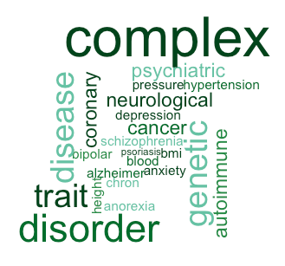
Complex genetic diseases
Unlike Mendelian disorders, there is no clear pattern of inheritance
Tend to “run” in families
Few large pedigrees of multiply affected individuals
Most people have no known family history
Common diseases > 0.5% are complex genetic diseases

Slide 21
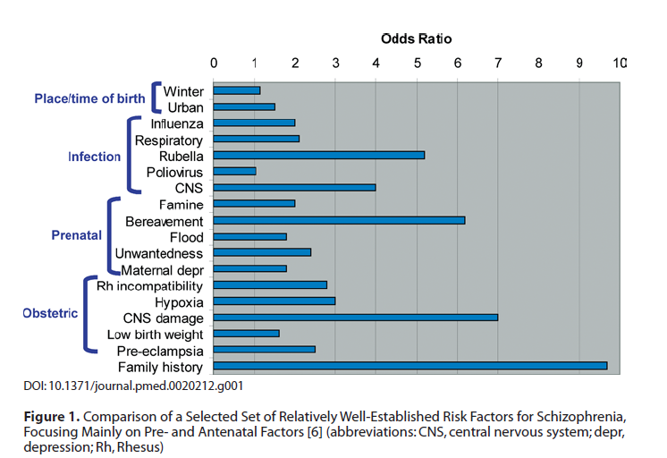
Risk Factors for Schizophrenia
Sullivan, PLoS Med 05

Slide 22
Evidence for a genetic contribution comes from risks to relatives

Slide 23
Affected Probands
13/30 are affected;
Risk = 0.433
Unaffected Probands
Relative Risk (RR) = 0.433 / 0.267 = 1.63
In siblings of affected compared to unaffected probands
8/30 are affected;
Risk = 0.267
Slide credit: Dale Nyholt

Slide 24
Relative risk to relatives
Recurrence risk to relatives
How much more likely are you to be diseased if your relative is affected compared to a person selected randomly from the population?
Relative risk to relatives (λ_{R}) = p(affected|relative affected) = K_{R} p(affected in population) K
How to estimate p(affected|relative affected) ?
Collect population samples – cases infrequent
Collect samples of case families and assess family members
How to estimate p(affected in population) ?
Census or national health statistics
  Is definition of affected same in population sample as family sample
Collect control families and assess family members
If disease is not common λ_{R} = p(sibling affected|case family) p(sibling affected |control family)

Slide 25
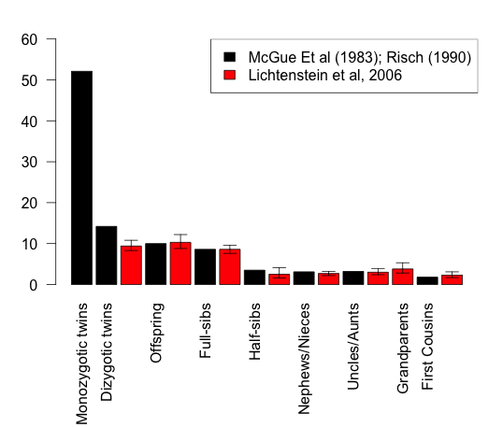
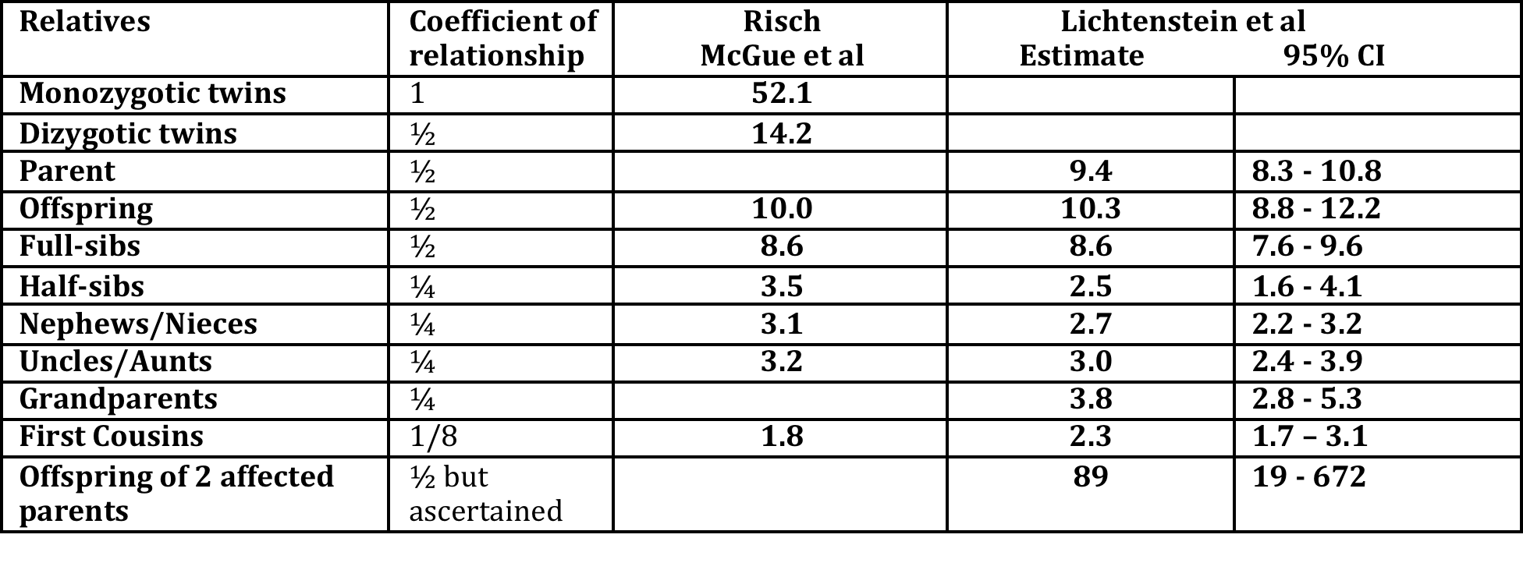
Schizophrenia risks to relatives
Baseline risk, K = 0.85% McGue et al
= 0.407% Lichtenstein et al
0.5 0.25 0.125 coefficient of relationship
Risch(1990) Linkage Strategies for Genetically Complex Traits AJHG
McGue et al (1983) Genetic Epidemiology 2: 99
Lichtenstein et al (2006) Recurrence risks for schizophrenia in a Swedish National Cohort.Psychological Medicine

Slide 26
For which disease is the genetic contribution more important?
Lifetime Risk 1%
Relative risk to 1st degree relatives: 10
Absolute Risk to 1st degree relatives 10%
Vs
Lifetime Risk 15%
Relative risk to 1st degree relatives: 2
Absolute Risk to 1st degree relatives 30%

Slide 27
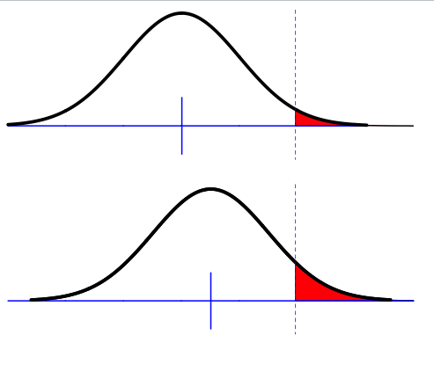
Liability threshold model
Phenotypic liability of a sample from the population
Proportion K affected
Liability to disease – usually not observed
Assumption of normality
Only appropriate for multifactorial disease
i.e. more than a few genes but doesn’t have to be highly polygenic
Key – unimodal

Slide 28
Visualising heritability of liability through continuous/categorical traits
Body Mass Index vs “obesity”
Blood pressure vs “hypertensive”
Bone Mineral Density vs “fracture”
Bronchial reactivity vs “asthma”
Neuroticism vs “anxious/depressed”
Reading ability vs “dyslexic”
Externalizing behavior vs “delinquent”

Slide 29
Heritability of liability
Phenotypic liability of a sample from the population
Proportion K affected
Relationship of relatives to affected individuals a_{R}
e.g., 0.5 for siblings
Phenotypic liability of relatives of affected individuals
Proportion K_{R} affected
Use normal distribution theory what percentage of the variance in liability is attributable to genetic factors given K, K_{R} and a_{R}
Use normal distribution to estimate heritability of liability from K, K_{R} and a_{R}
Reported estimates of heritability are heritabilities of liability

Slide 30
Heritability of liability
Phenotypic liability of a sample from the population
Proportion K affected
Relationship of relatives to affected individuals a_{R}
e.g., 0.5 for siblings
Phenotypic liability of relatives of affected individuals
Proportion K_{R} affected
Using normal distribution theory and understanding laws of inheritance (i.e. knowing coefficient of relationship a_{R} ) from 2 measures from data, proportion of population affected K and proportion of relatives affected K_{R} we can work out what proportion of the variance in liability must be attributable to genetic factors. …next lecture

Slide 31
Heritability of complex genetic traits

Slide 32
Summary
Lecture 1
Single locus disease model
Association analysis for disease
Power calculations for association analysis of disease
Genetic Epidemiology – risk to relatives
Lecture 2
Heritability of liability
Multi-locus models of disease
SNP-heritability for disease traits

Slide 33
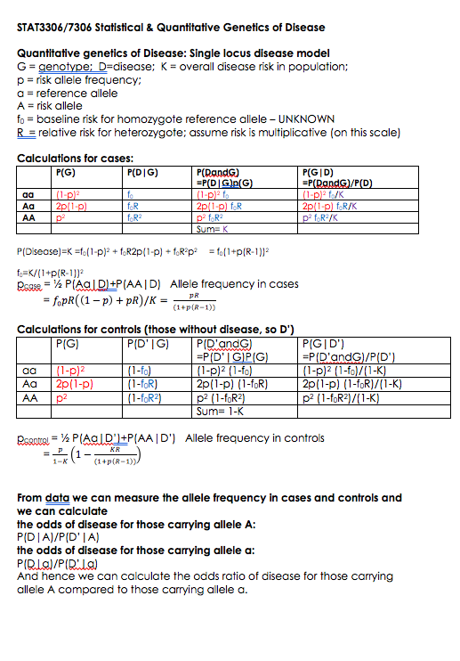
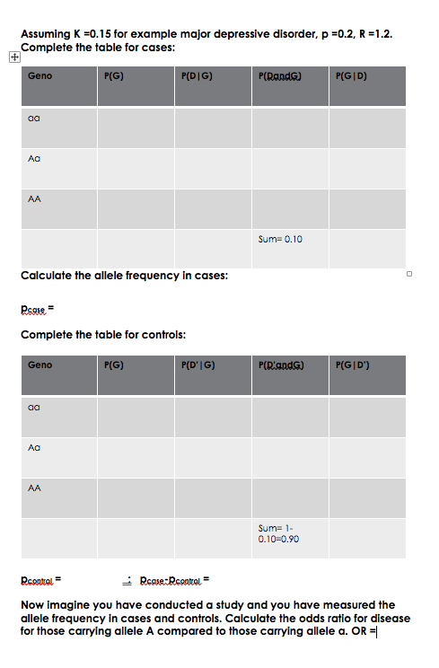
Homework – to be completed before practical

Slide 34
Practical
Part 1: single locus disease model and power in association analysis.
Part 2: heritability of liability
  Uses simulation to give understanding to the theory.
  How to calculate heritability of liability from risks to relatives.

