Slide 1

Quantitative Genetics of Disease Pt2
Loic Yengo
(slides Prof. Wray)
STAT3306/7306
imb
Institute for
molecular bioscience

Slide 2
Aim of this lecture
In this lecture, we will show why these statements are consistent :
If a disease affects 1% of the population and has heritability 80% then
If an individual is affected ~8% of his/her siblings affected
If an MZ twin is affected ~50% of their co-twins are affected
Notes:
In this lecture we will aim to understand why these statements are consistent.

Slide 3
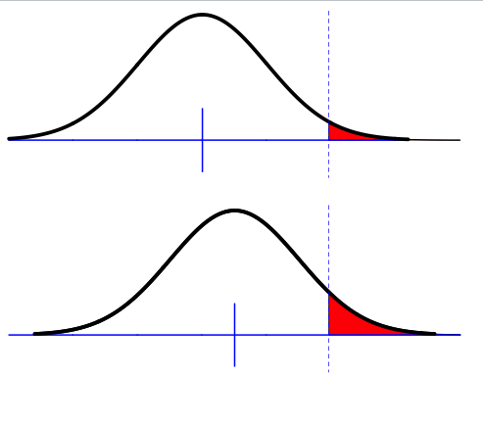
Liability threshold model
Phenotypic liability of a sample from the population
Proportion K affected
Assumption of normality
Only appropriate for multifactorial disease
i.e. more than a few genes but doesn’t have to be highly polygenic
Key – unimodal
Notes:
The liability threshold model is a view of the disease as an extreme expression of a continuous liability.
For diseases like T2D or Hypertension, the liability is observed and the diagnosis is based on the observed scaled.

Slide 4
Does an underlying normality assumption make sense?
Assumes approximately normal distribution of liability
Makes sense for many genetic variants and environmental/noise factors
1 Locus
→ 3 Genotypes
→ 3 Classes
2 Locus
→ 9 Genotypes
→ 5 Classes
3 Locus
→ 27 Genotypes
→ 7 Classes
4 Locus
→ 81 Genotypes
→ 9 Classes
Each Locus has alleles R and r, R = risk alleles.
Each class has a different count of number of risk alleles

Slide 5
Falconer (1965)
Phenotypic liability of a sample from the population
Proportion K affected
Relationship of relatives to affected individuals a_{R}
Phenotypic liability of relatives of affected individuals
Proportion K_{R} affected
Using normal distribution theory what percentage of the variance in liability is attributale to genetic factors given K, K_{R} and a_{R}
Notes:
The theory I’m going to present today has initially been developed by Falconer in 1965

Slide 6
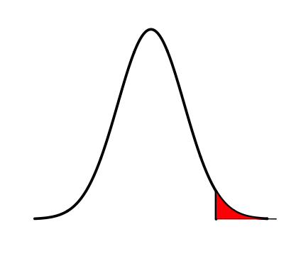
Definitions
z = density at t
K = Proportion of the population that are diseased
Density
Phenotypic liability
i = mean phenotypic liability of the diseased group
t = threshold

Slide 7


Liability Threshold Model
–truncated normal distribution theory
Φ(x) =cumulative density until liability x
standard normal distribution function
ϕ (x) = probability density at x
Phi
z = density at t
z = ϕ (t) = dnorm(t)
Density
K = Proportion of the population that are diseased
Standard
Deviation =1
σ_{p} = 1
K= 1-Φ(t) = 1-pnorm(t)
Phenotypic liability
i = mean phenotypic liability of the diseased group
i= z/K “selection intensity”
Variance in liability amongst the diseased individuals
= ((1-k), where k = i(i-t)
t = threshold
t= Φ⁻¹(1-K) = qnorm(1-K)
Inverse standard normal distribution (probit) function

Slide 8
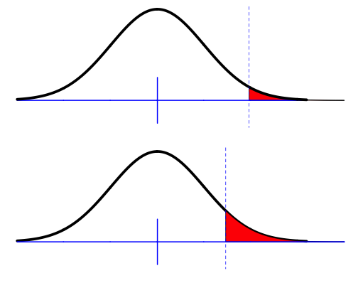
Falconer (1965)
The difference between the means for the same threshold
t
m
The difference between the thresholds when standardised to have the same mean
m_{R}
t_{R}
m_{R}-m = t-t_{R}
Given the difference in thresholds, and given known additive genetic relationship between relatives, what proportion of the total variance must be due to genetic factors
Falconer (1965) The inheritance of liability to certain diseases, estimated from incidences in relatives,
Ann. Hum Genet. 29 51
Crittenden (1961) an interpretation o familial aggregation based on multiple genetic and environmental factors
Ann NY Acad Sci 91 769
Notes:
We previously seen that when a disease has a genetic component, the prevalence among people with affected relatives (Pr) is larger than K.
This is can be expressed in two ways in the liability threshold model:
We could either assume that the liability in Pr has a larger mean but the same threshold; or
That the mean is the same but Pr has a smaller threshold.
Both approaches are equivalent.

Slide 9
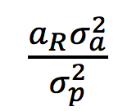
Calculate heritability of liability using regression theory
Y = phenotypic liability for individuals
Y_{R} = phenotypic liability for relatives of Y
E(Y) = E(Y_{R}) = m = 0
Relationship between Y_{R} and Y is linear
Y_{R} = m + b_{YR.Y}Y+ ε
= m + cov(A_{R},A) Y + ε , since m = 0
Var(Y)
= Y +ε= a_{R}h²Y + ε
z
K
m
t
i
Falconer (1965) The inheritance of liability to certain diseases, estimated from incidences in relatives,
Ann. Hum Genet. 29 51
Crittenden (1961) an interpretation o familial aggregation based on multiple genetic and environmental factors
Ann NY Acad Sci 91 769

Slide 10
Calculate heritability of liability using regression theory
Y = phenotypic liability for individuals
Y_{R} = phenotypic liability for relatives of Y
Y_{R} = a_{R}h²Y + ε
For affected individuals Y = i
Expected phenotypic liability of relatives of those affected
E(Y_{R}|Y>t) = m_{R} = m_{R}-m = t- t_{R}
Substitute t- t_{R}= a_{R}h²i
Rearrange h² =(t- t_{R})/ia_{R}
z
K
m
t
i
Falconer (1965) The inheritance of liability to certain diseases, estimated from incidences in relatives,
Ann. Hum Genet. 29 51
Crittenden (1961) an interpretation o familial aggregation based on multiple genetic and environmental factors
Ann NY Acad Sci 91 769

Slide 11
Assumptions made by Falconer (1965)
Assumption: Covariance between relatives reflects only shared additive genetic effects
Check: Use different types of relatives with different a_{R} and different u_{R}(dominance coefficient) and different shared environment to see consistency of estimates of h²
Assumption: Phenotypic variance in relatives is unaffected by ascertainment on affected probands

Slide 12
Accounting for reduction in variance in relatives as a result of ascertainment on affected individuals
t
Variance in liability amongst the diseased individuals
= ((1-k), where k = i(i-t)
P
m
Variance in liability amongst relatives of diseased individuals
V(Y_{R}|Y>t) = V(Y_{R})-kCov(Y_{R},Y)²
=
P_{R}
m_{R}
Reich, James, Morris (1972) The use of multiple thresholds in determining the mode of transmission of semi-continuous traits. Ann Hum Gen 36: 163.

Slide 13
Reich et al: heritability of liability
The difference between the means for the same threshold
t
The difference between the thresholds when standardised to have the mean 0 and variance 1
m
m_{R}
t_{R}
m_{R}-m = t-t_{R}
Reich, James, Morris (1972) The use of multiple thresholds in determining the mode of transmission of semi-continuous traits. Ann Hum Gen 36: 163.

Slide 14

Reich et al: heritability of liability
t
Y = phenotypic liability for individuals
Y_{R} = phenotypic liability for relatives of those with Y
Y_{R} = a_{R}h²Y + ε
For affected individuals Y = i
Expected phenotypic liability of relatives of those affected
E(Y_{R}|Y>t) = m_{R}-m =
Substitute
Rearrange
Also useful – calculation of t_{R} when K and h² are known

Slide 15
Single locus disease model
Single locus disease model:
G = genotype; D=disease; K = overall disease risk in population;
p = risk allele frequency;
f₀ = baseline risk for homozygote reference allele – UNKNOWN
R = relative risk for heterozygote; assume risk is multiplicative (on this scale)
How do we go from single locus model to multiple risk locus model ?

Slide 16
Two-locus risk model
Single locus disease model:
G = genotype; D=disease; K = overall disease risk in population
P(G)
P(D)
Sum P(D) = K
f₀ = probability of disease with no risk alleles. This baseline probability differs between the models

Slide 17
How to combine risk loci to explain disease
Additive on disease scale
Multiplicative on disease scale
Constrained multiplicative on disease scale
Multiplicative Odds on disease scale
Liability threshold model

Slide 18
Exchangeable models of disease
High heritability
Requires there be a large variance in risk among individuals. Consequently risk considered as a function of the number of causative alleles has to be steeply increasing.
Multiplicative model – standard model used but allows probability of disease to be >1.
P(Disease)=P(Disease|x=0)R^{x}
Constrained multiplicative model – constrain the multiplicative model to have a maximum probability of 1
“Additive” model
P(Disease)=b+xR, b=-18/7 set P(Disease)<0 to 0 and P(Disease)>1to 1
Probability of disease
Number of risk alleles(x)
Slatkin (2008)Exchangeable models of complex inherited diseases Genetics

Slide 19
Which polygenic model to use?
The liability threshold model is the model of choice because
It is the simplest parameterization that fits the observable data
It is mathematically tractable
It makes least assumptions about genetic architecture
“All models are wrong some models are useful”

Slide 20
Jumping ahead
REML lectures Jian Yang/Peter Visscher
Estimation of proportion of variance attributable to genome-wide SNPs:
  SNP-heritability

Slide 21
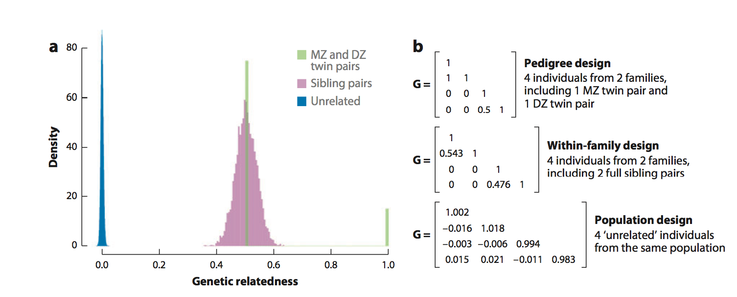
Jumping ahead
REML lectures Jian Yang/Peter Visscher
Estimation of proportion of variance attributable to genome-wide SNPs:
  SNP-heritability
Vinkhuyzen et al (2013) Estimation and Partition of Heritability in Human Populations Using Whole-Genome Analysis Methods
Annual reviews of genetics.

Slide 22
GREML: h²-SNP for disease
Observations are on disease scale but heritability is most interpretable on the liability scale
Case-control samples are ascertained
Differences between case and control samples may reflect artefacts
Use linear regression
Estimate on observed scale
Transform to Liability scale via Robertson Transformation
Up date transformation
Very stringent QC
Lee et al (2011) Estimating missing heritability for Disease from GWAS AJHG
Lee et al (2013) Estimation and partition of polygenic variation captured by common SNPs for AD, MS & Endo, HMG

Slide 23

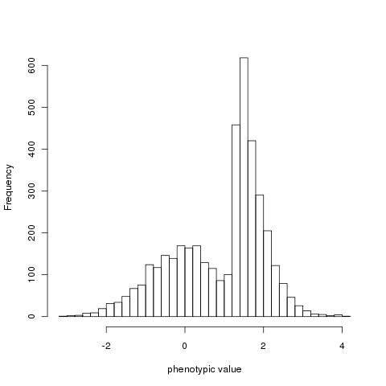
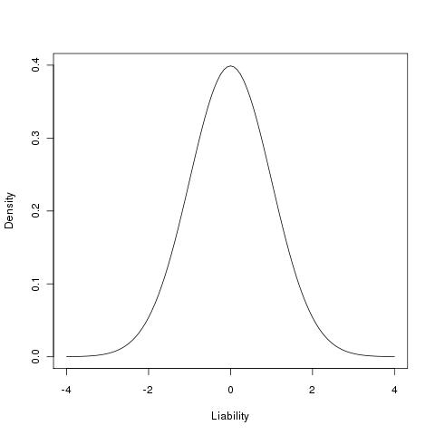

Ascertainment in case-control studies
Estimate of proportion of variance explained by SNP between cases and controls
z
x
t
Unaffected (1-K)
affected (K)
Control (1-P)
Case (P)
Robertson (1950)
Appendix of Dempster and Lerner (1950)
See Lecture 1
Lee et al (2011)AJHG
Zhou & Stephens (2013) Polygenic Modeling with Bayesian Sparse Linear Mixed Models PLoSG Text S3
Golan et al (2014) Measuring missing heritability: Inferring the contribution of common variants PNAS
See Lecture 1

Slide 24
Summary
If a disease affects 1% of the population and has heritability 80%
We have shown why these statements are consistent :
If an individual is affected ~8% of his/her siblings affected
If an MZ twin is affected ~50% of their co-twins are affected

